Slide 1
MediPrep
Hospital Procedure Preparation and Readiness System
MCA Project Review Presentation
STUDENT NAME: RYNU REJI | REGISTER NO: 24SJMCA-2052
S3 MCA
PROJECT GUIDE: Assistant Professor Rajesh A.V.

Slide 2
MediPrep – Project Introduction
MediPrep is a web application that helps doctors and patients manage preparation before hospital procedures.
Doctors can schedule procedures, assign preparation checklists, review uploaded reports, check patient vitals, and monitor readiness.
Patients can view their procedure details, follow preparation instructions, complete checklist tasks, upload required documents, enter vitals, and check their preparation progress.
The system keeps procedure preparation information in one place. It helps reduce missed tasks, misplaced reports, and last-minute confusion.
MediPrep uses predefined rules to highlight incomplete tasks and vital readings that need attention. It supports better communication between doctors and patients.

Slide 3
Existing System
In the existing process, hospitals often use paper forms, registers, phone calls, and verbal instructions to prepare patients for procedures.
Each procedure has its own preparation steps, such as fasting, consent forms, and required medical tests.
Staff may keep patient details, lab reports, and schedules in separate records. Patients may forget instructions or need to call the hospital to clarify them.
Doctors may discover missing reports or preparation tasks close to the procedure time.
This manual process can cause delays, communication problems, and difficulty tracking whether a patient is ready.

Slide 4
Drawbacks of the Existing System
• Preparation steps may be missed or completed incorrectly.
• Patient records and laboratory reports can be difficult to track.
• Consent forms and previous reports may be misplaced.
• Patients may not know their current preparation status.
• Fasting and medication instructions may be forgotten.
• Staff must manually monitor many scheduled patients.
• Missing or unverified reports can delay procedures.
• Preparing readiness summaries manually takes time.
• Communication between doctors and patients may be inconsistent.
• Incomplete preparation can affect procedure schedules.

Slide 5
Proposed System
MediPrep provides one web application for doctors and patients to manage procedure preparation.
Doctors schedule procedures for existing patients, assign preparation checklists, review and verify reports, monitor patient vitals, and check readiness.
Patients view procedure instructions, complete checklist tasks, upload required medical documents, enter pre-operative vitals, and follow their readiness progress.
The system uses predefined rules to highlight incomplete tasks and vital readings that need attention.
By keeping preparation information together, MediPrep helps reduce manual work and makes procedure readiness easier to monitor.

Slide 6
Objectives
• Provide an online system for hospital procedure preparation.
• Make procedure scheduling and checklist assignment easier.
• Keep patient preparation details and reports organized.
• Show patients their checklist progress and readiness status.
• Help doctors review reports and monitor patient preparation.
• Allow required medical documents to be uploaded and verified.
• Use predefined rules to flag vital readings that need attention.
• Improve communication between doctors and patients.
• Help doctors review procedure readiness from one dashboard.

Slide 7
MediPrep – Module Description
MediPrep has two main user modules:
1. Doctor Module
2. Patient Module
Doctors schedule procedures, manage preparation checklists, review uploaded reports, check patient vitals, and monitor readiness.
Patients view scheduled procedures, follow preparation instructions, complete checklist tasks, upload required documents, enter vitals, and track their preparation status.
Each module provides functions based on the user's role.

Slide 8
1. Doctor Module
The Doctor Module helps doctors manage scheduled procedures and check whether patients are prepared.
Functions:
• Doctor login
• Schedule procedures for existing patients
• Assign and manage preparation checklist tasks
• View uploaded medical reports
• Verify submitted reports
• View patient vital records
• Check rule-based safety alerts
• Monitor patient readiness
• Send messages to patients
• View available clinical summary reports
Purpose:
Helps doctors review patient preparation and identify incomplete requirements before a procedure.
Functions:
• Doctor Login & Role Control
• Schedule Procedure (Patient, CPT, Date, Room)
• Manage Patient Checklist Tasks
• View Uploaded Medical PDF Reports
• Verify Uploaded Reports & Sign-off
• View Patient Vital Logs
• Check Vital Risk Safety Alerts
• Monitor Patient Readiness Scores
• Send Patient Clinical Board Messages
• View and Export Clinical Summary Reports
Purpose:
Allows attending physicians to manage procedure bookings, audit patient compliance, verify lab files, and ensure patient safety from a centralized dashboard.

Slide 9
2. Patient Module
The Patient Module helps patients prepare for their scheduled procedures.
Functions:
• Patient login
• View scheduled procedure details and location
• Read preparation instructions
• Complete checklist tasks, such as fasting and escort arrangements
• Upload required medical PDF reports
• Enter pre-operative vital readings
• View preparation progress and readiness status
• Read messages from the doctor
Purpose:
Gives patients a clear place to check what they need to do before their procedure.
Functions:
• Patient Login & Portal Access
• View Scheduled Procedure Details & Location
• View Pre-operative Guidelines & Instructions
• Complete Checklist Tasks (Fasting, Driver Escort)
• Upload Required Medical PDF Reports
• Enter Pre-operative Vitals (Sugar, BP, Temp)
• View Live Readiness Percentage (0% - 100%)
• View Readiness Status (Ready / Pending)
• Receive Direct Doctor Messages & Directives
Purpose:
Provides patients with an easy, organized, and transparent experience to ensure 100% pre-procedure preparation compliance.

Slide 10
Technology Stack
• Frontend: HTML, CSS, JavaScript
• Backend: Python
• Framework: Flask
• Database: MySQL
• Development Environment: Visual Studio Code
• Operating System: Windows

Slide 11
System Workflow
Doctor schedules procedure
Checklist is created
Patient views checklist
Patient completes tasks
Ready / Pending status shown
System checks readiness
Doctor verifies reports
Patient uploads reports

Slide 12
MediPrep – Table Designs: tbl_users
Column Name | Data Type | Size | Constraint
id | INTEGER | - | Primary Key, Auto Increment
email | VARCHAR | 120 | Unique, Not Null
password_hash | VARCHAR | 255 | Not Null
role_name | VARCHAR | 20 | Not Null (doctor / patient)
full_name | VARCHAR | 100 | Not Null
phone | VARCHAR | 20 | Nullable
created_at | DATETIME | - | Current Timestamp

Slide 13
MediPrep – Table Designs: tbl_procedures
Column Name | Data Type | Size | Constraint
id | INTEGER | - | Primary Key, Auto Increment
procedure_code | VARCHAR | 50 | Unique, Not Null (e.g. CPT-93452)
name | VARCHAR | 150 | Not Null
category | VARCHAR | 50 | Not Null (Cardiology, Radiology)
description | TEXT | - | Nullable
est_duration_mins | INTEGER | - | Default 60

Slide 14
MediPrep – Table Designs: tbl_scheduled_procedures
Column Name | Data Type | Size | Constraint
id | INTEGER | - | Primary Key, Auto Increment
patient_id | INTEGER | - | Foreign Key → tbl_users.id
doctor_id | INTEGER | - | Foreign Key → tbl_users.id
procedure_id | INTEGER | - | Foreign Key → tbl_procedures.id
scheduled_at | DATETIME | - | Not Null
location | VARCHAR | 100 | Not Null
status | VARCHAR | 30 | Default Scheduled

Slide 15
MediPrep – Table Designs: tbl_checklist_items
Column Name | Data Type | Size | Constraint
id | INTEGER | - | Primary Key, Auto Increment
scheduled_procedure_id | INTEGER | - | Foreign Key → tbl_scheduled_procedures.id
task_name | VARCHAR | 200 | Not Null
task_type | VARCHAR | 50 | Not Null (text_check / file_upload)
status | VARCHAR | 30 | Default pending
is_critical | BOOLEAN | - | Default True

Slide 16
MediPrep – Table Designs: tbl_uploaded_reports
Column Name | Data Type | Size | Constraint
id | INTEGER | - | Primary Key, Auto Increment
checklist_item_id | INTEGER | - | Foreign Key → tbl_checklist_items.id
uploaded_by | INTEGER | - | Foreign Key → tbl_users.id
file_name | VARCHAR | 255 | Not Null
file_path | VARCHAR | 255 | Not Null
file_size | INTEGER | - | Bytes
uploaded_at | DATETIME | - | Current Timestamp

Slide 17
MediPrep – Table Designs: tbl_patient_vitals
Column Name | Data Type | Size | Constraint
id | INTEGER | - | Primary Key, Auto Increment
scheduled_procedure_id | INTEGER | - | Foreign Key → tbl_scheduled_procedures.id
patient_id | INTEGER | - | Foreign Key → tbl_users.id
blood_sugar_mg_dl | FLOAT | - | Nullable
bp_systolic | INTEGER | - | Nullable
bp_diastolic | INTEGER | - | Nullable
temperature_f | FLOAT | - | Nullable
creatinine_mg_dl | FLOAT | - | Nullable

Slide 18
MediPrep – Table Designs: tbl_procedure_readiness
Column Name | Data Type | Size | Constraint
id | INTEGER | - | Primary Key, Auto Increment
scheduled_procedure_id | INTEGER | - | Foreign Key → tbl_scheduled_procedures.id
readiness_percentage | FLOAT | - | Not Null (0.0 to 100.0)
readiness_status | VARCHAR | 30 | Not Null (Ready / Pending)
notes | TEXT | - | Nullable

Slide 19
MediPrep – Table Designs: tbl_health_suggestions
Column Name | Data Type | Size | Constraint
id | INTEGER | - | Primary Key, Auto Increment
procedure_id | INTEGER | - | Foreign Key → tbl_procedures.id
suggestion_text | TEXT | - | Not Null
trigger_condition | VARCHAR | 100 | Nullable

Slide 20
MediPrep – Table Designs: tbl_notifications
Column Name | Data Type | Size | Constraint
id | INTEGER | - | Primary Key, Auto Increment
user_id | INTEGER | - | Foreign Key → tbl_users.id
sender_id | INTEGER | - | Foreign Key → tbl_users.id
scheduled_procedure_id | INTEGER | - | Foreign Key → tbl_scheduled_procedures.id
title | VARCHAR | 150 | Not Null
message | TEXT | - | Not Null
sent_at | DATETIME | - | Current Timestamp

Slide 21
MediPrep – Table Designs: tbl_risk_alerts
Column Name | Data Type | Size | Constraint
id | INTEGER | - | Primary Key, Auto Increment
scheduled_procedure_id | INTEGER | - | Foreign Key → tbl_scheduled_procedures.id
alert_code | VARCHAR | 50 | Not Null
description | TEXT | - | Not Null
is_resolved | BOOLEAN | - | Default False

Slide 22
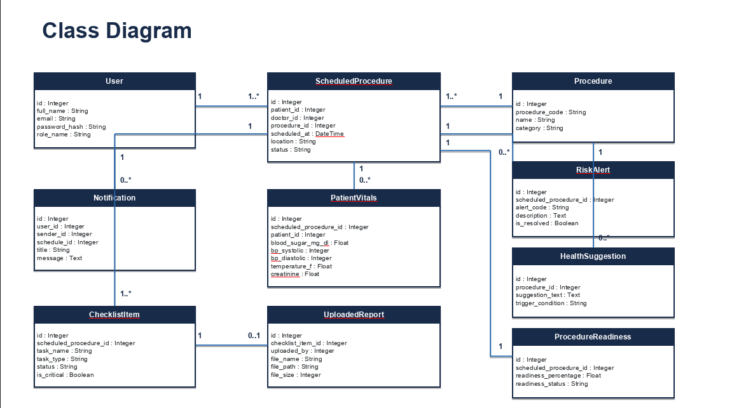

Slide 23
Use Case Diagram
Login
Login
Schedule Procedure
View Procedure
Manage Checklist
View Checklist
View Reports
Complete Checklist
Verify Reports
Upload Report
DOCTOR
PATIENT
View Patient Vitals
Enter Vitals
Check Risk Alerts
View Risk Alerts
Monitor Readiness
View Readiness
Send Patient Message
View Messages
View Clinical Reports

Slide 24
User Login Form
Secure role-based login for doctors and patients.
Email Address/Username
Password
priya.nair@mediprep.com
••••••••••••
LOGIN TO MEDIPREP

Slide 25
Doctor Schedule Procedure Form
Doctors schedule patient procedures and assign room allocations.
Patient Name
Procedure Catalog
Rahul Sharma (PAT-8042)
Left Heart Catheterization (CPT-93452)
Scheduled Date & Time
Location / Room
05 Oct 2026, 10:00 AM
Cardiology Dept - Lab 2
CONFIRM SCHEDULED PROCEDURE

Slide 26
Patient Checklist Page
Patients view scheduled procedure guidelines and preparation tasks.
Procedure Name
Attending Doctor
Left Heart Catheterization (CPT-93452)
Dr. Priya Nair
Task Checklist
Document Status
8-Hour NPO Fasting (Completed)
Blood Test PDF (Pending Upload)
VIEW CHECKLIST DETAILS

Slide 27
Patient Report Upload Form
Patients upload required medical PDF reports.
Checklist Item
Select PDF File
Upload Pre-op Blood Test Report
blood_test_report_rahul.pdf
Signed Consent Form
Fasting Checkoff
Upload signed consent form PDF
Mark 8-hour NPO fasting as completed
SUBMIT COMPLIANCE REPORT

Slide 28
Patient Vitals Form
Patients enter pre-operative vital parameters.
Fasting Blood Sugar
Blood Pressure
110 mg/dL
120 / 80 mmHg
Body Temperature
Serum Creatinine
98.6 °F
0.9 mg/dL
LOG VITALS RECORD

Slide 29
Doctor Checklist / Verification Page
Doctors audit submitted reports and sign-off.
Patient File
Verification Action
blood_test_report_rahul.pdf [Preview PDF]
Verify & Approve Report
Clinical Board Directive
Audit Status
Proceed with fasting. Report approved by Dr. Priya Nair.
Verified by Clinician
SUBMIT VERIFICATION SIGN-OFF

Slide 30
Doctor Dashboard
Real-time summary monitoring readiness scores and active cases.
Today's Cases
Ready Patients
12 total scheduled procedures
8 cases (100% Green)
Pending Patients
Compliance Overview
4 cases (Yellow / Orange)
Chart.js Dynamic Distribution Graph
VIEW CLINICAL SUMMARY

Slide 31
Patient Readiness Dashboard
Patient view of preparation progress and safety alerts.
Procedure Details
Preparation Progress
Left Heart Catheterization (CPT-93452)
85% Completion Bar
Readiness Status
Risk Warnings & Messages
YELLOW (Warning: Missing Lab File)
Fasting Blood Sugar Alert (> 200 mg/dL)
VIEW READINESS STATUS

Slide 32
THANK YOU

