Slide 1
Distribution functions & random numbers
Stochastic variables and distribution functions
Notes:
In the previous plot, I demonstrated how to simulate the dynamics of a model oscillator by numerically integrating the ordinary differential equations which govern the time evolution of the system.
Since the motion of such system is purely deterministic, valid simulations can be performed using well established numerical integration schemes such as the Euler and the Runge-Kutta methods.
In contrast to such deterministic processes, the Brownian motion must be modeled with random forces which can only be stochastically determined.
In this plot, we will learn basic properties of stochastic variables and their probability distribution functions.

Slide 2
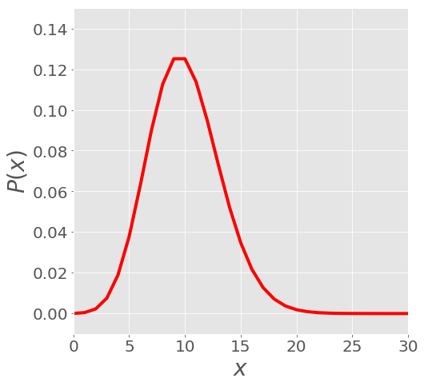
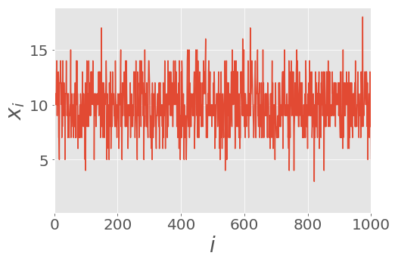
Stochastic variable and distribution functions
Example of P(x)
Example of X
Notes:
We start by introducing the concept of a random or stochastic variable
As its name suggests, a random variable is given by a process whose results are random.
We cannot, in general, predict what the measurement results will be, we can only talk in terms of probabilities.
Denote the stochastic variable by X, and a given realization or measurement as x.
Imagine that we perform a series of 1000 measurements of X, which we call x_i.
The figure on the right gives a sample illustration.
The results are “noisy” but not completely arbitrary. All the x_i are centered around a fixed value (x = 10) and most values fall within a very narrow range.
The proper mathematical way to define this random variable is to give its Probability distribution P(x).
P(x) gives the probability of observing a value around x
P(x) for our example is given in the figure on the right.
We see that it is peaked around 10 (10 is the most probable value), and it is only non-zero over a fixed range (values less than 5 or greater than 15 are very unlikely).

Slide 3
Stochastic variable and distribution functions
Average
Standard deviation
Notes:
The probability distribution contains all the information needed to characterize the random variable.
However, P(x) can be a very complicated function of x. Indeed, in some cases we cannot even know the exact form of P(x).
Therefore, it is useful to introduce additional quantities to describe the random process.
The two most important quantities that are used, are the average and the standard deviation
The average, as its name suggests, is simply the average or mean of the random variable.
Note that the average value does not necessarily coincide with the most probable value.
The standard deviation measures the fluctuations around the mean, that is, it provides a measure of how spread out the random variable is.
In the example figures, the black line marks the average of X, while the blue lines give the standard deviation.

Slide 4
Stochastic variable and distribution functions
Notes:
Now, we introduce the basics of probability distribution theory
Let X be a a real and continuous stochastic variable.
First, the probability distribution P(x) is greater than or equal to zero
2nd, It is normalized to one. That is, the sum of all probabilities is equal to one.
3rd, The m-th moment, denoted \mu_m, is defined as the average of x^m
4th, In general, the average of any function of X, f(x), is given by the weighted integral of f(x).
With P(x) the appropriate weight for observing x.
5th, Thus, we see that the average is just the first moment \mu_1.

Slide 5
Stochastic variable and distribution functions
Notes:
The variance, which is the square of the standard deviation, is defined as the average squared fluctuation.
The variance can also be expressed in terms of the first two moments. It is given by the difference between the second moment and the square of the first moment.
Finally, the moment generating function (also called characteristic function) G(k), is defined as the average of exp(-i k x).
Using the taylor expansion for the exponential function, we can express the generating function as a polynomial in k.
In particular, we see that the coefficient of the n-th term is proportional to the n-th moment.
In other words, the n-th derivative of G, evaluated at k=0, will give us the n-th moment.

Slide 6
Stochastic variable and distribution functions
Notes:
Now, let us consider the case where our stochastic variable is not continuous, but discrete.
Assume that the possible outcomes are labeled by n, which is a non-negative integer, namely 0, 1, 2, up to, N.
The discrete probability distribution P(n) gives the probability of observing n.
The properties of this distribution function are similar to the ones for the continuous case.
Mostly, they can be rewritten by changing integrals to sums.
1st, all probabilities are positive, greater than or equal to zero, and less than or equal to one.
2^{nd,} the sum of all probabilities is one.
3rd, the m-th moment is definite as here.
All averages are simply weighted sums, with P(n) the weight.

Slide 7
Stochastic variable and distribution functions
Notes:
As expected, the definition of the variance is the same as in the continuous case.
The generating function is again defined as the average of exp(-i k).
In this case, it is convenient to consider it as a complex function of $z$, where z=exp(-ik).
Derivatives of the generating function, evaluated at z=0, will again be related to the moments \mu_m.

Slide 8
Stochastic variable and distribution functions
Notes:
Now, let us discuss one of the most common probability distributions in all of science.
The Gaussian or normal distribution, which has a characteristic bell-shaped function that you are probably familiar with.
The probability distribution for a gaussian random variable is given in equation C1.
As you can see, it depends on only two parameters, x_0 and s.
It is easy to show that these two parameters are precisely the average and standard deviation.

Slide 9
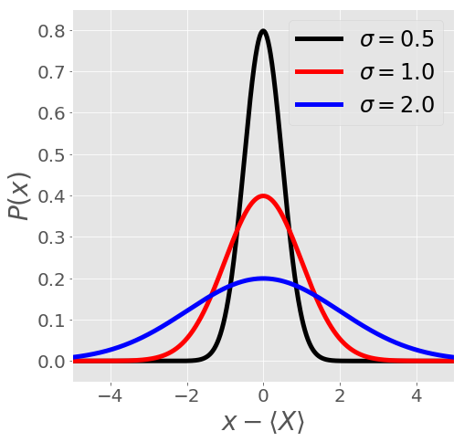
Stochastic variable and distribution functions
Notes:
The plot on the right shows examples of Gaussian distributions with changing standard deviation \sigma.
As you can see, a larger value of \sigma gives a broader or fatter distribution.
Roughly speaking, 2 sigma gives the width of the distribution at half maximum.
That is, the width at the point where the value of the distribution P(x) is half the maximum value.

Slide 10
Stochastic variable and distribution functions
Notes:
One example of a Gaussian distribution in physics is the Maxwell-Boltzmann distribution for the velocity of particles in a gas at thermal equilibrium.
Let V_alpha be the velocity components of any given particle
Assume that all particles have the same mass, and that the system has reached thermal equilibrium at a temperature T.
Here, k_B is Boltzmann’s constant, k_BT is the thermal energy.
The probability that a particle has a velocity v_\alphais given by a Gaussian distribution.
The average is zero, as the particles are equally likely to move left or right.
The variance, by definition is proportional to the average kinetic energy. From the equipartition theorem, we can then deduce that the variance is proportional to the thermal energy divided by twice the mass.

Slide 11
Stochastic variable and distribution functions
Notes:
Now let us consider another common probability distribution, this time for a discrete variable which has only two possible outcomes.
We can consider the random variable to be the outcome of a coin toss, which gives heads with probability p, and tails with probability (1-p).
If we perform the measurement M times, that is we toss the coin M times, what is the probability that the result was heads a total of n times?
For example, imagine that we toss a fair coin with p = 0.5 50 times. We expect that heads will come up half of the time, that is around 25 times.
If we do it 100 times, we expect heads to come up around 50 times.
Note that we do not say that heads should come up ‘exactly’ half of the time, every time. Only that on average, if we perform the experiment many times, heads will come up half of the time.
The appropriate probability distribution for this process is given by the Binomial distribution, Eq. (C6).
The average and variance can be easily calculated and take the simple form shown in eqs. (C7) and (C8).

Slide 12
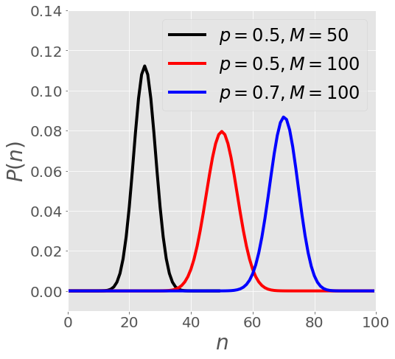
Stochastic variable and distribution functions
Notes:
In the figure, we have plotted the distribution for various values of p and M. As expected, we see that the distribution is peaked near the average (=M p).

Slide 13
Stochastic variable and distribution functions
Notes:
Another common discrete distribution function is the Poisson distribution.
This distribution P(n) describes the probability of n “events” occurring during a fixed time or space interval.
It is assumed that the average rate of occurrence , that is the average number of events per unit time or space, is known and is a constant.
In addition, all events are assumed to be independent of each other.
Examples of this type of process include the distribution of earthquakes, the arrival of customers at the post-office or the number of mutations in a strand DNA.
The Poisson distribution is given in equation C9.
As we can see it depends on only one parameter, a, which is the rate of occurrence.
The average, variance, and generating functions all take very simple forms.
In particular, we see that the average and the variance are both equal to a, the rate parameter.

Slide 14
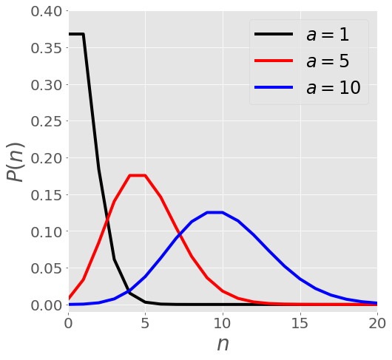
Stochastic variable and distribution functions
Notes:
Here, imagine that P(n) gives the probability that $n$ customers walk into the post office in one hour.

Slide 15
Stochastic variable and distribution functions
See supplemental note for derivation.
Notes:
Now, let us see how the distribution functions we introduced before are related to each other.
In the supplemental material, I give you the derivation showing the equivalence of the binomial distribution and the Gaussian distribution, in the limit when n,M are much greater than one.
The average and variance that should be used in the Gaussian distribution are simply given by the corresponding values of the original binomial distribution.
This is very convenient, as it is easier to work with a Gaussian function (Eq C14), than it is to work with the binomial distribution.
Consider again the coin toss experiment. We toss the coin a very large number of times. To find the probability that n heads were obtained, we can use the Gaussian distribution (Eq. C14), but only if n is itself very large.
If we want to ask for the probability to obtain 1,2,10 heads after very many throws, the equivalence does not hold, and in this case we must use the original binomial distribution (Eq. C6).

Slide 16
Stochastic variable and distribution functions
See supplemental note for derivation.
Notes:
We have seen that under certain conditions the binomial and Gaussian distributions are equivalent.
It turns out that under different conditions, the binomial distribution can be shown to be equal to the Poisson distribution.
For this, we must consider the limit when M is very large (as before), but now we assume that Mp stays constant (we make no assumptions about n).
This means that in the limit when M becomes bigger and bigger, p must become smaller and smaller, in such a way that their product is constant.
It is in this limit where the binomial and Poisson distributions are equivalent.
The derivation is too involved to show here, but is is available as a supplemental note.
Finally, we note that rate parameter of the Poisson distribution is determined by the average of the binomial distribution, which is the constant a. This immediately determines the variance of the distribution.

