Slide 1
BrainVLM
20250131

Slide 2
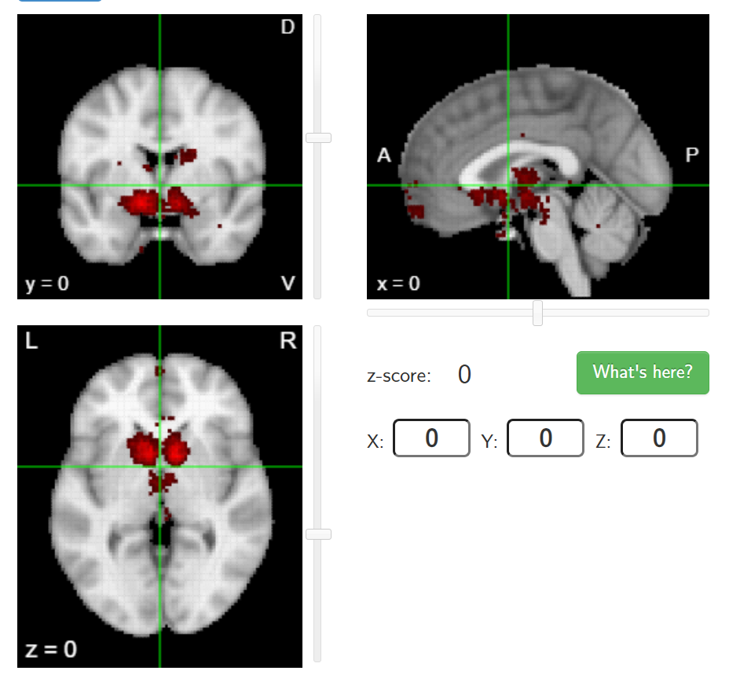



Background
Neuroscience papers corpus
Image Reviewer
Papers Reviewer
Doctor
Drawbacks
Time Consuming
Expensive
Inaccurate
Domain knowledge required
……
Possible Diseases
AD: Active Visual 1 is related to AD. For AD Patients, ROI 2 is also active.
PD: Active Limbic 2 is related to PD. For PD patients, ROI 9 is also active.
……
Diagnostic Report
PreCG.L is active.
ORBsup.L is active.
Visual 1 is active.
Limbic 1 is active.
These symptoms represents that the patient has AD.
Treatment Advice for AD:
1…;2…;
Anatomical Description
PreCG.L is active
ORBsup.L is active
……
Functional Description
Visual 1 is active
Limbic 1 is active
……
Image Description Report
Academical Report
Comprehensive Report

Slide 3
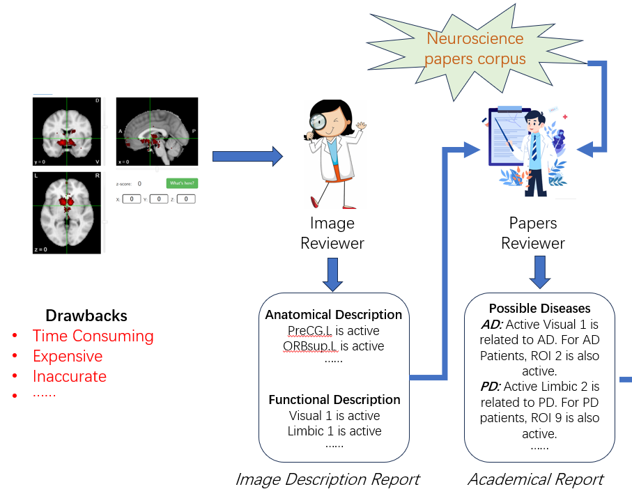
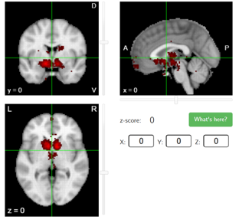
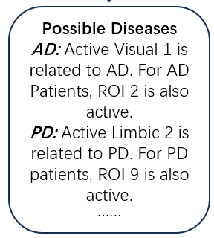
VLM
Training
Inference
fMRI
VLM
VLM
fMRI
Captions
Coarse Report

Slide 4
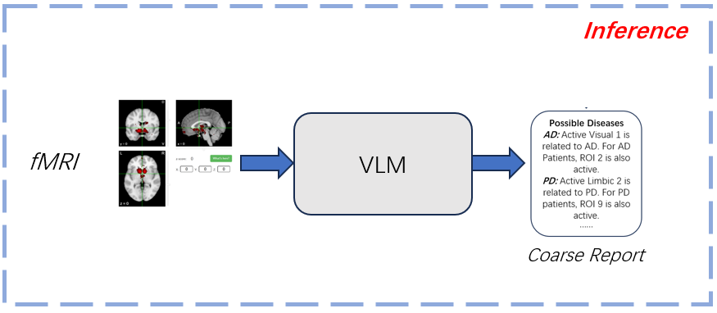



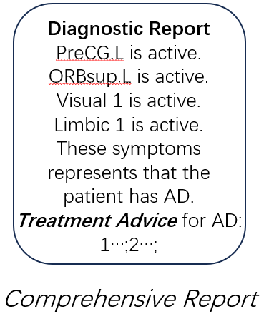
Question: Based on the description of fMRI (Coarse Report), can you give me more comprehensive diagnose? Can you give me treatment suggestions for each diseases?
AD
PD
Anxiety
Depression
Subset of Corpus
GPT
RAG

Slide 5
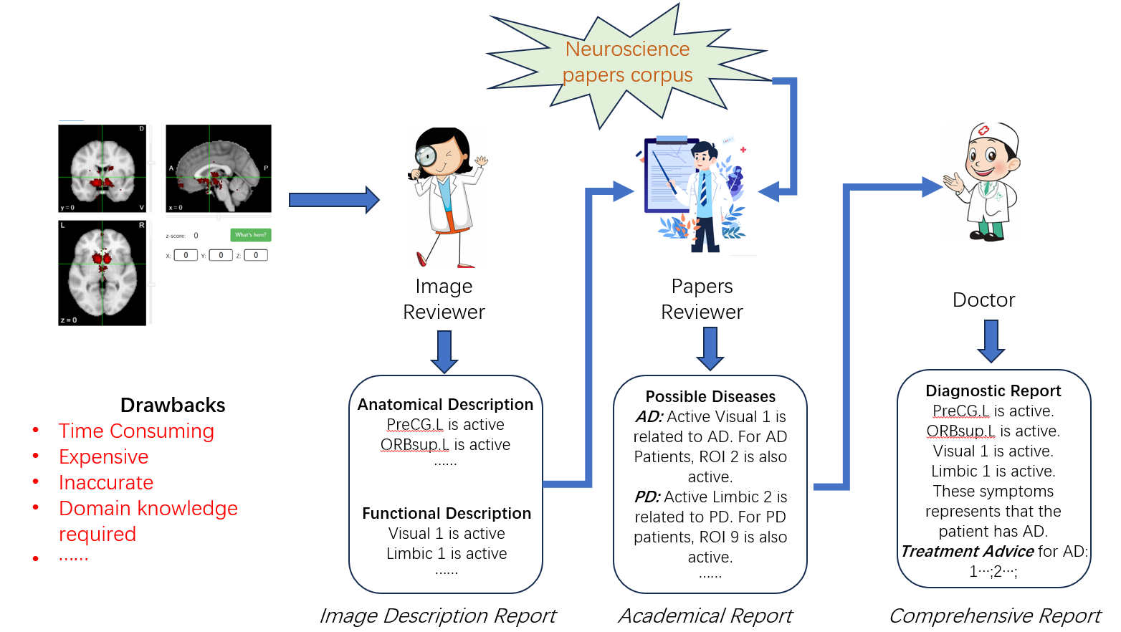
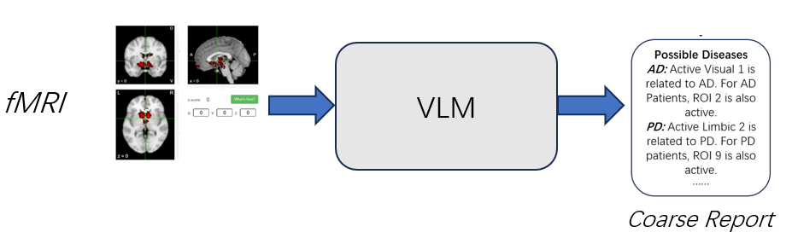
GPT
Advantages
Easy to use: Our model is an end-to-end report generation model.
Results Reliable: Combine RAG, the reports are generated based on existing published papers.
Domain knowledge Free: It is not necessary to generate report based on analyzing fMRI by neuroscientists.
Time saving and increasing accuracy of fMRI-based disease diagnose: Errors may occur in the information transmission between the three roles in existing fMRI-based disease diagnose, which won’t happen in our model.

Slide 6
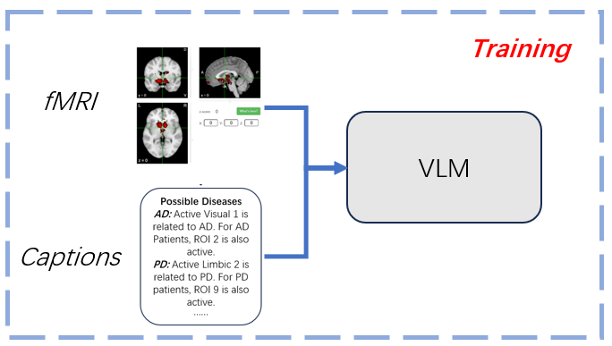
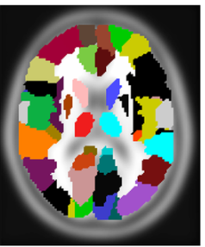
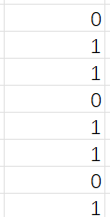
AAL_170 (170 ROIs) in MNI (91,109,91)
How to define the threshold to recognize whether a ROI is active or inactive ????
PreProcessed fMRI
(88,88,64,t)
fMRI in MNI space
(91,109,91,t)
Anatomical Matrix
(170*t)
Anatomical active Matrix
(170*1)

Slide 7
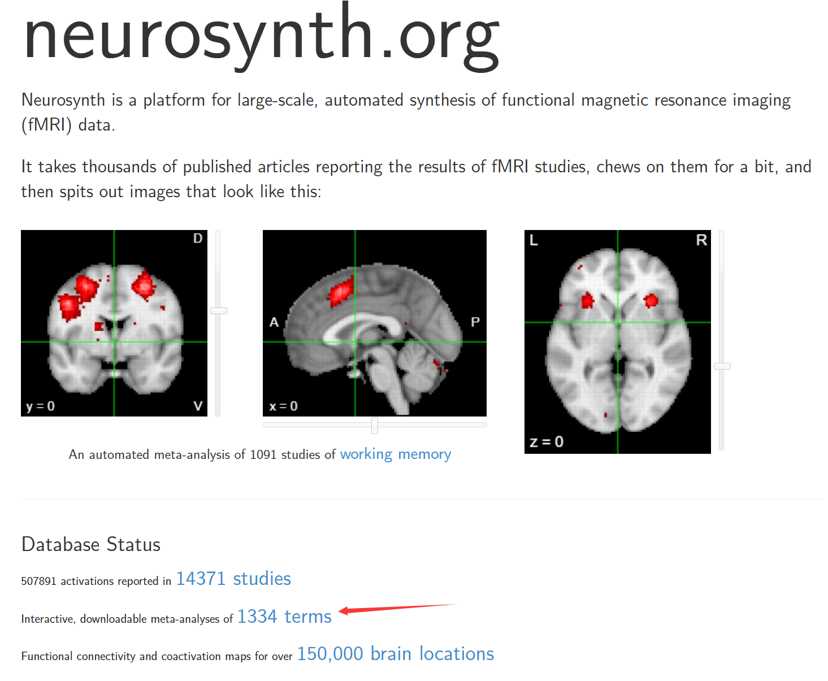
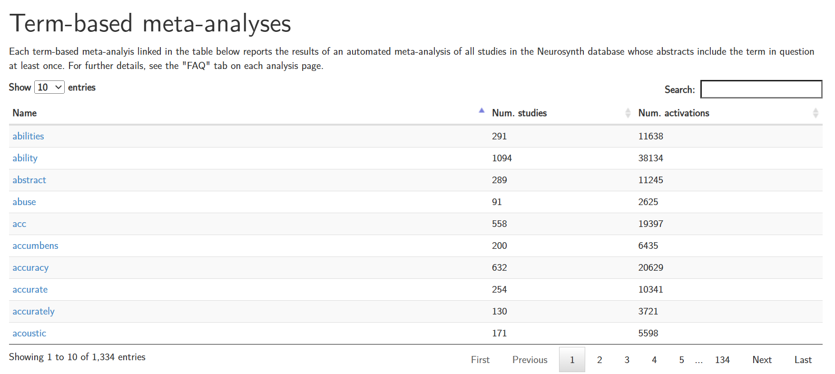
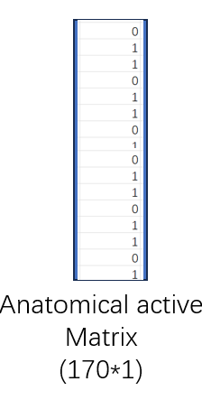
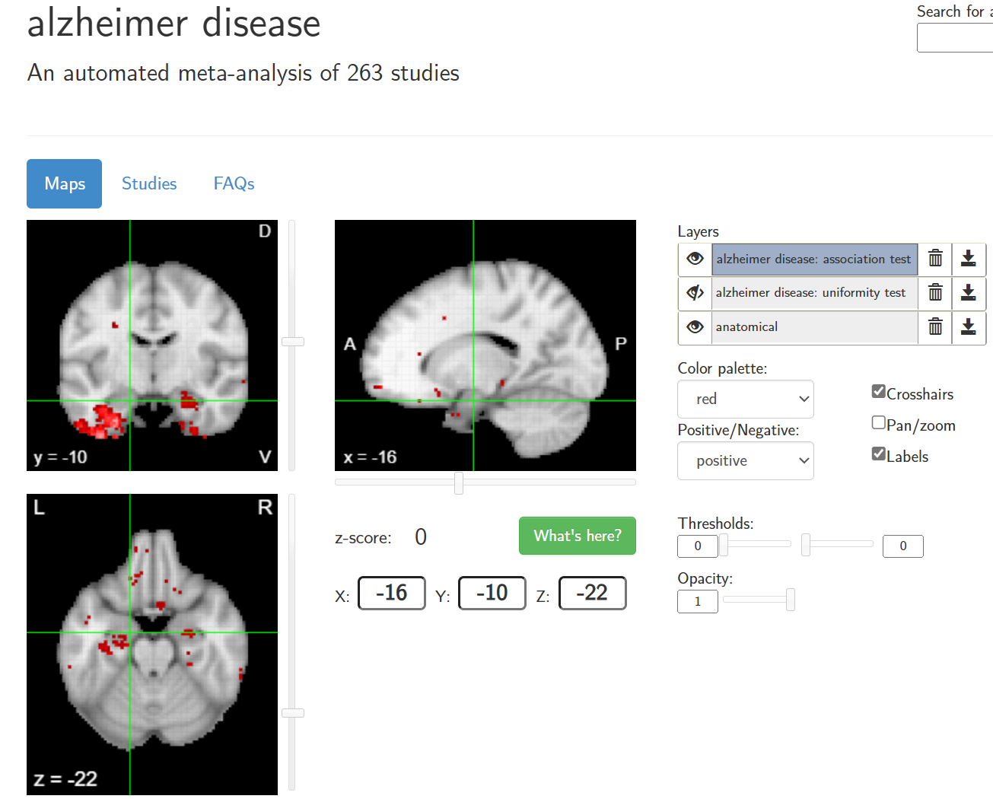
Reference
Diseases
Activity Map
AD
Abuse
Possible Diseases
AD,
PD,
Abuse,
……

Slide 8
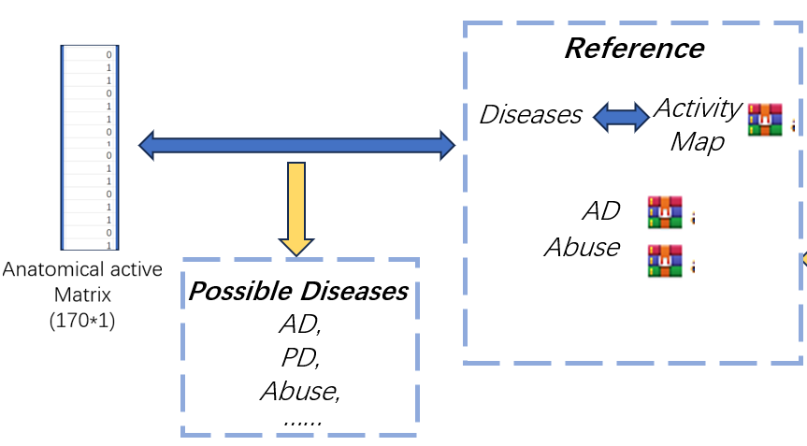
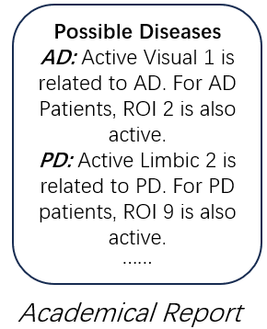
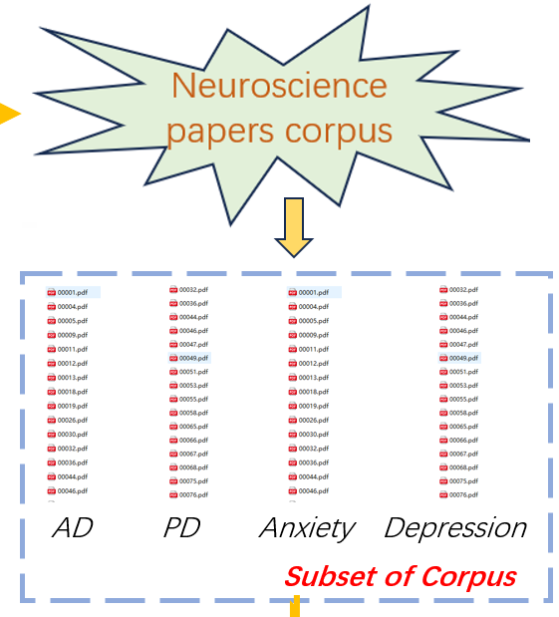
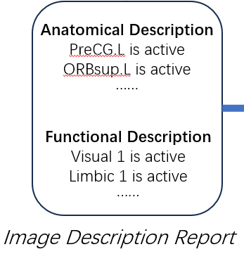
Paired
GPT

Slide 9
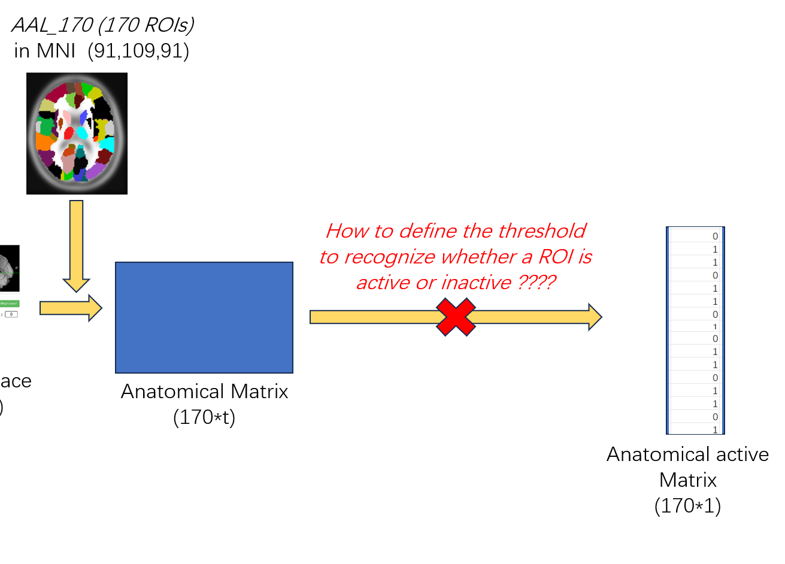
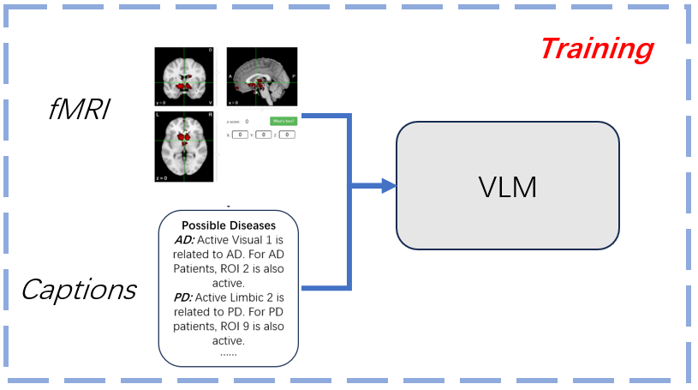
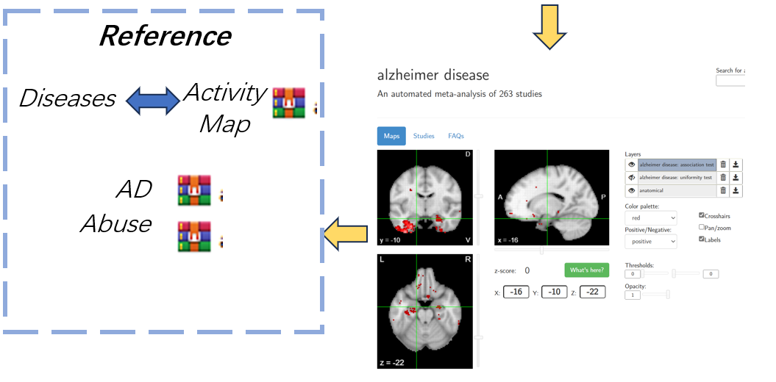
To do List
How to Get functional / Anatomical activity Matrix?
Constructing the Neuroscience papers corpus
Constructing the “Diseases-Activity Map” dataset

Slide 10
THANKS

