Slide 1
PRIMARY KEY
FOREIGN KEY
KAKAOTALK
LOGIN_NO
ID
PW
LOGIN_DATE
RESIGN
1
LOBBY
LOGIN_NO
GAME_ID
GAME_LEVEL
ACC_SKILL
SEL_CHAR1
SEL_CHAR2
SEL_CHAR3
SEL_CHAR4
SEL_CHAR5
LOBBYIN (DATE)
LOBBYOUT (DATE)
LEADER_CHAR
PET_NO
1
OWN_CHAR
OWN_CHAR_NO
OWN_CHAR_TEAM
OWN_CHAR_LEVEL
OWN_CHAR_EQUIP1
OWN_CHAR_EQUIP2
OWN_CHAR_EQUIP3
OWN_CHAR_EQUIP4
OWN_CHAR_EQUIP5
OWN_CHAR_EQUIP6
OWN_CHAR_EQUIP7
OWN_CHAR_EQUIP8
1
CHARACTER
CHAR_NO
CHAR_TYPE
CHAR_NAME
CHAR_OVERLEVEL
CHAR_PROMO
CHAR_AWAKEN
SKILL1
SKILL2
SKILL3
SKILL4
1
1
N
N
N
N
PET
PET_NO
PET_TYPE
PET_NAME
PET_PROMO
PET_AWAKEN
PET_FUNCT
1
N
N
EQUIP
EQUIP_NO
EQUIP_TYPE
EQUIP_NAME
EQUIP_GRADE
EQUIP_LEVEL
EQUIP_FUNCT
SKILL
SKILL_NO
SKILL_NAME
SKILL_TYPE
SKILL_GRADE
ACC_SKILL
SKILL_NO
SKILL_NAME
SKILL_TYPE
SKILL_GRADE
1
1
FUNCT
FUNC_NO
FUNC_NAME
FUNC_TYPE
FUNC_GRADE
FUNC_LEVEL
1
1
1
N

Slide 2
KAKAOTALK 테이블생성
CREATE TABLE KAKAOTALK(
LOGIN_NO NUMBER(17),
LOGIN_ID VARCHAR2(50),
LOGIN_PW VARCHAR2(20),
LOGIN_DATE DATE DEFAULT SYSDATE,
RESIGN VARCHAR2(3) DEFAULT 'NO',
CONSTRAINT KTT_LOGIN_PK PRIMARY KEY (LOGIN_NO),
CONSTRAINT KTT_EMAIL_UK UNIQUE (LOGIN_ID),
CONSTRAINT KTT_RESIGN_CK CHECK (RESIGN IN ('YES','NO'))
);

Slide 3
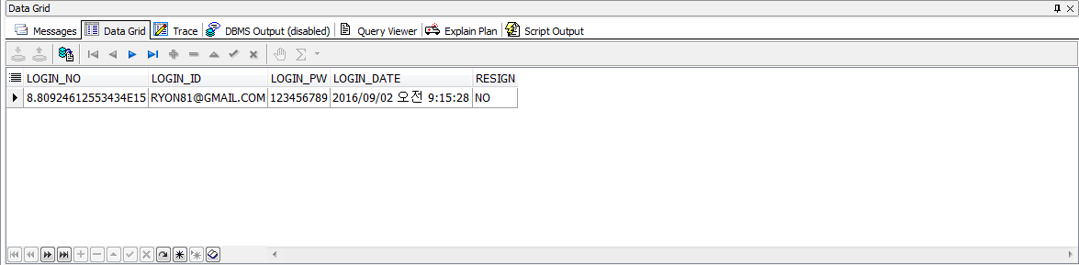
<데이터 삽입>
insert into kakaotalk (LOGIN_NO, LOGIN_ID, LOGIN_PW)
values (8809246125534336, 'RYON81@GMAIL.COM', '123456789');

Slide 4
ACC_SKILL 테이블생성
CREATE TABLE ACC_SKILL(
SKILL_NO NUMBER(15),
SKILL_NAME VARCHAR2(10),
SKILL_TYPE VARCHAR2(10),
SKILL_GRADE VARCHAR2(2),
CONSTRAINT ACCSKL_NO_PK PRIMARY KEY (SKILL_NO)
)

Slide 5
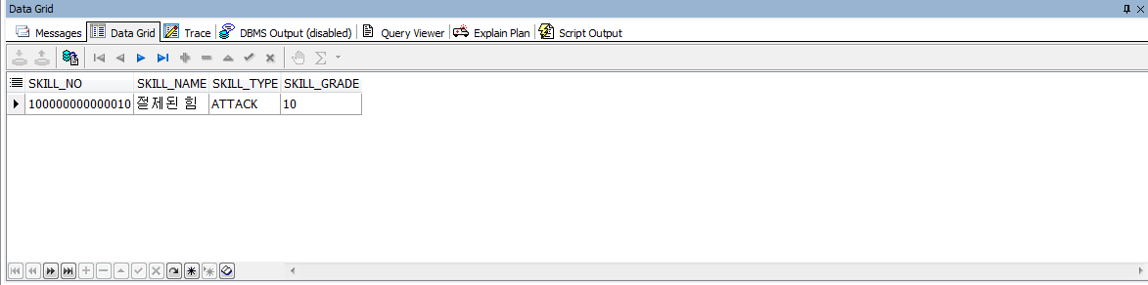
<데이터 삽입>
INSERT INTO ACC_SKILL (SKILL_NO, SKILL_NAME, SKILL_TYPE, SKILL_GRADE)
VALUES (100000000000010, '절제된 힘', 'ATTACK', 10);

Slide 6
FUNCTION 테이블생성
CREATE TABLE FUNCT (
FUNC_NO NUMBER(15),
FUNC_NAME VARCHAR2(10),
FUNC_TYPE VARCHAR2(10),
FUNC_GRADE VARCHAR2(2),
FUNC_LEVEL NUMBER(2),
CONSTRAINT FUNC_NO_PK PRIMARY KEY (FUNC_NO)
)

Slide 7
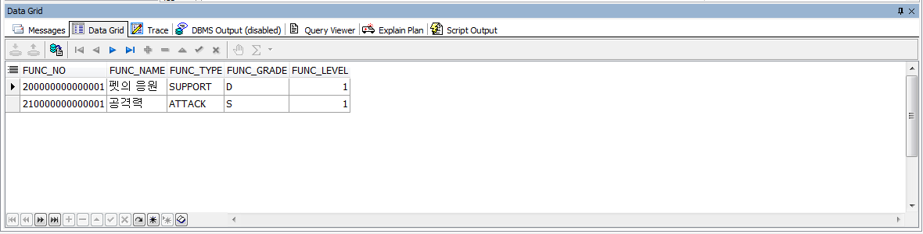
<데이터 삽입>
INSERT INTO FUNCT (FUNC_NO, FUNC_NAME, FUNC_TYPE, FUNC_GRADE, FUNC_LEVEL)
VALUES (200000000000001,'펫의 응원','SUPPORT','D','1')
INSERT INTO FUNCT (FUNC_NO, FUNC_NAME, FUNC_TYPE, FUNC_GRADE, FUNC_LEVEL)
VALUES (210000000000001,'공격력','ATTACK','S','1')

Slide 8
PET 테이블생성
CREATE TABLE PET (
PET_NO NUMBER(15),
PET_TYPE VARCHAR2(10),
PET_NAME VARCHAR2(20),
PET_PROMO VARCHAR2(3) DEFAULT 'NO',
PET_AWAKEN VARCHAR2(3) DEFAULT 'NO',
PET_FUNCT NUMBER(15),
CONSTRAINT PET_NO_PK PRIMARY KEY (PET_NO),
CONSTRAINT PET_PROMO_CK CHECK (PET_PROMO IN ('YES‘, 'NO')),
CONSTRAINT PET_AWAKEN_CK CHECK (PET_AWAKEN IN ('YES‘, 'NO'),
CONSTRAINT PET_FUNC_FK FOREIGN KEY (PET_FUNCT) REFERENCES FUNCT(FUNC_NO)
)

Slide 9
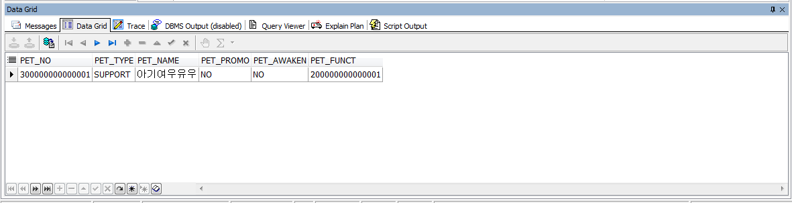
<데이터 삽입>
INSERT INTO PET (PET_NO, PET_TYPE, PET_NAME, PET_FUNCT)
VALUES (300000000000001, 'SUPPORT', '아기여우유우',200000000000001)

Slide 10
EQUIP 테이블생성
CREATE TABLE EQUIP (
EQUIP_NO NUMBER(15),
EQUIP_TYPE VARCHAR2(10),
EQUIP_NAME VARCHAR2(10),
EQUIP_GRADE VARCHAR2(2),
EQUIP_LEVEL VARCHAR2(3),
EQUIP_FUNCT NUMBER(15),
CONSTRAINT EQ_NO_PK PRIMARY KEY (EQUIP_NO),
CONSTRAINT EQ_FUNC_FK FOREIGN KEY (EQUIP_FUNCT) REFERENCES FUNCT(FUNC_NO)
)

Slide 11
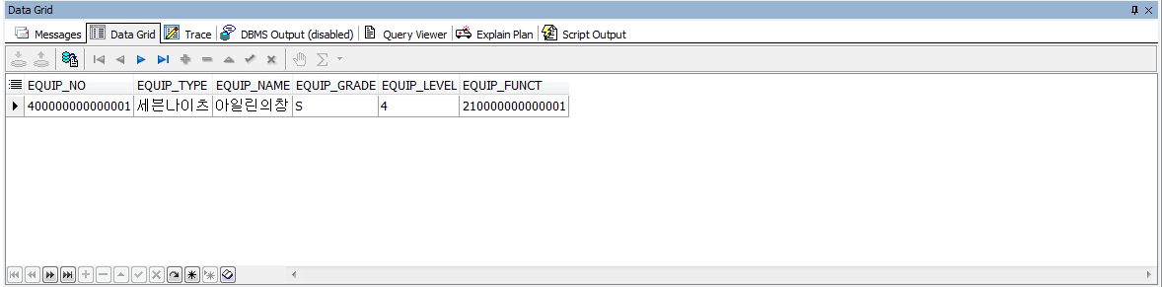
<데이터 삽입>
INSERT INTO EQUIP (EQUIP_NO, EQUIP_TYPE, EQUIP_NAME, EQUIP_GRADE, EQUIP_LEVEL, EQUIP_FUNCT)
VALUES (400000000000001, '세븐나이츠', '아일린의창','S','4',210000000000001)

Slide 12
LOBBY 테이블생성
CREATE TABLE LOBBY (
LOGIN_NO NUMBER(17),
GAME_ID VARCHAR2(20) NOT NULL,
GAME_LEVEL NUMBER(3) DEFAULT 1 NOT NULL,
ACC_SKILL NUMBER(15) NOT NULL,
SEL_CHAR1 NUMBER (15) NOT NULL,
SEL_CHAR2 NUMBER (15),
SEL_CHAR3 NUMBER (15),
SEL_CHAR4 NUMBER (15),
SEL_CHAR5 NUMBER (15),
LOBBYIN DATE NOT NULL,
LOBBYOUT DATE,
LEADER_CHAR NUMBER (15) NOT NULL,
PET_NO NUMBER (15),
CONSTRAINT LBY_LONINNO_PK PRIMARY KEY (LOGIN_NO),
CONSTRAINT LBY_ACCSKILL_FK FOREIGN KEY (ACC_SKILL) REFERENCES ACC_SKILL(SKILL_NO),
CONSTRAINT LNY_SELCHAR1_FK FOREIGN KEY (SEL_CHAR1) REFERENCES OWN_CHAR(OWN_CHAR_NO)
CONSTRAINT LNY_SELCHAR2_FK FOREIGN KEY (SEL_CHAR2) REFERENCES OWN_CHAR(OWN_CHAR_NO)
CONSTRAINT LNY_SELCHAR3_FK FOREIGN KEY (SEL_CHAR3) REFERENCES OWN_CHAR(OWN_CHAR_NO)
CONSTRAINT LNY_SELCHAR4_FK FOREIGN KEY (SEL_CHAR4) REFERENCES OWN_CHAR(OWN_CHAR_NO)
CONSTRAINT LNY_SELCHAR5_FK FOREIGN KEY (SEL_CHAR5) REFERENCES OWN_CHAR(OWN_CHAR_NO)
CONSTRAINT LBY_PETNO_FK FOREIGN KEY (PET_NO) REFERENCES PET(PET_NO)
);

Slide 13
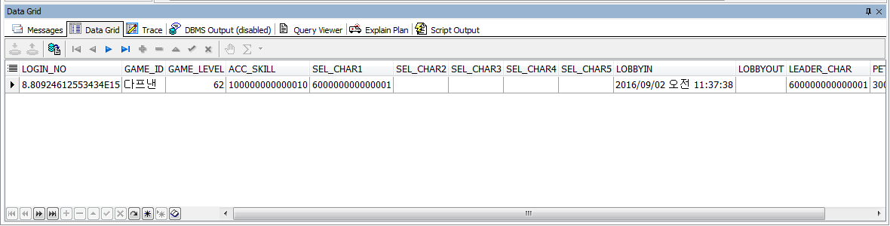
<데이터 삽입>
INSERT INTO LOBBY
VALUES (8809246125534336, '다프낸', 62, 100000000000010, 600000000000001,NULL,NULL,NULL,NULL,SYSDATE,NULL,600000000000001,300000000000001)

Slide 14
SKILL 테이블생성
CREATE TABLE SKILL (
SKILL_NO NUMBER(15),
SKILL_NAME VARCHAR2(20),
SKILL_TYPE VARCHAR2(10),
SKILL_GRADE VARCHAR2(2),
CONSTRAINT SKL_NO_PK PRIMARY KEY (SKILL_NO)
)

Slide 15
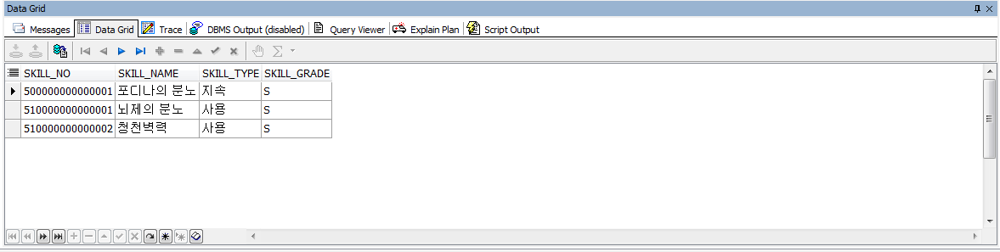
<데이터 삽입>
INSERT INTO SKILL (SKILL_NO, SKILL_NAME, SKILL_TYPE, SKILL_GRADE)
VALUES (500000000000001, '포디나의 분노', '지속','S')
INSERT INTO SKILL (SKILL_NO, SKILL_NAME, SKILL_TYPE, SKILL_GRADE)
VALUES (510000000000001, ’뇌제의 분노', ‘사용', 'S')
INSERT INTO SKILL (SKILL_NO, SKILL_NAME, SKILL_TYPE, SKILL_GRADE)
VALUES (510000000000002, ‘청천벽력', ‘사용','S')

Slide 16
CHARACTER 테이블생성
CREATE TABLE CHARACTER (
CHAR_NO NUMBER(15),
CHAR_TYPE VARCHAR2(10),
CHAR_NAME VARCHAR2(10),
CHAR_OVERLEVEL VARCHAR2(3),
CHAR_PROMO VARCHAR2(3),
CHAR_AWAKEN VARCHAR2(3),
SKILL1 NUMBER(15) NOT NULL,
SKILL2 NUMBER(15) NOT NULL,
SKILL3 NUMBER(15) NOT NULL,
SKILL4 NUMBER(15),
CONSTRAINT CHR_CHRNO_PK PRIMARY KEY (CHAR_NO),
CONSTRAINT CHR_CHROL_CK CHECK (CHAR_OVERLEVEL IN ('YES‘, 'NO')),
CONSTRAINT CHR_CHRPM_CK CHECK (CHAR_PROMO IN ('YES‘, 'NO')),
CONSTRAINT CHR_CHRAK_CK CHECK (CHAR_AWAKEN IN ('YES‘, 'NO')),
CONSTRAINT CHR_SKILL1_FK FOREIGN KEY (SKILL1) REFERENCES SKILL(SKILL_NO),
CONSTRAINT CHR_SKILL2_FK FOREIGN KEY (SKILL2) REFERENCES SKILL(SKILL_NO),
CONSTRAINT CHR_SKILL3_FK FOREIGN KEY (SKILL3) REFERENCES SKILL(SKILL_NO),
CONSTRAINT CHR_SKILL4_FK FOREIGN KEY (SKILL4) REFERENCES SKILL(SKILL_NO)
)

Slide 17
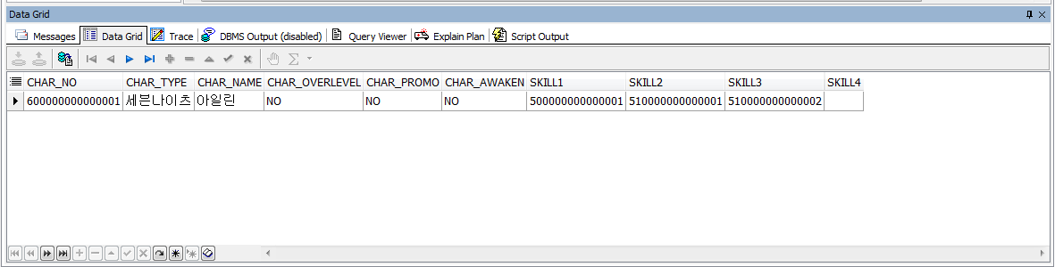
<데이터 삽입>
INSERT INTO CHARACTER (CHAR_NO, CHAR_TYPE, CHAR_NAME, CHAR_OVERLEVEL, CHAR_PROMO, CHAR_AWAKEN, SKILL1, SKILL2, SKILL3, SKILL4)
VALUES (600000000000001, '세븐나이츠','아일린', 'NO','NO','NO',500000000000001, 510000000000001,510000000000002,NULL)

Slide 18
OWN_CHAR 테이블생성
CREATE TABLE OWN_CHAR (
OWN_CHAR_NO NUMBER(15),
OWN_CHAR_TEAM VARCHAR2(3) DEFAULT 'NO',
OWN_CHAR_LEVEL VARCHAR2(2) DEFAULT 1 NOT NULL,
OWN_CHAR_EQUIP1 NUMBER(15),
OWN_CHAR_EQUIP2 NUMBER(15),
OWN_CHAR_EQUIP3 NUMBER(15),
OWN_CHAR_EQUIP4 NUMBER(15),
OWN_CHAR_EQUIP5 NUMBER(15),
OWN_CHAR_EQUIP6 NUMBER(15),
OWN_CHAR_EQUIP7 NUMBER(15),
OWN_CHAR_EQUIP8 NUMBER(15),
CONSTRAINT OCHR_NO_PK PRIMARY KEY (OWN_CHAR_NO),
CONSTRAINT OCHR_TEAM_CK CHECK (OWN_CHAR_TEAM IN ('YES','NO')),
CONSTRAINT OCHR_EQ1_FK FOREIGN KEY (OWN_CHAR_EQUIP1) REFERENCES EQUIP(EQUIP_NO),
CONSTRAINT OCHR_EQ2_FK FOREIGN KEY (OWN_CHAR_EQUIP2) REFERENCES EQUIP(EQUIP_NO),
CONSTRAINT OCHR_EQ3_FK FOREIGN KEY (OWN_CHAR_EQUIP3) REFERENCES EQUIP(EQUIP_NO),
CONSTRAINT OCHR_EQ4_FK FOREIGN KEY (OWN_CHAR_EQUIP4) REFERENCES EQUIP(EQUIP_NO),
CONSTRAINT OCHR_EQ5_FK FOREIGN KEY (OWN_CHAR_EQUIP5) REFERENCES EQUIP(EQUIP_NO),
CONSTRAINT OCHR_EQ6_FK FOREIGN KEY (OWN_CHAR_EQUIP6) REFERENCES EQUIP(EQUIP_NO),
CONSTRAINT OCHR_EQ7_FK FOREIGN KEY (OWN_CHAR_EQUIP7) REFERENCES EQUIP(EQUIP_NO),
CONSTRAINT OCHR_EQ8_FK FOREIGN KEY (OWN_CHAR_EQUIP8) REFERENCES EQUIP(EQUIP_NO)
)

Slide 19
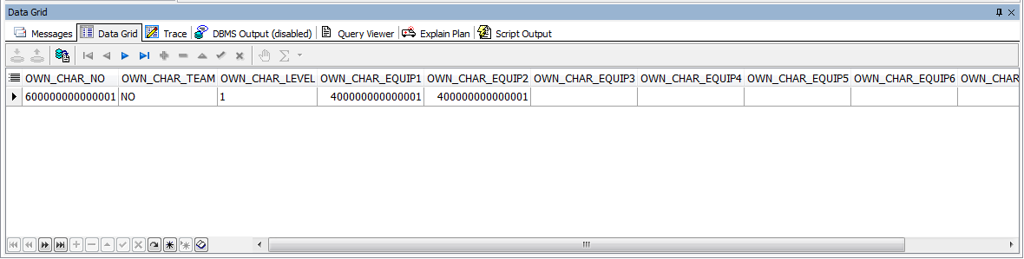
<데이터 삽입>
INSERT INTO OWN_CHAR
VALUES (600000000000001,'NO',1,400000000000001,400000000000001,NULL,NULL,NULL,NULL,NULL,NULL)

