Slide 1
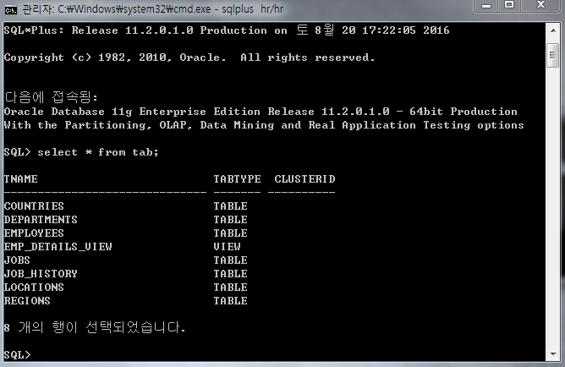
문제
hr 계정으로 접속
전체 관계도 그리기

Slide 2
PRIMARY KEY
FOREIGN KEY
1
DEPARTMENTS
DEPARTMENT_ID
DEPARTMENT_NAME
MANAGER_ID
LOCATION_ID
REGIONS
REGION_ID
REGION_NAME
1
JOB_HISTORY
EMPLOYEE_ID
START_DATE
END_DATE
JOB_ID
DEPARTMENT_ID
1
N
N
N
N
N
COUNTRIES
COUNTRY_ID
COUNTRY_NAME
REGION_ID
EMPLOYEES
EMPLOYEE_ID
FIRST_NAME
LAST_NAME
EMAIL
PHONE_NUMBER
HIRE_DATE
JOB_ID
SALARY
COMMISION_PCT
MANAGER_ID
DEPARTMENT_ID
1
1
N
N
1
N
1
LOCATIONS
LOCATION_ID
STREET_ADDRESS
POSTAL_CODE
CITY
STATE_PROVINCE
COUNTRY_ID
N
1
JOBS
JOB_ID
JOB_TITLE
MIN_SALARY
MAX_SALARY
1

