Slide 1
문제
1. HR 계정으로 접속
2. 아래 컬럼을 출력
FIRST_NAME, LAST_NAME, EMAIL, DEPARTMENT_ID, DEPARTMENT_NAME, JOB_ID, JOB_TITLE, CITY
3. 107명이 전부 나오게 한다
4. 이용할 테이블의 별칭은 EMPLOYEES EMP, DEPARTMENTS DEP, JOBS JOB, LOCATIONS LOC 를 사용한다.
5. 일반적인 JOIN을 사용한다.
select emp.FIRST_NAME, emp.LAST_NAME, emp.EMAIL, emp.JOB_ID, job.job_title,dep.department_ID, dep.department_name, loc.city
from employees emp, jobs job, departments dep, locations loc
where emp.job_id=job.job_id
and emp.department_id = dep.department_id (+)
and dep.location_id = loc.location_id (+)/

Slide 2
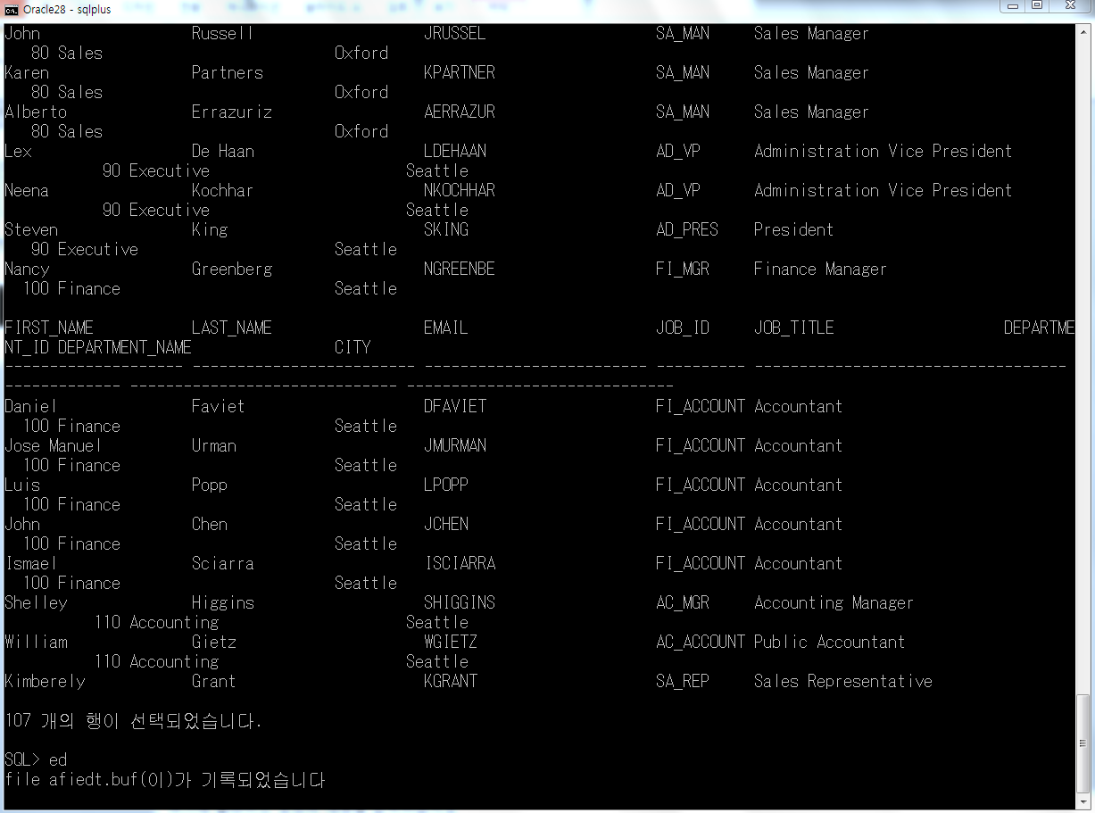

Slide 3
문제
1. HR 계정으로 접속
2. 아래 컬럼을 출력
FIRST_NAME, LAST_NAME, EMAIL, DEPARTMENT_ID, DEPARTMENT_NAME, JOB_ID, JOB_TITLE, CITY
3. 107명이 전부 나오게 한다
4. 이용할 테이블의 별칭은 EMPLOYEES EMP, DEPARTMENTS DEP, JOBS JOB, LOCATIONS LOC 를 사용한다.
5. ANIS JOIN을 사용한다.
select emp.FIRST_NAME, emp.LAST_NAME, emp.EMAIL, JOB_ID, job_title, department_ID, dep.department_name, loc.city
from employees emp inner join jobs job using (job_id)
left outer join departments dep using (department_id)
left outer join locations loc using (location_id)

Slide 4
