Slide 1
문제 1
hr 계정으로 접속
신규 테이블 생성
CREATE TABLE month_salary (magam_date DATE not null,
department_id number,
emp_count number,
total_salary number(9,2),
average_salary number (9,2)

Slide 2
문제 2
employees 컬럼을 이용해서 이번달 말일을 입력한다. 서브쿼리를 이용
employees 컬럼에서 department_Id 그룹별로 한개씩 넣는다. group by를 이용
insert into month_salary (magam_date, department_id)
select last_day(sysdate), department_id
from employees
group by department_id

Slide 3
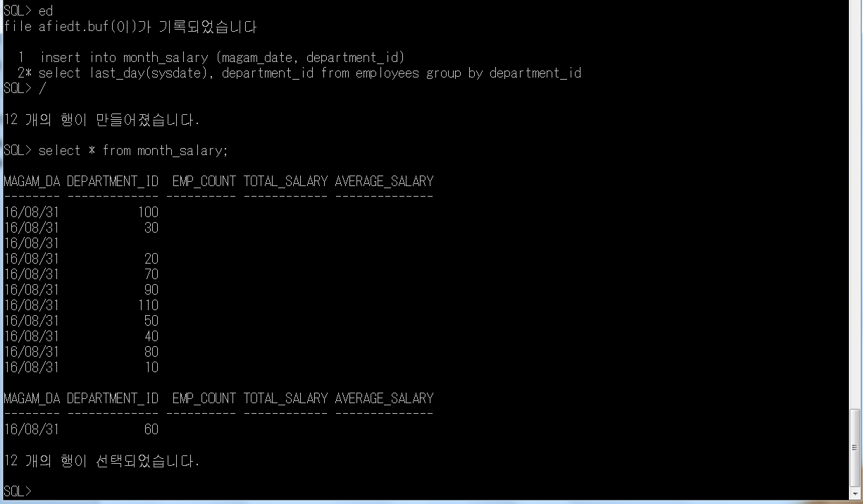

Slide 4
문제 3
hr 계정으로 접속
아래 방법으로 테이블을 생성
CREATE TABLE month_salary (
magam_date DATE not null,
department_id number,
emp_count number,
total_salary number(9,2),
average_salary number (9,2)
update month_salary a
set a.emp_count = (select count(*)
from employees k
where k.department_id = a.department_id
group by k.department_id),
a.total_salary = (select sum(k.salary)
from employees k
where k.department_id = a.department_id
group by k.department_id),
a.average_salary = (select round(avg(k.salary))
from employees k
where k.department_id = a.department_id
group by k.department_id)

Slide 5
문제 4
다른 문법형식으로 진행
update month_salary a
set (a.emp_count, a.total_salary, a.average_salary) =
(select count(*), sum(k.salary), round(avg(k.salary))
from employees k
where k.department_id = a.department_id
group by k.department_id)

Slide 6
