Slide 1
문제
프로시저를 활용하여 SCOTT이라는 사람의 전체 정보를 출력한다. (총8가지)
CREATE OR REPLACE PROCEDURE SEL_EMPLY
( VEMPNO IN OUT EMP.EMPNO%TYPE,
VENAME OUT EMP.ENAME%TYPE,
VJOB OUT EMP.JOB%TYPE,
VMGR OUT EMP.MGR%TYPE,
VHIREDATE OUT EMP.HIREDATE%TYPE,
VSAL OUT EMP.SAL%TYPE,
VCOMM OUT EMP.COMM%TYPE,
VDEPTNO OUT EMP.DEPTNO%TYPE
)
IS
BEGIN
SELECT ENAME, JOB, MGR, HIREDATE, SAL, COMM, DEPTNO
INTO VENAME, VJOB, VMGR, VHIREDATE, VSAL, VCOMM, VDEPTNO
FROM EMP
WHERE EMPNO=VEMPNO;
END;
/

Slide 2
<바인드 변수 생성>
VARIABLE VAR_ENAME VARCHAR2(15);
VARIABLE VAR_JOB VARCHAR2(15);
VARIABLE VAR_MGR NUMBER;
VARIABLE VAR_HIREDATE VARCHAR2(15);
VARIABLE VAR_SAL NUMBER;
VARIABLE VAR_COMM NUMBER;
VARIABLE VAR_DEPTNO NUMBER;
VARIABLE VAR_EMPNO NUMBER;

Slide 3
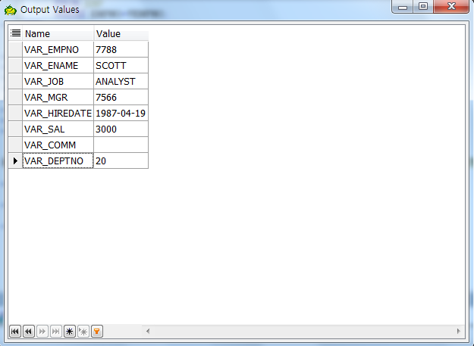
<실행>
EXECUTE SEL_EMPLY(:VAR_EMPNO, :VAR_ENAME, :VAR_JOB, :VAR_MGR, :VAR_HIREDATE, :VAR_SAL, :VAR_COMM, :VAR_DEPTNO);

