Slide 1
문제
HR 계정으로 접속한다.
아래 쿼리문에 일부를 저장함수로 생성하여 실행한다. (함수명: get_dep_name)
Select a.employee_id, a.first_name ||’’||a.last_name names, (select b.department_name from departments b where a.department_id=b.department_id) dep_names
From employees a
Where a.department_id=100;
create or replace function
get_dep_name (vdepartment_id in departments.department_name%type)
return varchar2
is
vdep_name varchar2(20);
begin
select department_name into vdep_name
from departments
where department_id = vdepartment_id;
return vdep_name;
end;

Slide 2
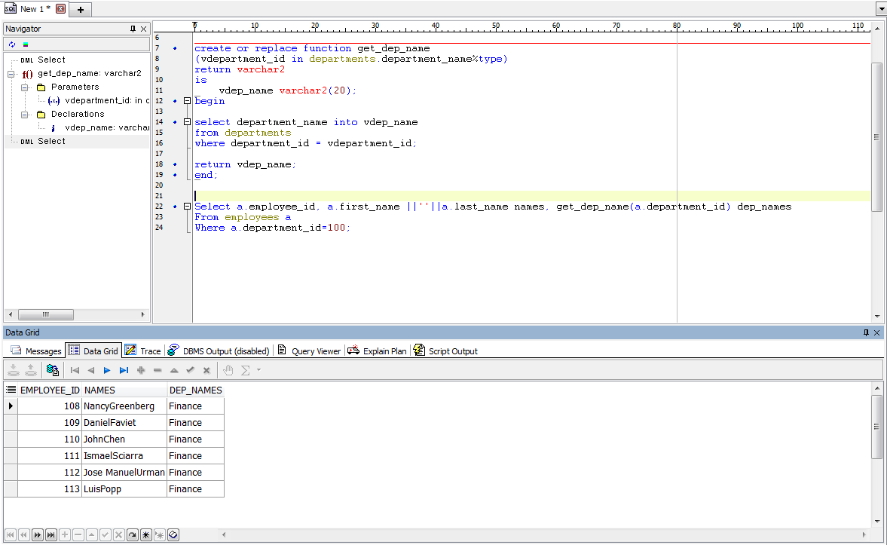
<저장함수를 포함한 select 절을 실행한다>
Select a.employee_id, a.first_name ||''||a.last_name names, get_dep_name(a.department_id) dep_names
From employees a
Where a.department_id=100;

