Slide 1
Crazy Alarm
-sleepyhead-
Ryo, Mona, Yoni
(Idea: Shu-Ming)

Slide 2

Concept
Problem - sometime we stop the Alarm unconsciously
Main Concept - this alarm app will not stop until user win the games
Notes:
Have you had a experience that you woke up late in the morning.
You definitely set the alarm last night….. But you didn’t hear the alarm….
You don’t remember whether you stop or not…. probably you stoped it unconsiously…

Slide 3

Function & Design

Slide 4

Design
Main Logo
Color - color of dawn
#F8CBC3
#F5E8D5
#838399
#B9A1AC
#7C707A
#F29098
Font

Slide 5
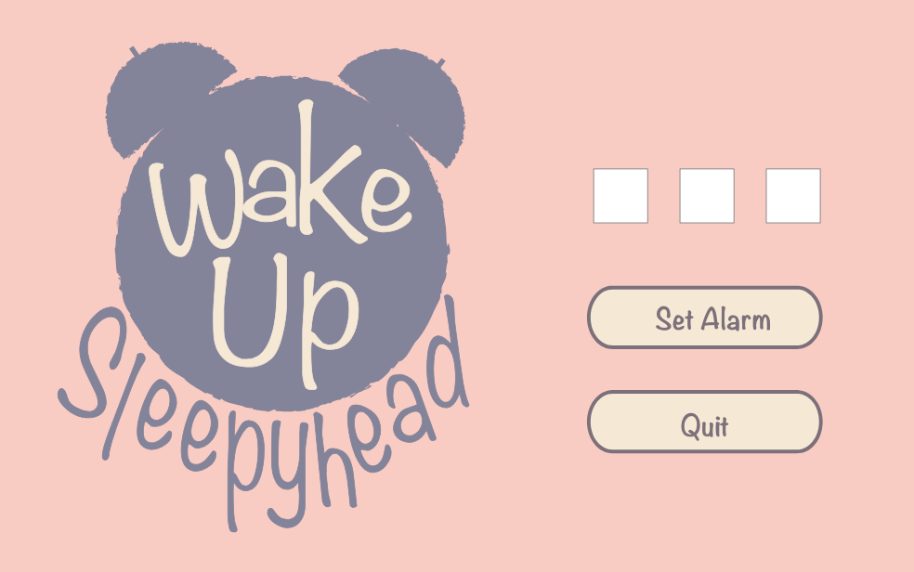
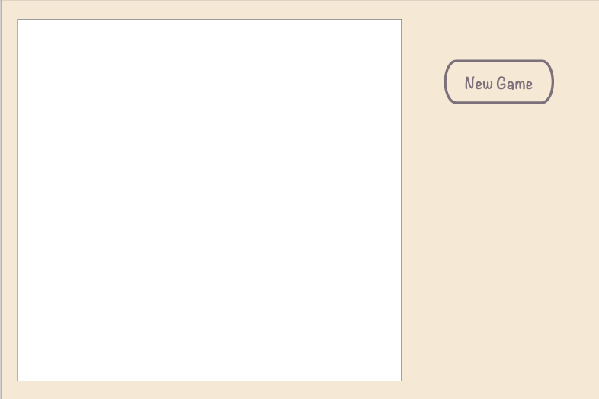
Design
Main Menu Screen
Game Screen

Slide 6
Alarm
The main purpose of this project was implementing a different, exciting alarm for those who wake up not so easily!
-Timer task runs an alarm and play the media player when the user sets the alarm and alarm reaches to ‘0’
-Game selector page opens and asks user to select a game and play to stop the alarm.

Slide 7
Games

Slide 8
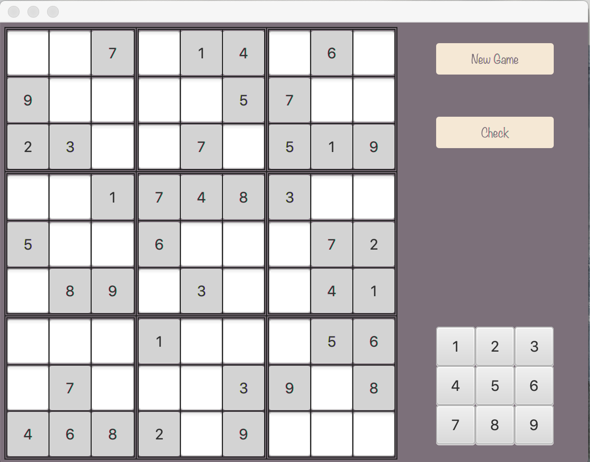
Game1 - Sudoku
A 9*9 Sudoku game that user must solve it
While the alarm is playing!

Slide 9
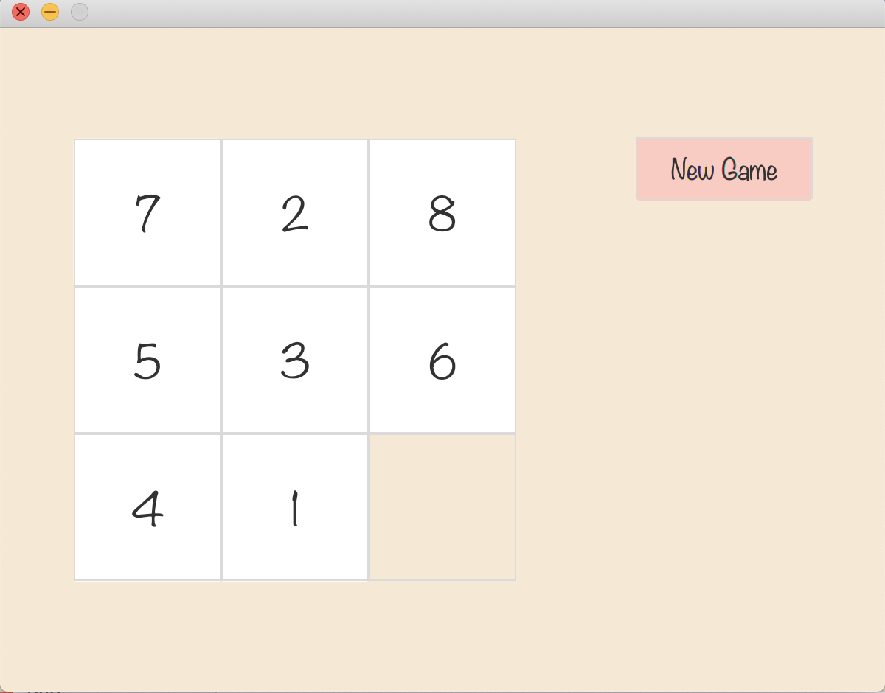








Game2 - Slide Puzzle
A simple 9-puzzle that should be solved to stop the alarm.
The numbers have to be in order from 1 to 8.

Slide 10
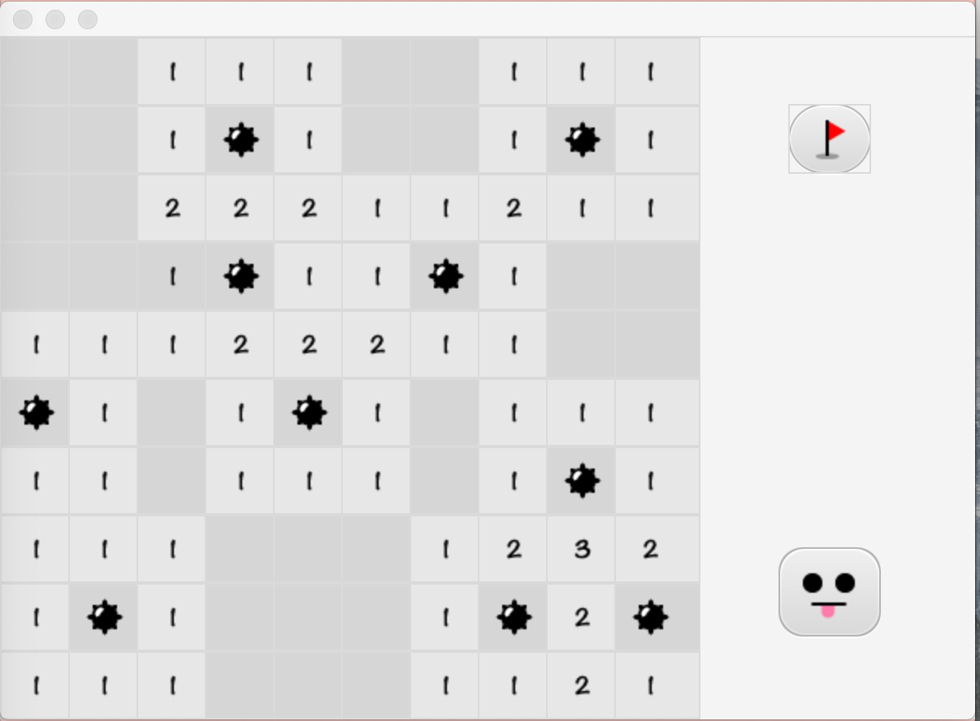




Game3 - Minesweeper
A basic 10x10 minesweeper.
There are 10 bombs on the board.
You have to solve it if you want to
stop the alarm.

Slide 11
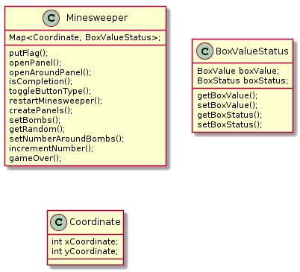
UML Diagram
e.g. Minesweeper

Slide 12
Project Management

Slide 13
Demonstration

Slide 14
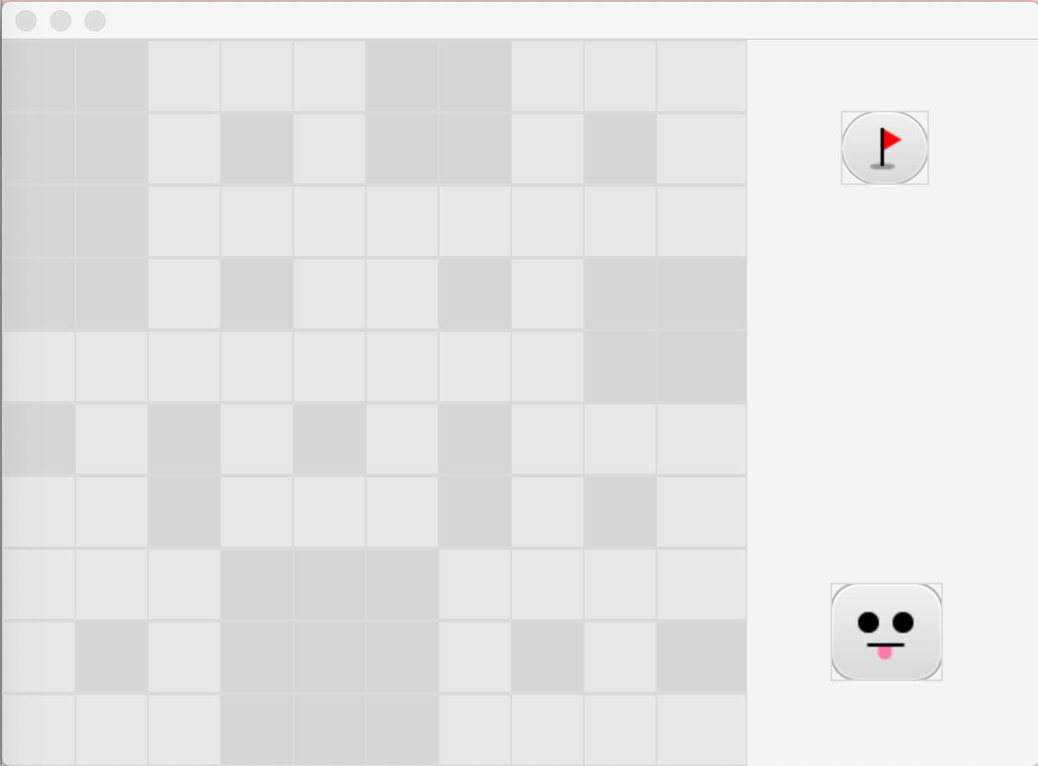
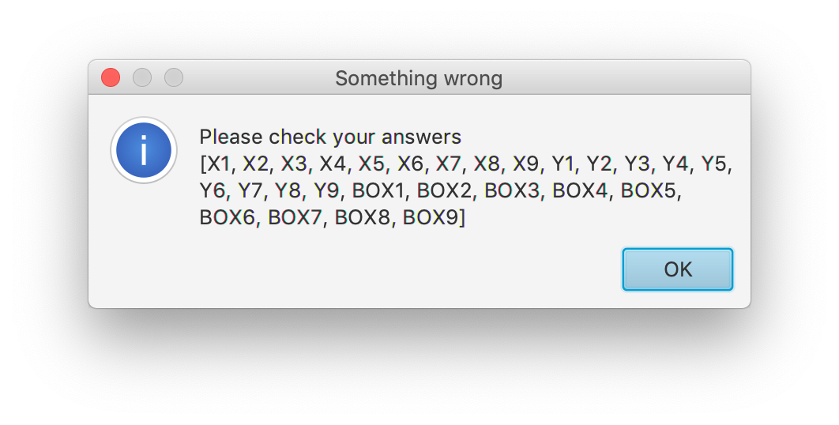
Remaining issues
Minesweeper: Cannot reset the game properly
Sudoku: Error message is not user friendly -> difficult to understand which places are mistaken
Design: Popup design

Slide 15
Questions ?

