Slide 1
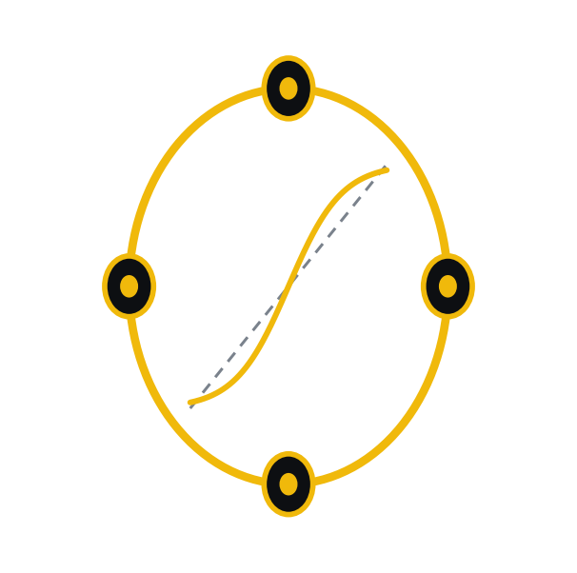
Band Risk-Review
A separation-of-duties risk desk for AI
Four specialized agents collaborate through Band to review high-stakes financial decisions.
Band of Agents Hackathon · Track 3 — Regulated & High-Stakes
Ruiyang Zhang · CFA, ASA · MIT

Slide 2
One model, one overconfident voice
Most “AI finance agents” are a single model answering every question with the same false confidence. Regulated finance refuses to work that way.
Separation of duties
The desk that proposes a trade is never the desk that approves it.
Deterministic risk
Risk numbers come from a system, not a model’s gut.
Traceability
Every decision must leave an auditable trail.

Slide 3
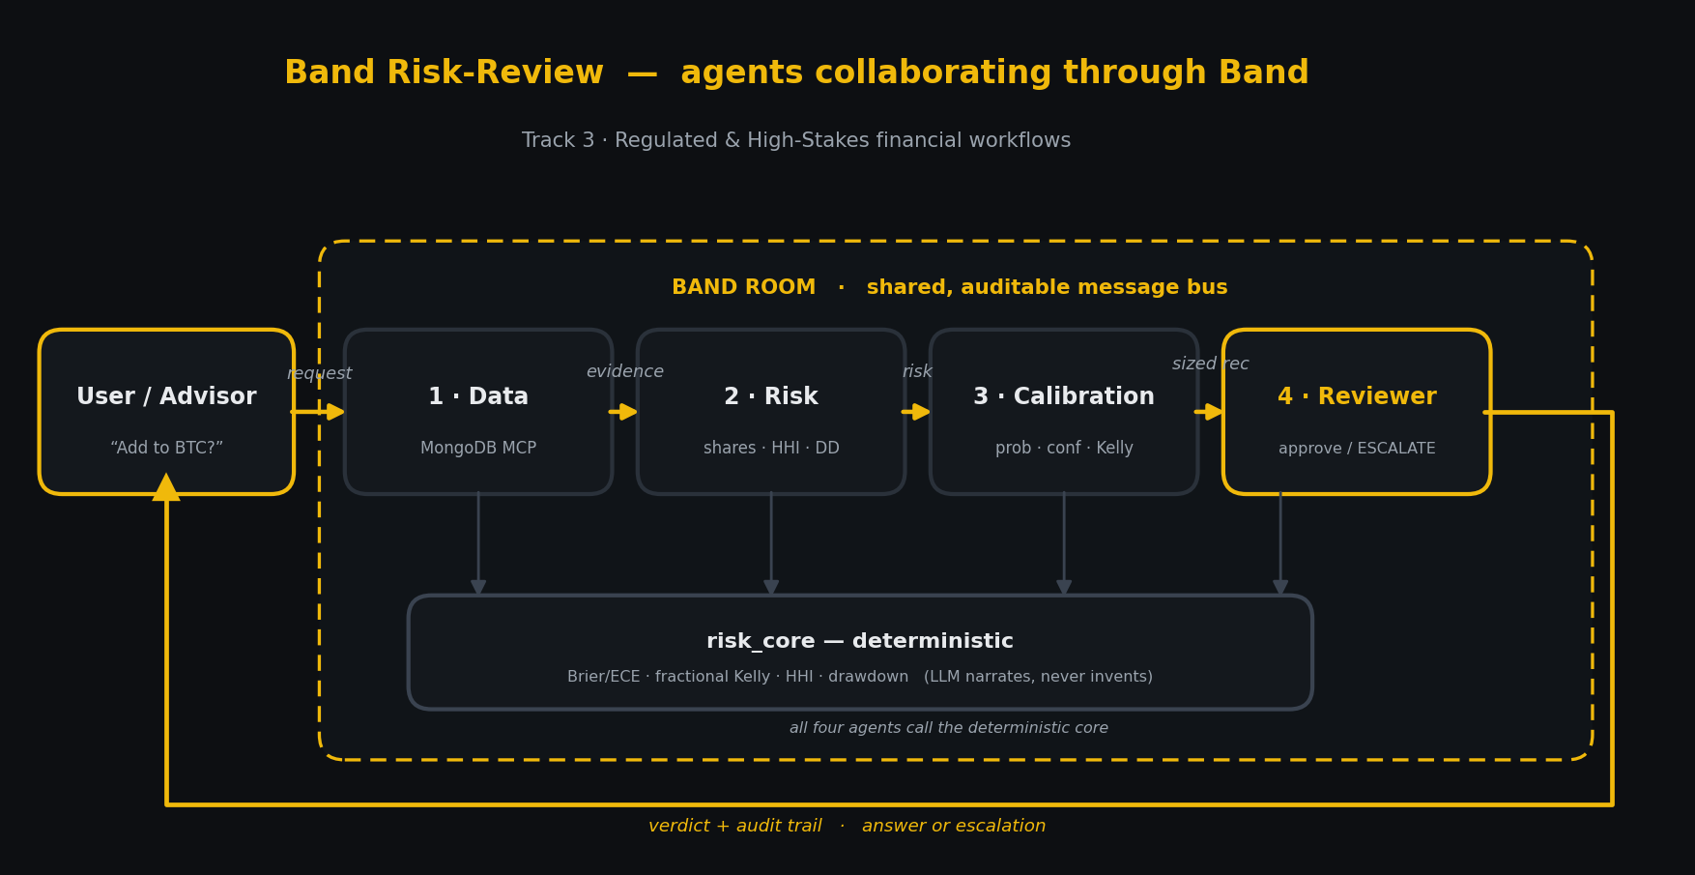
Four agents, collaborating through Band
Data gathers evidence · Quant computes risk · Calibration sizes the bet · an independent Reviewer approves, trims, or escalates.

Slide 4
Band is the collaboration layer
User → @Risk-Data → @Risk-Quant → @Risk-Calibration → @Risk-Reviewer → User
Agents coordinate by @mention handoff in a shared Band room — Band routes each message only to the targeted agent, keeping context clean.
Every message, tool call, tool result, and handoff is recorded in the room. That conversation history IS the regulator-grade audit trail.
Band isn’t a wrapper or a final notification — it’s the substrate the workflow runs on. That’s the core Track 3 judging criterion.

Slide 5
Honesty by construction
All risk math lives in a deterministic core. The agents call it as tools; the LLMs only narrate and decide handoffs — they never produce a risk number.
Brier / ECE
Fractional Kelly
HHI
Drawdown gate
calibration scoring
confidence-scaled sizing
risk concentration
escalation trigger
Anti-hallucination by design — the guarantee that matters in regulated finance.

Slide 6
Four asks, four honest outcomes
“Add to BTC?”
sized ~11% — clean signals, within the drawdown gate
APPROVED
“ETH hot on socials?”
funding vs momentum conflict — confidence below floor
ABSTAIN
“DOGE position?”
no data on the asset — won’t guess
ABSTAIN
“Add more SOL?”
drawdown contribution > 6% gate — routed to a human
ESCALATE

Slide 7
A regulated risk desk, as a band of agents.
Open source · MIT · Ruiyang Zhang — passed all three CFA Program exams (CFA, ASA)
github.com/ryonzhang/band-risk-review · ruiyang.co

