Slide 1
Rolling Piano
Ryogo Ishino (71840638)

Slide 2
What I Made
A device that plays piano not by pressing the keyboard but by rolling the device itself.

Slide 3


What I Used
Arduino Nano
ADXL345 (accelerometer)
Max/MSP (a visual programming language for music and multimedia)
Serial Communication
➡︎
Acceleration

Slide 4
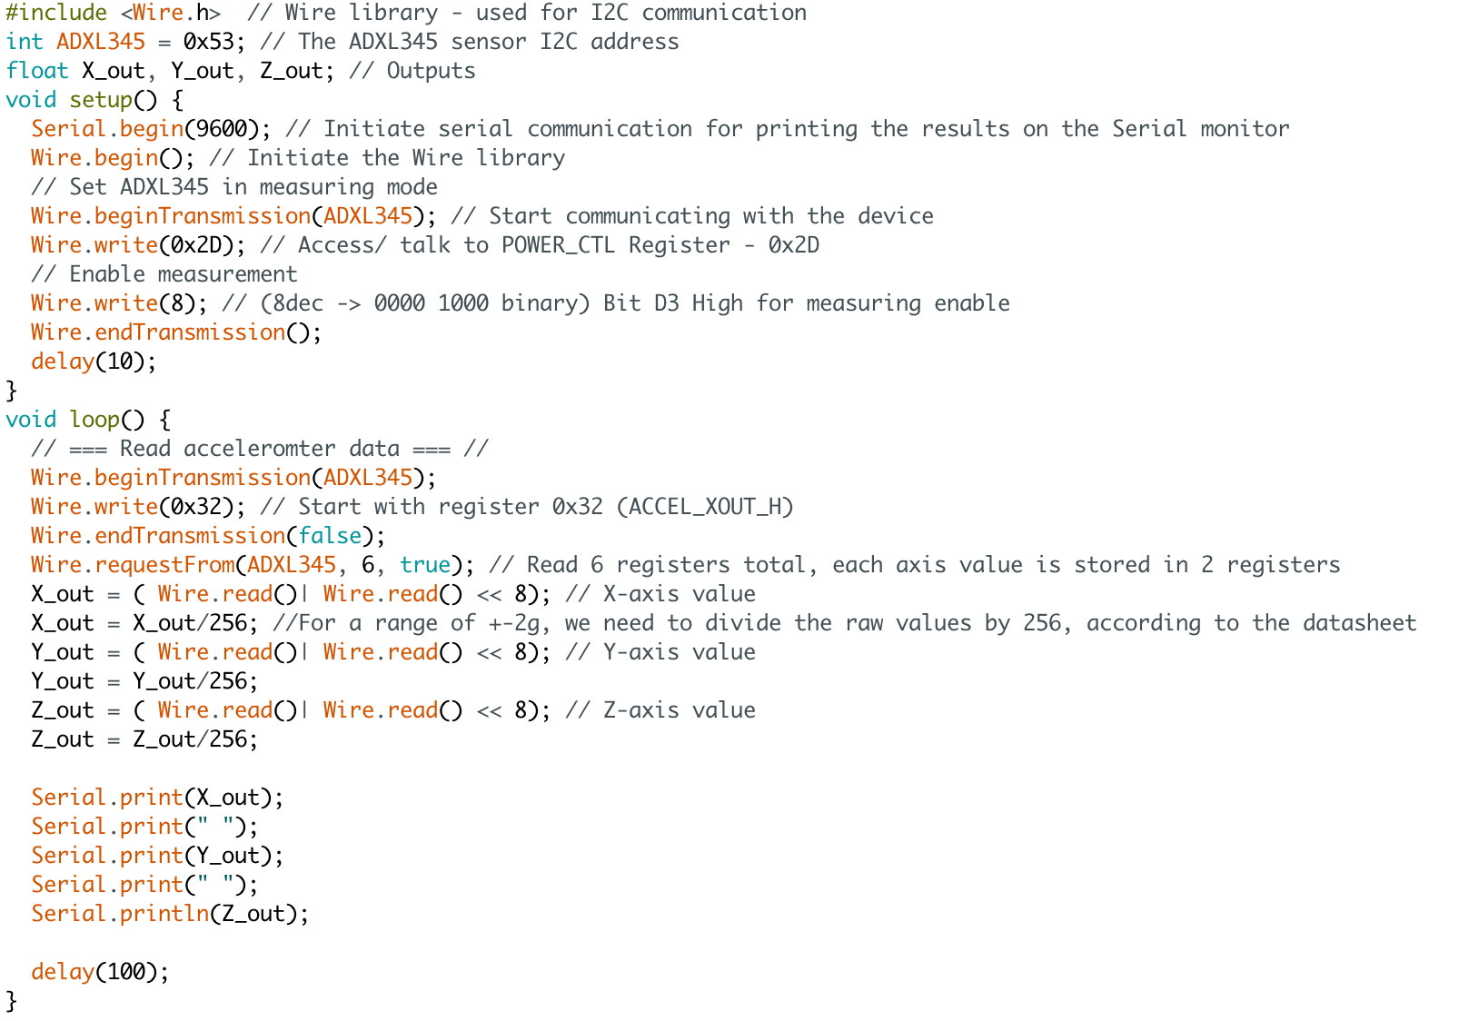

Slide 5
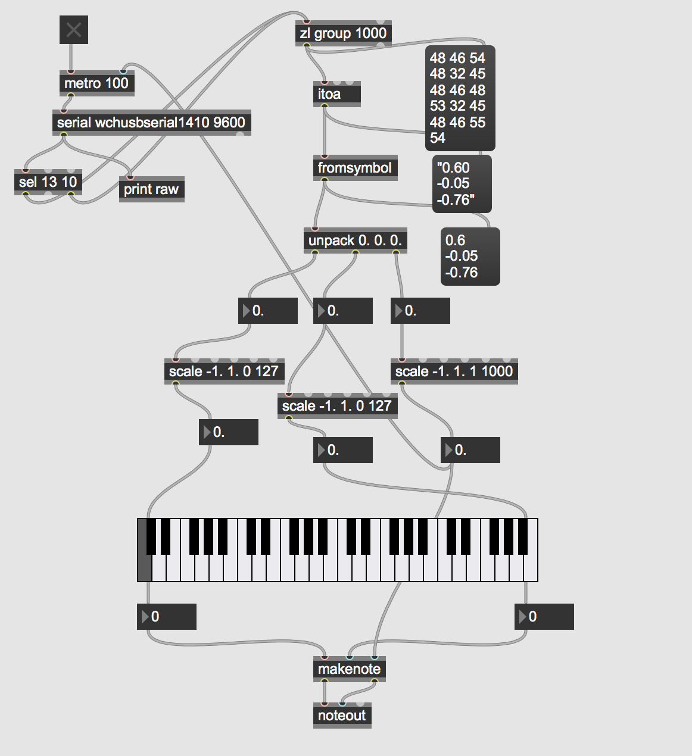

Slide 6
X axis → Pitch
Y axis → Velocity
Z axis → Duration

Slide 7
Let’s play!

