Slide 1

Disappearing Patients: Predicting No-Shows For Medical Appoinments
Machine Learning Final Project
Prince Birring & Ryan Orsini

Slide 2
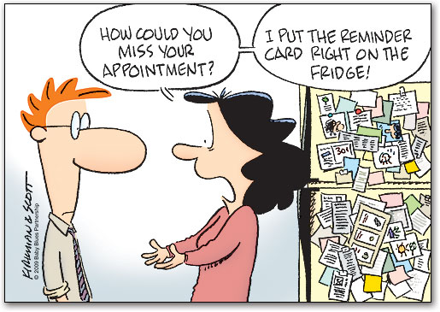

Slide 3
Abstract
This project is focused on the creation of a predictive model that could be used by healthcare providers in order to reduce their over-all monetary losses due to missed appointments. In order to reduce the level of market inefficiency caused by missed appointments, a data based approach can be used to target high risk patients. Once the individuals who are most likely to miss appointments are identified, steps can be taken to mitigate the likely-hood that they do not arrive.

Slide 4
Background
Companies that require their customers to make appointments to do business, face uncertainty as to whether the individual will arrive to the appointment. The healthcare industry relies heavily on the use of scheduling appointments to facilitate the care of patients. When patients do not arrive to their appointments & have not notified the service provider beforehand, there is an opportunity cost to the business.
Patient inflow directly affects revenues, but also staffing. The more patients that are expected to come in on any given day will influence the number of doctors & staff working. Moreover, patients who miss their own appointments put themselves at risk because they miss the care that they were originally seeking out.
There are cases of healthcare providers losing many thousands of dollars due to missed appointments.

Slide 5
Dataset
Dataset from Kaggle
Has 300K records and 14 features
Features are:
  Age
  Gender
  Appointment Registration Date
  Appointment Date
  Day of the Week
  Alcoholism
  Hyper-Tension
  Handicapped
  Smokes
  Scholarship
  Tuberculosis
  SMS Reminder
  Waiting time (In Days – Registration time to Actual Appointment)

Slide 6
Exploratory Data Analysis
Out of the 300,000 records:
  209,269 showed up (69.7%)
  90,731 did not show up (30.3%)
  200,505 records were from female patients (66.8%)
  99,495 records were from male patients (32.2%)
  Monday Appointments: 19.7%
  Tuesday Appointments: 20.9%
  Wednesday Appointments: 21.1% - Most Popular Day for Medical Appointments
  Thursday Appointments: 20.1%
  Friday Appointments: 17.6%
  Saturday Appointments:0.464%
  Sunday Appointments: 0.002%

Slide 7
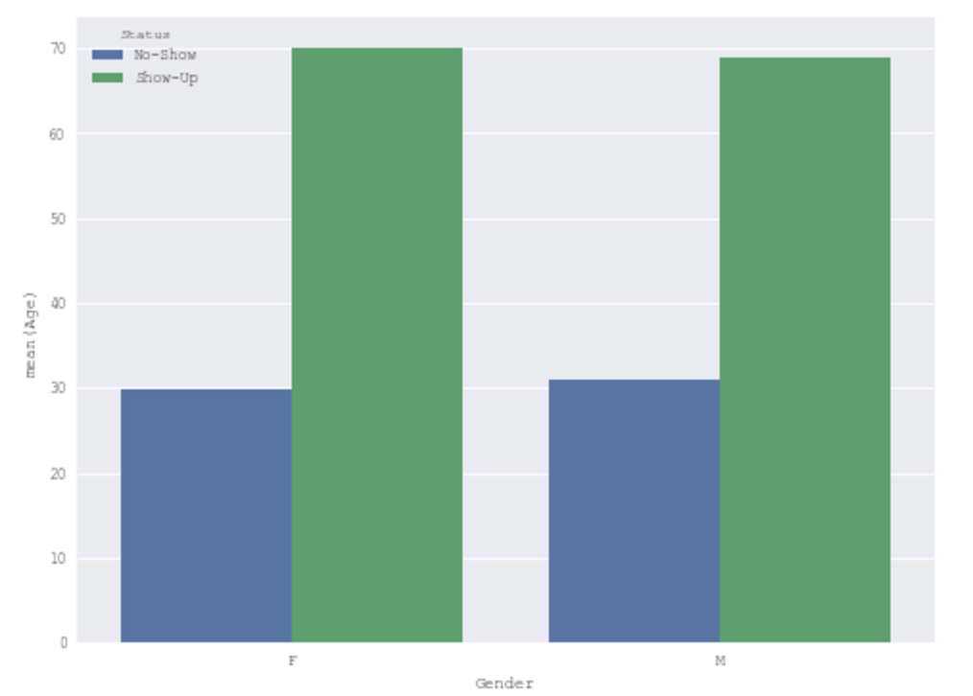
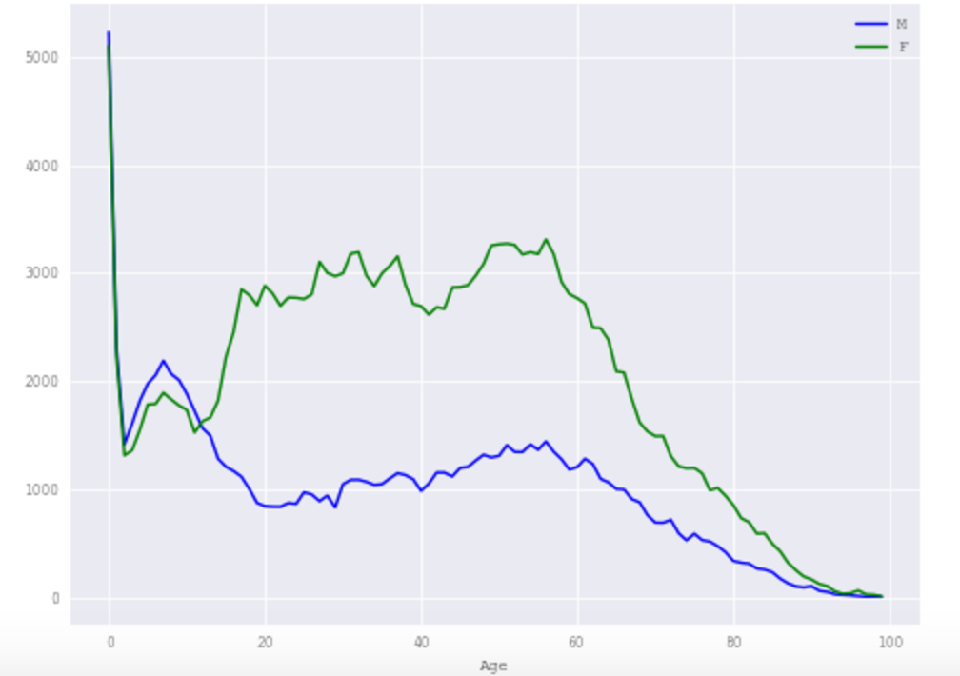
Does Gender Have Any Influence on Showing up To Appointments?
Probability of Showing Up Based on Sex
Doctors Visits oVer Different Ages

Slide 8
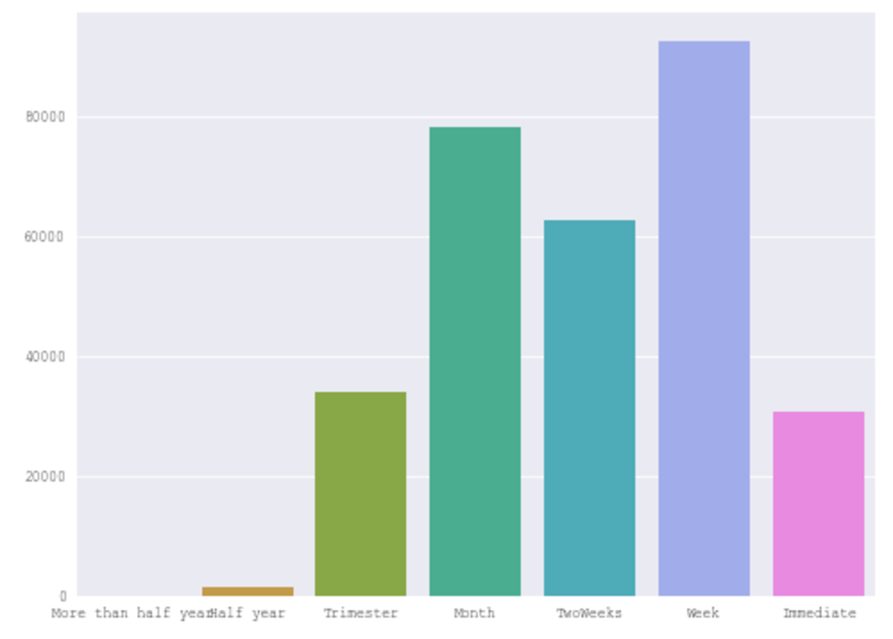
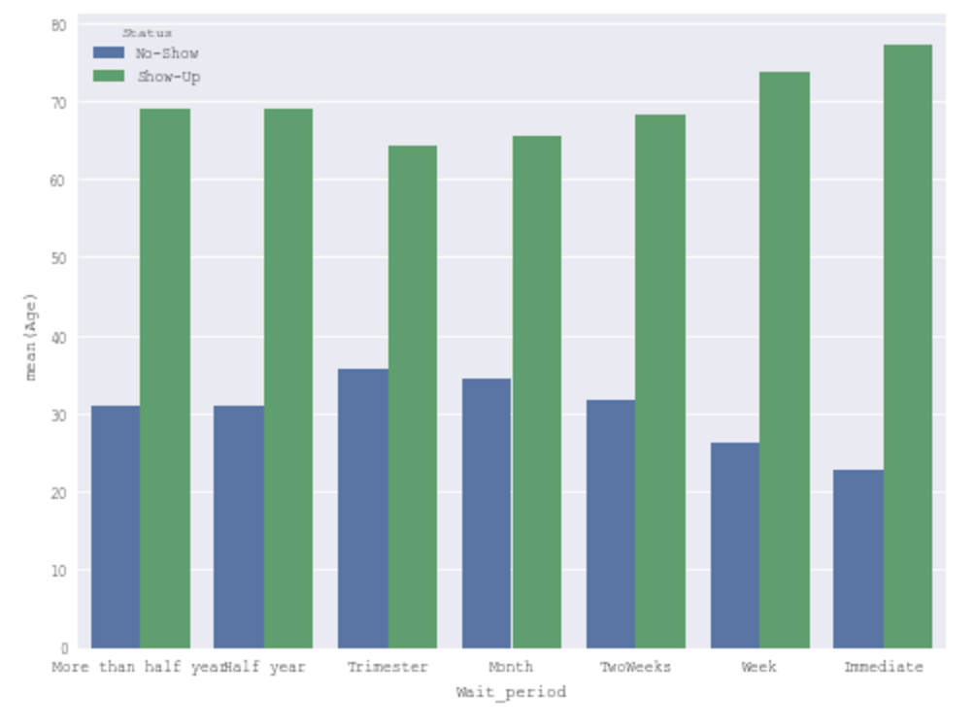
Wait time Between Registration & Appointment
Distribution of Wait Time
Probability of Showing up Based on Wait Time

Slide 9
Wait time Between Registration & Appointment
Distribution of Wait Time
Probability of Showing up Based on Wait Time

Slide 10
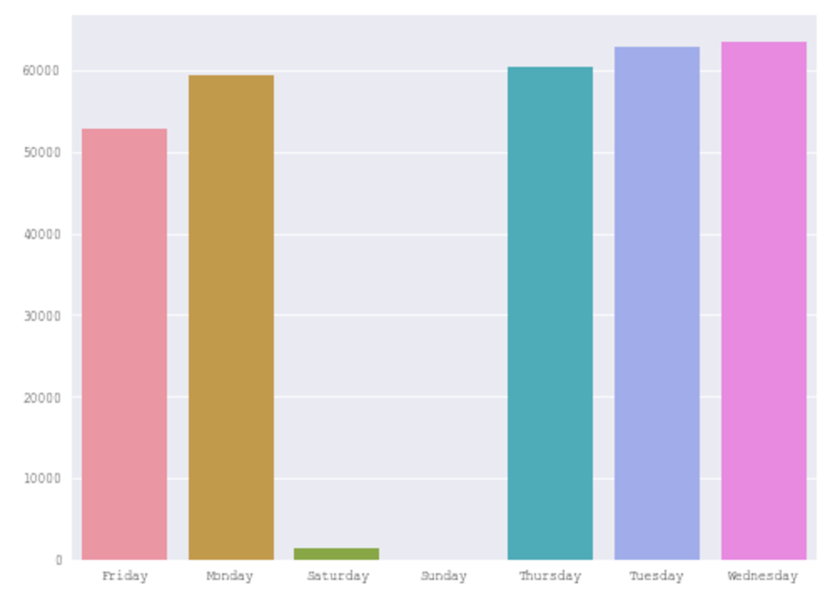
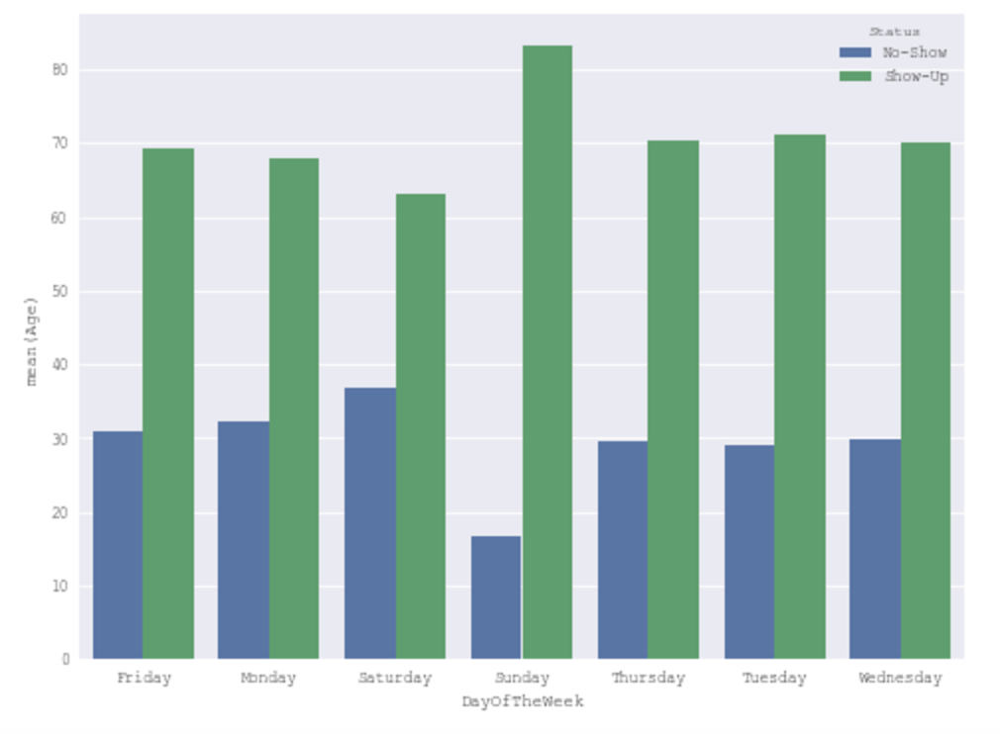
Day of Week
Distribution of Days Appointments Are Scheduled
Probability of Showing up Based on Day of week

Slide 11
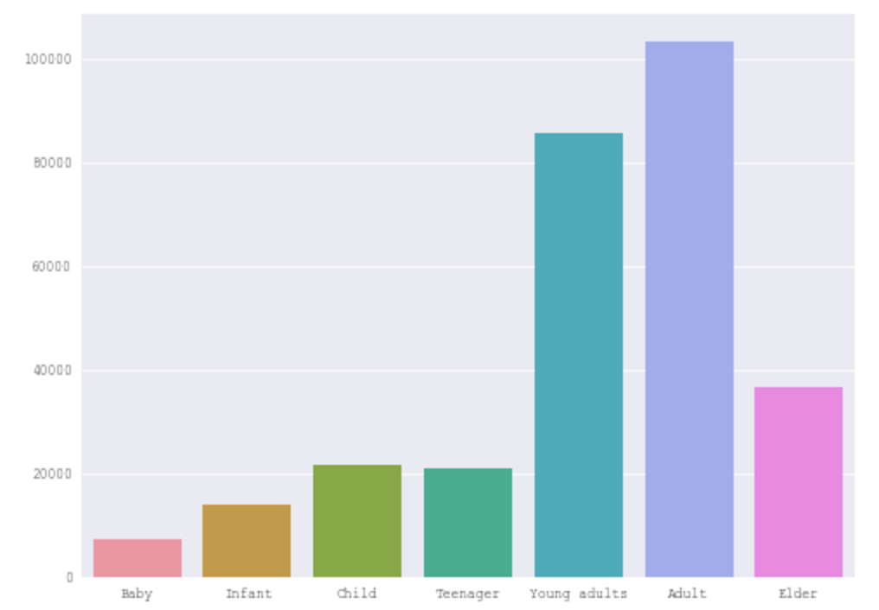
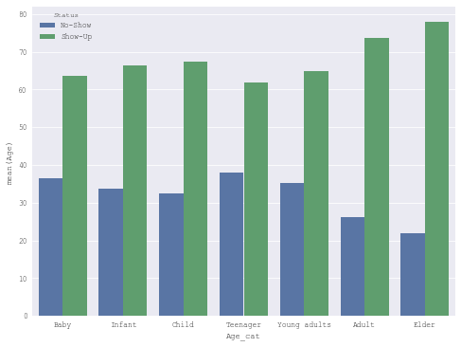
Does Age Influence Showing up to aPpointments?
Distribution of Days Appointments Are Scheduled
Probability of Showing up Based on Day of week

Slide 12
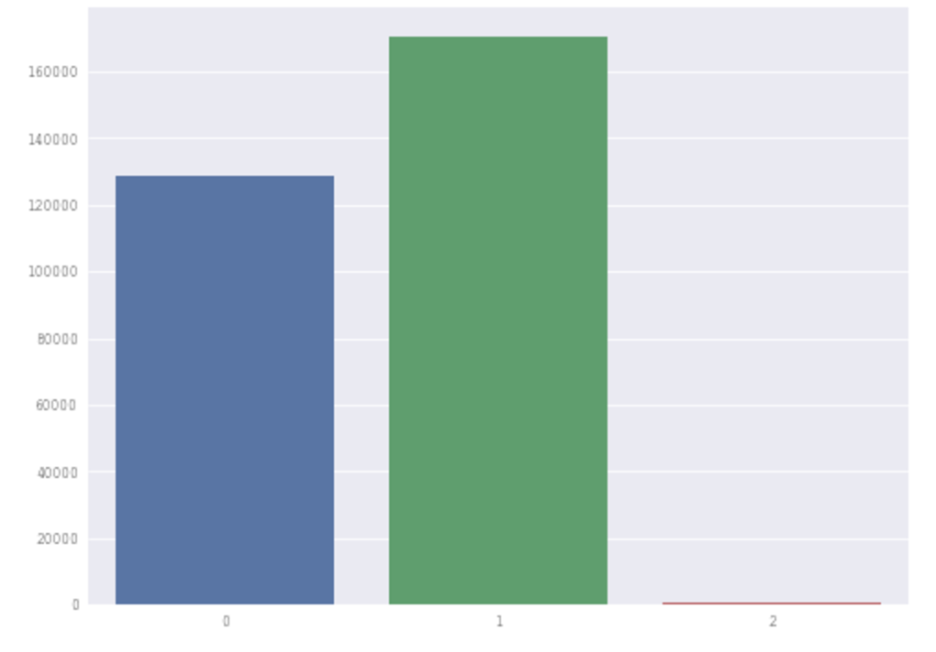
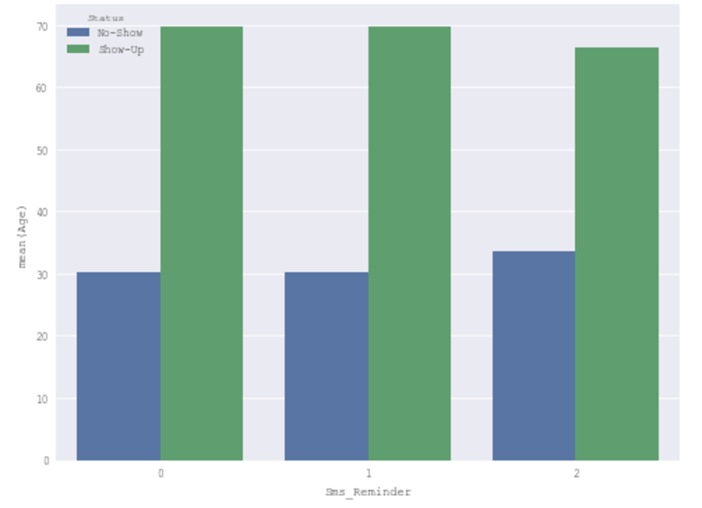
Does A SMS Reminder Help Improve Rates of Showing Up to Appointments?
Distribution of SMS Reminders
Probability of Showing up Based on Receiving SMS Reminder

Slide 13
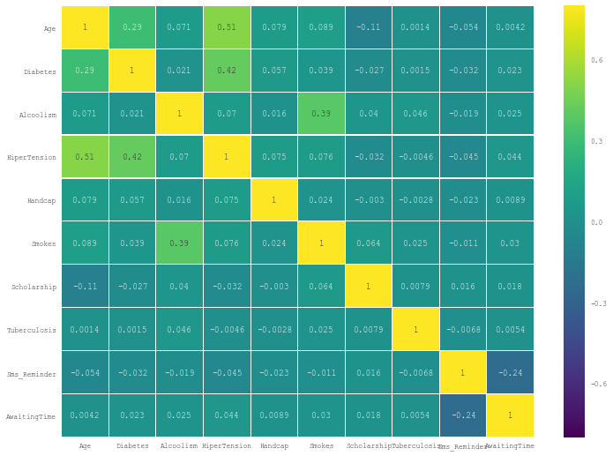
Heat Map Of Cross Correlation

Slide 14
Feature Selection
Feature Selection:
  Made a random forest model to determine feature importance (Random Forest was our most accurate model)
  Used these features in the other models (Logistic Regression)
    Age
    Awaiting Time
    SMS Reminder
    Diabetes
    Hypertension
    Scholarship
    Smokes
    Handicap
Working on doing stepwise feature selection in the next week

Slide 15
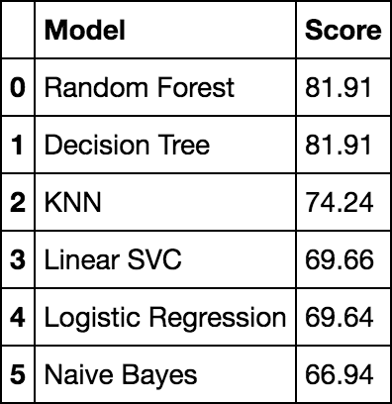
Models
Used multiple models to determine which is best.
The top three models regarding accuracy were decision tree, Random Forest, & KNN
Used training size of 67 percent
Created ROC Curve & Confusion Matrix
Working to solve the problem of high #s of false negatives

Slide 16
Suggestions
Find another data set with similar data to test our model on
Additionally, there may be other data sets that have different, but more valuable features
Some features that might be useful for the model are:
  Location of Residence & Location of Healthcare Provider
  Traffic Data
  Where the person works (both in regards to location & type of work)
  Weather data for those particular days

