Slide 1
The Scheduled Program Uploading Videos to Amazon S3 Automatically
2021/5/29
ryotaro-shimura3103

Slide 2
OUTLINE
INTRODUCTION
ARCHITECUTURE OF THIS PROGRAM
DETAILS OF THIS PROGRAM
HOW TO REALIZE THE AUTOMATION
CLOSING

Slide 3
OUTLINE
INTRODUCTION
ARCHITECUTURE OF THIS PROGRAM
DETAILS OF THIS PROGRAM
HOW TO REALIZE THE AUTOMATION
CLOSING

Slide 4
1．INTRODUCTION
I regularly take videos with my iPhone and store them in OneDrive served by Microsoft via iOS app. It costs free unless the total size of stored files reaches 5GB, but since video files have larger size than other types of files such as text , the total size of those videos soon and easily reach 5GB.
Although it would be almost impossible to store videos without any cost, Saving the costs as low as possible can be still realized.
The solutions for this problem are like below
  Upgrading the current plan for OneDrive to premium one
  Switch to other cloud storages

Slide 5
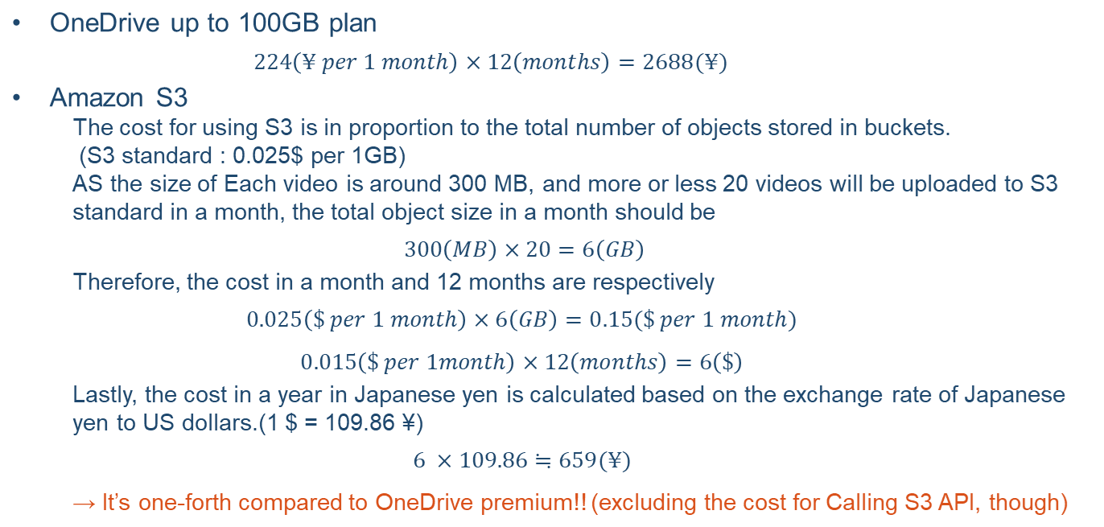
1 ．INTRODUCTION
“Other cloud storage” was defined as Amazon S3 here this time because I use it daily in my job and have some knowledge of it. The estimated costs in 12 months for those two solutions are like below
Rough calculation of the cost in 12 months

Slide 6
1 ．INTRODUCTION
Even though S3 has the advantage against OneDrive premium in light of cost, Storing items in OneDrive should be more convenient than uploading them to S3 from AWS console because it has the interface that is easily accessed from iPhone…
Solving this dilemma by developing the architecture to automate the process to upload videos in OneDrive to S3!!

Slide 7
OUTLINE
INTRODUCTION
ARCHITECUTURE OF THIS PROGRAM
DETAILS OF THIS PROGRAM
HOW TO REALIZE THE AUTOMATION
CLOSING

Slide 8
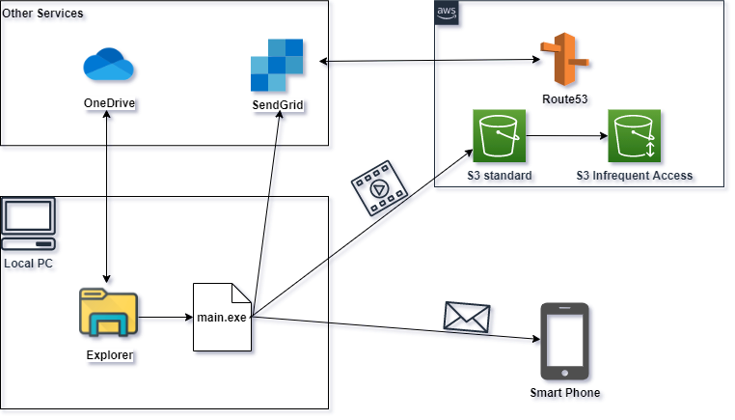
2．ARCHITECUTURE OF THIS PROGRAM
The architecture of this program is shown as the figure below
Run main.py and start the program Obtain videos in OneDrive via explorer
Upload them to S3
Call API provided by SendGrid
Sending an email to my phone to notify that the program has completed by SendGrid
※1
※2
③
②
①
④
※1 Register the personal domain I got in advance with SendGrid, and also register DNS record with AWS Route 53
※2 Thirty days after uploading items to S3, the storage type of S3 changes from S3 standard to S3 Infrequent Access automatically

Slide 9
OUTLINE
INTRODUCTION
ARCHITECUTURE OF THIS PROGRAM
DETAILS OF THIS PROGRAM
HOW TO REALIZE THE AUTOMATION
CLOSING

Slide 10


3．DETAILS OF THIS PROGRAM – Related Files
The files related to this program is shown below
① .env
Define some variables that should be kept classified such as S3 bucket name or the authentication information for SendGrid API in this file (this file was added to .gitignore)
Run the main process to upload videos in OneDrive to S3
Provide a method to notify the result of the process by sending an email via SendGrid
② main.py
③ semd_mail.py

Slide 11
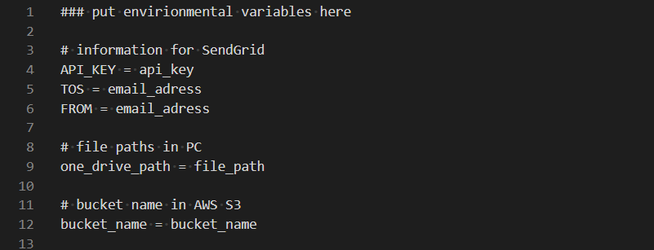
3．DETAILS OF THIS PROGRAM - .env
Define variables that need to be kept secret as environmental variables in this file.
They can be referred by calling load_env()
For security reason, variable values has been altered from actual ones

Slide 12
3．DETAILS OF THIS PROGRAM – main.py
Obtain video files from OneDrive via Explorer and upload them to S3. This process is mainly divided into 5 steps.
Obtain video files from OneDrive
Convert extensions of those videos (.MOV) into .mp4
Count up the number of objects in the specified bucket and decide prefixes that are set to the objects based on that number
Upload videos to S3
Notify that job has completed by email
（when job has failed, the email will be sent with details of the error.）
※ For more details of this process, you should check them on “src/main.py.”

Slide 13
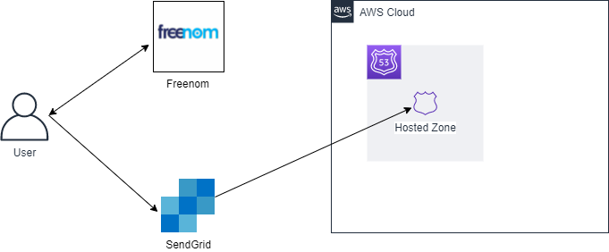
3．DETAILS OF THIS PROGRAM – send_mail.py
Provide a method to send an email to notify the result of job. This feature is realized by SendGrid, a cloud-based service that enables users to deliver emails easily. The method manages all of information for creating new emails such as the source and destination address, the mail subject or the mail body and so on.
I got a domain from freenom and authenticated it on SendGrid referring to the official document issued by SendGrid. Then, I registered DNS record provided by SendGrid with AWS Route53.
Obtain a domain from Freenom
Register the domain with SendGrid
Register DNS record issued by SendGrid with Hosted Zone in AWS Route53
①
②
③

Slide 14
OUTLINE
INTRODUCTION
ARCHITECUTURE OF THIS PROGRAM
DETAILS OF THIS PROGRAM
HOW TO REALIZE THE AUTOMATION
CLOSING

Slide 15
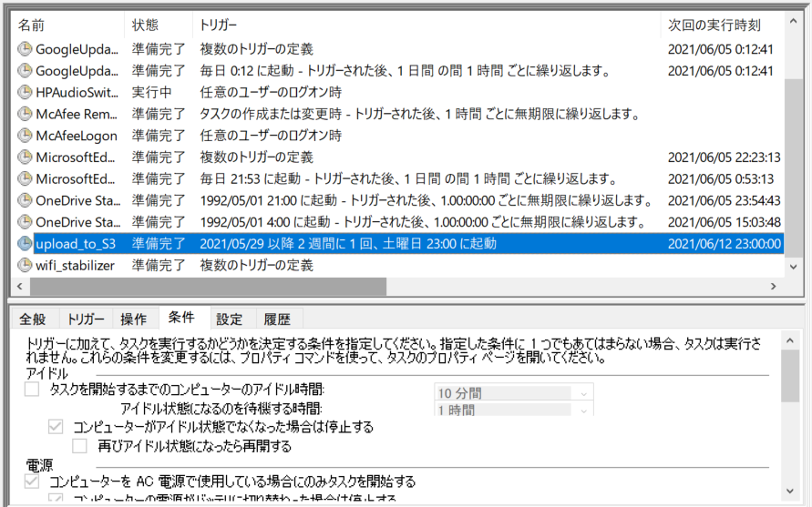
4．HOW TO REALIZE THE AUTOMATION
Changes main.py into main.exe by Pyinstaller, one of Python libraries, and create a new task with this exe file on Windows task scheduler.
Given the frequency that videos are stored in OneDrive, The task is designed to be executed once two weeks
Since the task takes a little bit long time to complete, it is scheduled to run at late night.
※ The best way to realize the automation should be that PC is logged on automatically, and then, task is executed. However, I was not able to set automatic logging on to my PC from BIOS, so this task requires me to turn on PC before the time scheduled.

Slide 16
OUTLINE
INTRODUCTION
ARCHITECUTURE OF THIS PROGRAM
DETAILS OF THIS PROGRAM
HOW TO REALIZE THE AUTOMATION
CLOSING

Slide 17
5. CLOSING
For this time, I developed a program with Python to upload videos in Explorer to Amazon S3 and then, created a exe file based on the program to set it to the Windows task scheduler.
Whole process is working without any problem, so I could finish the development with success. However, I couldn’t realize the complete automation because PC didn’t turn on automatically. This is a reflection point, and I should get it better next time.
The plan to develop another program is still up in the air, but now I consider creating some games like Tetris that works on desktops or developing a program to send LIKEs automatically on Tinder.
Thanks for reading this document so far!!

