Slide 1
Scheme metacircular evaluator
Nakamura ryotaro 4/6/2012

Slide 2
Scheme metacircular evaluator
Nakamura Ryotaro June 4, 2012
1

Slide 3
Toplevel ::= Exp
| Define
| Define Macro
| (load String)
(define (my-eval x env)
(cond
((symbol? x) (eval-exp x env)) (e.g., a b)
((not (pair? X)) (eval-exp x env)) (e.g., #t 1 2)
((macro-var? (car x)) (my-eval (expand-macro x env) env))
(else
(case (car x)
((define) (my-define x env)) (e.g., (define a 1))
((define-macro) (my-define-macro x env))
((load) (my-load x)) (e.g., (load “a.scm”))
(else (eval-exp x env))))))
Evaluation (Toplevel)

Slide 4
Toplevel ::= Exp
| Define
| Define Macro
| (load String)
(define (my-eval x env)
(cond
((symbol? x) (eval-exp x env)) (e.g., a b)
((not (pair? X)) (eval-exp x env)) (e.g., #t 1 2)
((macro-var? (car x)) (my-eval (expand-macro x env) env))
(else
(case (car x)
((define) (my-define x env)) (e.g., (define a 1))
((define-macro) (my-define-macro x env))
((load) (my-load x)) (e.g., (load “a.scm”))
(else (eval-exp x env))))))
Eval
2

Slide 5
(define (eval-exp exp env)
(cond
((symbol? exp) (get-val exp env))
((not (pair? exp)) exp)
((macro-var? (car exp)) (my-eval (expand-macro exp env) env))
(else
(case (car exp)
((lambda) (my-lambda exp env))
((quote) (cadr exp ))
((set!) (my-set! exp env))
((let) (my-let exp env))
((let*) (my-let* exp env))
((letrec) (my-letrec exp env))
((if) (my-if exp env))
((cond) (my-cond exp env))
((and) (my-and exp env))
((or) (my-or exp env))
((begin) (my-begin exp env))
((do) (my-do exp env))
((define define-macro load) (abort `("error Exp syntax: " ,exp)))
(else
(apply (eval-exp (car exp) env)
(map (lambda (e) (eval-exp e env)) (cdr exp))))))))
procedure
args
Eval Exp
3

Slide 6
(define (eval-exp exp env)
(cond
((symbol? exp) (get-val exp env))
((not (pair? exp)) exp)
((macro-var? (car exp)) (my-eval (expand-macro exp env) env))
(else
(case (car exp)
((lambda) (my-lambda exp env))
((quote) (cadr exp ))
((set!) (my-set! exp env))
((let) (my-let exp env))
((let*) (my-let* exp env))
((letrec) (my-letrec exp env))
((if) (my-if exp env))
((cond) (my-cond exp env))
((and) (my-and exp env))
((or) (my-or exp env))
((begin) (my-begin exp env))
((do) (my-do exp env))
((define define-macro load) (abort `("error Exp syntax: " ,exp)))
(else
(apply (eval-exp (car exp) env)
(map (lambda (e) (eval-exp e env)) (cdr exp))))))))
procedure
args
Evaluation (Exp)

Slide 7
A variable is associated with its value by the association list
start
(*global-env*)
global environment
(assoc
var env)
#f
((number? . Number?)
(+ . +) … )
#t
(cdr (assoc var env))
(my-eval x env)
Local environment
(cdr (assoc var *global-env*))
((a . 1) (b .2) .. )
end
Variable
4

Slide 8
A variable is associated with its value by the association list
start
(*global-env*)
global environment
(assoc
var env)
#f
((number? . Number?)
(+ . +) … )
#t
(cdr (assoc var env))
(my-eval x env)
Local environment
(cdr (assoc var *global-env*))
((a . 1) (b .2) .. )
end
Variables

Slide 9
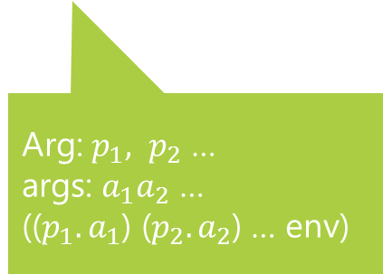
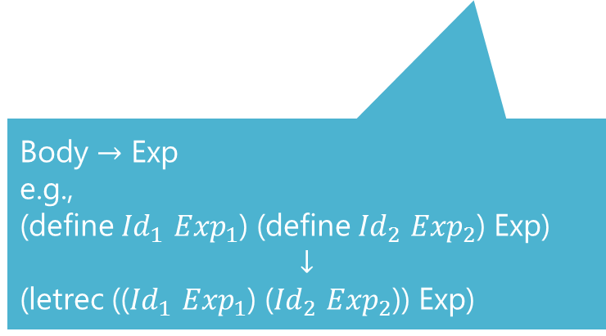
(my-lambda (lambda Arg Body) env)
(define (my-lambda exp env)
(lambda args (eval-exp (conv-to-exp (cddr exp) env)
(extend-env (cadr exp) args env))))
Body $→$ Exp
e.g.,
(define ${Id}_{1}$ ${Exp}_{1}$) (define ${Id}_{2}$ ${Exp}_{2}$) Exp)
$$↓$$
(letrec ((${Id}_{1}$ ${Exp}_{1}$) (${Id}_{2}$ ${Exp}_{2}$)) Exp)
Arg: $p_{1}, p_{2}$ …
args: $a_{1}a_{2}$ …
(($p_{1}.a_{1}$) ($p_{2}.a_{2}$) … env)
Lambda
5

Slide 10




Body = ${Def}_{1}$ … ${Def}_{m}$ ${Exp}_{1}$ … ${Exp}_{n}$
${Def}_{i}$ … ${Def}_{m}$ ${Exp}_{1}$ … ${Exp}_{n}$ DEF ‘()
${Def}_{i+1}$ … ${Def}_{m}$ ${Exp}_{1}$ … ${Exp}_{n}$ (cons (cdr ${Def}_{i}$) DEF) ‘()
Id Exp
${Exp}_{j}$ … ${Exp}_{n}$ DEF EXP
${Exp}_{j+1}$ … ${Exp}_{n}$ DEF (cons ${Exp}_{j}$ EXP)
`(letrec ,(reverse DEF) ,@(reverse EXP))
Body $→$ Exp
6

Slide 11
(my-define-macro (define Id Exp) env)
(define (my-define-macro x env)
...
(set! *global-env*
(cons (cons (cadr x) (eval-exp (caddr x) env))
*global-env*))
...)
Id
Exp
(expand-macro (macro-name args) env)
(define (expand-macro x env)
(if (and (list? x) (not (null? x)) (macro-var? (car x)))
(expand-macro (apply (get-val (car x) env) (cdr x)) env)
x))
macro-name
Not evaluated
Expand x into the code that its arguments aren’t evaluated
Macro
7

Slide 12
Syntax Sugar
(desugar-def (Id Id* [. Id]) Body))
(define (desugar-def def)
(if (symbol? (cadr def))
def
`(define ,(caadr def) (lambda ,(cdadr def) ,@(cddr def)))))
Id
Id* [.Id]
Body
Desugar Define syntax
8

Slide 13
(my-let (let ((Id Exp)*) Body) env)
(define (my-let exp env)
...
(eval-exp `((lambda ,(map car (cadr exp)) ,@(cddr exp))
,@(map cadr (cadr exp)))
env)
...)
((Id Exp)*)
Body
(let ((x a) (y b)) Body) $→$ ((lambda (x y) Body) a b)
(my-namedlet (let Id bindings Body) env)
(define (my-namedlet exp env)
...
(my-letrec
`(letrec ((,id (lambda ,(map car bindings) ,@body)))
(,id ,@(map cadr bindings))) env)
...)
(let Id Bindigs Body) -> (letrec ((Id (lambda (args) Body))) (Id actuals))
Let, named let
9

Slide 14
(my-let* (let* bindings Body) env)
(define (my-let* exp env)
...
(eval-exp
`((lambda (,(caar bindings)) (let* ,(cdr bindings) ,@body))
,(cadar bindings))
env)
...)
Id
Exp
(let* ((x a) (y b)) Body) $→$ ((lambda (x) ((lambda (y) body) b) a)
Let*
10

Slide 15
(my-letrec (letrec bindings Body) env)
(define (my-letrec exp env)
...
(my-let
`(let ,(map (lambda (lst) (list (car lst) "<#undef#>"))
(cadr exp))
,@(map (lambda (lst) (cons 'set! lst)) (cadr exp))
,@(cddr exp))
env) ...)
bindings
Body
(letrec ((x a) (y b)) Body) $→$ (let ((x “undef”) (y “undef”)) (set! x a) (set! y b) Body)
Let*
11

Slide 16
(my-do (do iter-specs (test tail-seq) body) env)
(define (my-do exp env)
...
(if (eval-exp test ex-env)
(eval-exp `(begin ,@tail-seq) ex-env)
(begin (eval-body body ex-env)
(step iter-specs ex-env)
(loop iter-specs test tail-seq body ex-env)))
...)
Update Ids
((Id Exp Exp)*)
do
12

Slide 17
tail-call optimization
nontail-recursive call
Similarly, if we are
using a Common Lisp that is properly tail-recursive, then our interpreter will be too,
without taking any special steps
tail-recursion, as we have seen above.
It is the same with call Icc. If our host language provides continuations with
indefinite extent, then it is trivial to implement call Icc.

