Slide 1


Combined classification and channel/basis selection with L1-L2 regularization with application to P300 speller system
Ryota Tomioka & Stefan Haufe
Tokyo Tech / TU Berlin / Fraunhofer FIRST

Slide 2
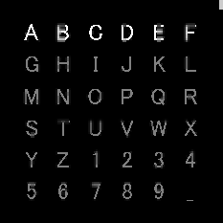
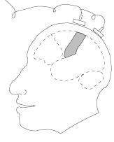
P300 speller system
Evoked
Response
Farwell & Donchin 1988

Slide 3
P300 speller system
ER detected!
ER detected!
The character must be “P”

Slide 4
Common approach
EEG signal
Lots of intemediate goals!!
Feature extraction
e.g., ICA or channel selection
Feature vector
?
P300 detection
e.g., Binary SVM classifier
Detector outpus
(6 cols& 6rows)
?
Decoding
e.g., Compare the detector outputs
Decoded character
(36 class)

Slide 5
Our approach
EEG signal
Define a “detector” f_{W}(X)
e.g., ICA or channel selection
Decoding
Feature extraction
P300 detection
e.g., Binary SVM classifier
Compare the detector outputs
Decoded character
(36 class)

Slide 6
Our approach
EEG signal
Regularized empirical risk minimization:
minimize L(W) + λΩ(W)
Decoding
Feature extraction
Data-fit
Regularization
P300 detection
Detect P300
Extract structure
Decoded character
(36 class)

Slide 7
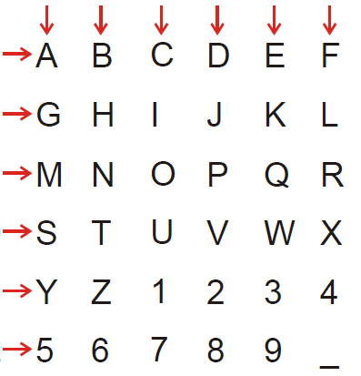
Learning the decoding model
Suppose that we have a detector f_{w}(X) that detects the P300 response in signal X.
f₁
f₂
f₃
f₄
f₅
f₆
f₇
f₈
f₉
This is nothing but learning 2 x 6-class classifier
f₁₀
f₁₁
f₁₂

Slide 8
How we do this
…
…
12
2
8
1
3
4
11
9
5
6
10
7
Multinomial likelihood f.
Multinomial likelihood f.
n
Σ
(
+
)
L(w) =
-log P_{W}(col | X_{i})
-log P_{W}(row | X_{i})
i=1

Slide 9
Detector
X
#channels
#samples
f_{W}(X) =<W, X>
W
#channels
#samples

Slide 10
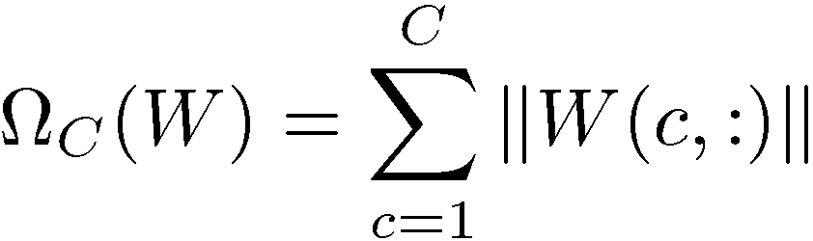
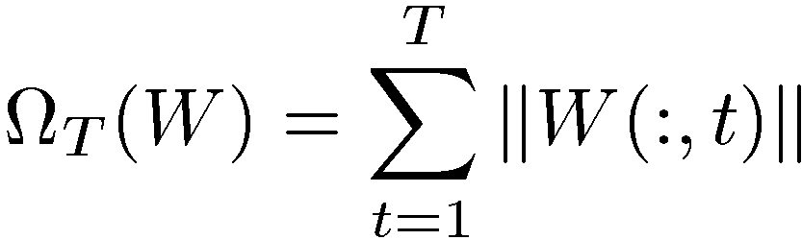
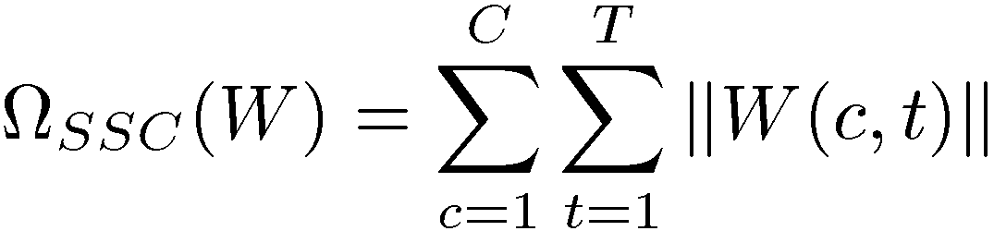
L1-L2 regularization
Channel selection
(linear sum of row norms)
W
(2) Time sample selection
(linear sum of col norms)
#channels
#samples
(3) Component selection
(linear sum of component norms)

Slide 11
The method
minimize L(W) + λΩ(W)
2 x 6-class multinomial loss
L1-L2 regularization
Nonlinear convex optimization with second order cone constraint

Slide 12
Results - BCI competition III dataset II [Albany]
(1) Channel selection regularizer
15 repetitions
5 repetitions
λ=5.46
Subject A:
99% (97%)
72% (72%)
Subject B:
93% (96%)
80% (75%)
(Rakotomamonjy
& Gigue)

Slide 13
Results- BCI competition III dataset II [Albany]
(2) Time sample selection regularizer
15 repetitions
5 repetitions
λ=5.46
Subject A:
98% (97%)
70% (72%)
Subject B:
94% (96%)
81% (75%)
(Rakotomamonjy
& Gigue)

Slide 14
Results- BCI competition III dataset II [Albany]
(3) Component selection regularizer
15 repetitions
5 repetitions
λ=100
Subject A:
98% (97%)
70% (72%)
Subject B:
94% (96%)
82% (75%)
(Rakotomamonjy
& Gigue)

Slide 15
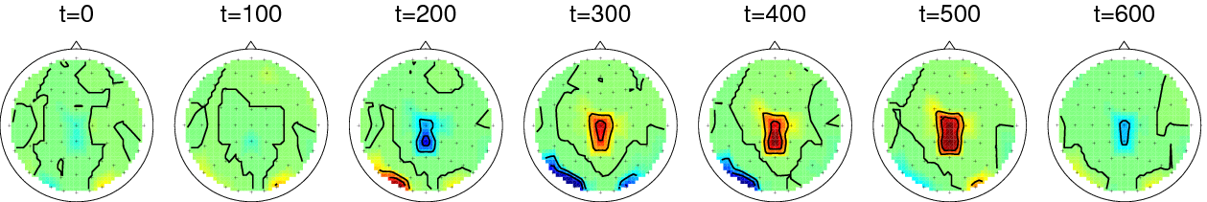
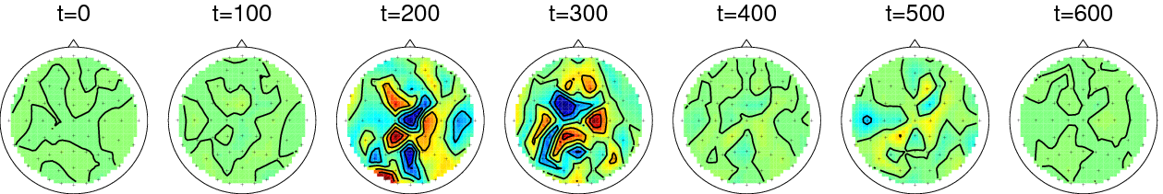
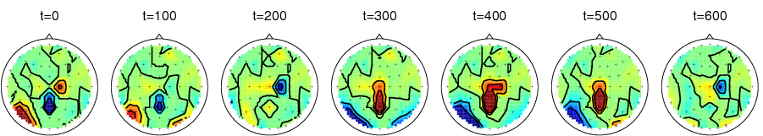
Filters
(1) Channel selection regularizer
(2) Time sample selection regularizer
(3) Component selection regularizer

Slide 16
Summary
Unified feature extraction and classifier learning
L1-L2 regularization
Use decoding model to learn the classifier
2x 6-class multinomial model
Solve the problem in a convex regularized empirical risk minimization problem
Nonlinear second-order cone problem
(efficient subgradient based optimization routine will be made available soon!)

Slide 17


