Slide 1
GE Silicone Sealants ²²²Rn Emanation Measurement
H. Ryott Glayzer
Lab Assistant
SD Mines

Slide 2
GE All-Purpose Sealant
GE All-Purpose Sealant has a rate of
  This measurement is taken from 465 hours of usable data
  The uncertainties in this figure were calculated separately for top and bottom errors in order to provide a more conservative estimate
A sample with ~200cm² of surface area was emanated six times throughout Summer 2023 at SD Mines
  Four of those runs contained useful data
The emanation rate of this sealant is sufficiently low for SuperCDMS

Slide 3
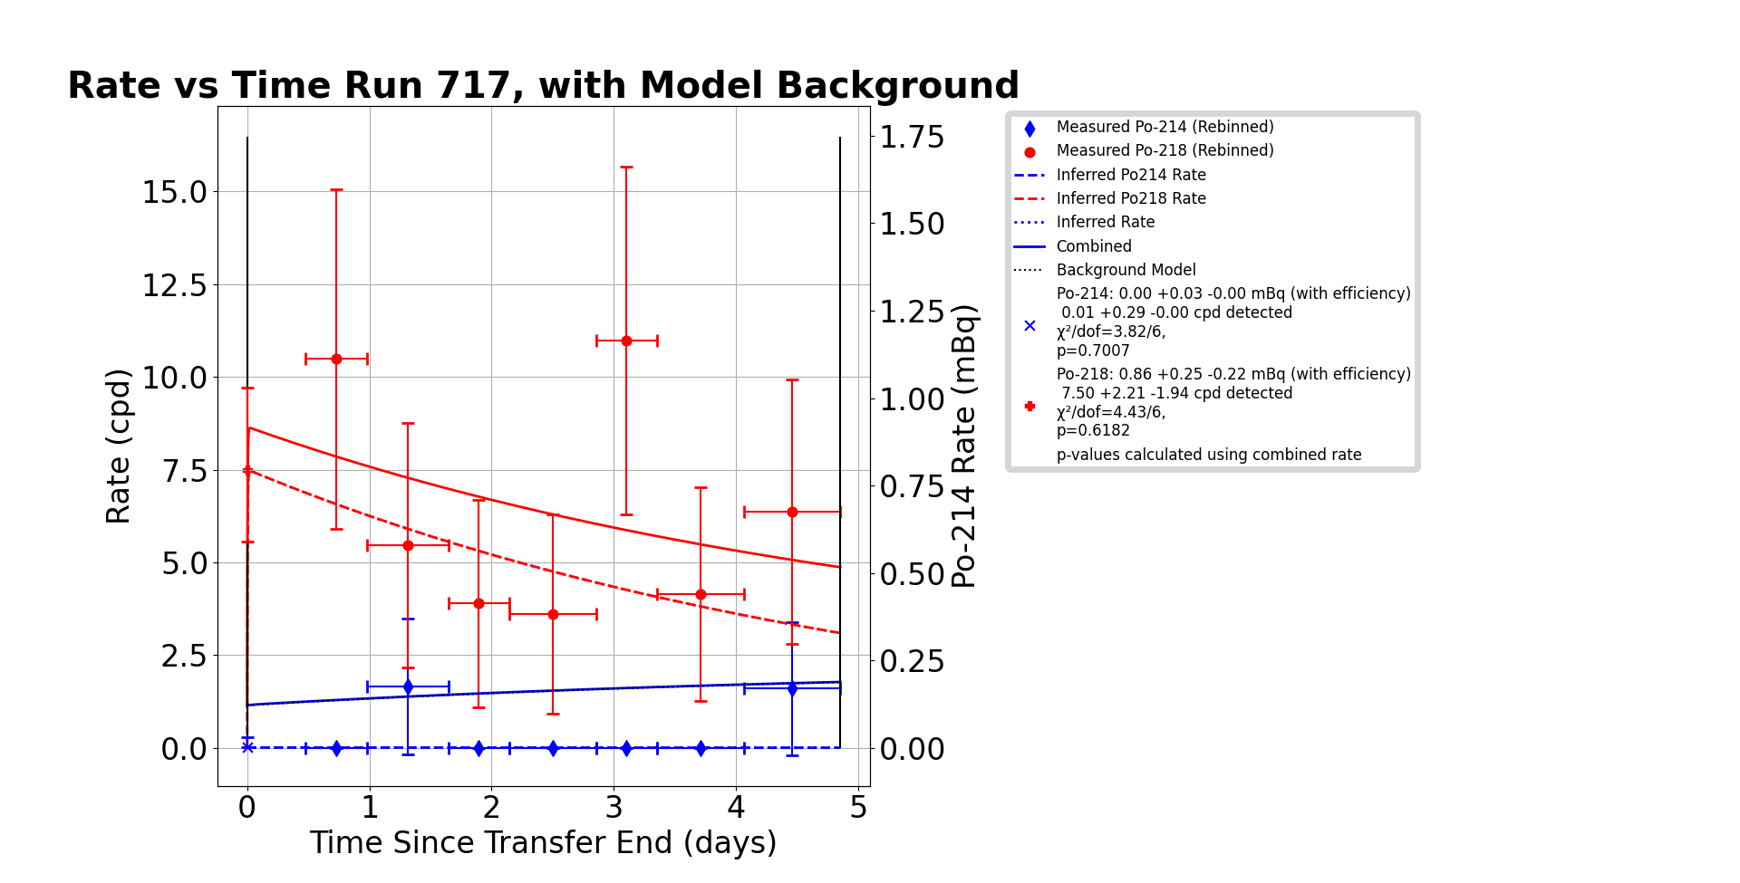
Rate vs. Time, Run 717
This run indicates a rate of
This is based solely off of the ²¹⁴Po rate because of low resolution between ²¹⁸Po and ²¹⁰Po peaks which caused ²¹⁰Po events to ‘spill over’ into the ²¹⁸Po ROI which makes the ²¹⁸Po rate unreliable

Slide 4
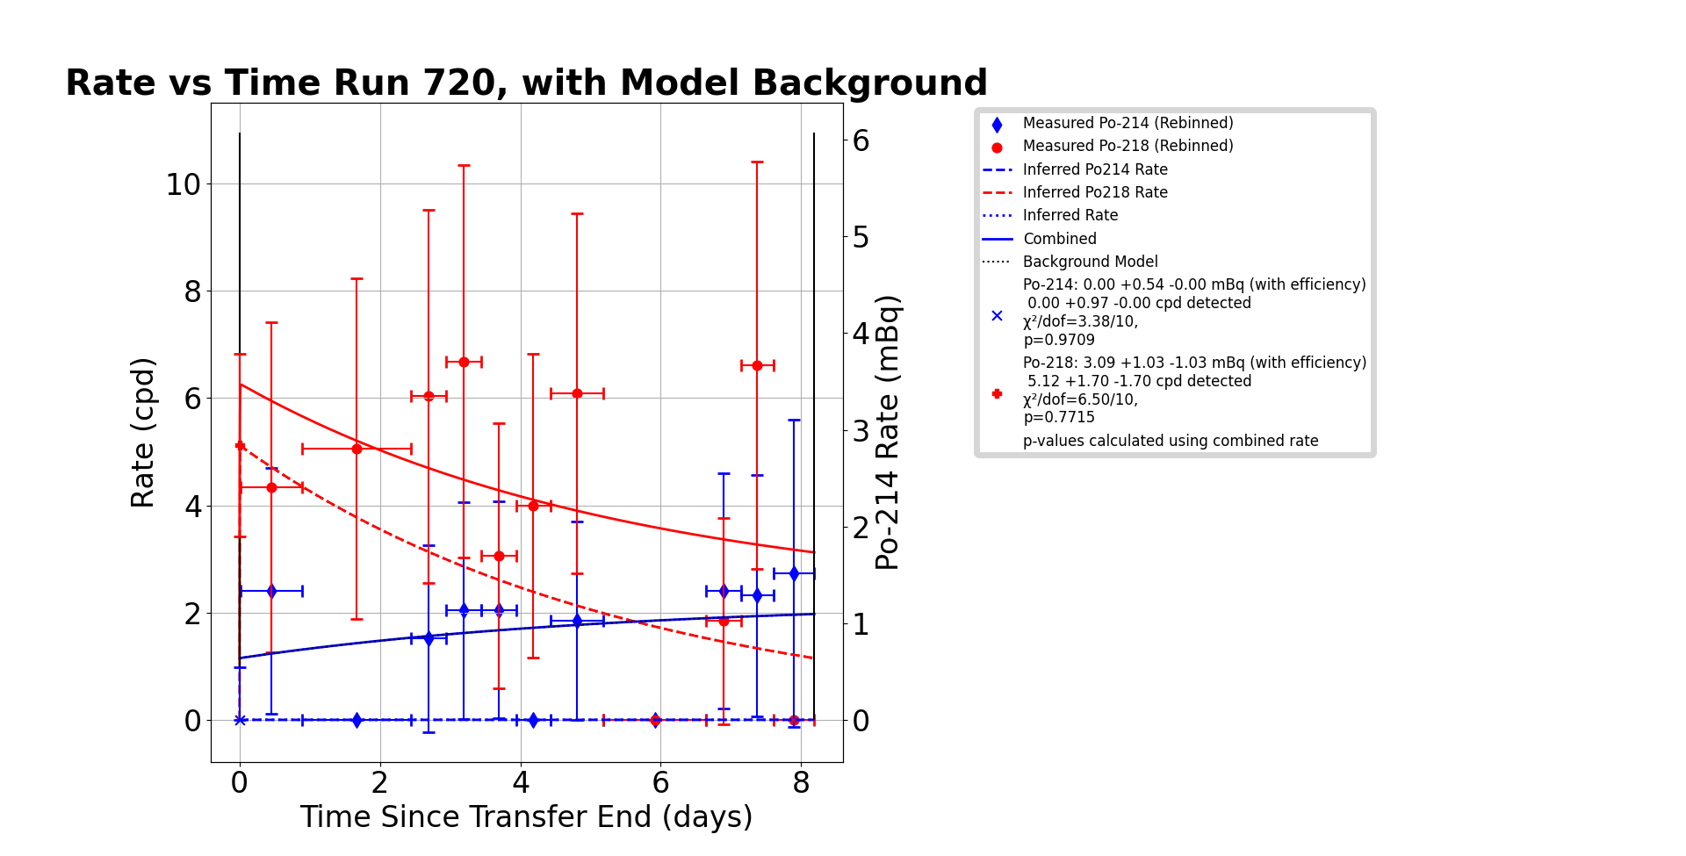
Rate vs. Time, Run 720
This run indicates a rate of
This is based solely off of the ²¹⁴Po rate because of low resolution between ²¹⁸Po and ²¹⁰Po peaks which caused ²¹⁰Po events to ‘spill over’ into the ²¹⁸Po ROI which makes the ²¹⁸Po rate unreliable

Slide 5
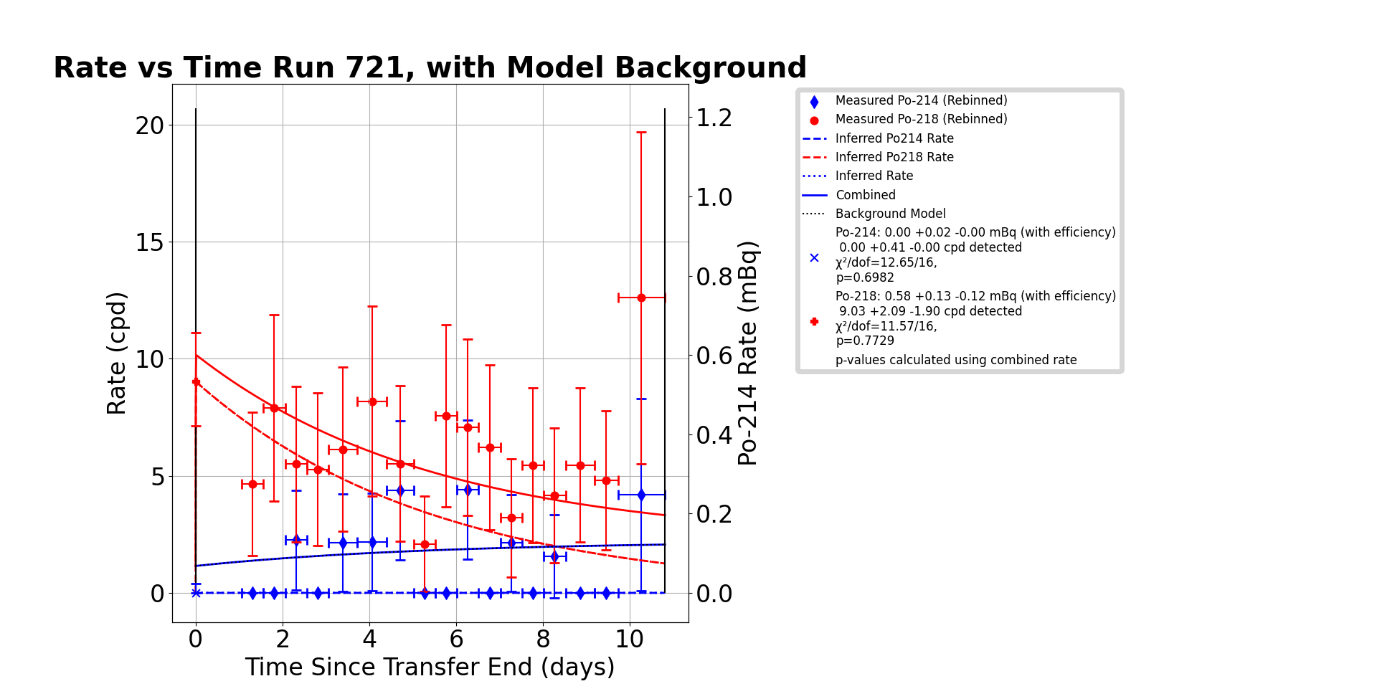
Rate vs. Time, Run 721
This run indicates a rate of
This is based solely off of the ²¹⁴Po rate because of low resolution between ²¹⁸Po and ²¹⁰Po peaks which caused ²¹⁰Po events to ‘spill over’ into the ²¹⁸Po ROI which makes the ²¹⁸Po rate unreliable

Slide 6
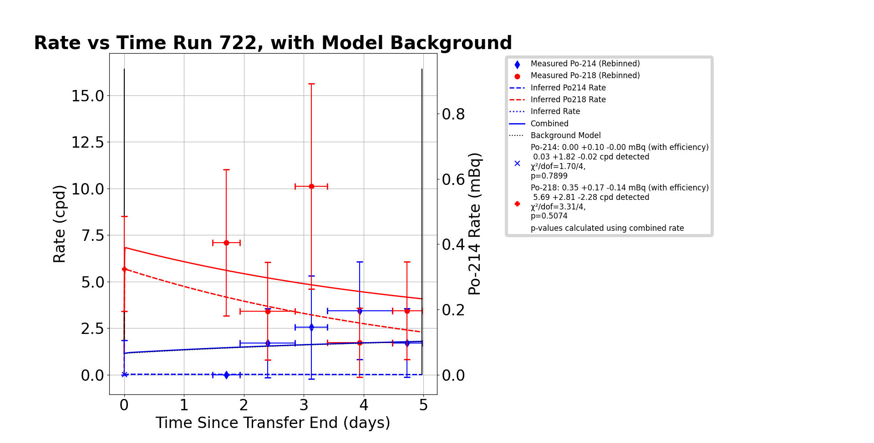
Rate vs Time, Run 722
This run indicates a rate of
This is based solely off of the ²¹⁴Po rate because of low resolution between ²¹⁸Po and ²¹⁰Po peaks which caused ²¹⁰Po events to ‘spill over’ into the ²¹⁸Po ROI which makes the ²¹⁸Po rate unreliable

Slide 7
GE Advanced Sealant
GE Advanced Sealant has a rate of
  This measurement is taken from 163 hours of usable data
A sample with ~200cm² of surface area was emanated one time in September 2023 at SD Mines
  This run resulted in 163 hours of usable data
The emanation rate for this sealant is sufficiently low for SuperCDMS purposes

Slide 8
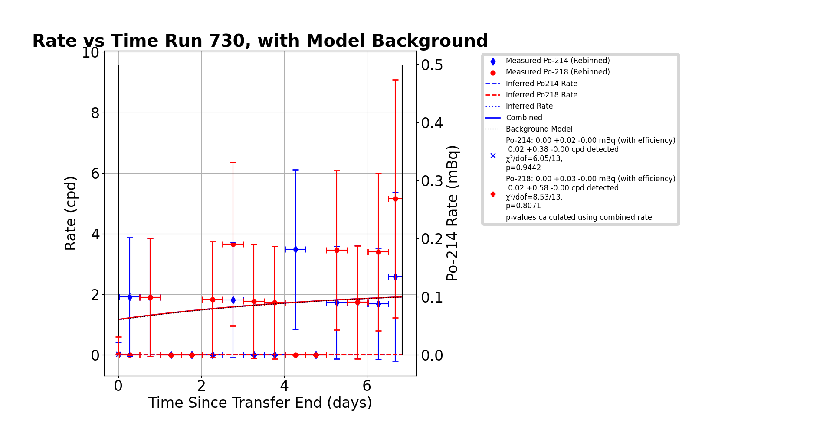
Rate vs Time, Run 730
Combined Rate of ²¹⁴Po and ²¹⁸Po rates gives a rate of
The combined rate was chosen because there was good resolution between the ²¹⁰Po and ²¹⁸Po ROIs

Slide 9
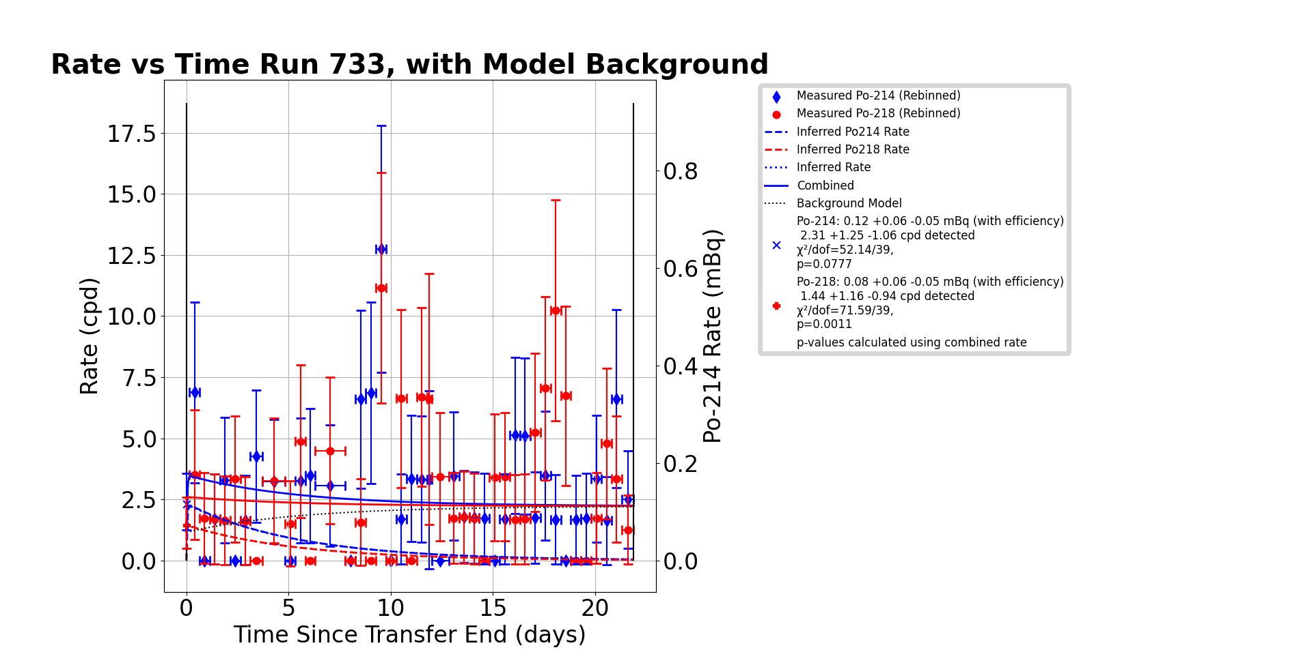
Rate vs. Time, Run 733

Slide 10
Rate vs Time, Run 739

Slide 11
Summary
Both Sealants assayed are sufficiently low for use in SuperCDMS
Both sealants assayed have a sufficient amount of usable data and no additional runs are necessary

Slide 12
Backup Slides

