Slide 1
A Brief Analysis of Gain Variation in the Warm Emanation System at SD Mines
Harley “Ryott” Glayzer

Slide 2
Proposed Types of Gain Variance
Type A Gain Variance can be called a “dip” or a “jump” and is loosely defined as a sharp change in gain that generally occurs at the beginning of a run, but can occur at any point.
Type B Gain Variance can be called a “squiggle” or “zig-zag” and is loosely defined as a periodic change in gain over time. Observations show that this variance occurs over an approximately 24-hour period
Type C Gain Variance can be called a “fall” or a “rise” and is loosely defined as a gradual change in gain ocurring over a significant portion of the run time.
Type D Gain Variance isn’t a specific trend in the variation of gain. Rather, it occurs when gain changes between different parts of the same run.

Slide 3
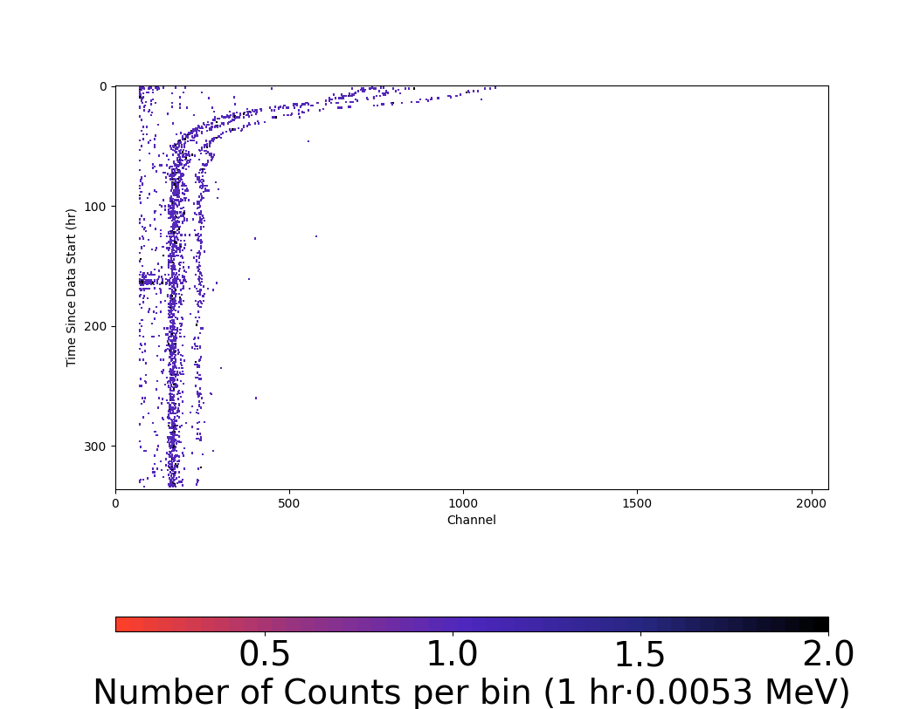
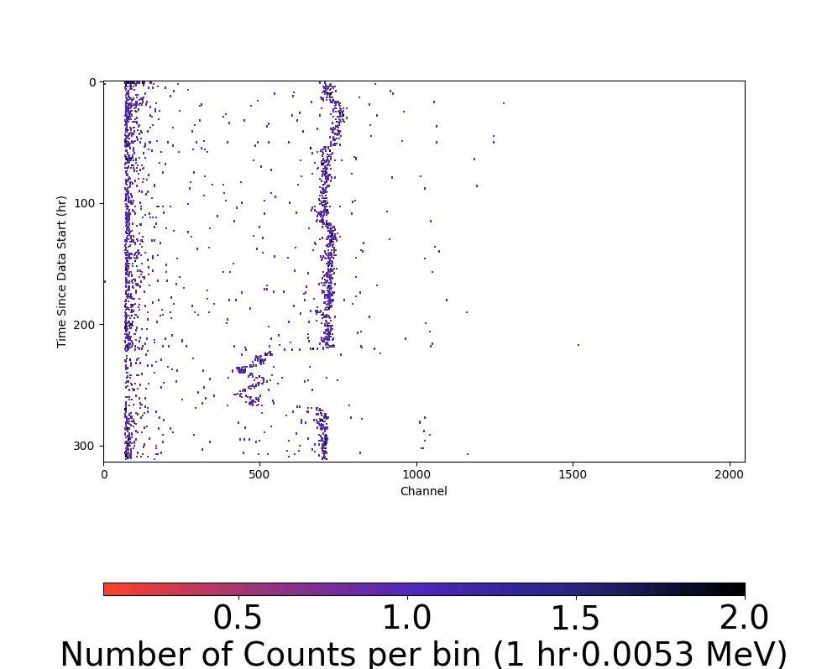
Type A Gain Variance Examples
Run 658 – Sample Run from Mar 2021
This run also shows Type B variance.
Run 651 – Background Run from Feb 2021
These are extreme examples I chose specifically to showcase this pattern

Slide 4
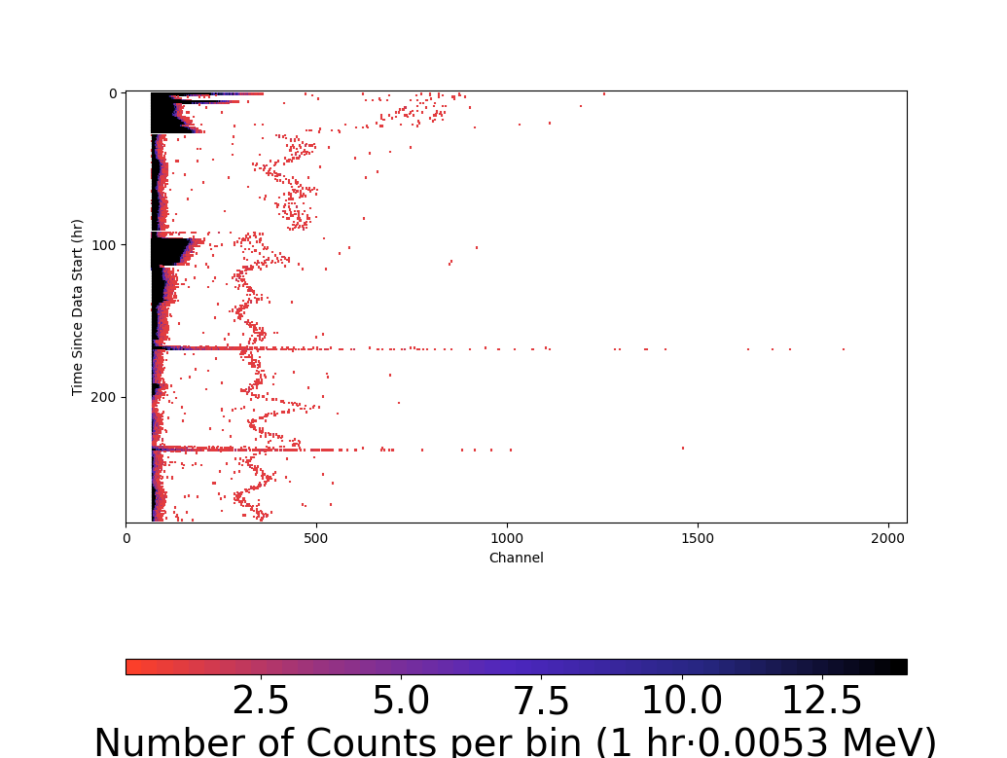
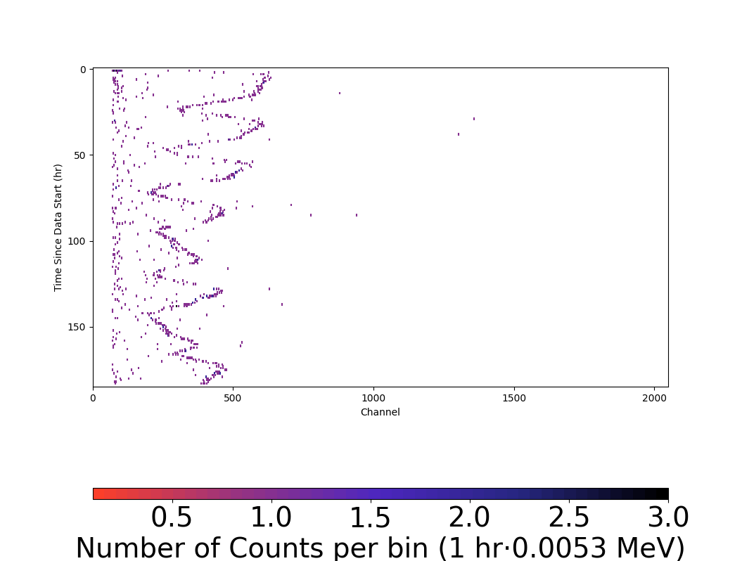
Type B Gain Variance Examples
Run 653 – Background run from Mar 2021
Run 726 – Blank Run Aug 2023
This run was scrapped because of the extreme amplitude of the Type B Gain Variation.
These examples are particularly extreme and were chosen to highlight this type of Gain Variance.
Almost every run presented in this slide and nearly every run I’ve seen shows at least slight Type B Gain Variance.

Slide 5
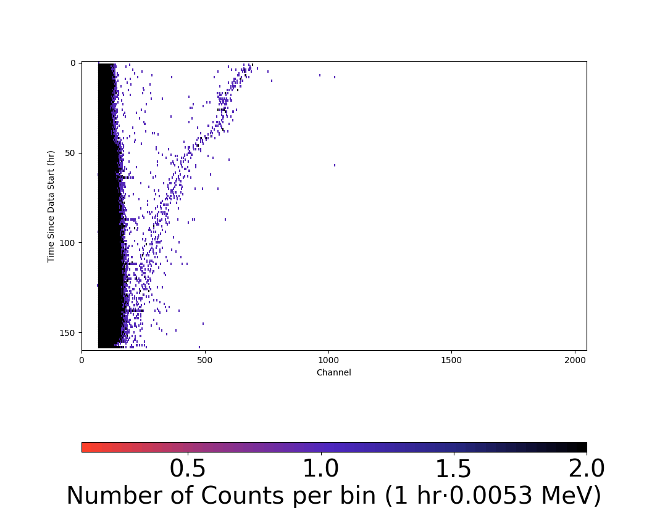
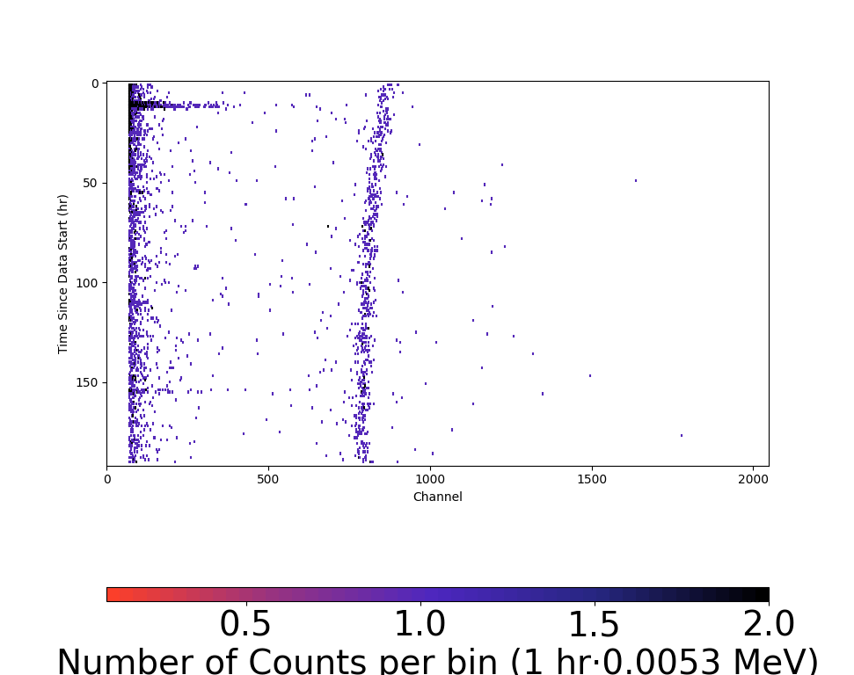
Type C Gain Variance Examples
Run 643 – Background Run from Dec 2020
Run 670 – Background Run from Jul 2021

Slide 6
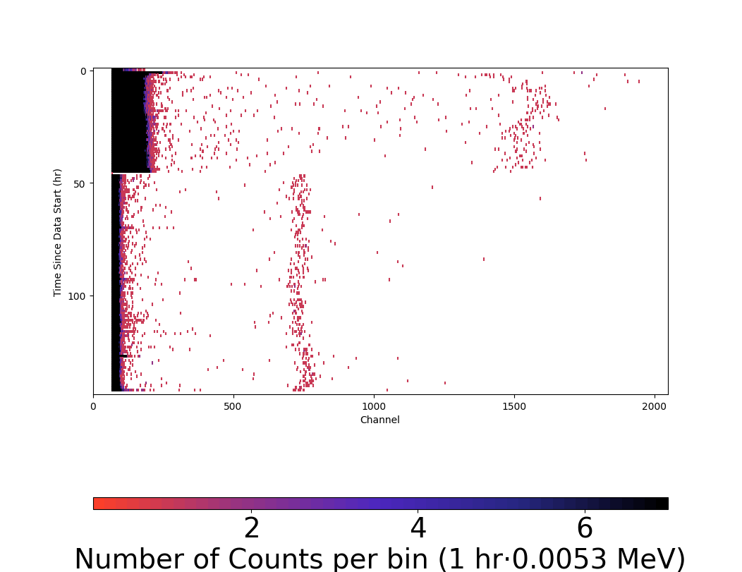
Type D Gain Variance Examples
Run 632 – Background Run Sep 2020

Slide 7
Speculations
Type A and Type C may very well be the the same thing with rate of change in the cause of gain variation differing
  Feels likely that if there is some sort of bad connection that these would be the types of gain variance that would cause.
Type D is human activity added to whatever’s causing A/B/C
Type B could be caused by anything periodic over the day, but there is variance in the amplitude of the GV
  Humidity/Temperature?
    Could test with a hygrometer/thermometer that records vs time and keeps logs, then compare to WES gain over time
  Human Activity/Vibrations?
    Test with some sort of seismometer in the lab recording vs time and compare to WES GV
    Feels unlikely because these factors likely wouldnt produce the near sinusoidal rhythm and variance in amplitude we observe
  Does electricity vary over the day?
    Power Demands vary according to time of day and can be different from day to day, causing some days to have less variation than others…
      Could test with some sort of electricity monitor plugged into same circuit as WES, log that vs time, and compare to measured gain variance

Slide 8
Questions
What causes some runs to stay stable but have different levels of gain than others?
Right now the idea that Type B Gain Variation is only an estimate based off of visual analysis of the data. How can I make a more math-based analysis of the periodicity af gain variation and use that to determine more accurately the period and other attributes?
  I can create an analysis of the gain correction “guess” function and analyze local extrema, creating a chart of periodicity and using that to find mean period.
How can we determine possible causes of this variance?
Have these patterns been noticed before?

Slide 9
A Further Look into Type B Gain Variance

Slide 10
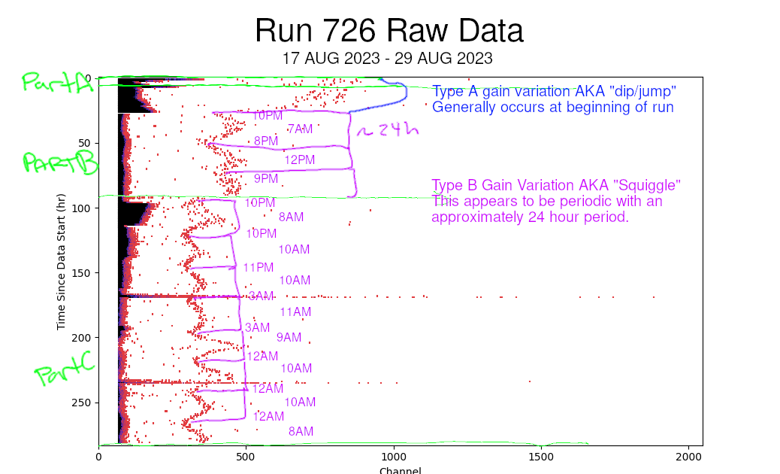
Take the times here with a grain of salt; the hour values of the extrema of the pattern were eyeballed and may not exactly reflect peak/trough times

