Slide 1
8” Silicone Gasket Radon Emanation Measurement
H. Ryott Glayzer
SDSMT Volunteer Research Assistant
September 2023

Slide 2
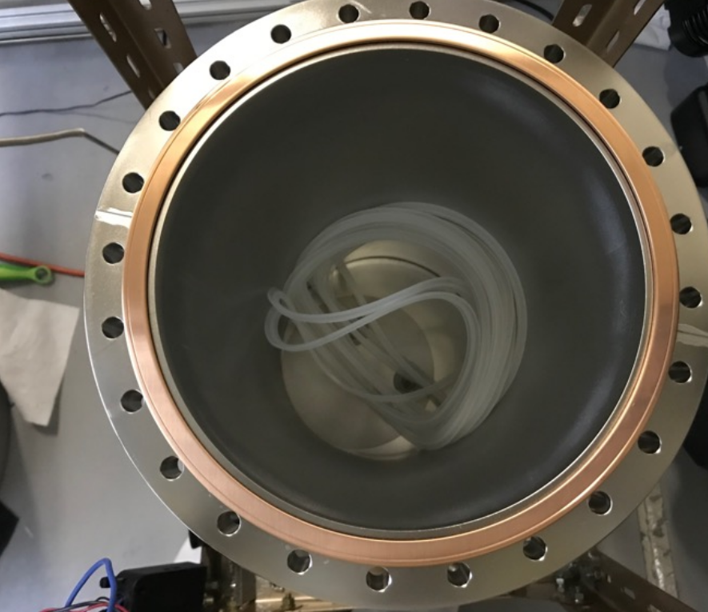
Sample Photos

Slide 3
Overview
Gasket Material for Tower Storage/Shipping Containers
Emanation of Bulk Material: September – October 2020
  Ten Silicone Gaskets were emanated three times in the Small Emanation Chamber at SDSMT
  Original analysis, performed by Nic Chott, indicated a total emanation rate of 35 mBq
  Current analysis of these same runs indicate a total emanation rate of 23.99 ± 0.60 mBq
  Assuming all gaskets are equally “hot”, this would indicate a single gasket emanation rate of 2.40 ± 0.06 mBq
  Data indicates that gaskets are not equally “hot”.
December 2020: four gaskets were sent to SLAC, chosen at random
  Gaskets were confirmed to fit the storage container, and one gasket was used for Tower 1 storage
Additional assays were performed on the remaining six gaskets
  In [TIME PERIOD], three additional gaskets were sent to SLAC for use on Towers 2, 3, and 4 Storage Containers

Slide 4
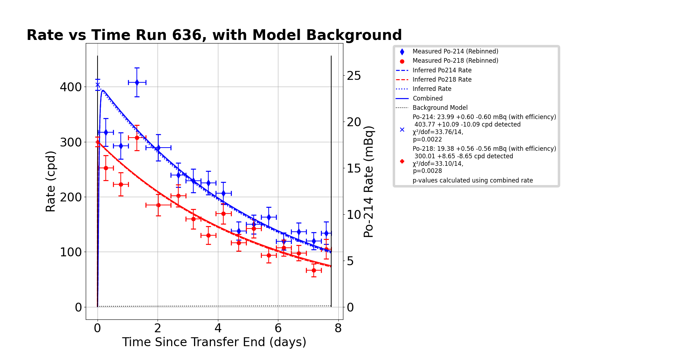
Emanation Rate, Run 636 (10 Gaskets)
2020-10-02 → 2020-10-13
Emanation Rate for Run 636:
  23.99 ± 0.60 mBq, based on the ²¹⁴Po sample rate
  The sole ²¹⁴Po sample rate was chosen rather than a weighted average of ²¹⁸Po and ²¹⁴Po due to poor resolution between the ²¹⁰Po and ²¹⁸Po ROIs, which likely led to a number of ²¹⁰Po events being counted as ²¹⁸Po events
High Chi-Squared value indicates a poor fit to the data
  Upon analysis of the ²¹⁴Po residuals, a single time bin was identified as the main contributor to the bad fit
  However, upon analysis of the raw and gain-corrected data for the same time bin, no inconsistencies or systematic errors were identified.

Slide 5
Ten Silicone Gasket Emanation Summary
Estimated emanation rate of the ten gaskets: 23.99 ± 0.60 mBq
  This is based on the ²¹⁴Po rate from Run 636
  This indicates a single-gasket emanation rate of 2.40 ± 0.06 mBq
Run 634 suffered from a partial sample loss
  During the sample transfer, the small Brass Wool Trap appeared to be clogged (see slide [EXP.SETUP])
  A portion of the sample was likely lost when the trap was subsequently isolated and unclogged
Run 631 contained no useful data
  The system gain was so low that any radon daughter events were obscured by low-energy noise
  Nic Chott attempted to fix this by rebiasing the detector and increasing gain on the amplifier to no avail
Original analysis vs. Current analysis
  Nic Chott’s original analysis proposed a ten-gasket emanation rate of ~35 mBq
  There was a bug in the code that plotted the data wrong and led to the assumption that the fit was wrong.
  Nic fit a rate of 35 mBq to this incorrectly manipulated data. The bug has since been fixed.

Slide 6
Overview of Six Gaskets Emanation
February to March 2021:
  Single Silicone Gasket was emanated four times
  Single Gasket emanation rate: 4.81 ± 0.18 mBq
  This is significantly higher than the predicted 2.40 ± 0.06 mBq
April – May 2021:
  Two Silicone Gaskets were emanated two times.
  Two gasket emanation rate: 6.43 ± 0.23 mBq
  Rate per gasket: 3.21 ± 0.12 mBq
  This is significantly higher than the predicted 2.40 ± 0.06 mBq
July – September 2021
  Three remaining Silicone gaskets were emanated four times
  Three Gasket emanation rate: 7.51 ± 0.16 mBq
  Single Gasket emanation rate: 2.50 ± 0.05 mBq
Total Six Gaskets Rate = 18.75 ± 0.64 mBq
  Please note that the predicted 2.40 ± 0.06 mBq is based off the assumtions that all gaskets are equally “hot”. This assumption is likely false.

Slide 7
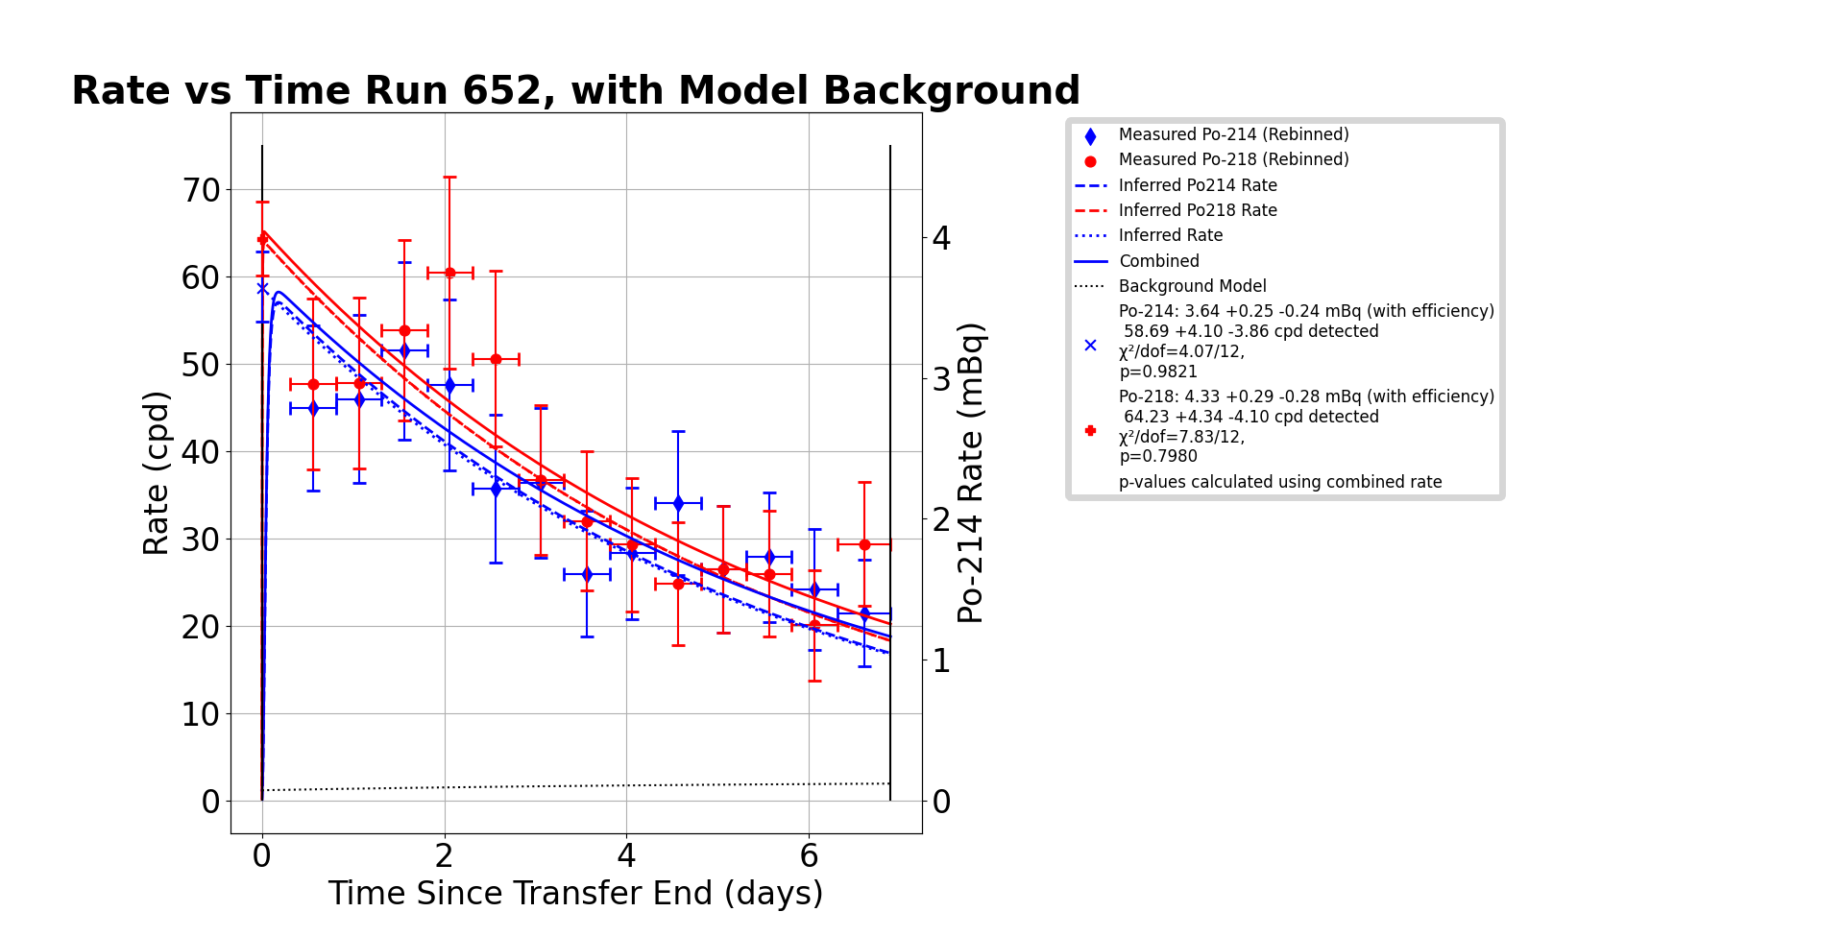
Emanation Rate, Run 652 (1 Gasket)
2021-02-10 → 2021-02-23

Slide 8
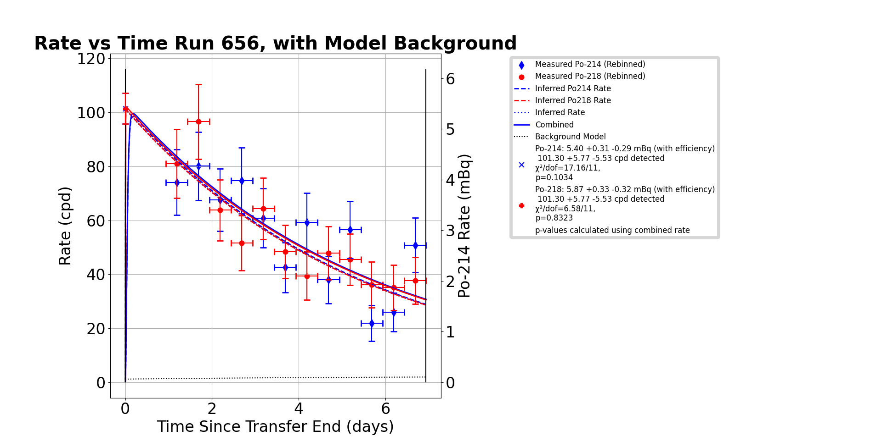
Emanation Rate, Run 656 (1 Gasket)
2021-02-23 → 2021-02-25

Slide 9
Emanation Rate, Run 652 (1 Gasket)
2021-02-10 → 2021-02-25

Slide 10
Backup Slides

Slide 11
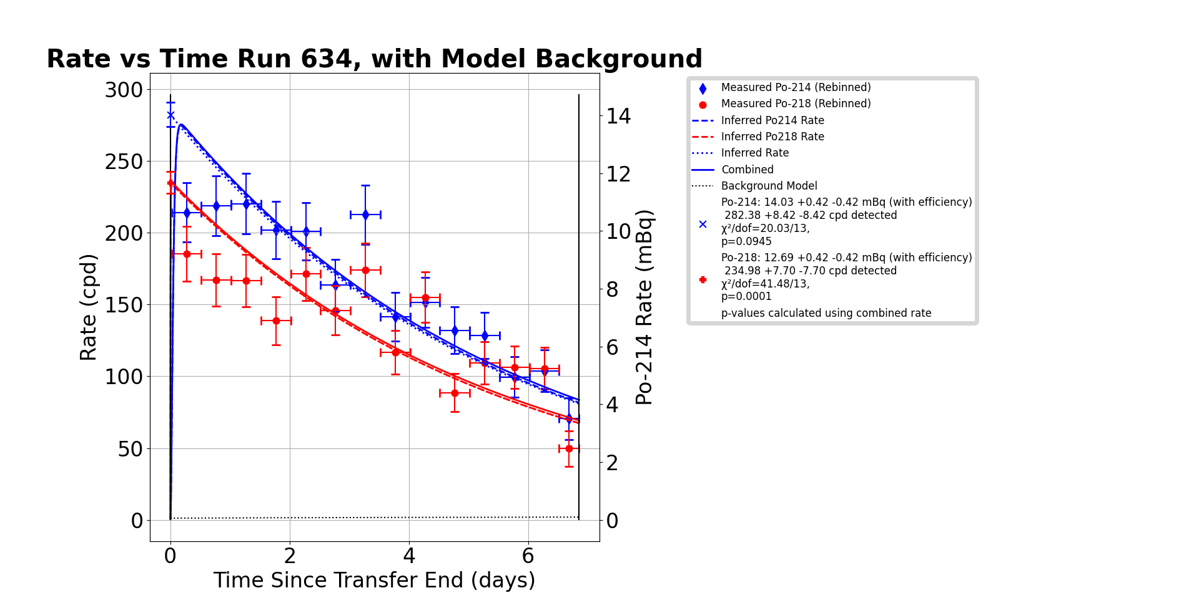
Emanation Rate, Run 634 (10 Gaskets)
2020-09-09 → 2020-10-02
Emanation rate for Run 634:
  13.36 ± 0.30 mBq based on a weighted average of Po-218 and Po-214 rates
It is likely that a loss of the radon sample occurred during transfer
  Nic Chott, who performed the transfer, noted that the small Brass Wool Trap (BWT) appeared to be clogged.
  A portion of the sample was likely lost while an attempt was made to flow through the clogged BWT, which escaped when the small BWT was isolated and unclogged.
  Thus, Run 634 is not included in the analysis of the ten silicone gaskets.

Slide 12
Experimental Setup

