Slide 1
Vision Board
SD Youth Activism meets Print Media

Slide 2

Why Print Media?
Open Avenue that SDYA hasn’t yet persued
Distribution carries beyond the alpha
Diversity of media is good
Tangible media means more to some

Slide 3
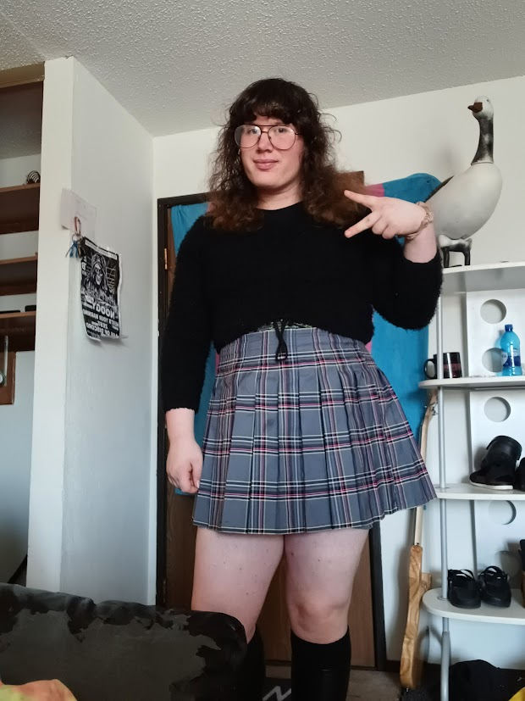
Who am I?
My name is Ryott
  20 y.o.
  She/They
SDSMT student
History in print media
  6 publications
Specialty in zines

Slide 4
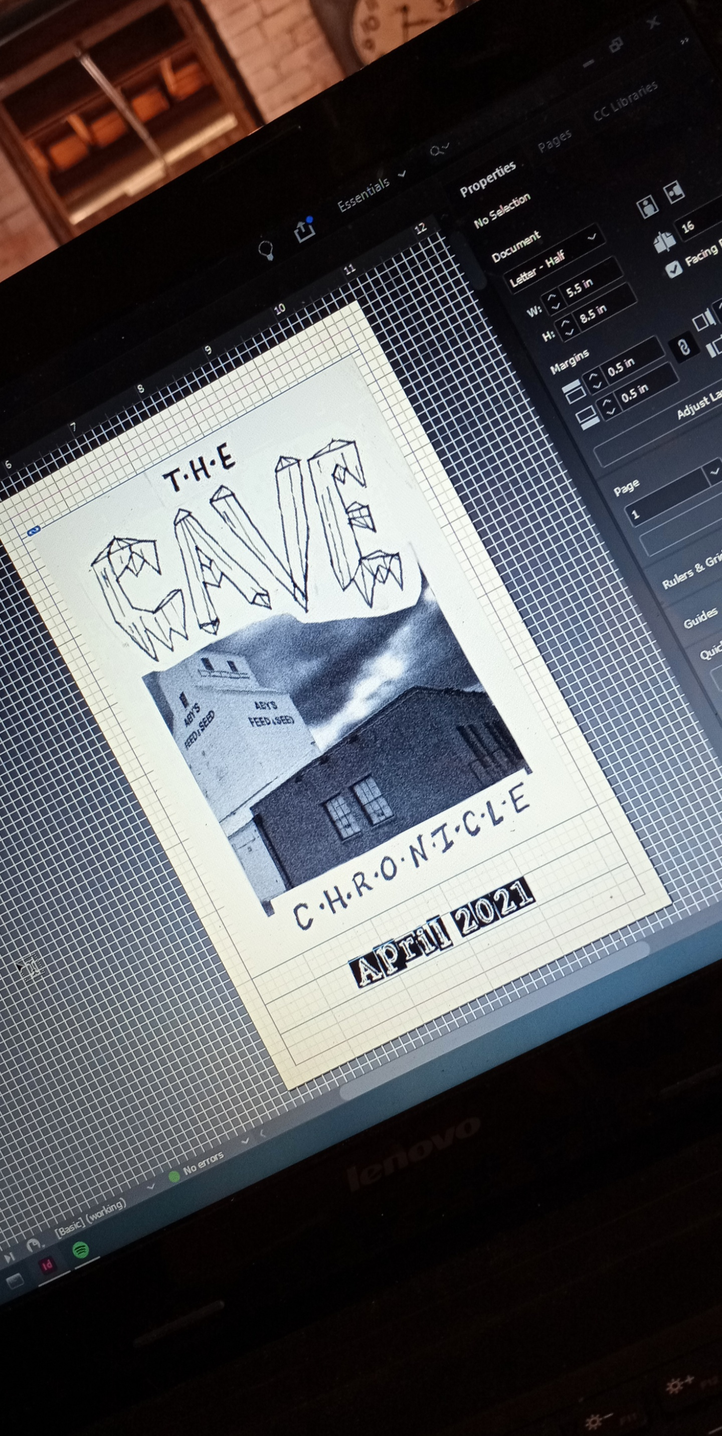
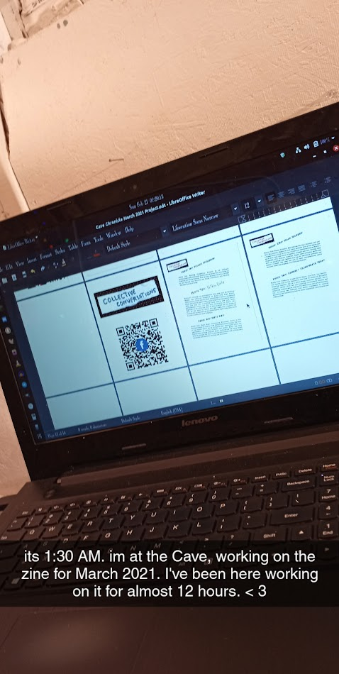
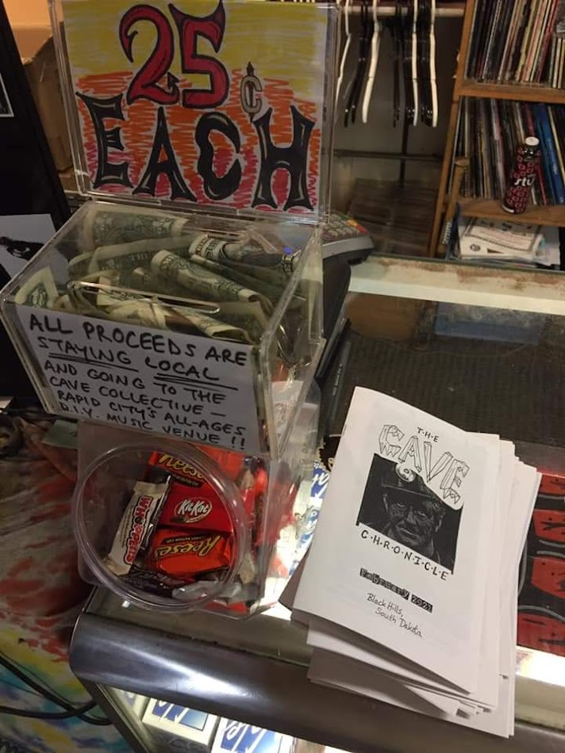
My Publication History
Spearheaded The Cave Collective’s “Cave Chronicle” zine
D.I.Y. distribution
Finished Products
Publications in progress

Slide 5
Print Media and SDYA
What forms?
  Zines, Posters, Pamphlets, Articles, Handbills...
  Each has different place/purpose
Distribution
  DIY distribution
  Use network to amplify marginalized voices

Slide 6
Publication Workflow
Collaborative = Best
  Google Drive
  Not necessity
Peer Review and Board Review
  Both necessary before Pressing
  Helps ensure vision is upheld

Slide 7
Contact
Email: ryottglayzer@gmail.com
Phone: 605 858 3899 (text preferred)
Telegram: @xryottx
Discord: ryott#1975

