Slide 1

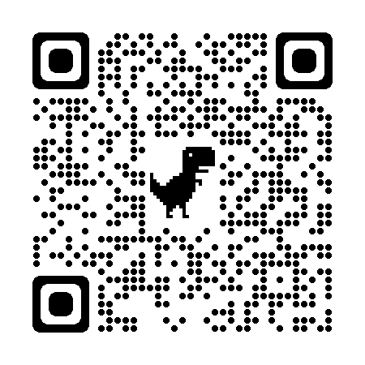
通信方法の変遷
T – 4 – 18 下沢亮太郎

Slide 2

ALOHA

Slide 3
PC1
Data 1.1
PC2
Data 2.1
T
PC3
Data 3.1
2T
衝突範囲

Slide 4
Slotted ALOHA

Slide 5
Successful
transmission
PC1
Data 1.1
Collision
PC2
Data 2.1
PC3
Data 3.1
T

Slide 6

CSMA

Slide 7
Successful
transmission
PC1
Data 1.1
Data 1.1
Successful
transmission
PC2
Wait
Data 2.1
Data 2.1
Data 1.1
Data 2.1
Carrier sense

Slide 8

CSMA/CA

