Slide 1
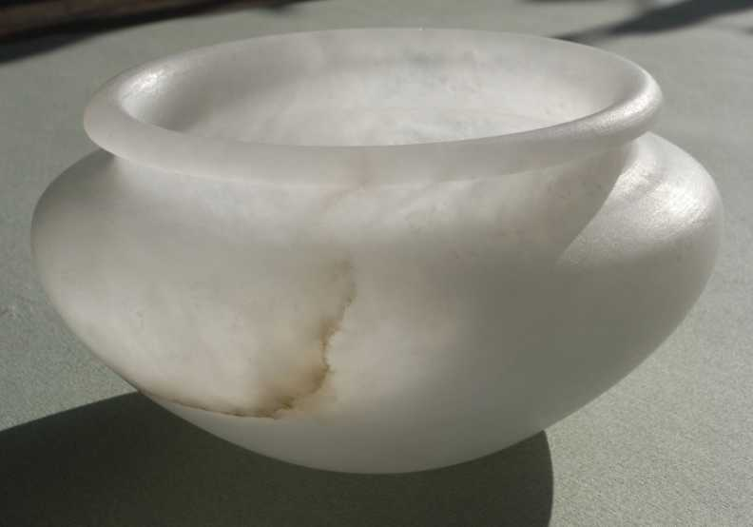
JOACHIM FAULHABER Boost.Alabaster A Law Based Tester
Lecture held at the
4th international conference
On boost c++ libraries
Boostcon 2010

Slide 2
A short History
A test tool developed along with the ITL-library of interval containers
An application exploiting polymorphic tuples based on typelists, inspired by Andrej Alexandrecu 2001: Modern c++ Design,
… named LaBatea, [Boost.]Validate …
Currently available in non-boost quality, as a prototype: Sandbox: https://svn.boost.org/svn/boost/sandbox/itl/boost/validate/
And as part of the extended ITL releases 3.2.x_plus Boost-Vault: itl_plus_3_2_0.zip Sourceforge: http://sourceforge.net/projects/itl/

Slide 3
A short Future
As a test tool for the ITL-library, it turned out that
Law based testing
Was very effective for refactoring and unit tests
Turned out to foster abstraction and quality in the development process
Contains challenging abstraction tasks as a library
Attracted interest in the boost community
… has the potential for future boost library in a currently underdeveloped field.
The name Boost.Alabaster is the label for that future project.

Slide 4
A short Presence
Today I will introduce the current prototype
That is non-boost quality and Loki biased
For the most part I will show what I have
… in order to make the ideas of properties of law based testing clear
Then I will outline the some aspects of a redesigned and boost-quality library Boost.Alabaster as a project to go about.

Slide 5

Motivation
Testing in (not so) ancient times
… is a Sisyphean Task
… is limited by the frame of knowledge of the tester
… is inherently ineffective and leads to frustration

Slide 6

Motivation
Testing in (more or less) modern times
… is automated.
Testing tools allow for unit tests
Developers use those, writing tests first and maintaining them vigorously.
… which costs time and discipline.
This works as effective as other new years resolutions like “exercising more” , “eating less” or “file my tax return ASAP”

Slide 7
Motivation
Let’s face it
While programming is frequently experienced as an interesting, creative and self motivating task,
testing remains an unloved duty
that tends to be postponed to the end of the development process.
There is a natural tendency to chase the bug at locations where it is not hiding.

Slide 8
Motivation: Realms of Knowledge
What we … | … know | … don’t know
… are aware of (not) knowing | known-knowns Here we are chasing bugs | known-unknowns
… aren’t aware of (not) knowing | unknown-knowns | unknown-unknowns This is the realm where the bug dwells.

Slide 9
Benefits
Law based testing provides direct access to the unknown unknowns
… an aha experience about the program or it’s properties
… providing a minimal counter example
… which makes testing extremely efficient
… and also fun

Slide 10
Benefits
Each time a law is falsified …
we detect a program error
or a specification error
… by means of minimal counter example
… so we can either
fix a bug in the program
rectify or refine a law
abandon a law, because it is not valid
refine our specification or program theory

Slide 11
Program Evolution
P_{i} S_{i}
i | Development cycle
P_{i} | Program for i
S_{i} | Specification for i: the set of laws.
V | A set of violations (counter-examples) ordered by simplicity
a_{i} | A law to be validated
Validate new law a_{i}
P_{i} V S_{i}’
++i
V≠ Ø, prog err
V≠ Ø,
spec err
V= Ø
fix bug
Ø
refine a_{i}
drop a_{i}

Slide 12
Design: A Law Based Testing Machine
A simple testing algorithm.
Generate law instance
Commutativity<T, U, +>: { T a; U b; a+b == b+a; }
Apply law to instance
Collect violations

Slide 13
Design: Law & Law Instance
A Law in Alabaster is a boolean c++ function: bool h(T₁, …, T_{n});
That depends on variables (x₁, …, x_{n}) of types (T₁, …, T_{n})
A law instance is the law’s function together with an instance of variables (h, (x₁, …, x_{n}))
It is assumed, that types (T₁, …, T_{n}) provide the functions and operations that are used to implement function h.

Slide 14
Design: Laws
A basic Law class template
template<class SubType, // For static polymorphism (CRTP)
class InputTypes> // Typelist for (T₁, …, T_{n})
class Law
{
public:
typedef typename Loki::tuple<InputTypes> input_tuple;
bool holds(); // Function h
private:
input_tuple _input_tuple; // Variables (x₁, …, x_{n})
};

Slide 15
Design: Laws
Adding features for debugging
template<class SubType, // For static polymorphism (CRTP)
class InputTypes, // Typelist for (T₁, …, T_{n})
class OutputTypes>// Types for intermediate and
// final results that we would like to monitor.
class Law
{
public:
typedef typename Loki::tuple<InputTypes> input_tuple;
typedef typename Loki::tuple<OutputTypes> output_tuple;
bool holds(); // Function h
bool debug_holds(); // Verbose variant of h
private:
input_tuple _input_tuple; // Variables (x₁, …, x_{n})
output_tuple _output_tuple; // Output-Variables (y₁, …, y_{n})
}; // for intermediate and final results.

Slide 16
Design: Laws
Interface
template<class SubType, class InputTypes, class OutputTypes>
class Law
{
public:
typedef typename Loki::tuple<InputTypes> input_tuple;
typedef typename Loki::tuple<OutputTypes> output_tuple;
bool holds(); // Function h
bool debug_holds(); // Verbose variant of h
void setInstance(const input_tuple& inVars);
void getInstance(input_tuple& inVars,output_tuple& outVars)const;
size_t size()const; // Size of the law instance as base for
bool operator < (const Law& rhs)const; // a simplicity ordering
std::string name()const;
std::string formula()const;
std::string typeString()const;
private: . . .
};

Slide 17
Design: Generators
A generator g generates instance variables (x₁, …, x_{n}) of types (T₁, …, T_{n}) for a given Law.
g<T<T₁, … , T_{n}>> → T<g<T₁>, … , g<T_{n}>> where g is a generator class template, T denotes a typelist. //Code typedef typename MapUnaryTemplate<GentorT, input_types>::Result gentor_types;

Slide 18
Design: Law Validater
A law validater holds a law to be validated,
and a generator for the law’s instance variables,
and a container to collect law violations.
It implements a function run() that … Todo animated graphic again.

Slide 19
Design: Law Validater
template <class LawT, template<class>class GentorT>
class LawValidater : public LawValidaterI
{ // Abstract base class
public:
void init();
void run();
void addViolations(ViolationMapT& collector);
typedef typename LawT::input_types input_types;
typedef typename
MapUnaryTemplate<GentorT, input_types>::Result gentor_types;
typedef typename tuple<gentor_types> input_gentor;
private:
LawT _law;
input_gentor _gentor;
LawViolations<LawT> _lawViolations;
};

Slide 20
Implementation: Validation Loop
template <class LawT, template<class>class GentorT>
void LawValidater<LawT, GentorT>::run()
{
input_tuple values;
for(int idx=0; idx<_trials_count; idx++)
{ // Generate law instance
_gentor.map_template<GentorT,SomeValue>(values);
_law.setInstance(values);
if(!_law.holds()) // Apply law to instance
_lawViolations.insert(_law); // Collect violations
}
}

Slide 21
Design: Calibrating Generators
The way in which a generator g generates values can be calibrated.
A random generator of integers may be calibrated to generate values x within a range [a, b).
A generator for containers may be calibrated to range [s_{min}, s_{max}) of container sizes …

Slide 22
Implementation: Calibrating Generators
template <class LawT, template<class>class GentorT>
void LawValidater<LawT, GentorT>::run()
{
// apply Calibrater< T_{i} ,GentorT< T_{i} >>::apply(g_{i}) to each
// generator g_{i} of the tuple of generators _gentor
_gentor.apply<GentorT, Calibrater, input_tuple>();
input_tuple values;
for(int idx=0; idx<_trials_count; idx++)
{ // Generate law instance
_gentor.map_template<GentorT,SomeValue>(values);
_law.setInstance(values);
if(!_law.holds()) // Apply law to instance
_lawViolations.insert(_law); // Collect violations
}
}

Slide 23
Example: Commutativity
Commutativity

Slide 24
Example: De Morgans Law
De Morgans Law on different interval containers

Slide 25
Design: Algebra Validater
template <class Type>
class abelian_monoid_validater : public algebra_validater
{
public:
enum Laws {associativity, neutrality, commutativity};
void setProfile(){
// Probability distribution for the choice of laws:
_lawChoice[associativity] = 33;
_lawChoice[neutrality] = 33;
_lawChoice[commutativity] = 34;
_lawChoice.init();
};
LawValidaterI* chooseValidater(){
switch(_lawChoice.some()){
case associativity: return new LawValidater<InplaceAssociativity<Type> >;
case neutrality: return new LawValidater<InplaceNeutrality <Type> >;
case commutativity: return new LawValidater<InplaceCommutativity<Type> >;
}
}
void validate() { _validater = chooseValidater(); ... }
...
};

Slide 26
The End
The End

Slide 27
Motivation
Access to the unknown-unknowns
Creating a new and independent view (Laws)
Exploring their validity against the code
Simulating coincidence by random generation
Enhancing effectiveness and efficiency
Automation
Case coverage by random case generation
Code coverage
A new way of structuring Tests

Slide 28
Motivation
How do we access unknown-unknowns
Communication: Asking other people.
Exploration: Being curious, making experiments.
Playing and trying.
Coincidence.
Letting go: Relaxing, doing something else.
Looking from a different point of view or paradigm.

Slide 29
Motivation
Enhancing Motivation
Creating and developing a set of testable laws
Which is a formal specification as well
Test cases are always generated
Violation cases are always minimal

