Slide 1
Project Concept Proposal
SSW 423: Software Engineering Design VII
Team Member Names
Software Engineering School of Systems and Enterprises

Slide 2
Team Introductions
Name, year, background, anything relevant.

Slide 3
Project Description
Details about the project. Total presentation 5-10min.

Slide 4
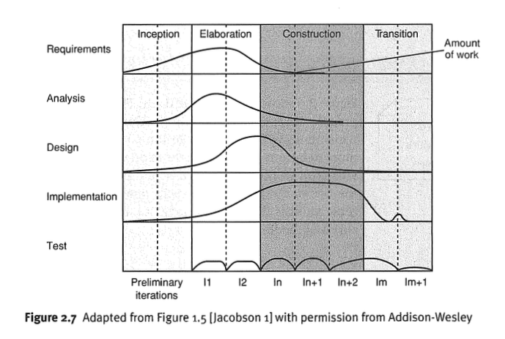
Agile Process
Highlight the fact that we are planning to follow the Agile Unified Process, described by the diagram above.
We are at the beginning half of the Elaboration Column and starting preliminary iterations with sample code
And interfaces
Notes:
Every team needs to be aware of the Agile Unified Process we are planning to implement in this class. Every team should explain that our design approach will follow this process goals and you can break this down into different steps for your project.

Slide 5
Remind Audience about Development Plan
-- Relevant information only, such as milestones.

Slide 6
Requirements
Must, Should, Could, Would
Table of the requirements:
Prioritized via:
Must
Should
Could
Would
Segment into: functional, non-functional, user, business, domain, anything relevant.
Reference Use Case Diagrams and Use Cases

Slide 7
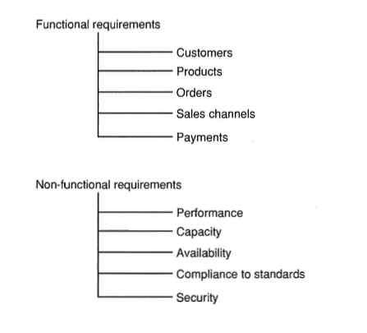
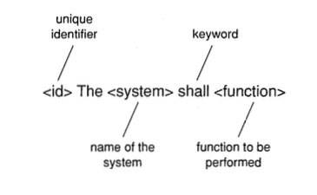
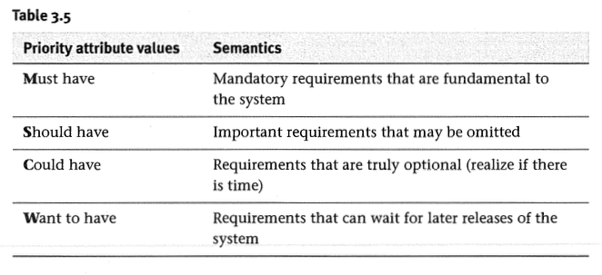
Requirements
7

Slide 8
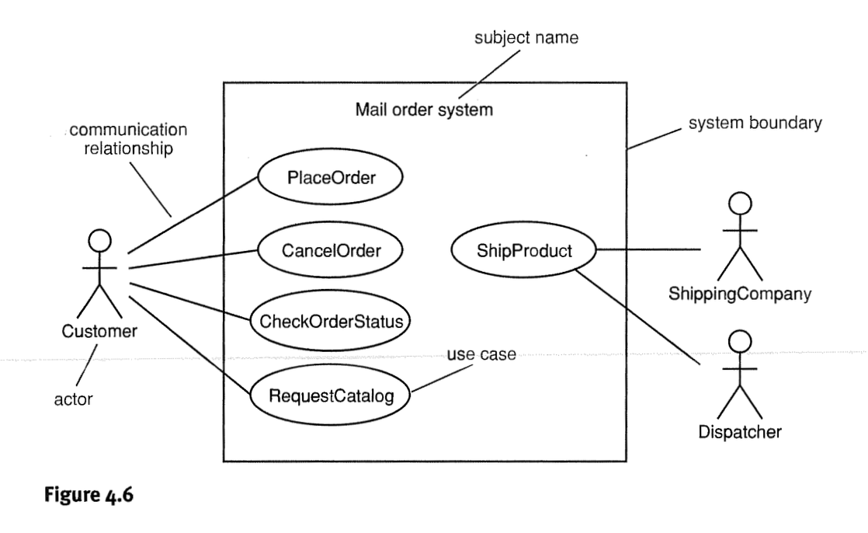
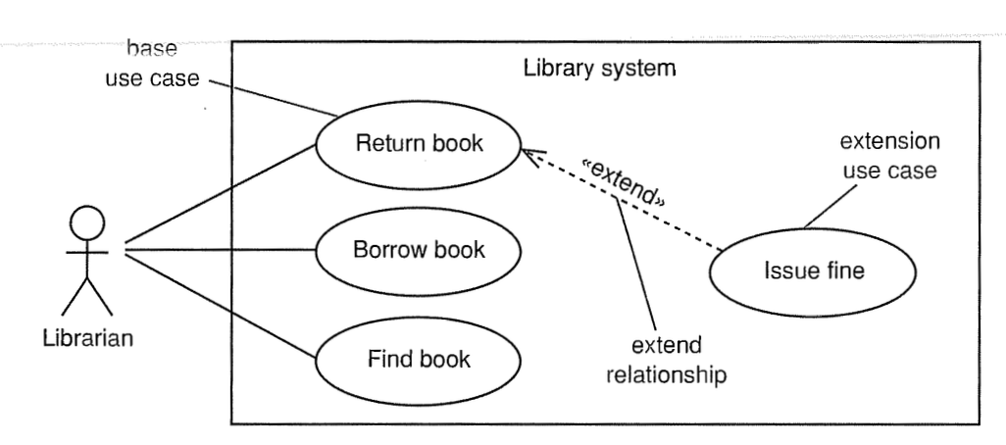
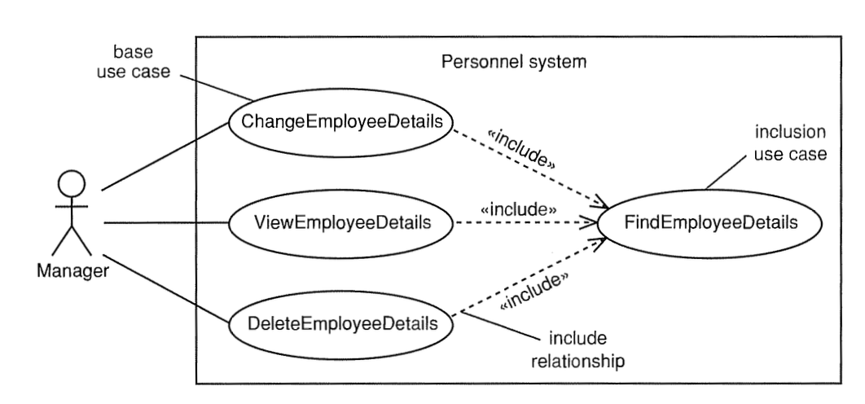
Use Case Modeling

Slide 9
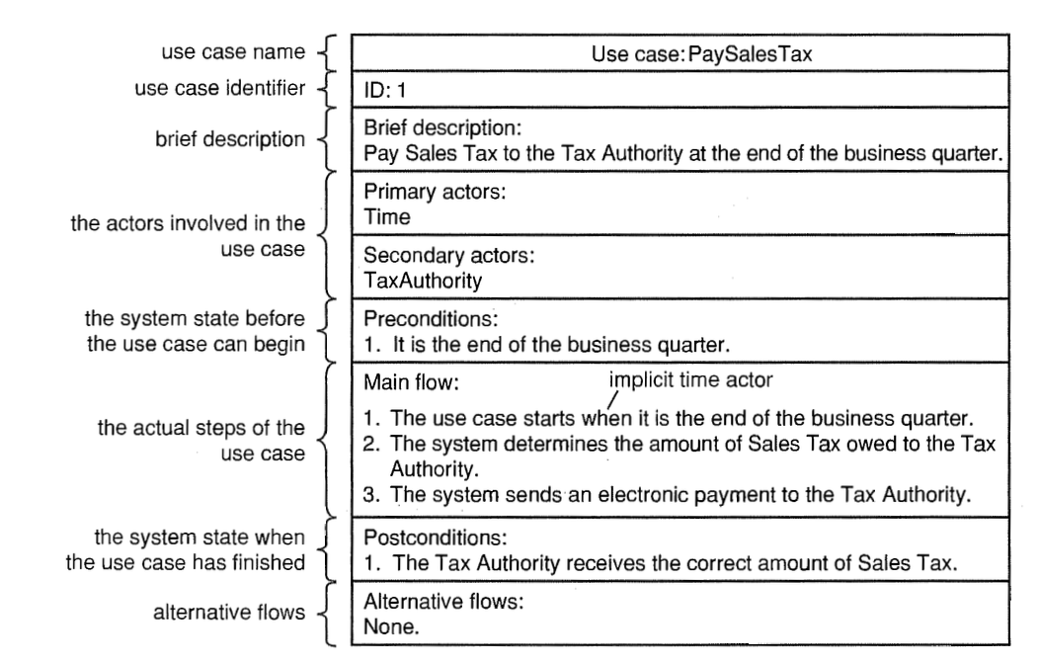
Use Case Specifications

Slide 10
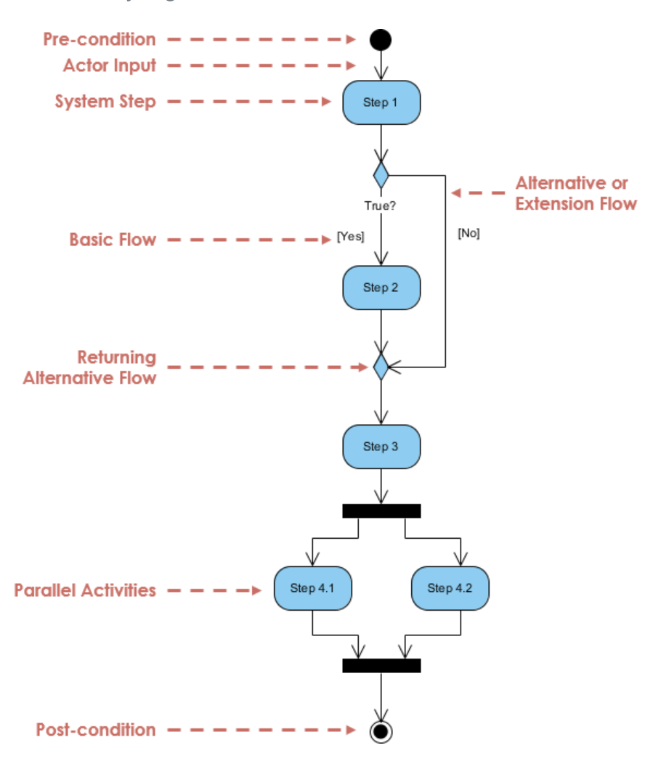
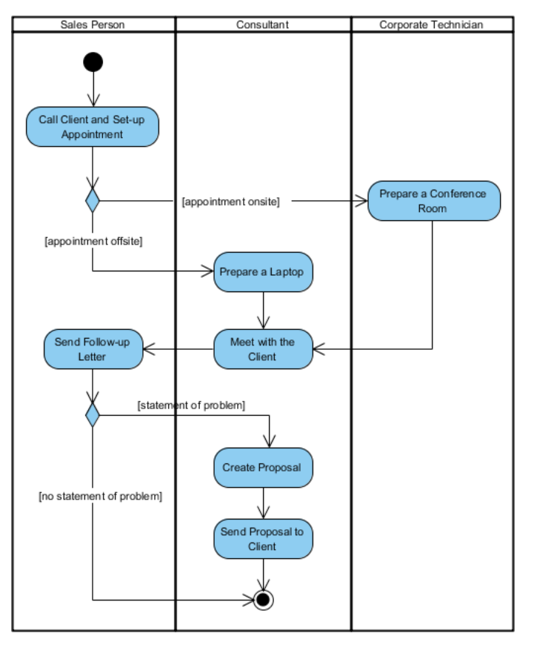
Activity Diagrams for Each Use Case

Slide 11
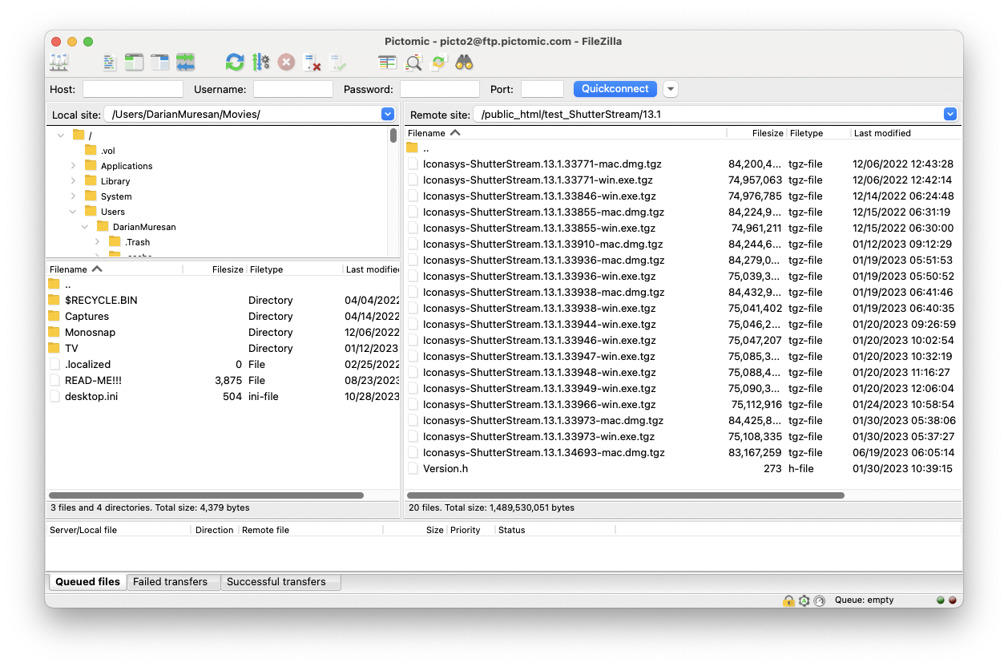
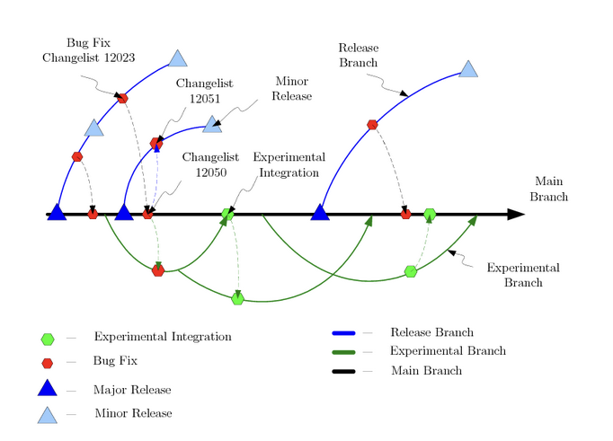
Software Versioning
Include screenshot showing auto-build with versioning:
Major.Minor.Changelist
Describe Major and Minor versions.
Show version in your PDF documentation

Slide 12
PDF Manual Demo
Show that you have:
Version on your manual
Update history table
Labeled and numbered requirements, use cases, and activity diagrams.
All requirements need to map to at least one use case
All use cases need to map to at least one requirement.
If user stories, each needs to map to one requirement but requirements don’t need to be mapped to user stories.
Show glossaries, indexes, and bibliography terms.
Show that linking works between figures and labels.

