Slide 1
Project Concept Development and Specification
SSW 423: Software Engineering Design VII
FindIt – Group 2
Roy Tas, Ryan Davis, & Cory Vitanza
Software Engineering School of Systems and Enterprises

Slide 2
Team Introductions
Ryan Davis​
4/4 Software Engineering
​
Roy Tas​
4/4 Engineering Management​
Cory Vitanza​
4/4 Software Engineering

Slide 3
Project Description
FindIt is a LoRaWAN-based location tracking and data communication system which aims to provide long-range, low-power tracking and real-time monitoring.
The system targets healthcare and caregiving applications, allowing for caregivers to monitor movement patterns and receive alerts for potential safety concerns.
It connects our physical trackers to a web platform, making it easier for caregivers to stay aware of location and safety changes.

Slide 4
Key Stakeholders
Primary Stakeholder :
Wearable Robotics Systems Lab
Dr. Damiano Zanotto
Secondary Stakeholder(s)
Caregivers
Parent(s) of children with autism
Patrons with autism or dementia

Slide 5
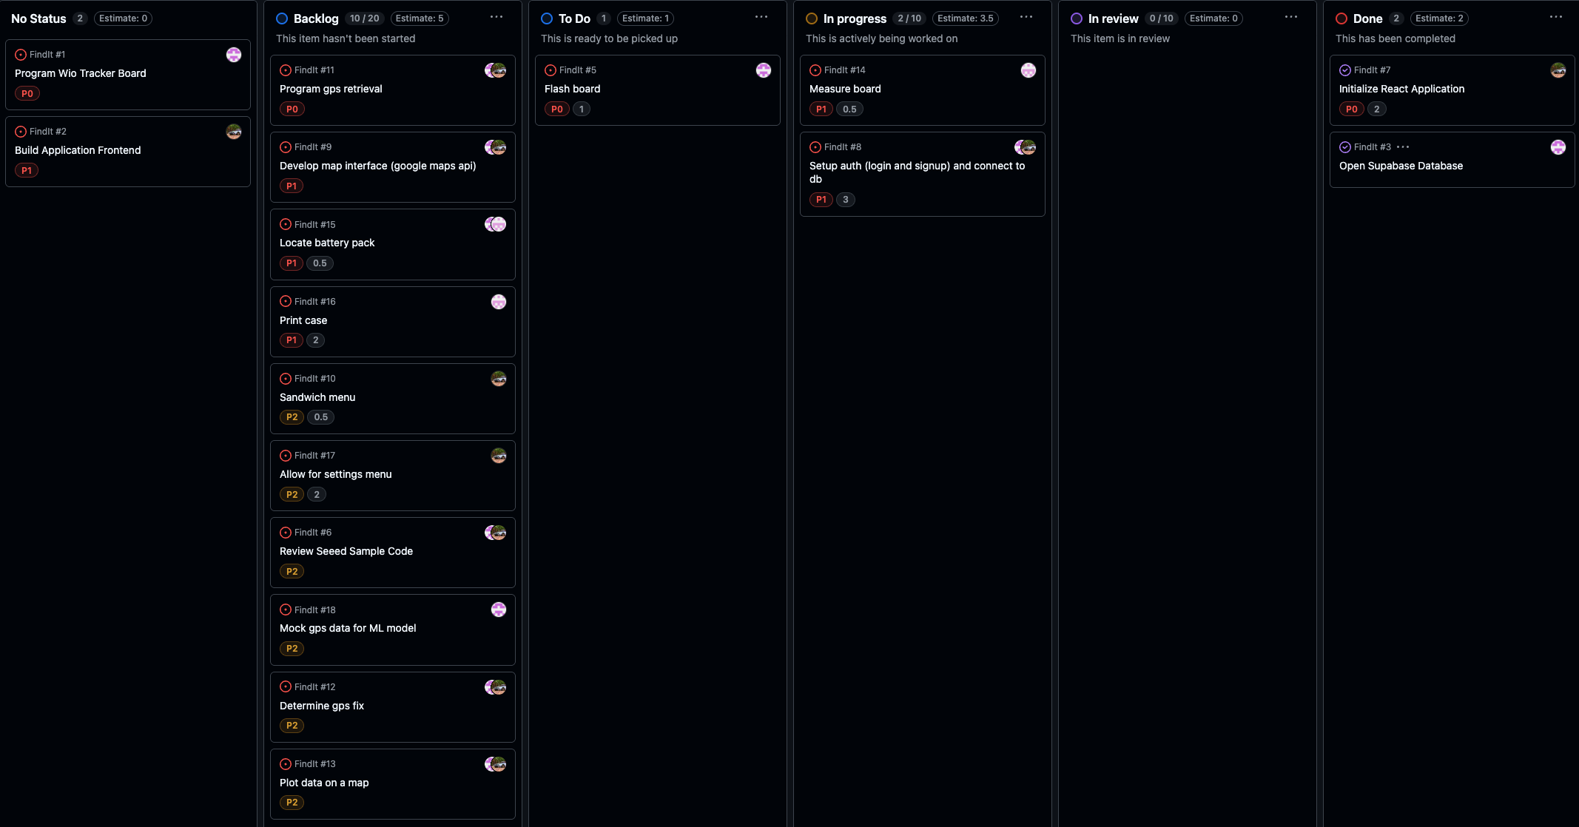
Agile Process
Notes:
Every team needs to be aware of the Agile Unified Process we are planning to implement in this class. Every team should explain that our design approach will follow this process goals and you can break this down into different steps for your project.

Slide 6
Remind Audience about Development Plan
Milestone 1: Project Setup & Requirements Finalization
Deliverables: Project repository initialized, Kanban board configured, requirements document finalized, hardware/software resources received and confirmed.
Milestone 2: Core System Architecture & Prototype Communication
Deliverables: Draft system architecture, initial Arduino board programming for basic LoRaWAN communication, mock frontend interface, database schema in Supabase.
Milestone 3: Integration of Hardware and Software Components
Deliverables: Hardware successfully transmitting data to backend, frontend connected to database, Docker setup for local deployment, integration testing initiated.
Milestone 4: Feature Implementation & System Testing
Deliverables: Full set of planned features implemented, CI/CD pipeline operational, unit and integration tests passing, preliminary user documentation drafted.
Milestone 5: Final Review & Delivery
Deliverables: Final acceptance testing completed, documentation finalized, project demonstration delivered, final repository and deployment package prepared for submission.

Slide 7
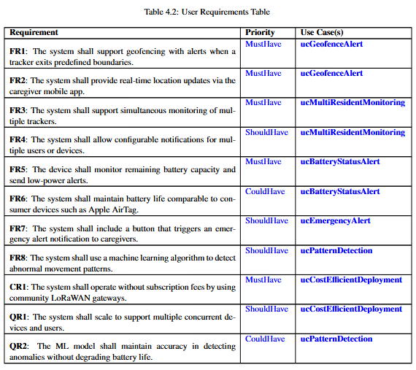
User Requirements

Slide 8
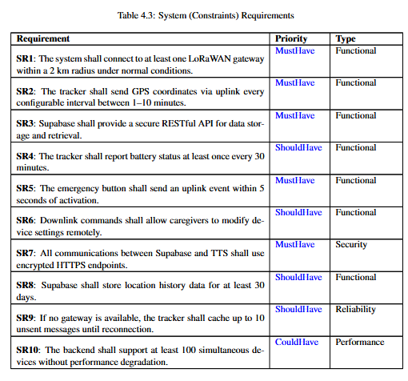
System Requirements

Slide 9
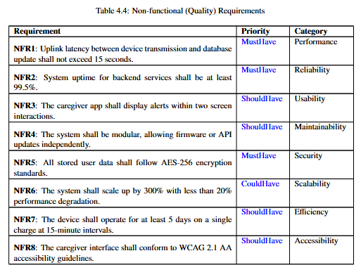
Non-Functional Requirements

Slide 10
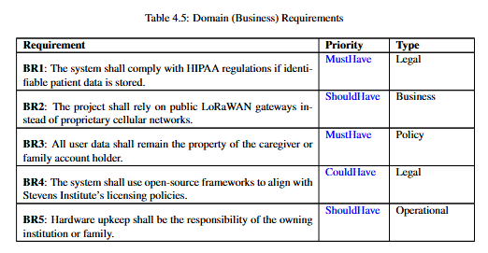
Domain / Business Requirements

Slide 11
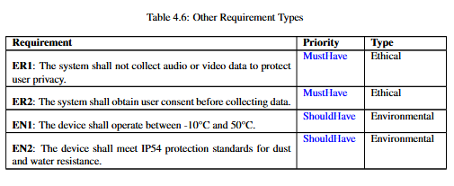
Other Requirements

Slide 12
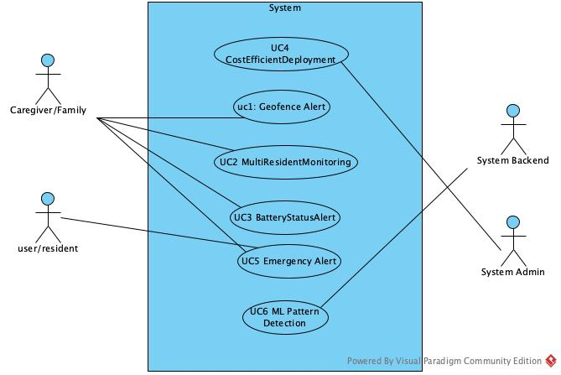
Use Case Modeling

Slide 13
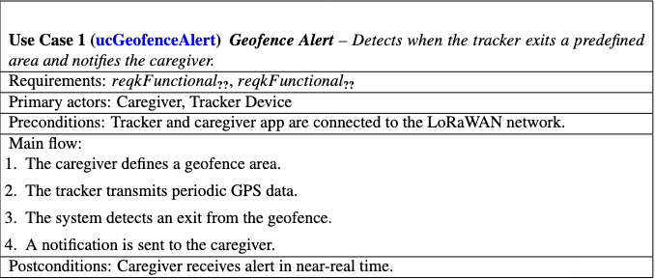
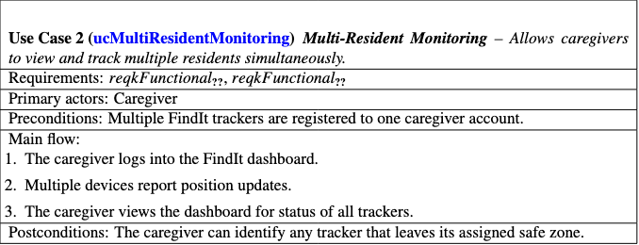
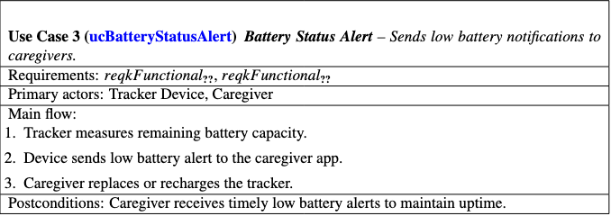
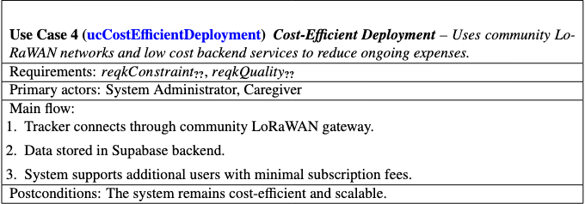
Use Case Specifications

Slide 14
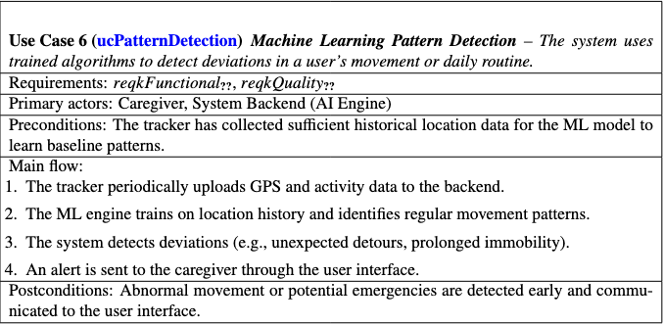
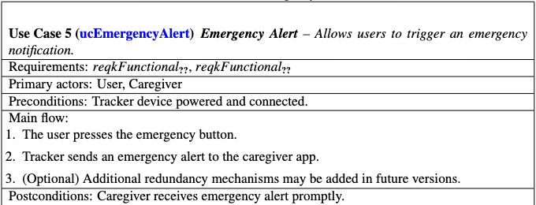
Use Case Specifications (Continued)

Slide 15
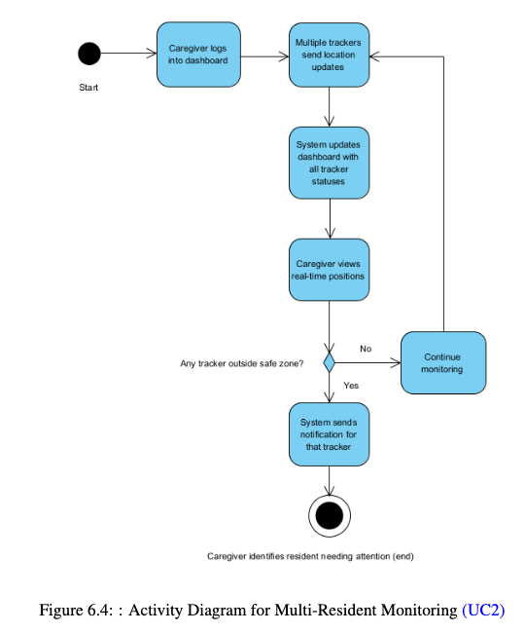
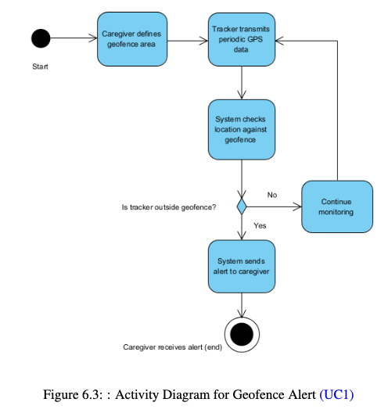
Activity Diagrams for Each Use Case

Slide 16
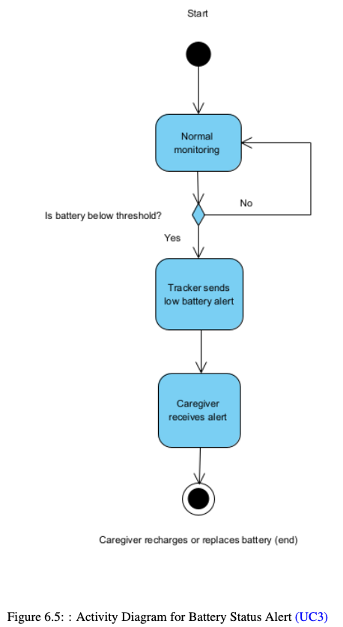
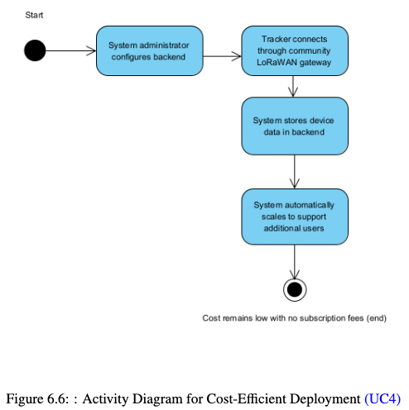
Activity Diagrams for Each Use Case

Slide 17
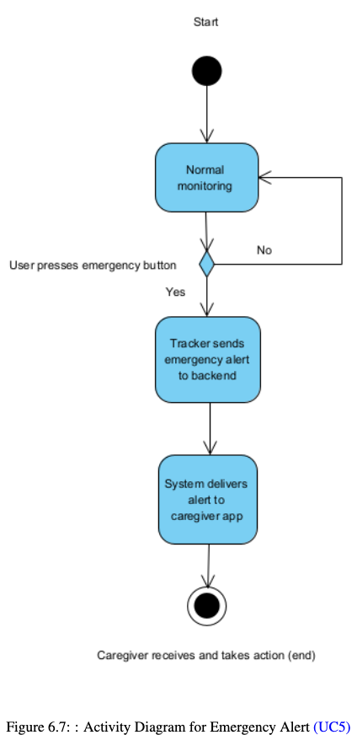
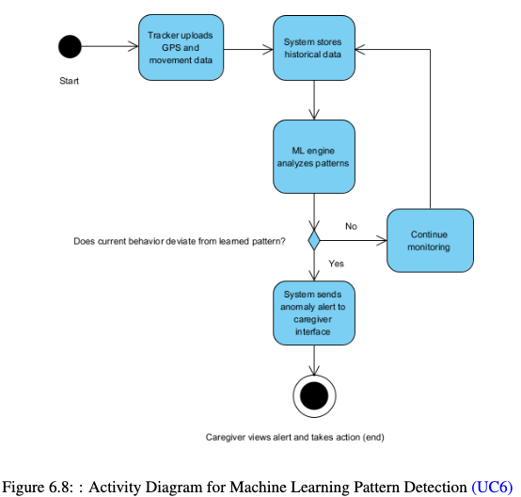
Activity Diagrams for Each Use Case

Slide 18
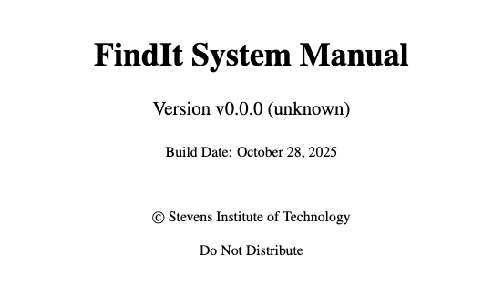
Software Versioning
Major
Fundamental Changes to structural components (User interface, Firmware Updates, Full Software release).
Minor
Feature additions to dashboard, database schema updates, or documentation expansions
Changelog
Bug fixes, user interface improvements, or minor optimizations

Slide 19
_______________________ PDF Manual Demo! _______________________

