Slide 1
Identifying Employee Attrition and Salary
A Data Analysis by Ryan Kinney

Slide 2

Executive Summary
DDS Analytics specializes in talent management and have tasked the data science team with:
Identifying main factors leading to company turnover
Build a model to predict future turnover
Build a model to predict Salaries
Present any additional findings from the employee data set

Slide 3

Notes About the Employee Data Set
Data set contains 36 variables to explore with
Variables are general employee information that is not sensitive
No missing values
Fairly clean. Conversion of variables to factor

Slide 4

Naive Bayes Classification Model to Predict Attrition
Variables included are:
Age
Department
Gender
Hourly Rate
Job Level
Job Satisfaction
Confusion matrix classifications:
Performance metrics:
 | No | Yes
No | 206 | 45
Yes | 6 | 4
Accuracy | 80.46%
Sensitivity | 97.17%
Specificity | 8.16%

Slide 5

KNN Classification Model to Predict Attrition
Variables included are:
Age,
Daily Rate,
Monthly Income,
Work Life Balance,
Years at Company
Confusion matrix classifications:
Performance metrics:
 | No | Yes
No | 208 | 4
Yes | 43 | 6
Accuracy | 81.99%
Sensitivity | 82.87%
Specificity | 60%

Slide 6

Salary Prediction Model
Techniques:
Multiple linear regression
Independent Factors used to predict Salary:
Job Level, Job Role, Total Working Years, Years at Company
Adjusted R² | p-value | RMSE
.9465 | <2.2e⁻¹⁶ | 1055.69

Slide 7
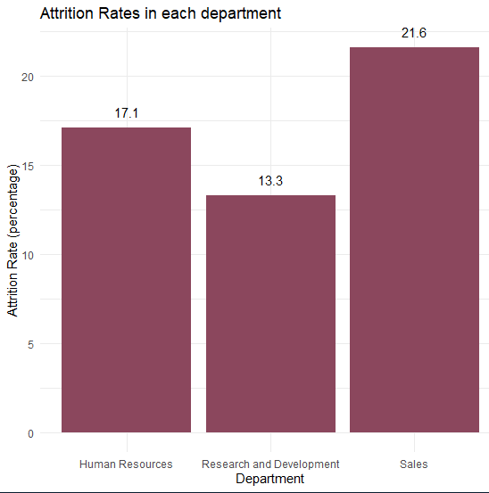
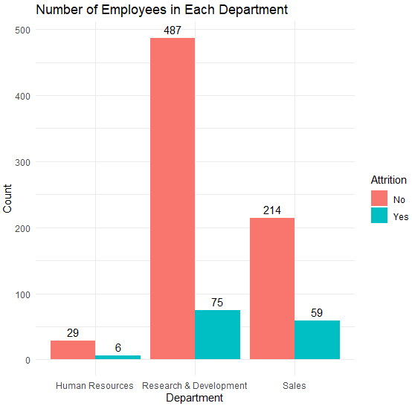
Department Being a Factor Leading to Attrition

Slide 8

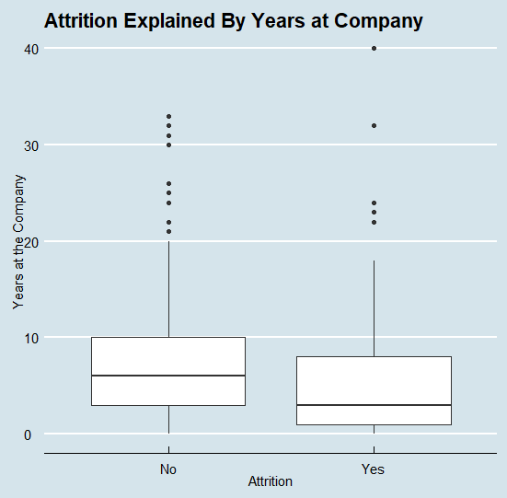
Years at the Company

Slide 9
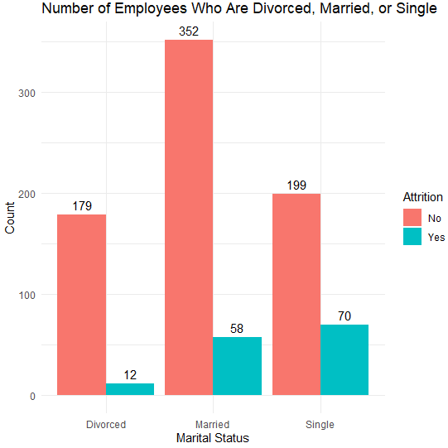
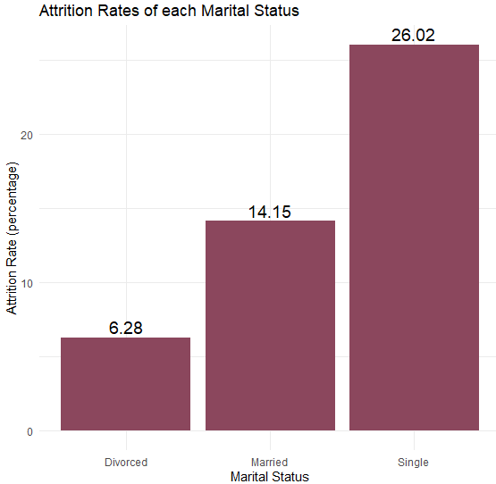
Marital Status

Slide 10
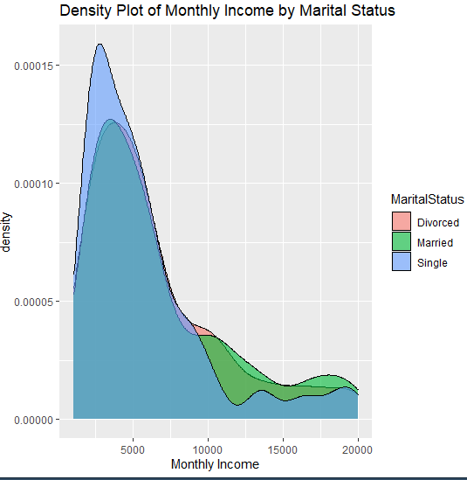
Marital Status Cont.
Single employees tend to make less than divorced and married employees.
Married employees make on average have the highest salaries

Slide 11
Conclusion and Recommendations
Naive Bayes Model and KNN models were used
KNN had better metrics overall.
Used multiple linear regression to guess employee salaries
Recommendations for talent management:
Single and younger employees tend to have higher turnover rates.
Employees working overtime have 32% attrition rate compared to employees not working overtime who have a 10% attrition rate.

