Slide 1


Spotify Tracks Data
By: Ryan Nguyen
Notes:
"Does a song stop being Jazz just because it has an Electronic beat?"
"We’ve spent decades forcing music into boxes—Rock, Pop, Classical. But music doesn't live in a box; it lives on a spectrum. Today, I’m going to show you how we moved from 'predicting labels' to decoding the Music DNA—proving that a song isn't just one thing, but a signature of overlapping affinities."

Slide 2
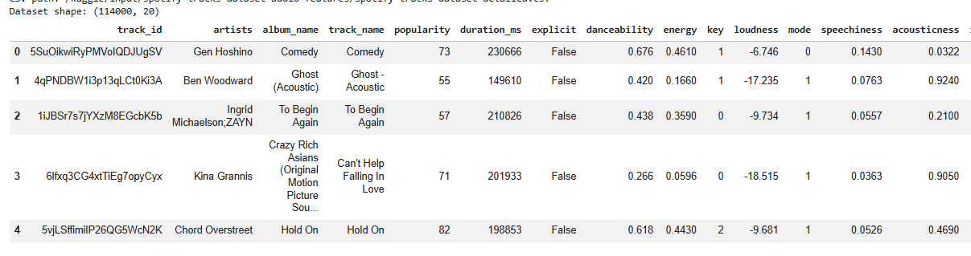
Problem & Dataset:
Decoding Music DNA: Multi-Label Genre affinity from Spotify Audio Features
114,000 Spotify Tracks
114 noisy sub-genres mapped to 8 families
Goal: Test whether audio features support human genre labels
Notes:
How project evolved from simple genre classifier into a more interpretable music-DNA framework. Started with spotify audio features like danceability, acoustiness, energy, speechiness, and valence. Central question became: do these raw audio features naturally support 8 broad genre families, or do genres overlap so much that a rigid one-label system is musically unrealistic? Not just classifying but decoding Music DNA. Audio features are like nucleotides of music.

Slide 3
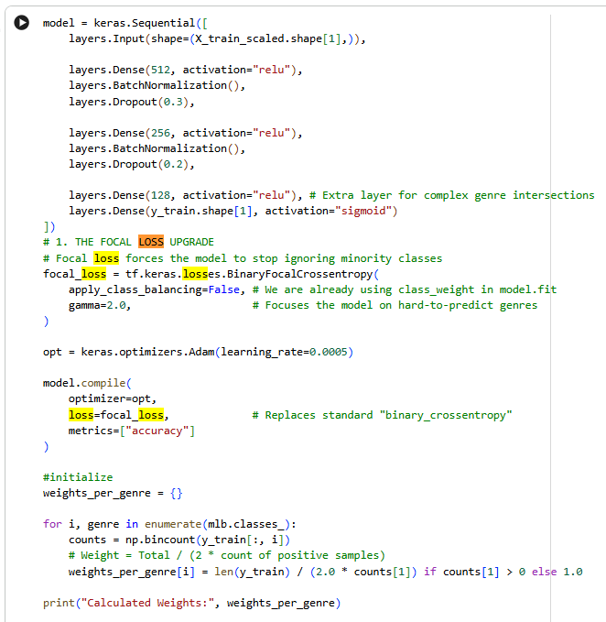
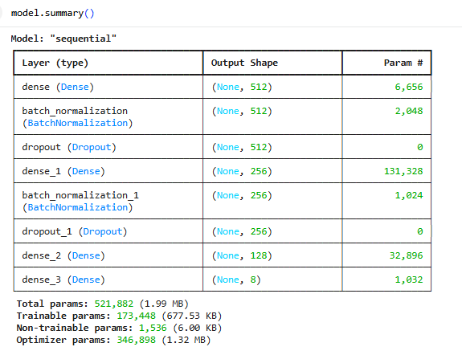
Model Summary
12 raw features to 8 genre affinities
512 nodes with high-capacity layer
Batch Normalization
Dropout (Primary Defense)
Bottleneck (128 nodes)
Parameters (knobs)
Binary Focal Cross Entropy
Notes:
Allows model to capture complex, non-linear relationships between audio features- like how high energy and low acousticness interact differently in Rock than Electronic. Batch is internal regulator like thermostat for neural network, normalize the inputs between layers, model trains fast and efficient. Prevents gradients from exploding or vanishing, keeping math stable. Dropout generalizers against accuracy trap, turning off 30% of neurons during training that force model to learn multiple ways to identify genre (primary defense against memorizing dominant class). Prevents from memorizing “other/indie” majority class only. Start with 512 nodes. Bottleneck distills information, by time data reaches layer model has filtered out noise and looking at most essential genetic markers of song.521K total parameters, half a million tunable knobs, only takes up 1.99 MB which makes model deployable and lightweight, can run on mobile device with spotify without massive server power. 1536 non-trainable params belong to Batch Normalization layers. Are the “running means” model keeps to ensure stability. Accuracy is a vanity metric in imbalance data. Maximizes Macro F1 Score. Chasing interpretable intelligence.
Binary focal crossentropy with gamma = 2, forcing model to focus on ‘hard examples’ - rare genres like Hip-Hop while down-weighting easy majority class. Tune sensitivity for each of the 8 genre families to maximize F1-score.

Slide 4
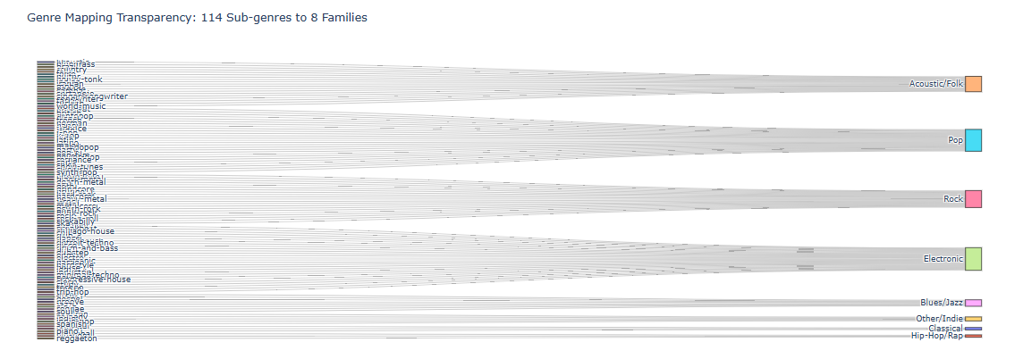

Data Pipeline and Mapping Transparency
114 original Spotify sub-genres collapsed into 8 core families
12 raw audio features used as model inputs
Goal was interpretability and computational tractability
Notes:
Network trains stably over 20 epochs, but good convergence alone does not mean model is useful, because imbalance can still inflate the metric. Sankey diagram shows the taxonomy transparent. Instead of modeling 114 noisy labels directly, I grouped them into Acoustic/Folk, Blues/Jazz, Classical, Electronic, Hip-Hop/Rap, Other/Indie, Pop, and Rock. That gave me a cleaner structure while still preserving the diversity of the Spotify dataset. This is foundational because it defines the target space I’m evaluating.

Slide 5
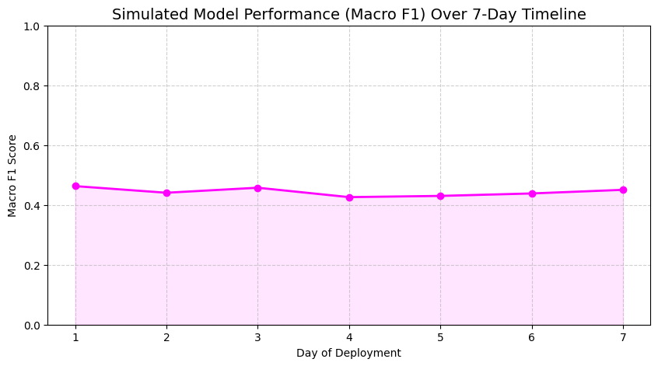
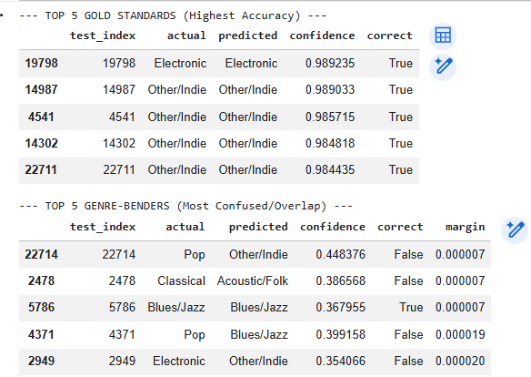
Architecture & Timeline
Simulated 7-day deployment using batches from test set
Steady Macro F1
Generalized audio DNA > Overfitting
Notes:
Model maintains 0.45 day over day, it has learned generalized audio DNA rather than overfitting to specific batch of songs. Based on the table below that, we can see the model is 98% confident on “pure” electronic tracks, identifying tracks with less than 0.00001 margin between Pop and Indie. Seeing the test song, the model saw a near-perfect tie between Pop and Indie. In the softmax model, this would be a ‘wrong’ guess. In the Sigmoid model, this is a successful identification of a crossover track. Our architecture isn’t just a stack of layers, it’s a filtration system that captures complexity of the 114-sub genres and narrow down to 128-node latent representation.

Slide 6
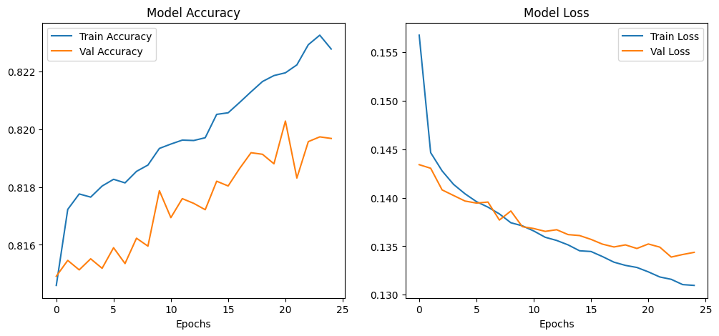
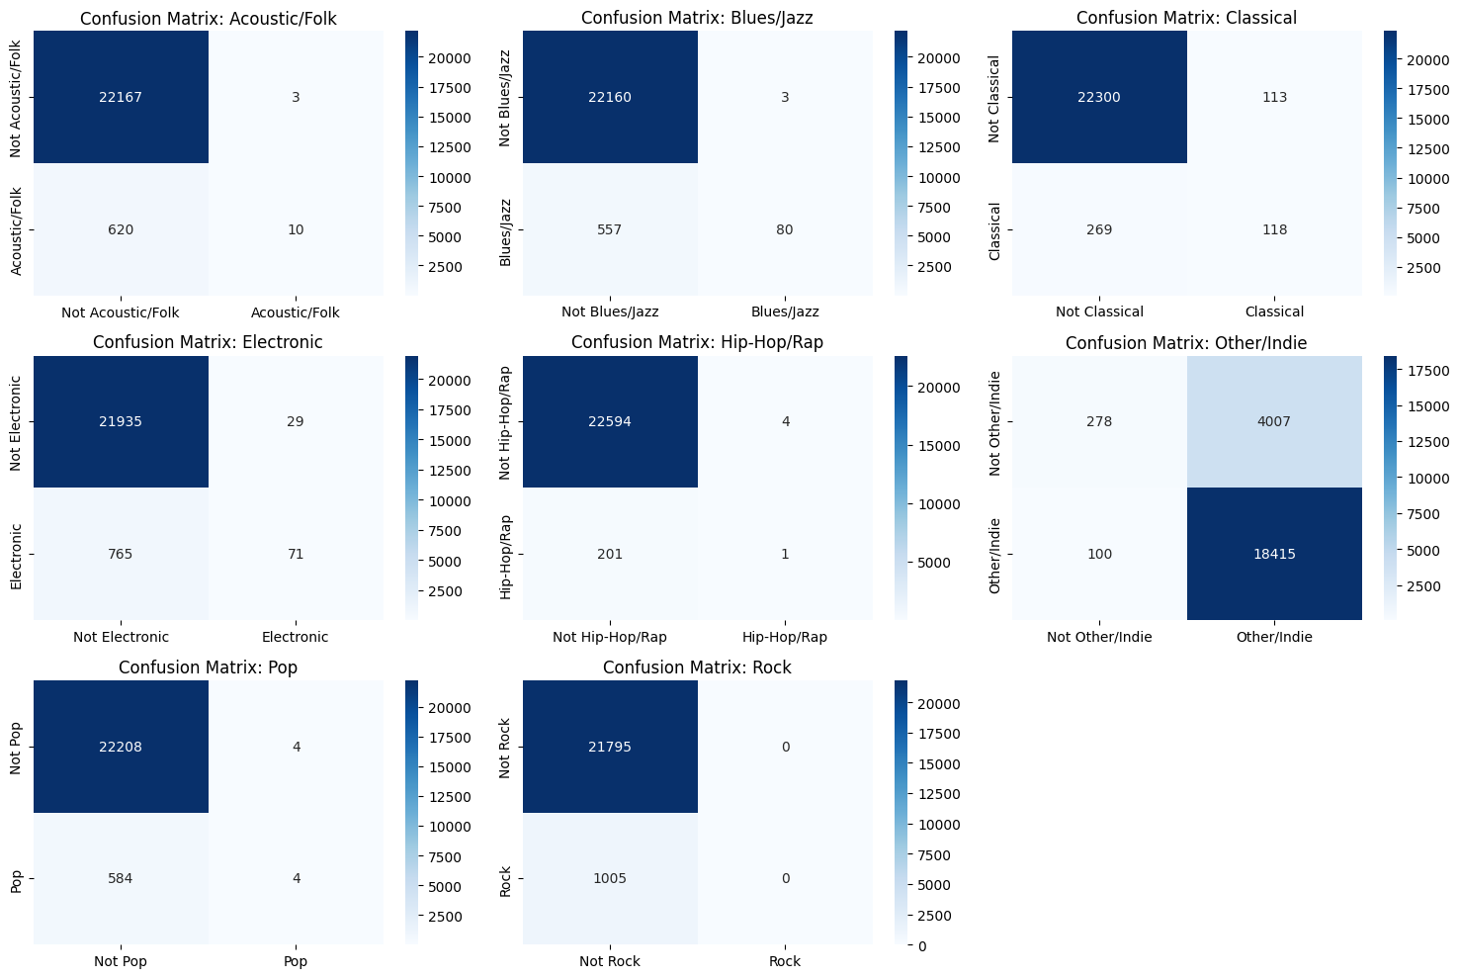
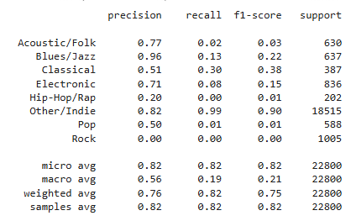
First failure - why 82% accuracy was misleading
Initial neural net reached ~ 82 % accuracy
Label permutation test exposed the problem
Model was exploiting imbalance, not learning signal
Old Result:
Notes:
When shuffled labels randomly, accuracy stayed at 82%, proving model wasn’t learning music - just learning probability of the majority class. 0.5 threshold too high need to change, baseline model had 0% recall for Rock. Distinguish between initial baseline exploiting majority class (inflated accuracy) and label permutation test on final model (dropped to 25%, proving final 43% model is learning genuine patterns).

Slide 7
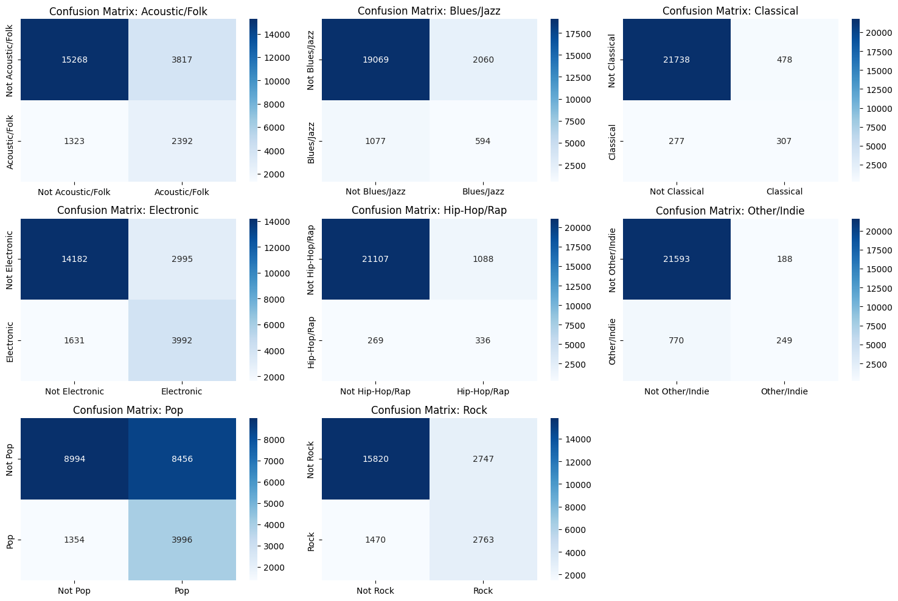
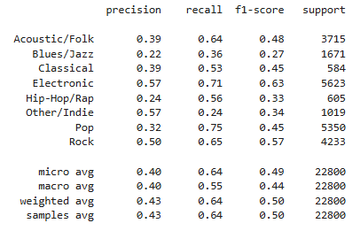
New Result: with Sigmoid Multi (Binary Focal)
Notes:
My first model appeared successful because it reached about 82% accuracy. But after permuting the labels and retraining, it still reached roughly the same accuracy. That was the smoking gun. The model had learned the label distribution, not audio signal. Mostly predicting the dominant Other/Indie bucket. But now you see with the new model it has increasing similar accuracy trend for test/train, but low validation model loss but high training model loss accuracy. The Other/Indie genre isn’t as overpowering anymore so more variation with the genres from confusion matrix. Precision went down but recall went up. F1 score also went up with more support, so model is more balanced. But overall precision and recall increased regardless.

Slide 8
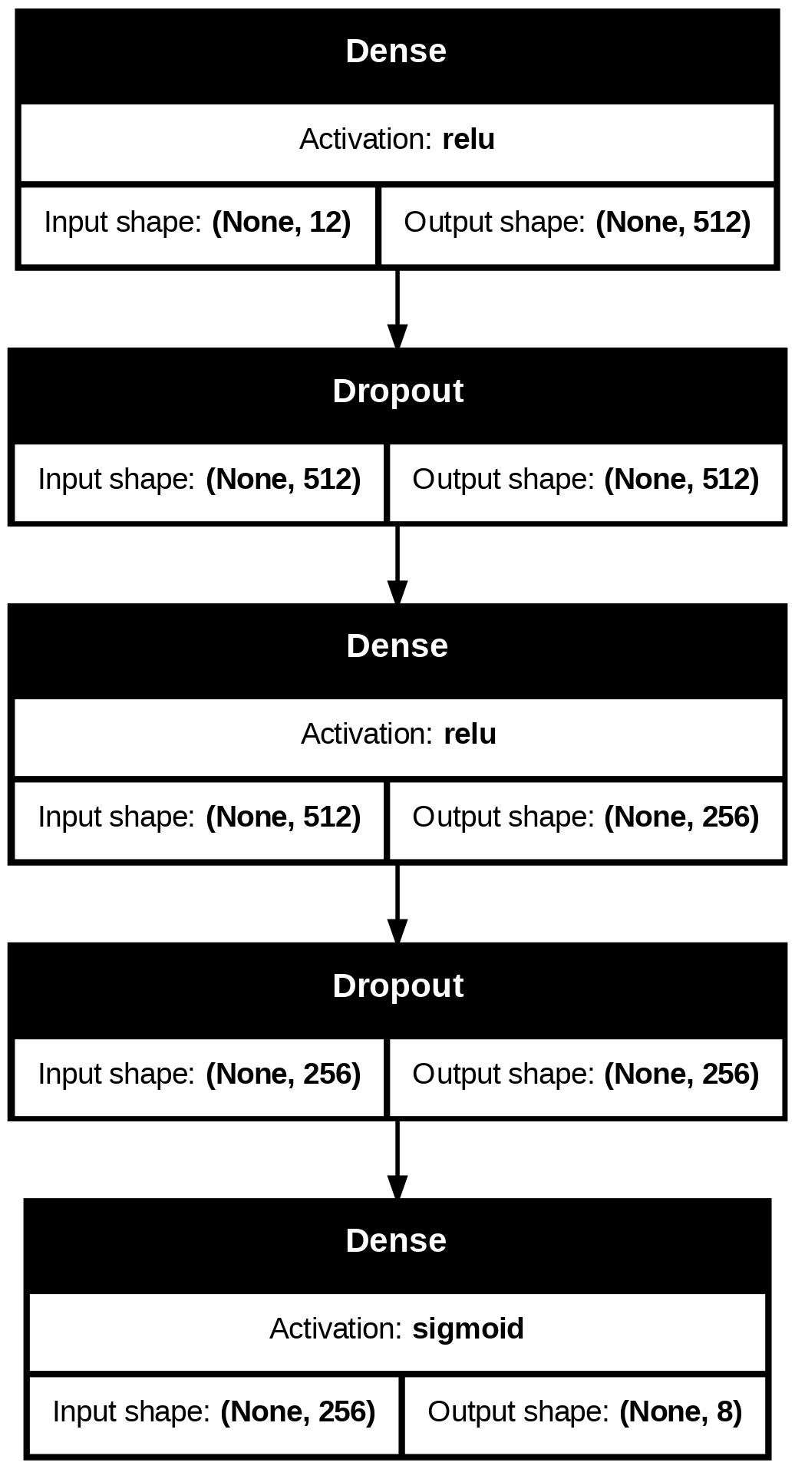
Why I pivoted from softmax to sigmoid
Softmax forces one strict winning class
Unsupervised plots showed overlap in audio space
Sigmoid models genre as multi-family affinity
Notes:
This was the main conceptual pivot. Softmax is appropriate when classes are mutually exclusive and must sum to one. But based on our results, unsupervised evidence points otherwise since songs not naturally separated into strict boxes in raw audio space. Track can sound partially. Moved to sigmoid outputs, where each of the 8 genre families is scored independently. So model predicts affinities rather than enforcing rigid label. Schematic of final network with compression from 512 to 256 to 128 nodes, which forces model to learn dense representation of audio before outputting 8 independent sigmoid probabilities. Softmax forces winner takes all box. Sigmoid allows for polygenic scoring that a song can have genes for multiple genres. Bridge to mindful discovery.

Slide 9
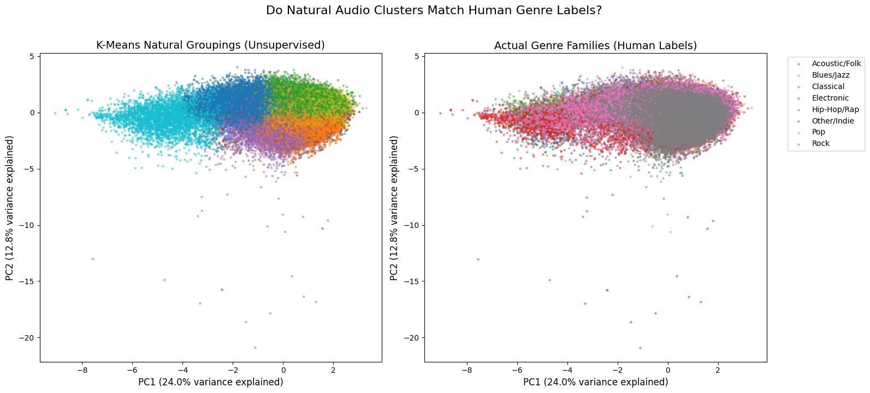
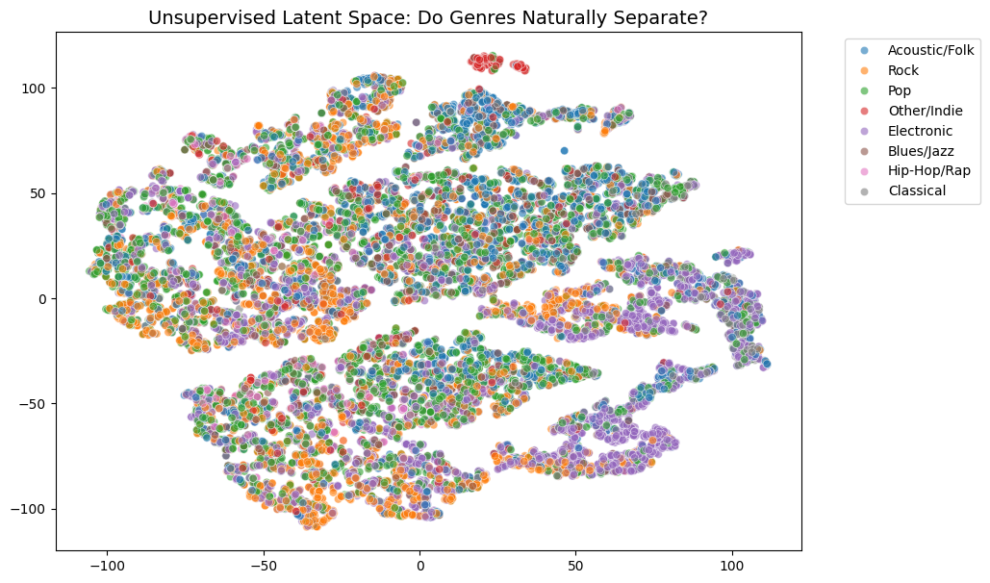
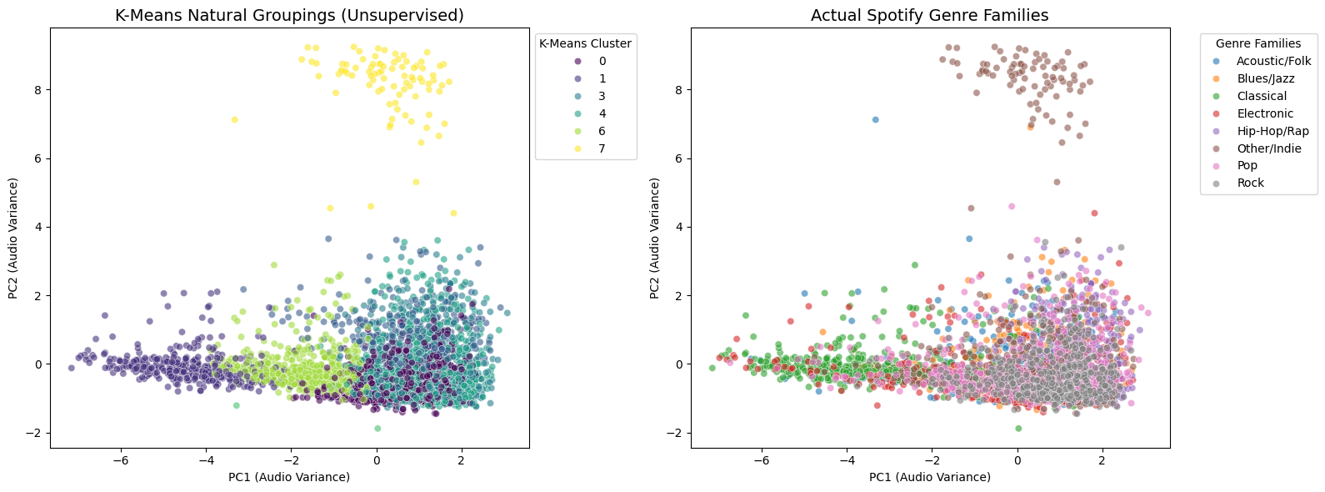
Unsupervised Evidence:
Do genres naturally separate?
PCA/ K-means on raw audio
t-SNE / latent-space visualization
Notes:
These plots answer one of the biggest questions: If labels are ignored and only look at audio, do the 8 clean clustered emerge? No, not perfectly. Some structure, but substantial overlap remains. That is useful to know. Suggests human genre families are only partially recoverable from low-dimensional audio features. So unsupervised analysis supports the idea that genre boundaries are fuzzy than absolute. No 8 natural clusters. But you can see somewhat of a separation between the classes and more variance compared to the first run. Some outliers noted.

Slide 10
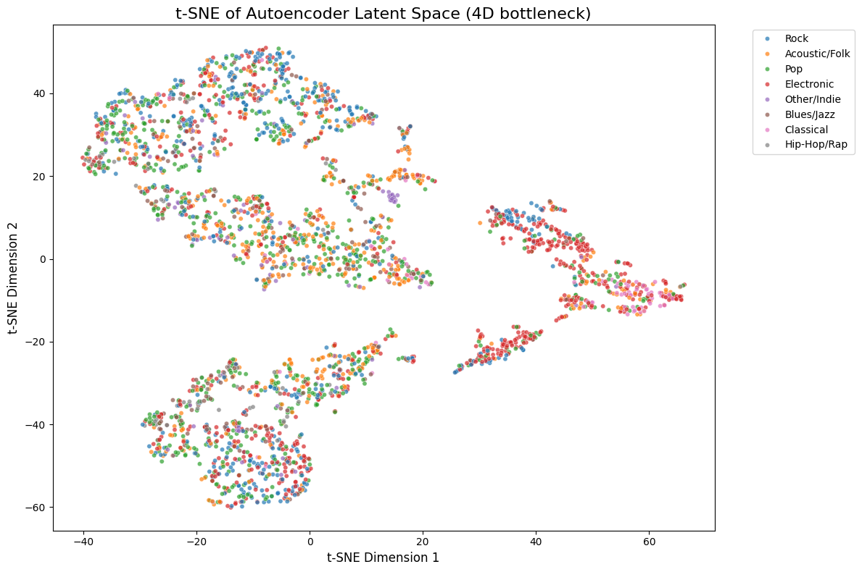
Final Supervised Model and Training Behavior
Deep feedforward network
Binary focal / weighted multi-label training
Stable training over epochs
Autoencoder on Latent Space shows more gap
Higher chance of variation and accuracy
Notes:
Final unsupervised setup. Network takes 12 scaled audio features and outputs 8 sigmoid scores. Used focal-style imbalance - aware setup plus threshold tuning to push the model to care about minority genres. Training curve shows steady convergence and no catastrophic divergence between training and validation. Key difference from earlier model is one is not rewarded for simply guessing majority class. Model seems to be more stable.

Slide 11
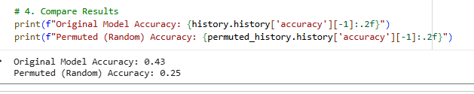
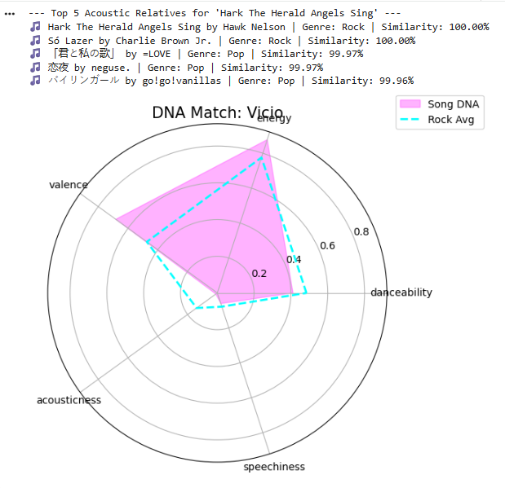
Final Metrics: Lower accuracy, better intelligence
Accuracy: 0.43
Permuted baseline: 0.25
Macro F1: 0.44
Weighted F1: 0.50
Human labels are cultural
Acoustic DNA is Universal
Notes:
instead of global 0.5 threshold, maximized F1-score for each genre family on held-out validation set, lowering bar for minority genres like rock and hip hop, which had been prev ignored. Headline accuracy only 43%, actually progress because permuted baseline is 25%, so model is now learning genuine audio-label association. More, macro F1 is around 0.44 and recall is much stronger across multiple minority genres. Hip-Hop/Rap recall is 0.56, Pop recall is 0.75, and Rock recall is 0.65. This is a much better model than the earlier 82% system because it is actually distinguishing genres rather than collapsing everything into Other/Indie.With the 99.9% match, we can say from results even though accuracy dropped that model is not lazy and actually tries to predict majority class, focal loss forced model to work harder on rare genres. 128-node bottleneck acts like a filter that strips away production noise to find the core musical structure.

Slide 12
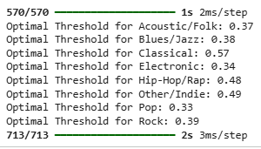
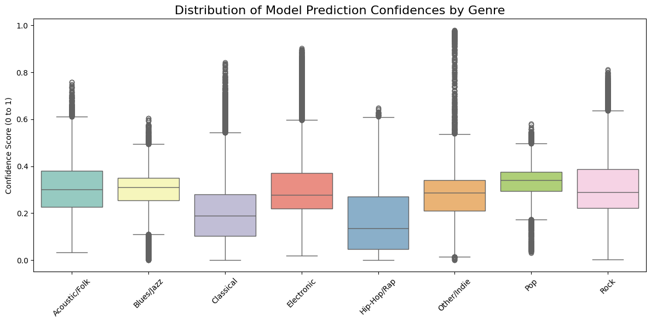
Threshold tuning rescued minority classes
0.5 threshold too blunt
Tuned per- class thresholds on validation set
Different families require different operating points
Notes:
unsupervised structure does not recover 8 perfectly separated islands. Suggesting human genre taxonomy only partially aligns with audio feature geometry. Partial grouping with substantial bleed across classes. Suggests audio features don’t support rigid mutually exclusive. Multi-label probabilities should not be thresholded at 0.5. Different genres have different operating points. Score distribution varies by genre. Tuned thresholds per class using validation set. Pop worked best around 0.33, etc. Helped rescue recall for minority and harder classes. Boxplot makes logic visible: each genre family has a different confidence distribution, so a one-size-fits-all threshold is not optimal. Increased our Macro F1 and real-world intelligence with this change.

Slide 13
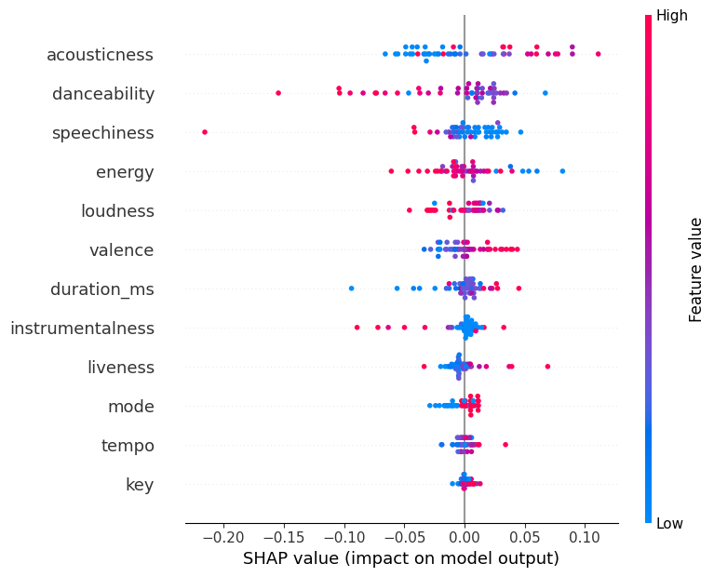
SHAP: What the model is actually using
Takeaways:
SHAP makes the model interpretable
Acousticness, danceability, speechiness, energy are influential
Model is using musical cues, not only distribution tricks
Notes:
SHAP lets me move from black-box classifier to an interpretable model. Features are ranked from top to bottom based on their total impact on the model. High value at red or low value at blue for a feature pushes the prediction. Acousticness being high is a strong indicator of a certain genre.This plot shows which raw audio features are pushing predictions up or down. Acousticness is a strong positive driver for Acoustic/Folk, while danceability, speechiness, and energy shape the boundary differently for other classes. That matters because it shows the model is using musically plausible signals rather than only exploiting imbalance. Shift from engineer to interpreter. So acousticness of a song would best predict what kind of genre it would be, but also the other features play a factor.

Slide 14
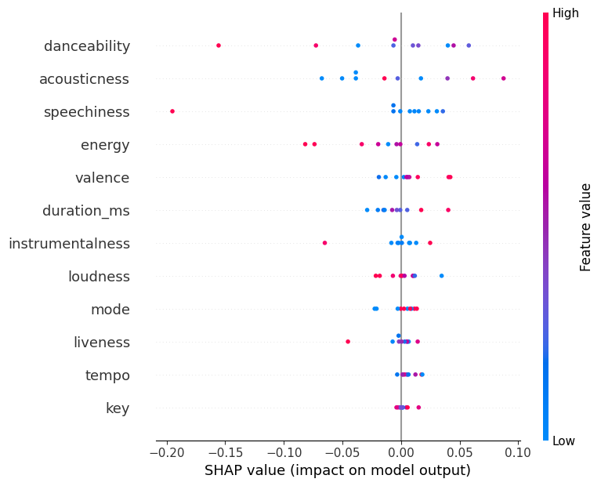

Slide 15
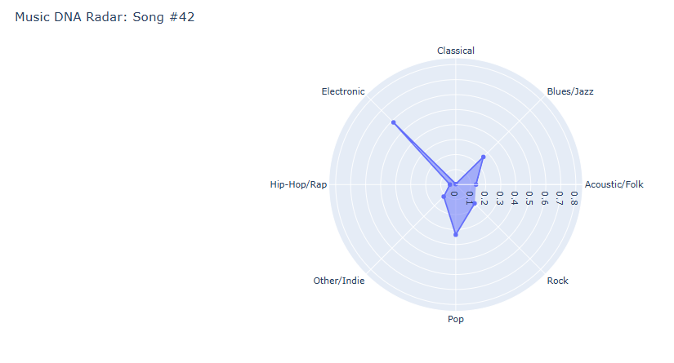
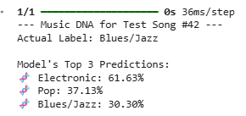
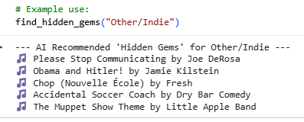
Music DNA and Hidden Gems
Takeaways:
Genre not just a label; it is a profile
Song #42: actual = Blues/Jazz
Model detects overlapping Electronic and Pop characteristics
Notes:
Applied AI tool: True label is Blues/Jazz, but model can detect strong Electronic and Pop traits. Musically reasonable for modern crossover tracks. So instead of forcing a single rigid label, model can produce a richer DNA-like profile. Opens the door to finding hidden gems: tracks whose official label may not match their deeper audio signature. Great study to analyze and evaluate everything. It is interpretable intelligence which is how Spotify finds hidden gems.

Slide 16
Limitations and Future Steps
Cons:
Conclusion
Weak taxonomy (imperfect)
Label noise
Heavy Other/Indie bucket
Audio features alone may not fully capture genre
Unmapped sub-genres
Class-specific SHAP
Better label engineering
Embedding-based classifier
Notes:
A loss function that down-weights ‘easy’ examples like Indie and increases importance of ‘hard’ misclassified examples like Rock is mathematically expressed as (1 - p_1)^
Not perfect final model. Children, comedy, indie-pop, indie, spanish - some unmapped sub-genres. 8-family taxonomy is useful, but still imperfect. Future work would include refining family mapping, testing autoencoder bottleneck directly as classifier input, and further improving imbalance handling through focal loss variants, label-aware batching, or taxonomy redesign. Tie to 7-day simulation, not just school project but deployable framework so the music therapists and independent artists can find proper audiences. The data science isn’t about translation- but translating raw signals into human feelings.

Slide 17
Questions?
Code Link

