Slide 1
Chapter 8:
Transformation Operators

Slide 2
This Chapter: we will learn
Vectors
Representing vertices
Matrix
Representing transformation operators
Review
Translation/Scale/Rotation
Examine Unity Implementation

Slide 3
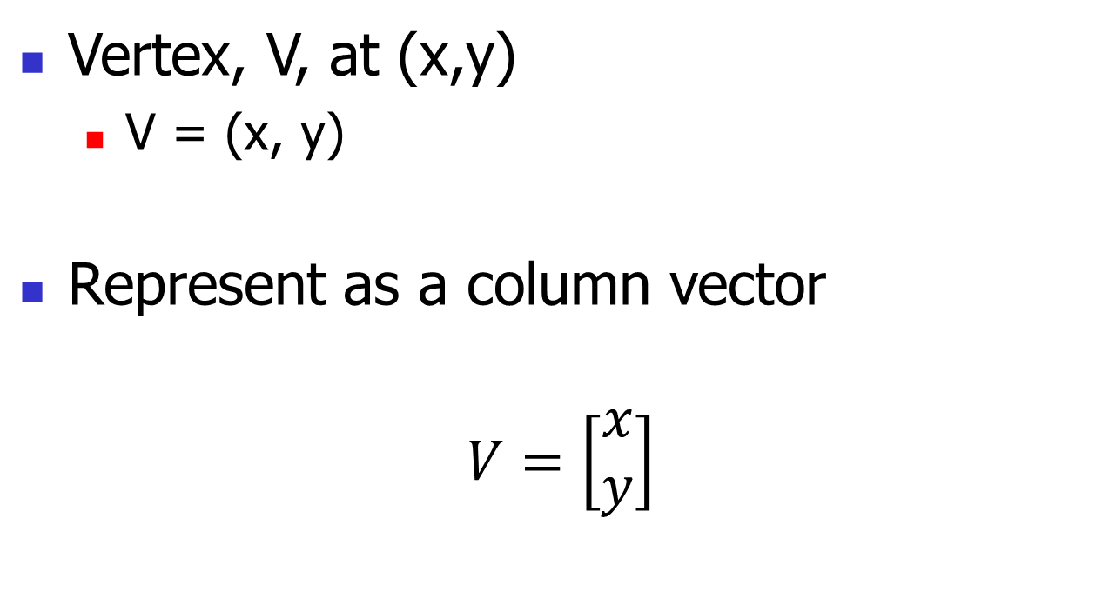
Vertex position and Column Vector
Vertex, V, at (x,y)
V = (x, y)
Represent as a column vector
$$V=\left[\begin{matrix}x \\ y\end{matrix}\right]$$

Slide 4
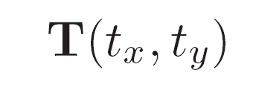
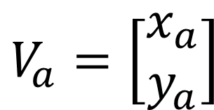
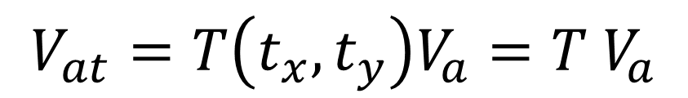
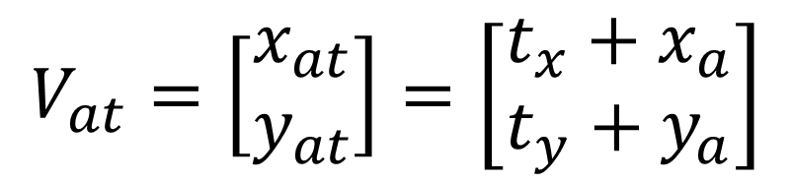
Translation Operator:
Translation means moving
Operator:
Moves vertex:
To:
We represent:
$$V_{a}=\left[\begin{matrix}x_{a} \\ y_{a}\end{matrix}\right]$$
$$V_{at}=\left[\begin{matrix}x_{at} \\ y_{at}\end{matrix}\right]=\left[\begin{matrix}t_{x}+x_{a} \\ t_{y}+y_{a}\end{matrix}\right]$$
$$V_{at}=T\left(t_{x},t_{y}\right)V_{a}=T V_{a}$$

Slide 5
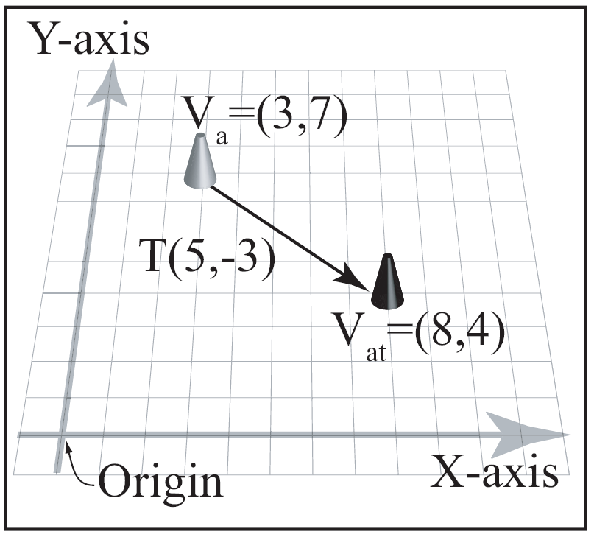

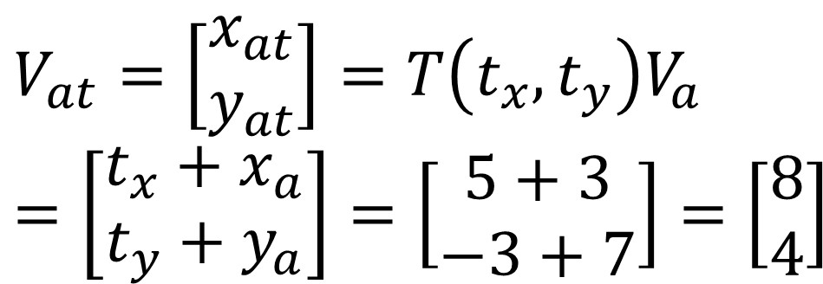
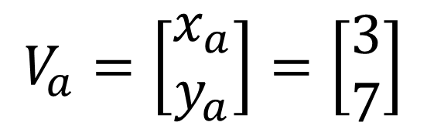
Translation Example:
Operator:
Vertex:
Result:
$$V_{a}=\left[\begin{matrix}x_{a} \\ y_{a}\end{matrix}\right]=\left[\begin{matrix}3 \\ 7\end{matrix}\right]$$
$$V_{at}=\left[\begin{matrix}x_{at} \\ y_{at}\end{matrix}\right]=T\left(t_{x},t_{y}\right)V_{a}$$
$$=\left[\begin{matrix}t_{x}+x_{a} \\ t_{y}+y_{a}\end{matrix}\right]=\left[\begin{matrix}5+3 \\ −3+7\end{matrix}\right]=\left[\begin{matrix}8 \\ 4\end{matrix}\right]$$

Slide 6
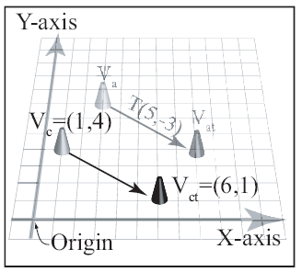
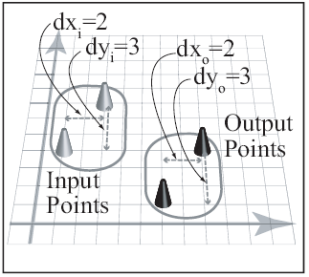
Translation: Properties
Moves relative
Relation of input/output points maintains

Slide 7
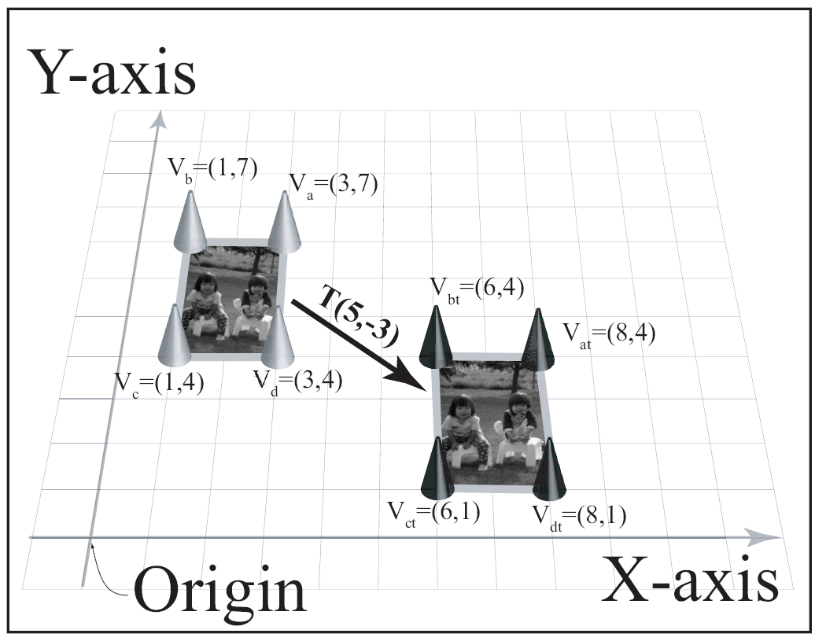
Translating entire object:

Slide 8


Translation Properties
Geometric: does not change shape:
Size, edges, and angles between angles
Reversibility
Identity: T(0,0)
Extension to 3D: simple

Slide 9


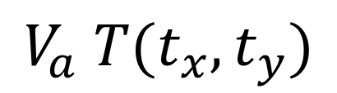
Note on order of operation
True for ALL operators: T, S, R
is different from
With column vector representation
is undefined!
$$V_{a} T(t_{x},t_{y})$$

Slide 10


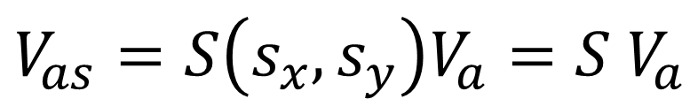
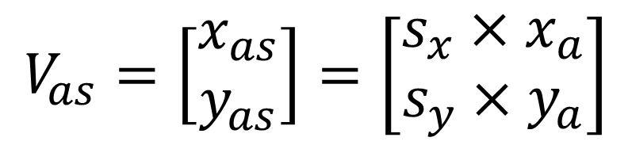
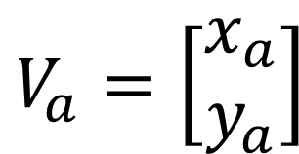
Scaling Operator:
scaling means change size
Operator:
scales vertex:
To:
We represent:
$$V_{a}=\left[\begin{matrix}x_{a} \\ y_{a}\end{matrix}\right]$$
$$V_{as}=\left[\begin{matrix}x_{as} \\ y_{as}\end{matrix}\right]=\left[\begin{matrix}s_{x}×x_{a} \\ s_{y}×y_{a}\end{matrix}\right]$$
$$V_{as}=S\left(s_{x},s_{y}\right)V_{a}={S V}_{a}$$

Slide 11
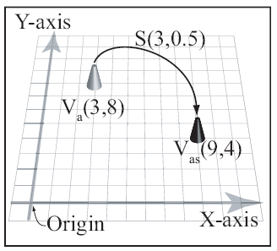


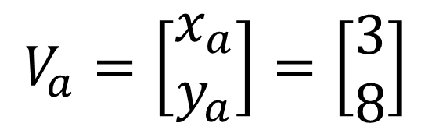
Scaling Example:
Operator:
Vertex:
Result:
$$V_{a}=\left[\begin{matrix}x_{a} \\ y_{a}\end{matrix}\right]=\left[\begin{matrix}3 \\ 8\end{matrix}\right]$$
$$V_{as}=\left[\begin{matrix}x_{as} \\ y_{as}\end{matrix}\right]=S\left(s_{x},s_{y}\right)V_{a}$$
$$=\left[\begin{matrix}s_{x}×x_{a} \\ s_{y}×y_{a}\end{matrix}\right]=\left[\begin{matrix}3×3 \\ 0.5×8\end{matrix}\right]=\left[\begin{matrix}9 \\ 4\end{matrix}\right]$$

Slide 12

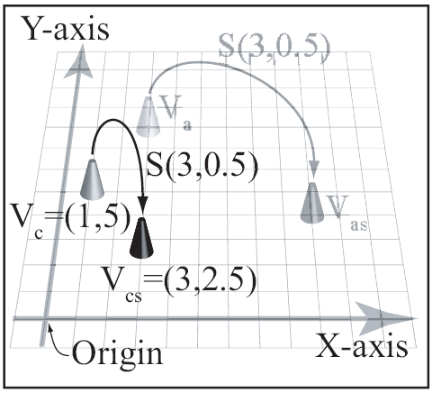
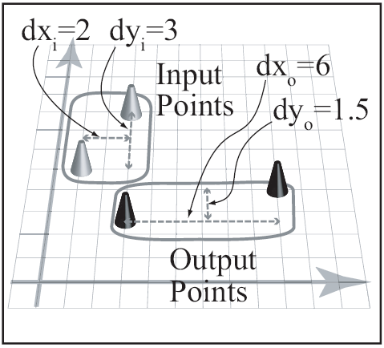
Scaling stretches distance (from axes)
Operator:
Individual points
Groups of points

Slide 13
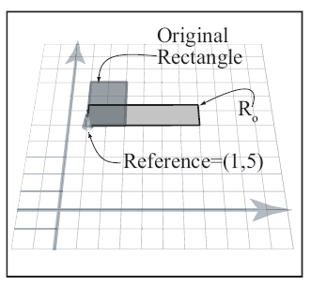
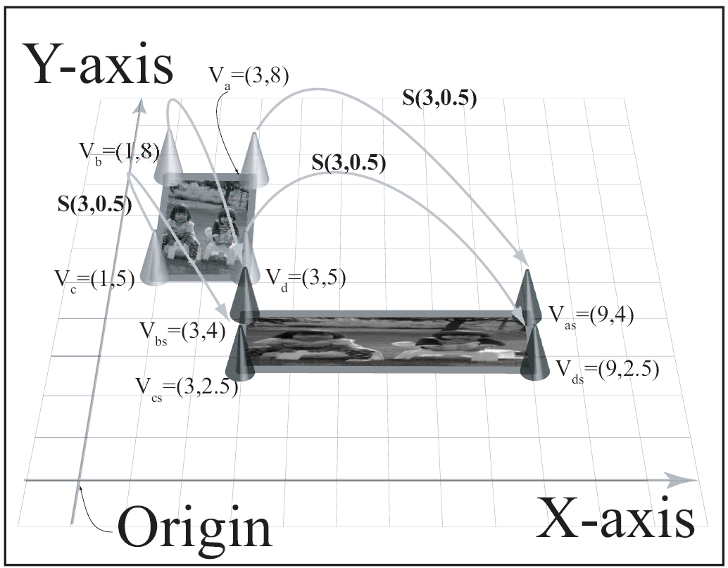
Scaling entire object

Slide 14
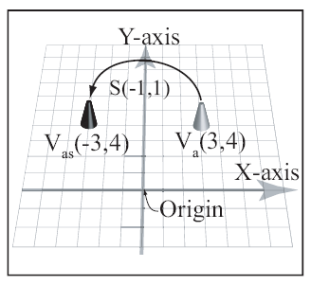
Reflection: Negative scaling factors
Negative factor in x:
Reflect across y
Negative factor in y:
Reflect across x

Slide 15
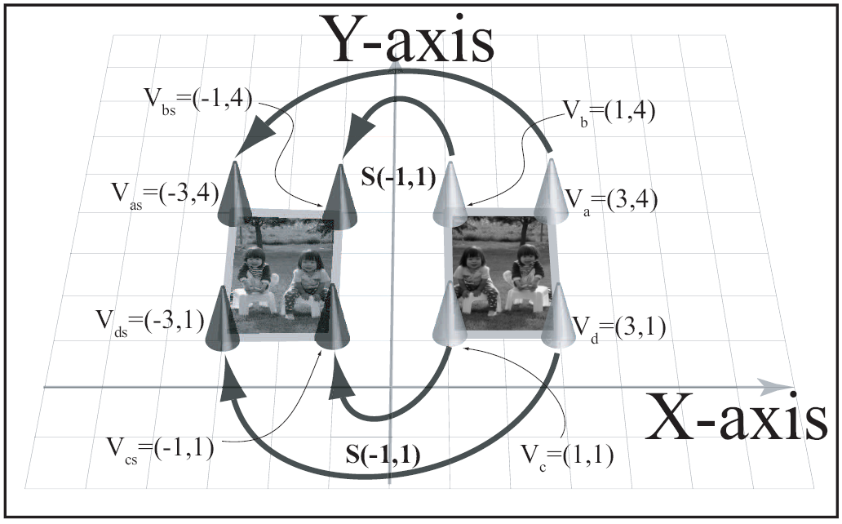
Reflection: entire object

Slide 16
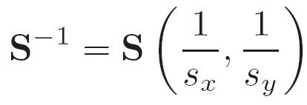

Scaling Properties
Geometric: scale factors
scale distances to the axes.
Reversibility
Identity: S(1,1)
Extension to 3D: simple

Slide 17



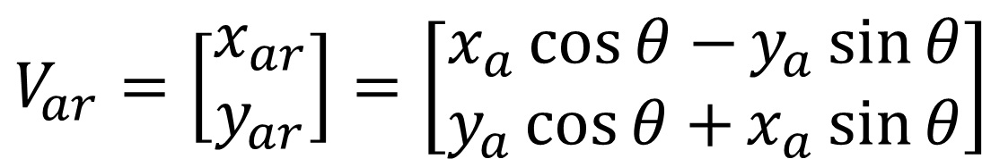
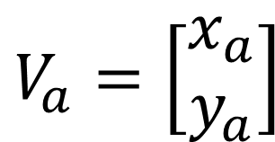
Rotation Operator:
Rotation means turning
Operator:
Moves vertex:
To:
We represent:
$$V_{a}=\left[\begin{matrix}x_{a} \\ y_{a}\end{matrix}\right]$$
$$V_{ar}=\left[\begin{matrix}x_{ar} \\ y_{ar}\end{matrix}\right]=\left[\begin{matrix}x_{a}\cos{θ−}y_{a}\sin{θ} \\ y_{a}\cos{θ+}x_{a}\sin{θ}\end{matrix}\right]$$
$$V_{ar}=R\left(θ\right){ V}_{a}={R V}_{a}$$

Slide 18
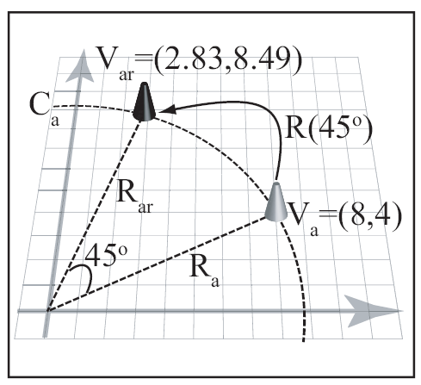

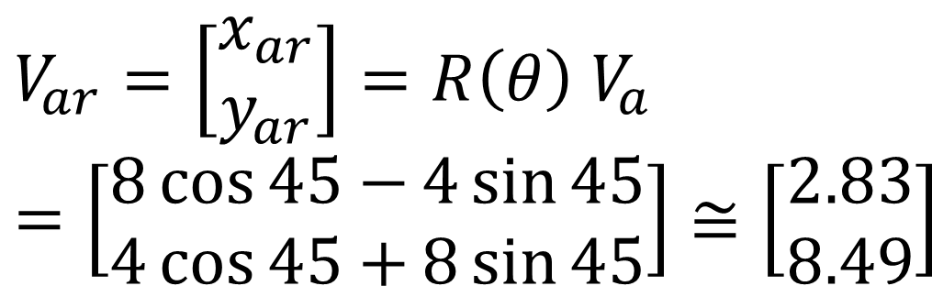
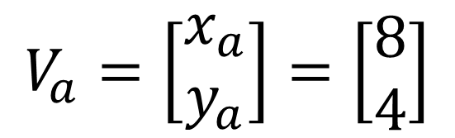
Rotation Example:
Operator:
Vertex:
Result:
$$V_{a}=\left[\begin{matrix}x_{a} \\ y_{a}\end{matrix}\right]=\left[\begin{matrix}8 \\ 4\end{matrix}\right]$$
$$V_{ar}=\left[\begin{matrix}x_{ar} \\ y_{ar}\end{matrix}\right]=R\left(θ\right){ V}_{a}$$
$$=\left[\begin{matrix}8\cos{45−}4\sin{45} \\ 4\cos{45+}8\sin{45}\end{matrix}\right]≅\left[\begin{matrix}2.83 \\ 8.49\end{matrix}\right]$$

Slide 19
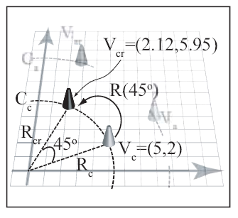
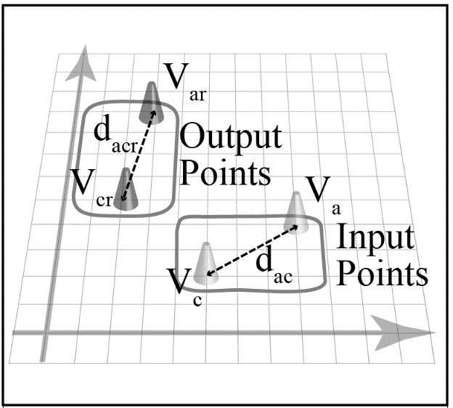
Rotation: Fixed distance from Origin
Move along circumference
Distance between points do not change

Slide 20
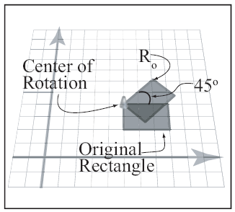
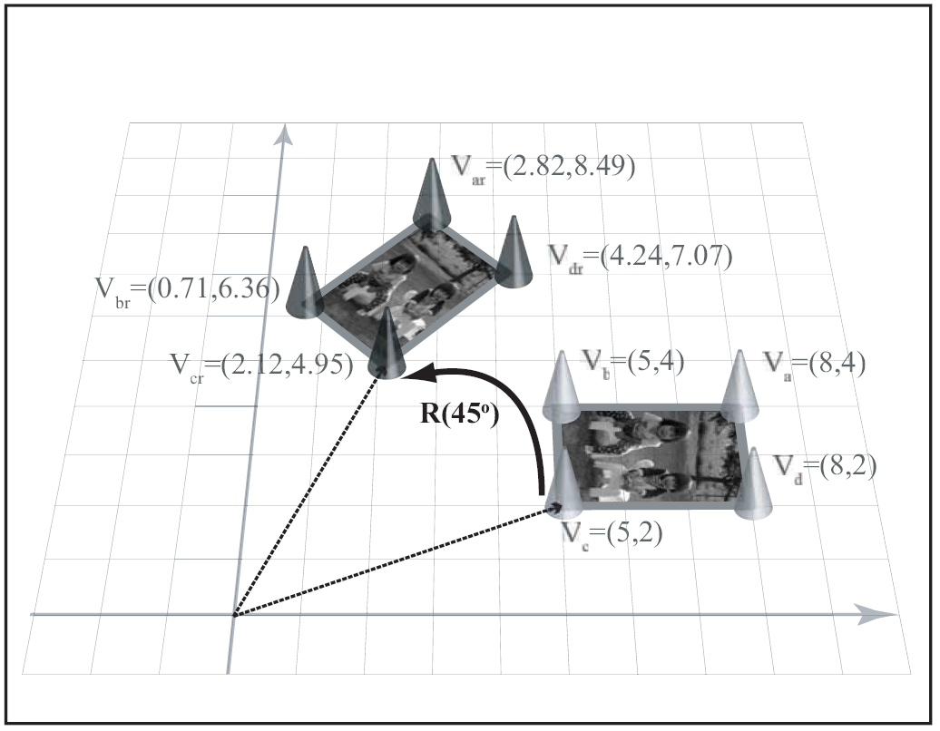
Rotating entire object:

Slide 21

Rotation Properties
Geometric:
Shape and area does not change
Reversibility
Identity: R(0)
Extension to 3D: tricky!
Will study in detailed in later chapter

Slide 22
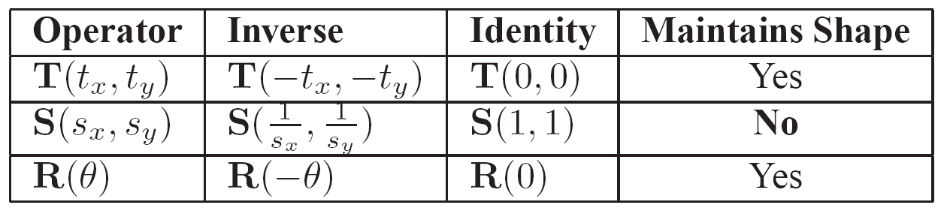
Summary: operators

Slide 23

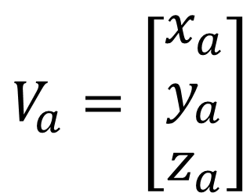

A Word about vectors …
Vertex position:
Column Vector
Row Vector (Transpose)
$$V_{a}=\left[\begin{matrix}x_{a} \\ y_{a} \\ z_{a}\end{matrix}\right]$$
$$V_{a}^{T}=\left[\begin{matrix}x_{a} & y_{a} & z_{a}\end{matrix}\right]$$

Slide 24
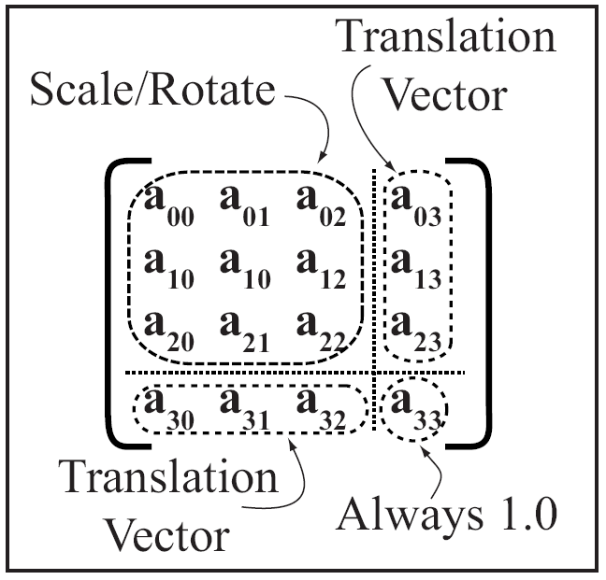
A Word about Matrices
4x4 array of floats

Slide 25
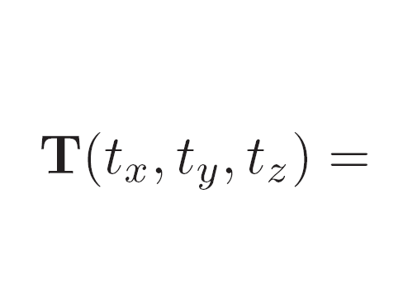
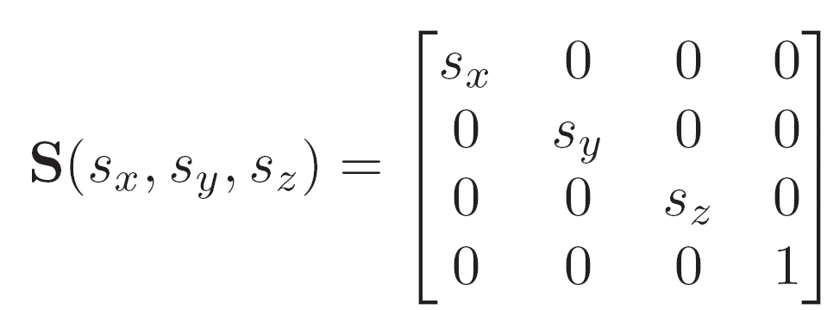
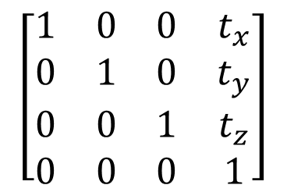
Operators: Translate and Scale
$$\left[\begin{matrix}1 & 0 & 0 & t_{x} \\ 0 & 1 & 0 & t_{y} \\ 0 & 0 & 1 & t_{z} \\ 0 & 0 & 0 & 1\end{matrix}\right]$$

Slide 26
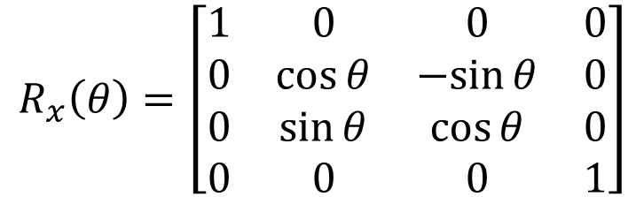
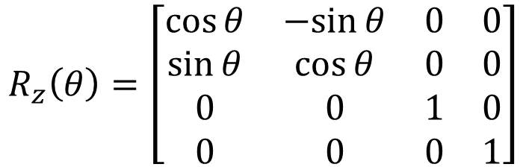
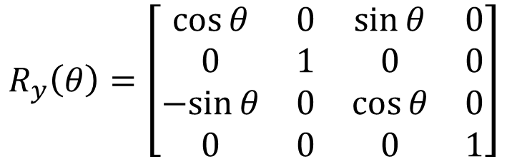
Rotation Operators:
$$R_{z}\left(θ\right)=\left[\begin{matrix}\cos{θ} & −sin{θ} & 0 & 0 \\ \sin{θ} & \cos{θ} & 0 & 0 \\ 0 & 0 & 1 & 0 \\ 0 & 0 & 0 & 1\end{matrix}\right]$$
About Z-axis
About Y-axis
About X-axis
$$R_{y}\left(θ\right)=\left[\begin{matrix}\cos{θ} & 0 & \sin{θ} & 0 \\ 0 & 1 & 0 & 0 \\ −sin{θ} & 0 & \cos{θ} & 0 \\ 0 & 0 & 0 & 1\end{matrix}\right]$$
$$R_{x}\left(θ\right)=\left[\begin{matrix}1 & 0 & 0 & 0 \\ 0 & \cos{θ} & −sin{θ} & 0 \\ 0 & \sin{θ} & \cos{θ} & 0 \\ 0 & 0 & 0 & 1\end{matrix}\right]$$

Slide 27
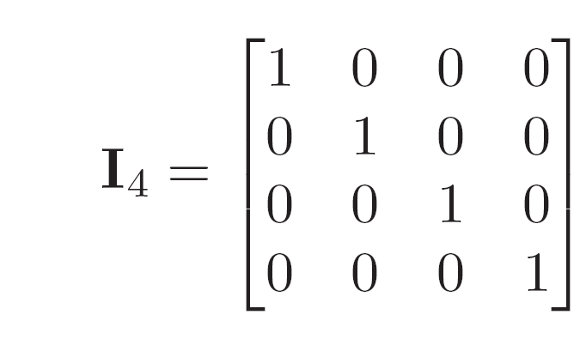
Identify Matrix
Does not do any thing!
M is a matrix
MI = M and IM = M
Important matrix for initialization!

Slide 28
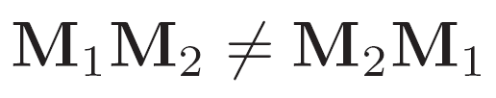
Some properties of Matrices
Order of operation is important!
Precedence of operation is not important!

Slide 29




Matrices and Vectors
$$V_{a}=\left[\begin{matrix}x_{a} \\ y_{a} \\ z_{a}\end{matrix}\right]$$
Column vector:
To translate by T:
Row vector:
To translate by T’:
$$T V_{a}$$
$$V_{a}^{T}=\left[\begin{matrix}x_{a} & y_{a} & z_{a}\end{matrix}\right]$$
$$V_{a}^{T} T′$$

Slide 30
Column vs. Row Vectors
One should never mix column and row vector representation
We use Column representation exclusively!
Operator always appear on the left side of the vector!
Referred to as:
Pre multiplying a vector

