Slide 1
Chapter 9:
Combining Transformation Operators

Slide 2
This Chapter: we will learn
How and Costs of combine operators
Inverse Operators
Pivoted Scale/Rotate
Programming Support
UWBGL

Slide 3


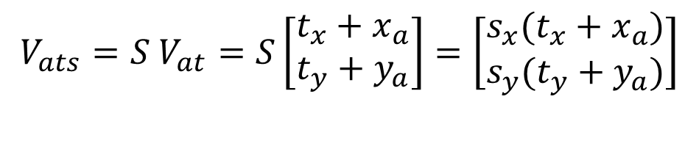
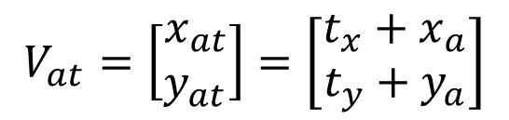

Translate Then Scale
Given vertex:
Translate then Scale:
If
Then
And
$$V_{at}=T V_{a}$$
$$V_{ats}=S V_{at}=S T V_{a}$$
$$V_{a}=\left[\begin{matrix}x_{a} \\ y_{a}\end{matrix}\right]$$
$$V_{at}=\left[\begin{matrix}x_{at} \\ y_{at}\end{matrix}\right]=\left[\begin{matrix}t_{x}+x_{a} \\ t_{y}+y_{a}\end{matrix}\right]$$
$$V_{ats}=S V_{at}=S\left[\begin{matrix}t_{x}+x_{a} \\ t_{y}+y_{a}\end{matrix}\right]=\left[\begin{matrix}{s_{x}(t}_{x}+x_{a}) \\ s_{y}(t_{y}+y_{a})\end{matrix}\right]$$

Slide 4
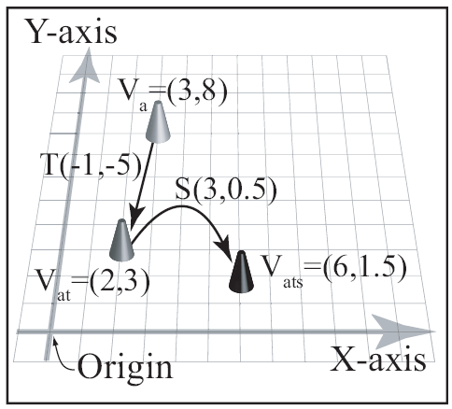
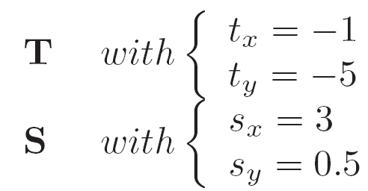
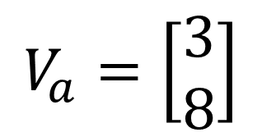
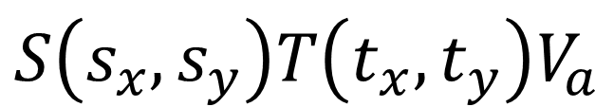
Example:
$$S\left(s_{x},s_{y}\right)T\left(t_{x},t_{y}\right)V_{a}$$
$$V_{a}=\left[\begin{matrix}3 \\ 8\end{matrix}\right]$$

Slide 5
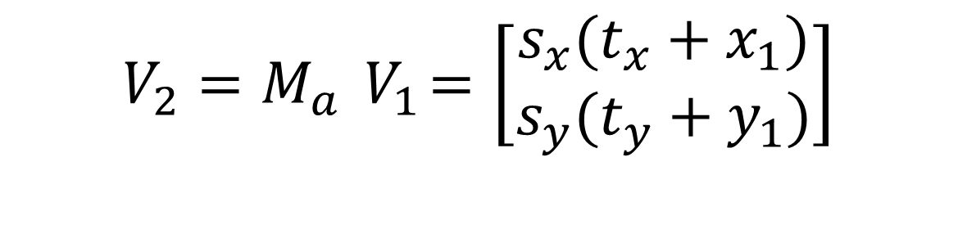
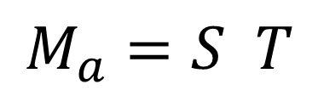
Concatenate:
$$M_{a}=S T$$
$$V_{2}=M_{a}{ V}_{1}=\left[\begin{matrix}{s_{x}(t}_{x}+x_{1}) \\ s_{y}(t_{y}+y_{1})\end{matrix}\right]$$
Compact Representation
Computation Efficiency
Cost to concatenate
Worthwhile if uses operator many times

Slide 6




!Warning! Order of operation
Recall …
So, if
Then, in general

Slide 7

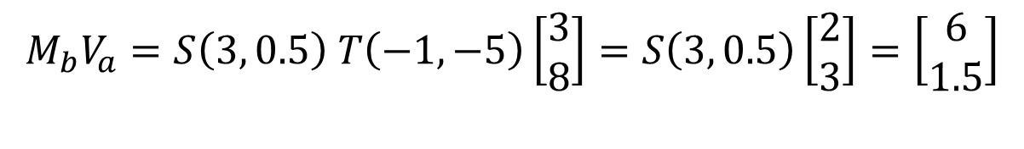
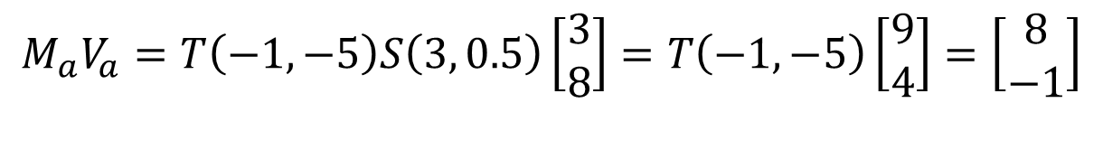

Example: Order of operation
For:
If and
$$V_{a}=\left[\begin{matrix}3 \\ 8\end{matrix}\right]$$
$$M_{a}V_{a}=T\left(−1,−5\right)S\left(3, 0.5\right)\left[\begin{matrix}3 \\ 8\end{matrix}\right]=T\left(−1,−5\right)\left[\begin{matrix}9 \\ 4\end{matrix}\right]=\left[\begin{matrix}8 \\ −1\end{matrix}\right]$$
$$M_{b}V_{a}=S\left(3, 0.5\right) T\left(−1,−5\right)\left[\begin{matrix}3 \\ 8\end{matrix}\right]=S\left(3, 0.5\right)\left[\begin{matrix}2 \\ 3\end{matrix}\right]=\left[\begin{matrix}6 \\ 1.5\end{matrix}\right]$$

Slide 8
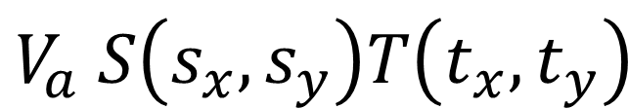
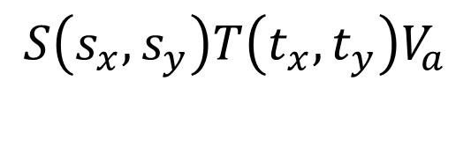
Reminder …
Transforms V_{a}
Translation (T) followed by
Scale (S)
Vertex is to the right of the operators!!
In our case (column vectors): the following is undefined!!
$$S\left(s_{x},s_{y}\right)T\left(t_{x},t_{y}\right)V_{a}$$
$$V_{a} S\left(s_{x},s_{y}\right)T\left(t_{x},t_{y}\right)$$

Slide 9
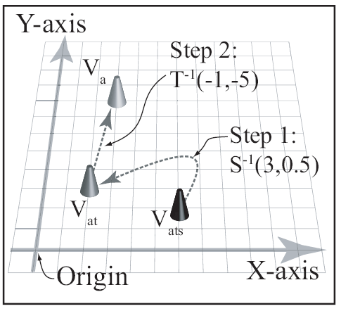
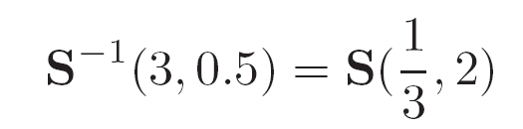




Inverse Transform: Undo
$$M_{a}=S T$$
$$M_{a}=S \left(3, 0.5\right) T(−1, −5)$$
$M_{a}^{−1}=T^{−1}$ $S^{−1}$

Slide 10
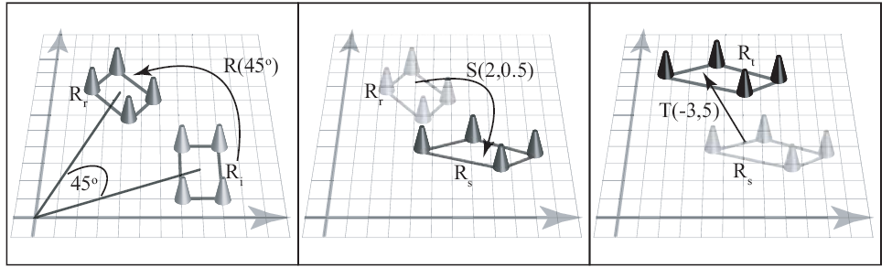

For example:
$$M_{n}=T S R$$
$$M_{n1}=T\left(−3, 5\right) S\left(2, 0.5\right) R\left(45\right)$$

Slide 11

Inverse of:
$$M_{n}=T S R$$
To undo (inverse):
If:
Then
Or:
$$M_{n}^{−1}={R^{−1}S}^{−1}T^{−1}$$
$$M_{n1}=T\left(−3, 5\right) S\left(2, 0.5\right) R\left(45\right)$$
$$M_{n1}^{−1}={R^{−1}(45)S}^{−1}(2, 0.5)T^{−1}\left(−3, 5\right)$$
$$M_{n1}^{−1}=R\left(−45\right) S\left(0.5, 1\right) T(3, −5)$$

Slide 12
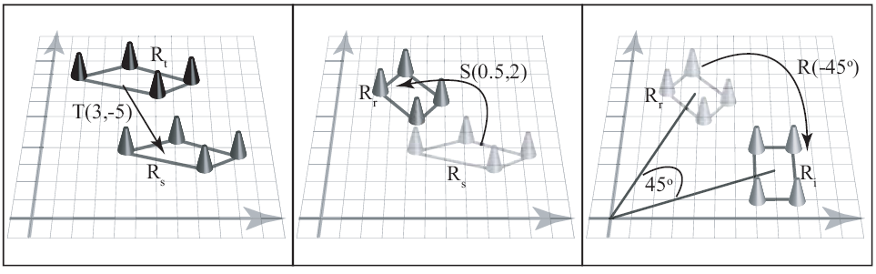


Inverse of:
$$M_{n}=T S R$$
$$M_{n1}=T\left(−3, 5\right) S\left(2, 0.5\right) R\left(45\right)$$
$$M_{n1}^{−1}=R\left(−45\right) S\left(0.5, 1\right) T(3, −5)$$

Slide 13
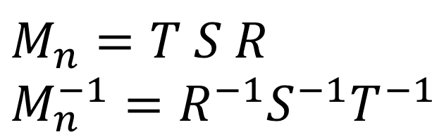
Inverse of concatenated operator
Apply the inverse in reverse order!
In general: Inverse is not unique
E.g., R(θ), inverse can be
R(-θ) or
R(-θ+360), or R(- θ+270) …
$$M_{n}=T S R$$
$$M_{n}^{−1}={R^{−1}S}^{−1}T^{−1}$$

Slide 14
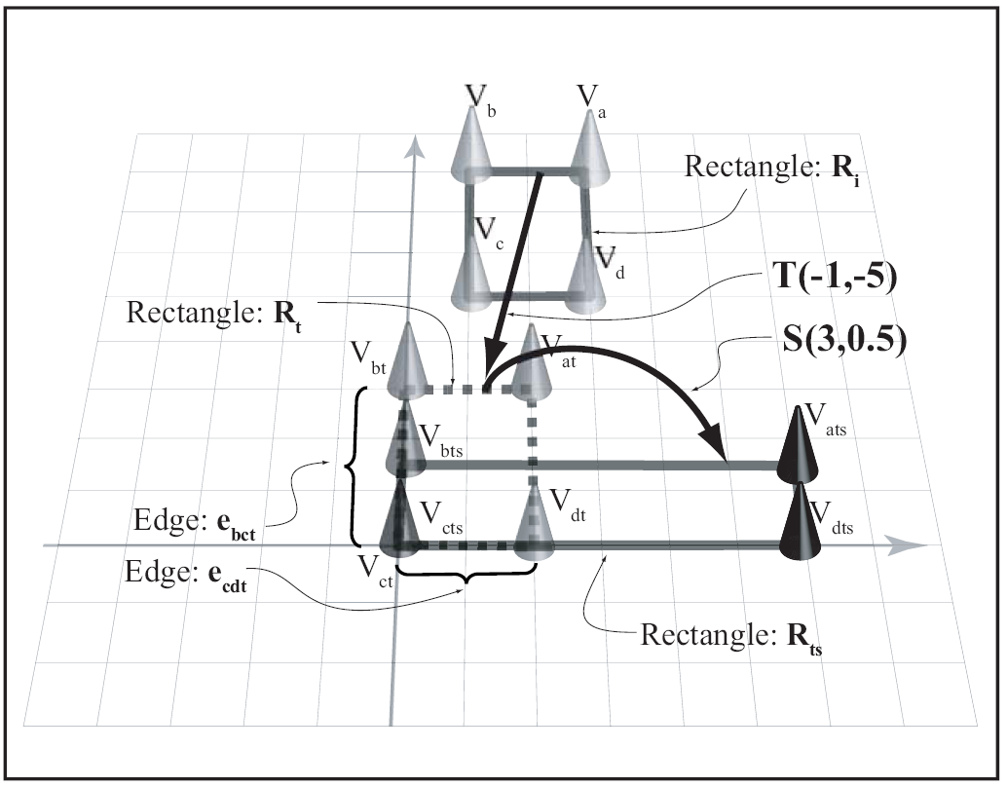
Combining Translation and Scaling
Translate before scale to
align vertex with origin
“anchor” the vertex
E.g., scale rectangle by S(3,0.5) with a fixed anchor (V_{c})

Slide 15

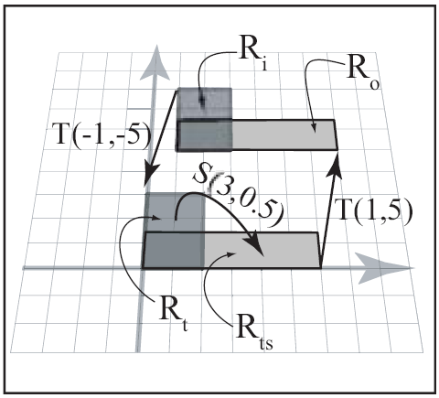

Pivoted Scaling:
Scaling with respect to
Pivot position:
E.g., scale rectangle with respect to pt=(1,5)
$$pt=\left[\begin{matrix}pt.x \\ pt.y\end{matrix}\right]$$
$$S_{pt}\left(s_{x},s_{y}\right)=T\left({pt}_{x},{pt}_{y}\right) S\left(s_{x},s_{y}\right) T\left({−pt}_{x},{−pt}_{y}\right)$$
$$S_{pt}\left(3,0.5\right)=T\left(1,5\right) S\left(3,0.5\right) T\left(−1,−5 \right)$$

Slide 16
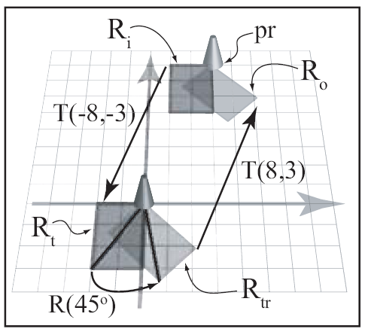

Rotation with Arbitrary Pivot
$$pt=\left[\begin{matrix}pt.x \\ pt.y\end{matrix}\right]$$
Pivot position:
E.g., rotate rectangle with respect to top-right corner (pr) pt=(8, 3)
$$R_{pt}\left(θ\right)=T\left({pt}_{x},{pt}_{y}\right) R\left(θ\right) T\left({−pt}_{x},{−pt}_{y}\right)$$

