Slide 1
Radiatus: a Shared Nothing Server-Side Web Architecture
Raymond Cheng William Scott, Paul Ellenbogen, Jon Howell, Franziska Roesner, Arvind Krishnamurthy, Thomas Anderson

Slide 2

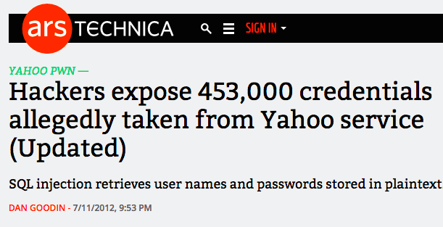
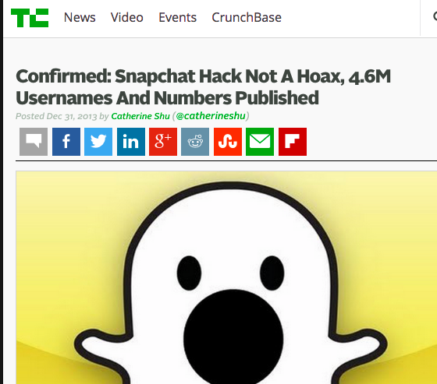
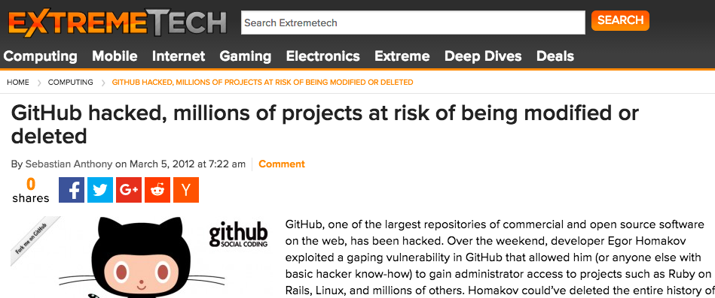
Problem: Websites Are Routinely Broken Into
Notes:
Resulting in:
Service disruptions
Defacement
Surveillance / Manipulate users
Massive data breaches
These are big problems
Average cost of data breach ~$5.4M
Yahoo – affect Verizon deal
JP Morgan hack – 76M accounts in 2014 – first got in from a 0-day on a public facing web server
Focus:
Remote exploits
Dangerous – anyone can mount from anywhere on the Internet
All stories above were the result of a remote exploit the website’s software

Slide 3
Traditional Architecture
Global Shared DB
Memcache
Sockets
Sockets
Sockets
Trusted Computing Base
Global Application Logic + Access Control + Authentication
Global Application Logic + Access Control + Authentication
Global Application Logic + Access Control + Authentication
Client
. . .
Server 1
Server 2
Server 3
Load Balancer
. . .
User A
User B
User C
User D
User E
User F
User G
User H
User I
Notes:
To understand Why?
Here is the architecture of nearly every web service out there
Clients (Orange) – can be serviced by any web server
Servers
Interpret HTTP request
Log user in
Retrieve content from database(s)
Assemble a page
Developer is responsible for properly handling requests
Administer access control
Prevent information leakage
Any error vulnerability in server-side logic => access to global data
Blue - trusted computing base
Remote code execution is particularly bad

Slide 4
Example: GitHub Key Update (2012)
class ProfileController < ApplicationController
…
# Server-side handler for # POST https://github.com/account/public_keys
def updateSshKey
@key = PublicKey.find(params[:id])
@key.update_attributes(params[:public_key])
end
…
end
http://homakov.blogspot.com/2012/03/how-to.html
Notes:
A typical bug: GitHub exploit 2012 This is server-side code
Callback triggered when user issues POST to URL
Update SSH key
““You might notice something is missing here”
White hat hacker gave himself commit access to the Ruby on Rails organization to protest them ignoring his report

Slide 5
Example: GitHub Key Update (2012)
class ProfileController < ApplicationController
…
# Server-side handler for # POST https://github.com/account/public_keys
def updateSshKey
@key = PublicKey.find(params[:id])
@key.update_attributes(params[:public_key])
end
…
end
Missing check for valid user
http://homakov.blogspot.com/2012/03/how-to.html
Notes:
Missing security checks
- Check if signed in / has cookie
Check the account associated with the cookie
Check validity of the cookie (IP address / session timeout)
Check if the public key attributes matched

Slide 6
Example: GitHub Key Update (2012)
class ProfileController < ApplicationController
…
# Server-side handler for # POST https://github.com/account/public_keys
def updateSshKey
@key = PublicKey.find(params[:id])
@key.update_attributes(params[:public_key])
end
…
end
Attacker can associate public_key with arbitrary user profiles
Application logic is part of the trusted computing base
Notes:
The user specifies param = (id,public_key)
Attacker uploaded key to the Ruby-on-Rails project

Slide 7
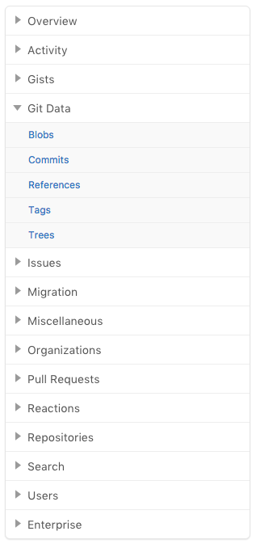
HTTP Interfaces Are Complex
GitHub Developer API: Git Data
GET /repos/:owner/:repo/git/blobs/:sha
POST /repos/:owner/:repo/git/blobs
GET /repos/:owner/:repo/git/commits/:sha
POST /repos/:owner/:repo/git/commits
GET /repos/:owner/:repo/git/commits/:sha
GET /repos/:owner/:repo/git/refs/:ref
GET /repos/:owner/:repo/git/refs
GET /repos/:owner/:repo/git/refs/tags
POST /repos/:owner/:repo/git/refs
PATCH /repos/:owner/:repo/git/refs/:ref
DELETE /repos/:owner/:repo/git/refs/:ref
GET /repos/:owner/:repo/git/trees/:sha
POST /repos/:owner/:repo/git/trees
Notes:
Now multiply these handlers by dozens, even hundreds
Intermingles authentication, user actions, and content fetching
Commonly both developer and user-facing HTTP handlers
Mistake in any could lead to wider compromise

Slide 8

Threat Model
Web Service
External Attacks
Craft arbitrary network requests
Out of scope:
Insider attacks
Attacks on the Client
Notes:
Threat Model
External Attacks – arbitrary network requests (e.g. code injection, SQL injection, path traversal, buffer overflows)
Not insider attacks
Attack flaws in server-side logic, not client-side logic e.g. XSS or CSRF

Slide 9

Radiatus
Shared-nothing server-side architecture for strongly isolating users in web applications
Sandboxed user containers for code and data
Challenges
Sharing data with other users
Storing data efficiently
Scaling
Notes:
Suppose we assign a sandboxed process on the server for every user?
- Call this a `user container`
Shared nothing
any server-side code running on behalf of a user runs in an isolated sandbox with only access to that user’s data
Limit impact of vulnerabilities – only access to the container for the users for which attacker has credentials
As a consequence, need to solve a set of other problems to make this architecture work:
- How do we restructure an application to support sharing and storing of data
- Compatible with scale
Analyze cost of this architecture

Slide 10
Traditional Architecture
Global Shared DB
Memcache
Sockets
Sockets
Sockets
Trusted Computing Base
Global Application Logic + Access Control + Authentication
Global Application Logic + Access Control + Authentication
Global Application Logic + Access Control + Authentication
Client
. . .
Server 1
Server 2
Server 3
Load Balancer
. . .
User A
User B
User C
User D
User E
User F
User G
User H
User I
Notes:
For reference
- Old system – shared everything through a database

Slide 11
Radiatus
Memcache
A
B
C
D
E
F
G
H
I
Guard
Guard
Radiatus API
Radiatus API
Radiatus API
Trusted Computing Base
Client
. . .
Sandbox
A
B
C
D
E
F
G
H
I
Server 1
Server 2
Server 3
User Router + Auth
. . .
User A
User B
User C
User D
User E
User F
User G
User H
User I
Notes:
Users are isolated into sandboxes –
All developer code runs in this sandbox
User:
Authenticates – explain user router
Triggers code in own user container
Stores to own partition- No access shared data – explain storage guard
Attacker:
User router: forwarder
Attacker’s packets are only routed to containers for which they have credentials

Slide 12
Radiatus
Memcache
A
B
C
D
E
F
G
H
I
Guard
Guard
Approach
Strong Isolation
Message Passing
Distributed Capabilities
Radiatus API
Radiatus API
Radiatus API
A
B
C
D
E
F
G
H
I
Server 1
Server 2
Server 3
User Router + Auth
User A
User B
User C
User D
User E
User F
User G
User H
User I
Notes:
Minimal Trusted Computing Base (blue)
user authenticator
user router
storage guard
container mechanism
How do we make functional applications under this architecture?
Imagine a service like GitHub where a lot of data is shared between users.
We introduce a cheap message passing mechanism based on distributed capabilities

Slide 13



Social Network
Alice’s User Container
Bob’s User Container
User Router
Alice
Passive Containers
Bob
Notes:
Passive Containers - Run identical copies of developer code
- User container only active when user online

Slide 14
Social Network: Authentication
Alice’s User Container
Bob’s User Container
User Router
Authentication
Authenticate
Alice
Limited Interfaces
Bob
Notes:
Limited Interfaces
Before access to any other interface
Must authenticate with user router
Get valid session cookie

Slide 15
Social Network: Frontend Interface
Alice’s User Container
Bob’s User Container
Upload
Frontend
User Router
Alice
Limited Interfaces
Bob
Notes:
Limited Interfaces
Requests are routed based on cookie

Slide 16
Social Network: Cross-Container
Cross-container
Bob’s User Container
Alice’s User Container
Send
Save
Typed Interfaces
{ title: ‘string’, author: ‘string’, timestamp: ‘number’, image: ‘buffer’
}
Alice
Bob
Notes:
Limited Interfaces
3rd interface only accessible to user containers
- RPC-like interface to send messages between user containers
- Requires developer declare the types of messages, which is enforced at runtime

Slide 17
Social Network: Frontend Interface
Alice’s User Container
Bob’s User Container
Save
User Router
Upload
Download
Alice
Bob

Slide 18
Social Network
Cross-container
Bob’s User Container
Alice’s User Container
Send
Save
Save
Upload
Download
Alice
Bob
Notes:
Extra programming overhead – as a consequence of the model
New attack surface that didn’t exist before
Have to design message interface defensively
We believe this to be less vulnerable compare to monolithic applications
Thin interface
Limited access (defense in depth)
Defer to paper for additional techniques used when user attacks their container
Goal: More secure, not perfectly secure

Slide 19
Distributed Capabilities
Alice’s User Container
cap = storage.set(k,data)
Bob.send(cap)
Bob’s User Container
Alice.on(“msg”,(cap)=>{
data = storage.get(cap);
...
});
Notes:
Sending copies between user containers would be expensive
Want to use a shared database
Send pointers
Need mechanism for access control – compatible with shared nothing

Slide 20
Distributed Capabilities
Alice’s User Container
cap = storage.set(k,data)
Bob.send(cap)
k, data, H(data, nonce)
Storage Guard
Owner | Capability
(user, k) | H(data, nonce)
… | …
Bob’s User Container
Capability | Data
H(data, nonce) | data
… | …
Alice.on(“msg”,(cap)=>{
data = storage.get(cap);
...
});

Slide 21
Distributed Capabilities
Alice’s User Container
cap = storage.set(k,data)
Bob.send(cap)
Storage Guard
Owner | Capability
(user, k) | H(data, nonce)
… | …
H(data, nonce)
Bob’s User Container
Capability | Data
H(data, nonce) | data
… | …
Alice.on(“msg”,(cap)=>{
data = storage.get(cap);
...
});

Slide 22
Distributed Capabilities
Alice’s User Container
cap = storage.set(k,data)
Bob.send(cap)
Storage Guard
Owner | Capability
(user, k) | H(data, nonce)
… | …
Bob’s User Container
Capability | Data
H(data, nonce) | data
… | …
Alice.on(“msg”,(cap)=>{
data = storage.get(cap);
...
});
data
Notes:
Capability provides proof of access, any storage guard can independently verify a capability
Database and application scale independently.
Deduplication by content hash
Transferring capabilities is cheap, regardless of the content size or number of users with access.
If a capability is granted to a malicious user, they cannot destroy the owner’s data.
Also mention deletion and revocation – refer to paper

Slide 23
Implementation
8674 lines on top of Node.js runtime
Linux containers for isolation
Storage guard for MongoDB
Message routers
Custom WebSockets-based server
AWS Simple Queue Service

Slide 24
Evaluation Overview
Security Analysis
Single-Server Throughput
Scaling
Notes:
How many severe web-related vulnerabilities would this architecture address?
What is the additional overhead imposed on a single server?
– now that each server may run many separate processes (one for each user)
How far can we push the scale of our applications?

Slide 25
Security Analysis
Analyzed all 40 of most severe web-related vulnerabilities in the National Vulnerability Database – in 2014
32 – Impact limited to single container
3 – Prevented entirely
4 – Delegated authentication
1 - Unclear impact
Notes:
2014 National Vulnerability Database – tracks software vulnerabilities
7316 entries
233 with max score = 10
Remotely exploitable
Low barrier to access
Requires no authentication
Total information disclosure
Complete loss of system integrity
Leads to total loss of availability
40 related to server-side web software
Manual analysis – translating vulnerabilities to Radiatus architecture
Does not account for potential vulnerabilities in cross-container interface
- A limitation of this security analysis, was that we were not able to validate types of vulnerabilities across the cross-container interface

Slide 26
Single Server Throughput
100 users – parallel requests
Simple counter web app
Notes:
Siege load testing tool
100 users making requests in parallel
Implement a counter application across a variety of frameworks
Response = HTML page of # cumulative requests (disable caching)
60.7% maximum overhead over Node.js baseline
Real applications would have less overhead.

Slide 27
Single Server Throughput
60.7% maximum overhead
Notes:
Siege load testing tool
100 users making requests in parallel
Implement a counter application across a variety of frameworks
Response = HTML page of # cumulative requests (disable caching)
60.7% maximum overhead over Node.js baseline
Real applications would have less overhead.

Slide 28
Scaling Radiatus
500 nodes on AWS EC2
Scale from 1-180K clients
Notes:
500 VMs on EC2 – r3.large (2 CPU, 15GB memory, 32GB SSD, $0.175/hr in 2015)
- 180,000 containers
- Each container performs an operation every 4-6 seconds
Messaging through AWS Simple Queuing Service
Read: read to personal storage partition
Write: sending a message between containers
- More expensive
Comparison: Wikipedia had 414M readers/mo, 100K editors/mo,
2000 HTTP requests/sec

Slide 29
Cost
Memory: 30.5MB per process
~$0.008 / user-year
Case Study: Facebook
2015 Revenue: $17.9B
$10-12/ user
Radiatus Additional Cost ~$200K / year
~26M concurrent users
Assuming $0.008 / user
Notes:
Cost: Memory 30.5MB per process
Assuming:
2015 DRAM prices
average server lifetime of 3 years
+ CPU overhead – Assume EC2 pricing (2 cores @$0.175/hour)
Users make 1000 req/day
differential CPU cost of handling requests in Radiatus versus Node.js from Figure 9
$0.008/user/year
Facebook – analyze worst case
- 968M daily active. 1.2B daily monthly
Use Little’s Law and some public numbers
Most web services will be smaller than this
Ponemon Institute
Average cost of a data breach - $5.4M

Slide 30
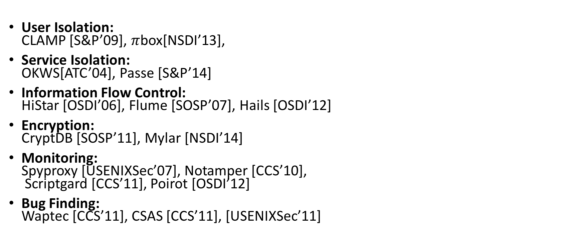
Related Work
User Isolation: CLAMP [S&P’09], $π$box[NSDI’13],
Service Isolation: OKWS[ATC’04], Passe [S&P’14]
Information Flow Control: HiStar [OSDI’06], Flume [SOSP’07], Hails [OSDI’12]
Encryption: CryptDB [SOSP’11], Mylar [NSDI’14]
Monitoring: Spyproxy [USENIXSec’07], Notamper [CCS’10], Scriptgard [CCS’11], Poirot [OSDI’12]
Bug Finding: Waptec [CCS’11], CSAS [CCS’11], [USENIXSec’11]
Notes:
Much research in securing web applications
Most of these techniques are compatible, represent a defense in depth solution to security.
Service Isolation:
Break apart a web app into many isolated services (e.g. search, shopping cart)
Already done today in service-oriented architectures
IFC – limit flow of information
Encryption – hide contents, even if database is leaked
Monitoring – monitor for anomalous behavior
Bug Finding – automatically search for bugs
User Isolation
CLAMP – Isolated code execution, but not data
Pibox – Looked at sandboxes that span a mobile device and web server – privacy
Single machine implementations
Expand on User Isolation – Architecture that is compatible with scale – 500 nodes on EC2
Analyze cost of this architecture
All developer code runs in this sandbox

Slide 31
Radiatus
Shared-nothing server-side architecture for strongly isolating users in web applications
Prevents large-scale exploitation of the most severe web-related vulnerabilities of 2014
Modest overhead over existing web servers
Demonstrate scaling to a 500-node cluster
Notes:
We propose an alternative architecture for web applications
Strongly isolate users in deprivileged sandboxes
Demonstrate that it prevents the most severe web-related vulnerabilities
modest overhead
compatible with scaling
With the prevalence of security attacks on websites: It’s time to rethink how we code websites

Slide 33
Appendix

Slide 34
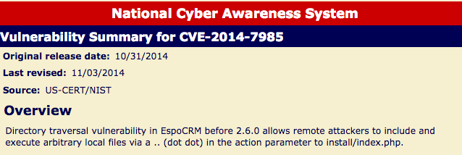
Notes:
These types of problems are common.
Analyzed National Vulnerability Database from 2014
- Hundreds of instances of these kinds of bugs
Execute arbitrary shell commands specified by user

Slide 35
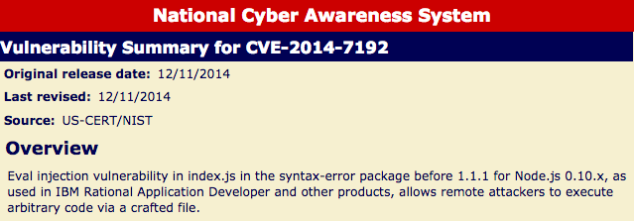
Notes:
Passes user input into a JavaScript `eval` - code injection

Slide 36
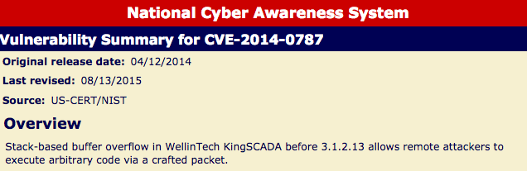
Notes:
Buffer Overflow

Slide 37
Social Network
Alice’s User Container
Bob’s User Container
Send
Save
Save
Upload
Download
Alice
Bob
Notes:
Extra programming overhead – as a consequence of the model
New attack surface that didn’t exist before
Have to design message interface defensively
We believe this to be less vulnerable compare to monolithic applications
Thin interface
Limited access (defense in depth)
Defer to paper for additional techniques used when user attacks their container
Goal: More secure, not perfectly secure

Slide 38

Cross-Container Communications
Alice
Bob
Typed Interfaces
Limited connectivity
Resource Limits
User Eviction
Charlie
Notes:
Let’s assume that developer
1. gets user’s credentials
2. Finds code injection vulnerability
Only then has access to this interface

Slide 39
Distributed Capabilities
Alice’s User Container
cap = storage.set(k,data)
Bob.send(cap)
k, data, H(data, nonce)
Storage Guard
Owner | Capability
(user, k) | H(data, nonce)
… | …
H(data, nonce)
Bob’s User Container
Capability | Data
H(data, nonce) | data
… | …
Alice.on(“msg”,(cap)=>{
data = storage.get(cap);
...
});
data

Slide 40
Distributed Capabilities: Deletion
Alice’s User Container
storage.delete(k,data)
Storage Guard
Owner | Capability
(user, k) | H(data, nonce)
… | …
Bob’s User Container
Capability | Data
H(data, nonce) | data
… | …
Alice.on(“msg”,(cap)=>{
data = storage.get(cap);
...
});
Notes:
Capability provides proof of access, any storage guard can independently verify a capability
Database and application scale independently.
Deduplication by content hash
Transferring capabilities is cheap, regardless of the content size or number of users with access.
If a capability is granted to a malicious user, they cannot destroy the owner’s data.

Slide 41
Distributed Capabilities: Revocation
Alice’s User Container
cap = storage.revoke(k)
Bob.send(cap)
k, H(data, newN)
Storage Guard
Owner | Capability
(user, k) | H(data, nonce)
(user, k) | H(data, newN)
… | …
Bob’s User Container
Capability | Data
H(data, newN) | data
… | …
Alice.on(“msg”,(cap)=>{
data = storage.get(cap);
...
});
Notes:
Capability provides proof of access, any storage guard can independently verify a capability
Database and application scale independently.
Deduplication by content hash
Transferring capabilities is cheap, regardless of the content size or number of users with access.
If a capability is granted to a malicious user, they cannot destroy the owner’s data.

Slide 42
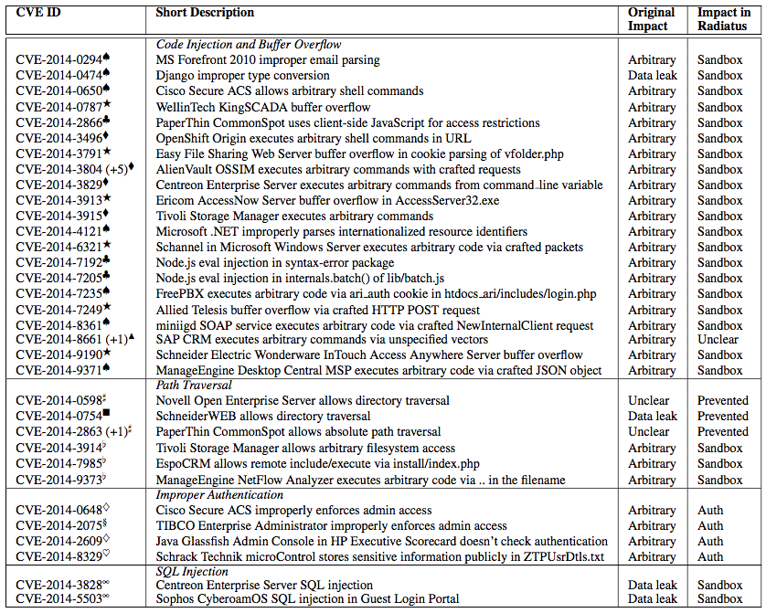
Security Analysis
Notes:
2014 National Vulnerability Database
7316 entries
233 with max score = 10
Remotely exploitable
Low barrier to access
Requires no authentication
Total information disclosure
Complete loss of system integrity
Leads to total loss of availability
40 related to server-side web software
Tags
Arbitrary = arbitrary code execution, service disruption, information disclosure
Data Leak = lead data, not run code
Prevented
Sandbox = limited to single user’s container
Auth = app developer delegate authentication to Radiatus
Top Categories
Code execution (27) – buffer overflow, code injection (e.g. eval), shell commands
Path Traversal (7) - ../
Improper Authentication (4) – Missing access control checks for privileged actions
SQL Injection (2) – Parameterized client libraries really reduced this
From 1476 vulnerabilities in 2008
Cross-site scripting
Most common web vulnerability
None with most severe score
use Content Security Policies
Cross-container communication
Still possible if hijack a user container
Have to design message interface defensively
Defense in Depth – enforce types, resource limits, limit network graph, evict bad actors, monitoring

Slide 43
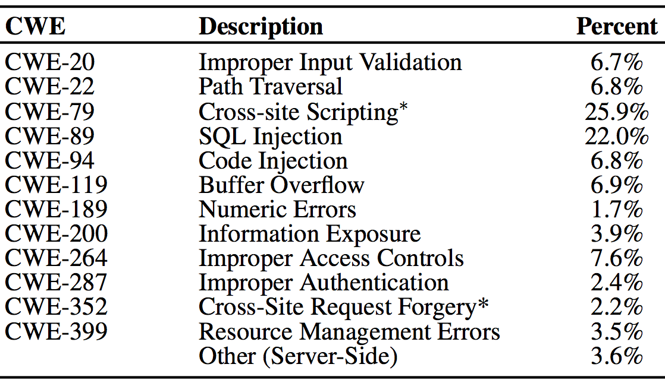
National Vulnerability Database

Slide 44
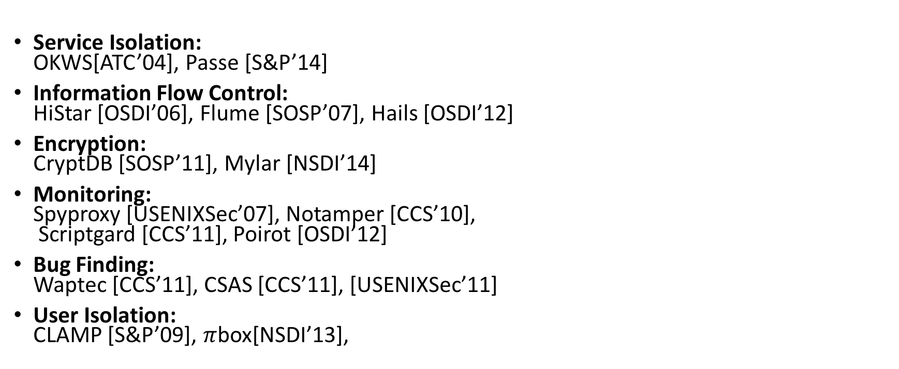
Related Work
Service Isolation: OKWS[ATC’04], Passe [S&P’14]
Information Flow Control: HiStar [OSDI’06], Flume [SOSP’07], Hails [OSDI’12]
Encryption: CryptDB [SOSP’11], Mylar [NSDI’14]
Monitoring: Spyproxy [USENIXSec’07], Notamper [CCS’10], Scriptgard [CCS’11], Poirot [OSDI’12]
Bug Finding: Waptec [CCS’11], CSAS [CCS’11], [USENIXSec’11]
User Isolation: CLAMP [S&P’09], $π$box[NSDI’13],
Notes:
Much research in securing web applications
Service Isolation:
Break apart a web app into many isolated services (e.g. search, shopping cart)
Already done today in service-oriented architectures
IFC – limit flow of information
Encryption – hide contents, even if database is leaked
Monitoring – monitor for anomalous behavior
Bug Finding – automatically search for bugs
Most of these techniques are compatible, represent a defense in depth solution to security.
User Isolation
CLAMP – Isolated code execution, but not data
Pibox – Looked at sandboxes that span a mobile device and web server – privacy
Single machine implementations

