Slide 1
Kineograph: Taking the Pulse of a Fast-Changing and Connected World
Raymond Cheng, Ji Hong, Aapo Kyrola, Youshan Miao, Xuetian Weng, Ming Wu, Fan Yang, Lidong Zhou, Feng Zhao, Enhong Chen
University of Washington
Microsoft Research Asia
Carnegie Mellon University University of Science and Technology of China
Fudan University
Peking University

Slide 2



It is the Age of Real-Time Data
Departure from traditional static web pages
New time-sensitive data is generated continuously
Rich connections between entities
Goal: Compute Global Properties on the Changing Graph
Notes:
Data: i.e. tweets, status updates, location checkins, likes, dislikes
Entities: i.e. people, locations, topics, organizations

Slide 3
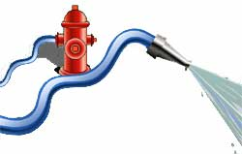
Example: Mention Graph
Alice:
You should see this @bob @carol
Alice
…
…
2
1
3
Bob
Carol
Notes:
Mentions have stonger social context, but time-sensitive
Weight newer mentions higher
Tweet consists of multiple updates to different vertices in the graph
Edge weights decay over time
High rate of change

Slide 4
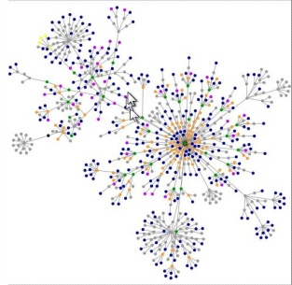
Example: User Ranking over Mention Graph
Influence Ranking
Rank | Twitter Handle
1 | justinbieber
2 | addthis
3 | foursquare!
4 | ladygaga
5 | kanyewest
Timeliness
t
Notes:
Timeliness – End-to-end time from tweet entering system, to being reflected in computed result set
Important for certain applications (i.e. news, search)

Slide 5
System Challenges
High rate of graph updates
Consistent graph structure
Static graph mining algorithms
Timely results reflecting graph updates
Fault tolerant
Notes:
October 2011 – Facebook: 1 billion pieces of shared content per day, Twitter: 200 million tweets per day

Slide 6
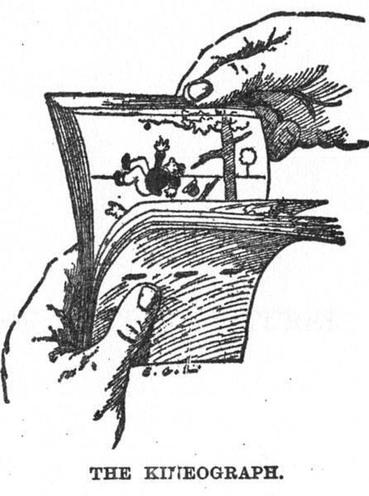
Kineograph
Scalable and fault-tolerant system for nearline graph mining
Built-in support for incremental computation
Kineograph API
Examples:
InfluenceRank
Approximate all-pairs shortest paths
K-exposure
Epoch Commit Protocol
Separation of graph construction from graph computation
Zeitgenossische Illustration (1886)
Notes:
Developers write arbitrary graph mining algorithms in terms of 4 short functions
Kineograph handles parallelism, consistency, scalability, fault tolerance
and periodically returns updated results
Supports static graph algorithms by operating over a snapshot
Kineograph is a term for an early flipbook

Slide 7
Graph Update / Compute Pipeline
Multiple data sources
Serializable order of graph operations
Tweet Transaction of graph operations
Limitation: No cross-partition dependencies
Snapshot consistency
Atomic transactions
Consensus on set of updates and ordering between snapshots
Incoming Tweets
…
…
Time
Snapshot Construction
S_{i-1}
S_{i}
S_{i+1}
Graph Computation
Epoch
C_{i}
t_{i-1}
t_{i}
t_{i}’
t_{i}’’
Timeliness
Notes:
Atomic,Consistent,Isolation,Durable

Slide 8
System Overview
Master
Progress table
Continuous Data feeds
Ingest nodes
Snapshooter
Graph nodes
Global consistent snapshots
Graph Storage
Computation
Incremental computation on a static graph snapshot
Notes:
Fault-tolerance
Snapshots and updates: Quorum-based replication
Computation: Primary/backup of checkpoints and recompute
Master: Using traditional mechanisms (i.e. Zookeeper)

Slide 9
Epoch Commit
Progress table
3
s₁
1
2
0
…
…
Global tx vector
3
s_{n}
7
Ingest nodes
s₁
…
s_{n}
4
Snapshooter
No locking mechanisms required for global order
Defer ordering decisions to master snapshooter
Partition u
Partition v
1
2
4
s₁
2
3
5
s₁
Graph nodes
…
…
…
Epoch specified by progress table and snapshooter
4
6
7
s_{n}
5
6
8
s_{n}
Notes:
Each ingest node maintains a local sequence number
Progress table reflects which tweets have been committed into the system for each ingest node
Vertices of graph are partitioned across logical partitions
Each partition stores a log for each ingest node
1.) Ingest node preprocesses incoming data
2.) Forwards individual vertex/edge updates to respective paritition
3.) Updates progress table upon ack
4.) At the end of an epoch, snapshooter forwards global transaction vector to graph nodes
5.) Apply updates up to the global transaction vector boundary

Slide 10
Incremental Graph Computation
Updates from other vertices
N
Change Significantly?
Detect Vertex Status
Compute New Vertex Values
Init
Graph-Scale Aggregation
Propagate Updates
Y
Notes:
Vertex-based iterative propagation
Vertices store dirty bit – monitored for changes
Computed results are stored with the snapshot

Slide 11
Programming with Kineograph
UpdateInfluence (v) { //event handling callback for a vertex
val newRank = (1+p*v[“influence"]) / v.numOutEdges()
foreach(e in vertex.outEdges()) {
val oldRank = v.(”influence", e.target)
val delta = newRank - oldRank
if (|delta| > threshold)
v.pushDeltaTo(“influence", e.target, delta)
} //pushDeltaTo propagates changes to other vertices
} //UpdateInfluence() triggered at changed vertices only

Slide 12
Evaluation
System implementation
Platform LoC: 16K~ C#
3 Apps LoC: 1.5K~ C# (Influence Rank, approximate all-pair shortest path, hashtag-histogram)
40+ servers, 1-week Tweets (~100M tweets)
Key performance numbers
Graph update rate: up to 180K tweets/s, 20+ times more than Twitter peak record (Oct.2011)
Influence Rank average timeliness over 8M vertices, 29M edges: ~2.5 minute
Notes:
Demonstrated high throughput exceeds requirements for Twitter
Evaluation did not hit the performance bottleneck yet

Slide 13
Graph Update Throughput
200000
K-Exposure
175000
Influence
SP
150000
2PL
125000
Throughput (tweets/s)
100000
75000
50000
25000
2
4
8
16
Number of Ingest Nodes
Notes:
Fixed 32 graph nodes, 10 sec. epoch
Throughput = highest rate of updates we can include into snapshots
Graph nodes perform both snapshot creation and graph computation – contending for resources
More complex computations reduces throughput
Scales non-linearly – Load imbalance problem
Some graph nodes get more updates and take longer to produce snapshot
Less of an issue with longer epoch windows
2PL line – no computation, just updates into graph
Does not scale due to lock contention

Slide 14
Incremental vs. Non-Incremental Computation
Non-Incremental
Incremental
Average Timeliness (s)
K-Exposure
Influence
SP
Application
Notes:
Fixed 32 graph nodes, 4 ingest nodes
Implemented over same Kineograph API for both non-incremental and incremental
Non-incremental recomputes all results after snapshot

Slide 15
Failure Recovery
Notes:
Property of separate fault tolerance mechanisms
Failure at t0
Snapshot creation and throughput unaffected as there are multiple replicas
New node recovers silently until it has caught up
Computation is not replicated
Need to roll back to previous checkpoint
By that time, multiple epochs may have passed
Batch missing epochs into a larger delta for incremental computation
Batch fewer and fewer epochs in subsequent rounds until computation has caught up
Full recovery time: order of couple minutes

Slide 16
Contributions
Kineograph
A system that computes timely results on a fast changing graph
Separate graph update mechanism that supports high-throughput graph update and produces consistent snapshots
An efficient graph engine that supports incremental computation
Implementation validates design goals
More than 100k sustainable update throughput and 2.5-minute timeliness with 40 machines

Slide 18
Fault Tolerance
Ingest node failure
Each ingest node i assigns an incarnation number along with each tx no. [c_{i}, s_{i}] and marks it in the global progress table
A resurrected ingest node i seals c_{i} at s_{i}, and uses new incarnation number c_{i}+1: any op [c_{i}, s] (s > s_{i}) is discarded
Graph node failure
Graph data : quorum-based replication, i.e., graph updates sent to k replicas and can tolerate f failures (k >= 2f+1)
No replication during computation: rollback and re-compute; computation results are replicated using primary backup
Others: Paxos-based solution
Maintain progress table, coordinate computation, monitor machines, tracking replicas, etc.

Slide 19
Snapshot Consistency
Guarantee atomicity
All or none of the operations in a tx are included in a snapshot
Global tx vector
A consensus on the set of tx to be included in a global snapshot
Applying graph updates
Impose an artificial order within the set of tx: e.g., apply ops of s₁ first, and s₂, and so on.
Assumption: cross-partition ops do not have causal dependency

Slide 20
Applications
Graph construction by extracting tweets
Mention graph: A @ B: A->B
HashTag graph: U posts a tweet that has #tagA: U->tagA
Influence Rank: computing user influence
Calculate “PageRank” on a mention graph
Approximate shortest paths
Shortest path between two vertices S(A,B): S(A, LandmarkA)+S(B, LandmarkB)
K-Exposure: calculating hashtag exposure histogram (WWW’11)
If at time t user U posts a tweet S containing hash tag H, K(S) is the number of U’s neighbors who post tweets containing H before t

