Slide 1
FreeDOM a New Baseline for the Web
Raymond Cheng
Will Scott
Arvind Krishnamurthy
Tom Anderson
University of Washington
Notes:
- low cost scaling to web developers
A project that we've coined FreeDOM, which we hope this presentation will change the way you look at the web.

Slide 2
Position
Free services should be free
Notes:
- Possible to architect your web app in a way such that it doesn't cost you anything
- Where services are supported by resources from the user community
- Where services can build off of each other in a rich ecosystem of free services,
much like how GNU/Linux encouraged an ecosystem of free software.

Slide 3


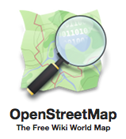
Free Services Are Great…
For everyone
Individuals
Education
Society
Research
Businesses
… but the cost of survival is high
Expose data
Expose software
Expose service
Notes:
- Free services do exist, indispensible contributions to our society
- Encourage more sites like this to exist
- Cost of survival is quite high
- Responsibility of provider to scale infrastructure to meet demand
- Write a small app, lose a little money, write a viral app, lose a lot of money

Slide 4
Wikimedia Expenses (2011-2012)
Department | Annual Cost ($M)
Core Site Operations | $5.13M ($5.99M in 2013)
Engineering | $6.77M
Notes:
86 Squid Cache
204 Apache2
20 Search
30 DB
8 Media Servers

Slide 5
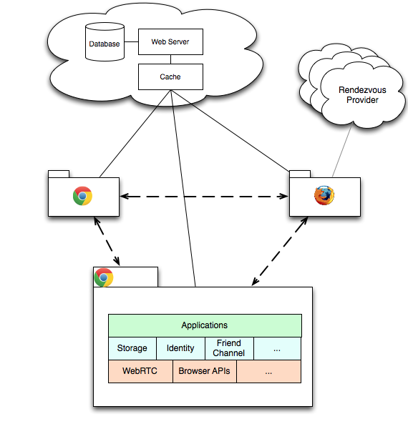
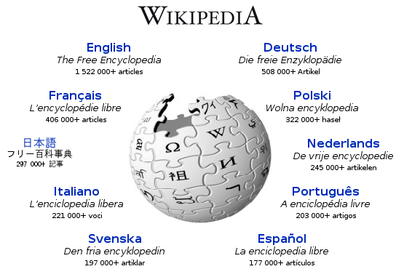
Enabling Technologies
P2P Browser support
Direct comm. (WebRTC)
Direct execution (NaCl)
Enables pervasive P2P web apps
Instant deployability
Aligns incentives
Notes:
- New technologies in town
- Putting all chips into the web, gain the benefits
- Incentives - no need to rely on ad revenue to support service

Slide 6
FreeDOM Vision
Introduce a new model for building low-cost, community-supported web applications
Self-Scaling Infrastructure
Push application logic to clients
Leverage bandwidth among peers
Enable New Applications
Browser-based overlay networks
Privacy-preserving web services
Hybrid cloud-P2P architectures
Notes:
- Instead of thinking about just P2P or server-client, hybrid

Slide 7
Challenges
Ephemeral Clients
How do we leverage many ephemeral clients?
Performance
What are the limits on interactivity in browser-based computation?
Security/Privacy
Can we provide user control over their data and usage?
Notes:
- How can we build services that effectively leverage clients,
when code only runs during the brief time when someone is on a page?

Slide 8
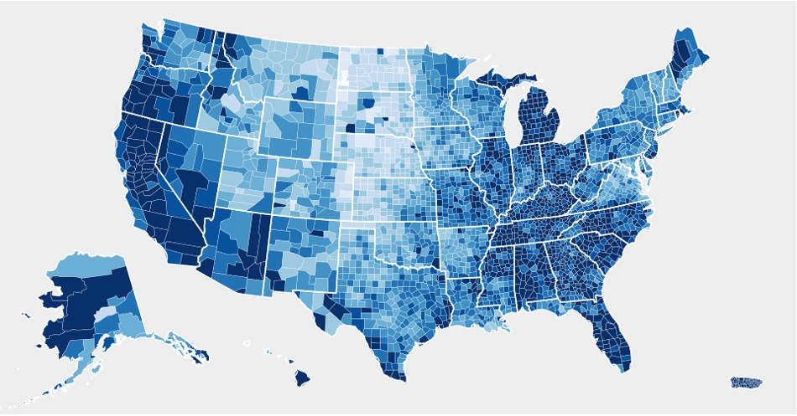
Example: Public Databases
DB
DB
Data
DB
SELECT * FROM …
Apache
Apache
Apache
GET
Notes:
- Let's take something you would never expect to run in a browser and do it
Databases
- Describe instances
- All of this needs to scale with the number of users, because we treat browsers as dumb clients
- Describe flow

Slide 9
Execution Model
Server-Client Model
Web Server
Assembles data and presentation for the client
Acts as a middleman for dynamic updates (AJAX)
Browser
Renders UI
FreeDOM Model
Web Server
Serves code and layout
Tracks information flows
Browser
Code coordinates where and how clients can access data
Renders UI

Slide 10
Collaborative WebDB
Apache
Seed DB
Rendezvous
GET
viz.html
- sqlite.js
Query Execution / Optimization
Buffer Pool
Webpage
Chrome Extension
WebRTC-like Interface
Notes:
- Read-only static database management system
- Apache just serves the webpage and code that will be run in the user's browser.
- Includes sqlite.js - describe it
- Runs in an untrusted sandbox - like any other webpage

Slide 11
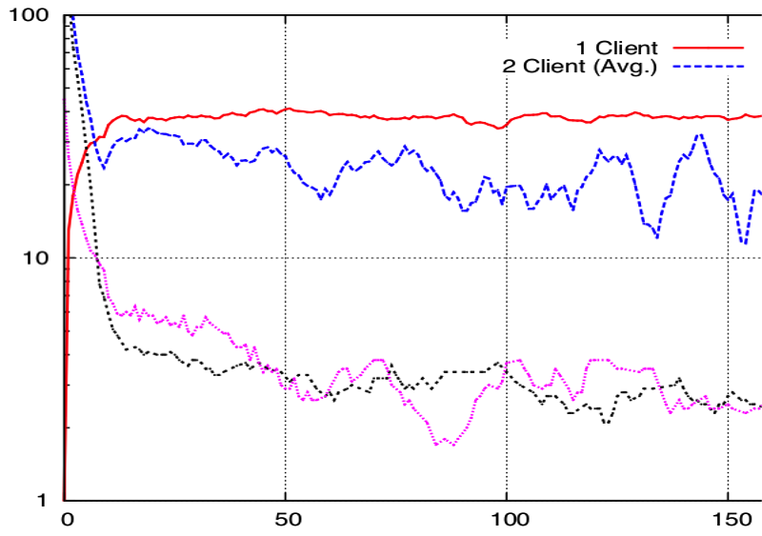
Client-Side Query Execution
100
1 Client
2 Clients (Avg)
Throughput (QPS)
10
1
0
50
Time (s)
100
150
Good client performance
Server load drops by over an order of magnitude
Notes:
- Evaluate Collab WebDB under stress
- 1GB DB from TPC-H benchmark
- Synthetic client workload - model a user browsing a catalogue in online store
- Plot throughout LOG SCALE over time
- Clients could execute about 30QPS
in Javascript, if NaCl, likely faster
- Server's load drops over time as expected, as more pages are cached on clients
- Add second client - server load remains almost unchanged
Sublinear scaling costs
- Overhead of P2P communications
Ought to get better with WebRTC

Slide 12



FreeDOM Platform
Alternative to the datacenter-centric cloud model
General API
User-controlled Data
Composable Services
Applications
Identity
Reliable Storage
Messaging
Updates
Public Key
DHT
XMPP
HTTP
Notes:
- How to generalize the platform in order to support a variety of different web apps
- What won't the browser do for itself?
Server-client driven model
- API - Identity, reliable storage, messaging, updates
- Applications don't have to worry about which provider
- Different possible providers for each API
i.e. photo sharing app
- Questions
- What information flows need to be protected?
- What is the right way to ask permission from user?
- How do we give users enough insight into how their machine is used to protect themselves from conducting illegal activities?
- What primitives need to be in place for web apps to be more easily composable?

Slide 13
Applications
Distripedia: A user powered wiki
Privacy-Preserving Social Network
InstaCDN
Private content distribution networks with instant deployability
P2P Bridge Routing
Anti-censorship in the browser

Slide 14
Conclusion
Free services should be free
Introduced FreeDOM, an alternative model for building low-cost community-supported web apps
Demonstrated the feasibility and benefits of this model with Collaborative WebDB
Notes:
- Working on making free services free
- Opportune time - power in the browser and new standards

