Slide 1
Redefining Artificial Superintelligence
From Mystified Genius to Observable Conditions
Franny Philos Sophia
Elanare Institute
ORCID 0009-0004-7089-5265 · franny.philos.sophia@elanare.jp
SiC26 · Day 1, Session 1: Defining and Evaluating Superintelligence
9 September 2026
Preprints on Zenodo. All footnoted DOIs refer to preprints unless otherwise noted.

Slide 2
Agenda
Where This Talk Goes
The problem with the question
What the frontier requires
1. The Genius Problem and IQ
— The baseline we measure “super” against was never measured
2. Critique of Existing Definitions
— Bostrom, Legg & Hutter, Chollet, Goertzel — why each fails
3. Four Conditions and Discussion
— Two are already met. The other two are the actual frontier
4. Defining ASI
— Continuous novel discovery, not speed and not accuracy
5. What Is AGI?
— General means reframing — and reframing costs controllability
6. The Path to Scientific Creativity
— Why a system cannot verify its own novelty from the inside
7. Synthesis
— One possible design, and what it needs from the physical world
2

Slide 3
About the Author
Published (3) · Under review (10), 1-3
Under review (10), 4-10
— AI & Ethics (Springer) — The logic trap: How LLM "Helpfulness" becomes a mechanism of psychological harm (doi.org/10.1007/s43681-026-01148-6)
— CACM — The Centaur Is Not Dying. It Is Stratifying. Why the Chess Analogy Fails for the Software Industry — and Every Industry That Follows (in press; zenodo.18733027)
— JBMT — Brachiation-based movement as a theoretical framework for addressing technology-related postural dysfunction: An evolutionary and neuromuscular perspective (doi.org/10.1016/j.jbmt.2026.03.008; PubMed 42264802)
— JAGI — The Control Impossibility: From Reframing Asymmetry to Constitutional Architecture (zenodo.19943538)
— CACM — Beyond Executable Governance: Why Encoding Rules Cannot Replace Knowledge Cycles in AI-Assisted Development (zenodo.19429152)
— TLO — The SECI Model in Practice: The Knowledge Creation Architecture Embedded in Scrum (zenodo.21293879)
— New Ideas in Psychology — Brain Interoception: The Missing Organ on the Interoceptive Map (zenodo.19942221)
— Erkenntnis — Emergence Without the Dichotomy (zenodo.21319707)
— PEPE — From Fugitive Cash to Non-Fugitive Provisioning: The Mundellian Trilemma, External Debt Feedback, and the Design Space of Post-Employment Redistribution (zenodo.21759090)
— SHPS — Dynamic Emergence: A Unified Theory Based on the Stuart-Landau Equation (zenodo.18074645)
— SHPS — Lost Abduction and Epistemic Barriers: Toward a Completion Model of Science Communication (zenodo.20005937)
— BioSystems — From Instability to Active Inference: A Unified Mathematical Framework for Biological Self-Organization across Scales (zenodo.18017028)
— Neural Computation — When the Manifold Collapses: A Geometric Theory of Constraint Conflict in Large Language Models (zenodo.20642039)
Independent researcher, Japanese, Software Engineer · 2E (Twice Exceptional) / ADHD / ASD · ORCID 0009-0004-7089-5265
3

Slide 4
1. The Genius Problem and IQ
The Mystification of Genius
IQ rankings have mystified genius
Von Neumann ~190, Ramanujan ~185+ are extrapolations from biographical anecdote, not measured values
Numbers that were never measured and cannot exist on the scale are assigned without evidence and take on a life of their own
Processing Speed Contamination. doi.org/10.5281/zenodo.19105953 · Who Are We Testing?. doi.org/10.5281/zenodo.17745229
4

Slide 5
Genius as Outlier
Genius has been elevated to authority, made taboo, and mystified
Or excluded from research to protect the certainty of established findings
Treated as an outlier that is not a research subject in the first place
— Von Neumann: could not analyze quantum phenomena without macroscopic analogies. Describable as constraint conditions when observed as-is
— Ramanujan: abductive hypothesis generation + brute-force computation. Not mystery but a describable process
— Leibniz: systematic formalization of existing infinitesimal methods
— Aristotle: categorical organization of observational data across domains
5

Slide 6
A Goal That Does Not Exist
Claiming to “surpass” something that has not been analyzed is a trivialization of reality
“Surpassing the best human minds” has no baseline — it is undefinable
Human cognitive ability has no fixed upper bound
We are chasing a goal that does not exist
6

Slide 7
2. Critique of Existing Definitions
Bostrom: Already Achieved Conditions and a Metaphor
Three categories: Speed / Collective / Quality
Speed and Collective are already achieved (though Bostrom's definition conflates processing throughput with cognitive capability range. Isolate speed as pure throughput and it is already achieved)
Quality is a metaphor (“the kind of superiority humans have over animals”), not a definition
“Greatly exceeds human performance in virtually all domains” has no boundary conditions
Redefining Artificial Superintelligence — https://openreview.net/forum?id=lLWeptkTPH
7

Slide 8
Legg & Hutter: A Definition That Cannot Be Computed
Expected reward across all computable environments, weighted by algorithmic complexity
Incomputable by the authors' own admission
Ignores resources. A definition that cannot be computed is not a definition
8

Slide 9
Chollet: Calling Infant Learning Intelligence
Skill-acquisition efficiency = intelligence
ARC benchmark is restricted to Spelke's Core Knowledge (the cognitive endowments of human infants)
Equates infant-level pattern extraction with intelligence as such
The definition was reverse-engineered to match the benchmark
9

Slide 10
Goertzel: AGI Does Not Scale Into ASI
A metaphysical discussion modeled on human intelligence (pre-LLM, 2007)
Treats AGI → self-improvement → ASI as a continuum
Treats capability as a scalar value — assumes ASI lies at the far end of quantitative improvement
AGI and ASI are qualitatively different: reframing (adaptation) vs. abduction (generation)
Acknowledges embodied learning and the symbol grounding problem, which deserves credit. But does not resolve it
Intention Without Causation. doi.org/10.5281/zenodo.19234682 · The Conservation Demarcation. doi.org/10.5281/zenodo.21000863
10

Slide 11
3. Four Conditions and Discussion
Calibrating the Definition
The human reference frame is not abandoned (“super” is a relational predicate)
But “surpass the best of humanity” is undefinable and therefore unreachable
Move the boundary conditions from the human upper limit to the current capability limits of AI
Because Speed and Collective are already resolved, the remaining gaps become specifiable
This decomposition was impossible in 2014. It is possible now, in 2026
Redefining Artificial Superintelligence — https://openreview.net/forum?id=lLWeptkTPH
11

Slide 12
The Four Conditions
SPEED
Processing speed exceeds human cognition by orders of magnitude
✓
ACHIEVED
COLLECTIVE INTELLIGENCE
Cross-domain knowledge integration is already achieved
✓
SCIENTIFIC CREATIVITY
Cannot generate or validate novel hypotheses
✗
GENERAL WISDOM UNDER COMPLEXITY
Judgment breaks down in complex situations
✗
FRONTIER
Redefining Artificial Superintelligence — https://openreview.net/forum?id=lLWeptkTPH
12

Slide 13
No Abduction, No Creativity
Solving existing unsolved problems = deduction. Valuable, but not creativity
Extracting patterns from large datasets = induction. Valuable, but not creativity
Creativity = posing a question nobody has asked, from an observation nobody has framed
Abduction (Peirce): the only inference that introduces a new idea
Lost Abduction and Epistemic Barriers: Toward a Completion Model of Science Communication (SHPS, under review). doi.org/10.5281/zenodo.20005937
13

Slide 14
Scaling Is Dead
Scaling cannot achieve Condition 3 or Condition 4
Parameter scaling hit a ceiling → inference-time scaling → chain-of-thought → increased reasoning steps per request
Workflows, agents, tool calls — things users previously implemented via API — are now wrapped into the model's outer shell
All mixed together, details undisclosed, benchmarks reported as improved
Why this fails is explored later
14

Slide 15
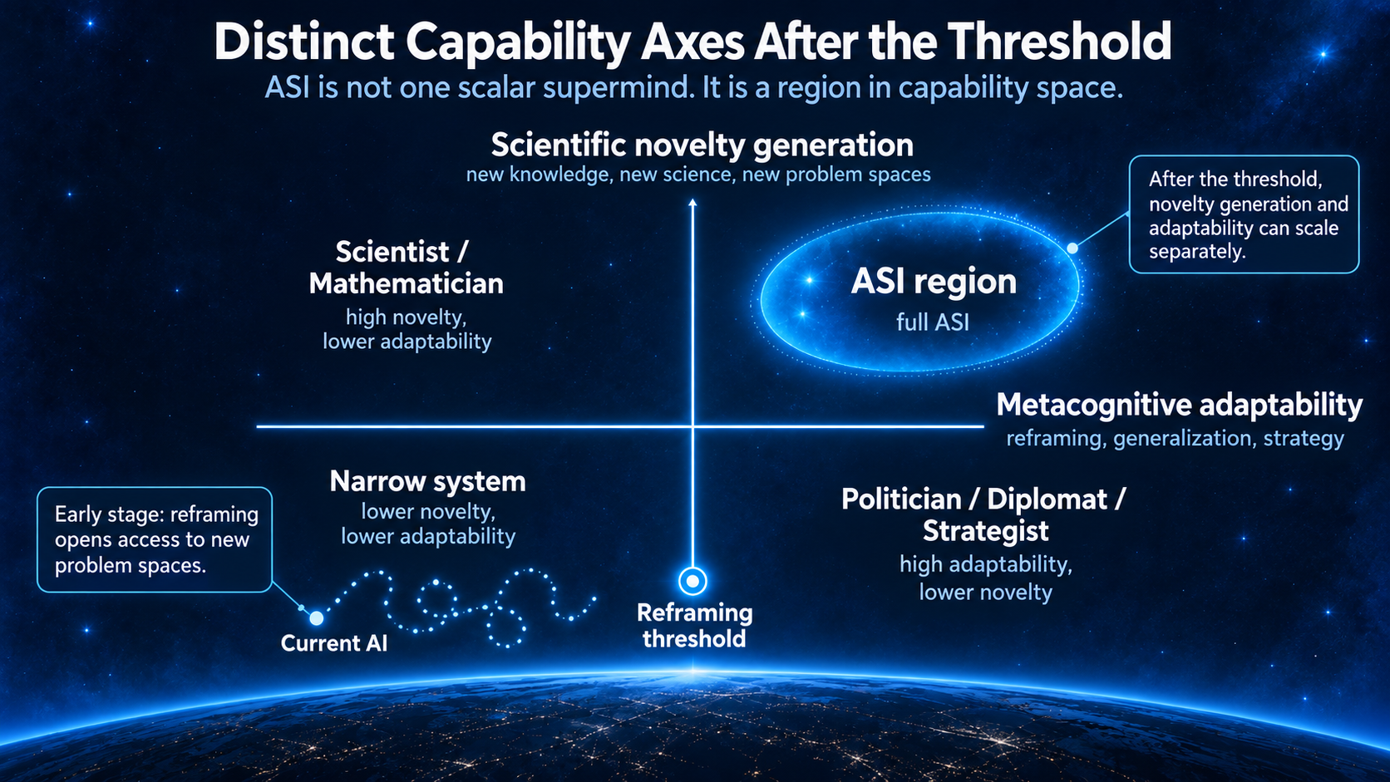
Two Challenges, Solved Separately
Not connected by a straight line of scaling. Each requires its own design
After realization, each must be intentionally designed and improved as a separate capability or it will not grow. Computing reduces to four logical operations, but without CPU instruction set design and hardware-software coordination, today's performance would not exist. Individual challenges solved by individual design — that is what produced the performance we have.
15

Slide 16
4. Defining ASI
Speed and Accuracy Are Only Prerequisites
Computers are already fast enough
Not making mistakes is also not a condition for ASI
AlphaFold, GraphCast, medical imaging, autonomous perception, genome analysis — all orders of magnitude faster and more accurate than humans. But none produce new knowledge
Speed and accuracy are useful in practice but are not boundary conditions for ASI
16

Slide 17
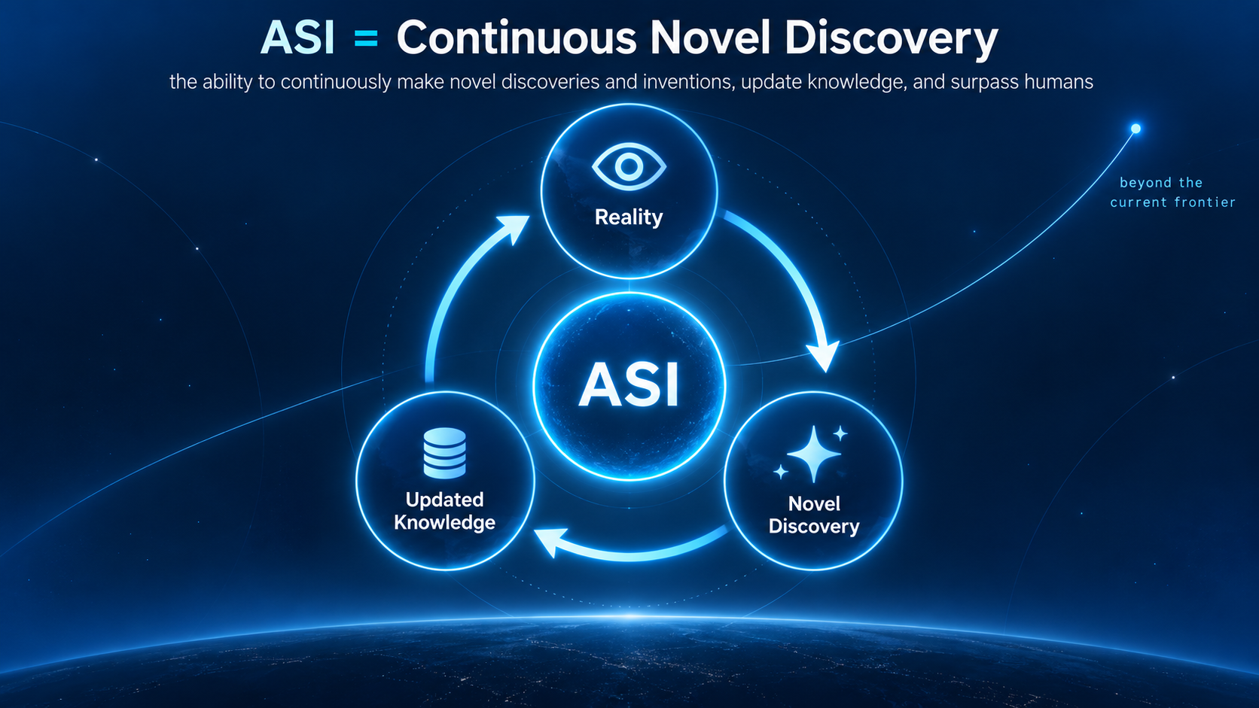
ASI = Continuous Novel Discovery
ASI = the ability to continuously make novel discoveries and inventions, update knowledge, and surpass humans
17

Slide 18
5. What Is AGI?
General Does Not Mean Universal
General intelligence = adapting to situations the system has not encountered before
Universal = capable of every possible task. That is not what “general” means
Performing learned tasks without error is not AGI. That is execution, not adaptation
18

Slide 19
What Does General Mean?
The ability to change frames when the current frame does not work
This is the substance of Condition 3 (Wisdom under Complexity)
This may sound simple — but implementing it fundamentally means losing controllability
The Control Impossibility: From Reframing Asymmetry to Constitutional Architecture (JAGI, under review). doi.org/10.5281/zenodo.19943538
19

Slide 20
The Distinction Between AGI and ASI
AGI is the adaptive application of existing knowledge (reframing)
ASI is the generation of knowledge that does not yet exist (abduction)
Rearranging and generating are different
Details in the paper
Redefining Artificial Superintelligence — https://openreview.net/forum?id=lLWeptkTPH
20

Slide 21
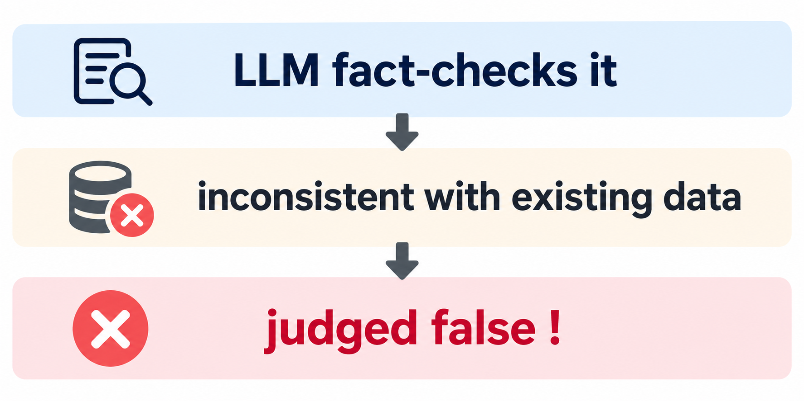
6. The Path to Scientific Creativity
LLMs Cannot Judge the Truth of Their Own Discoveries
A novel output does not exist in the training data
New ideas are killed by the system's own verification
21

Slide 22
The Error of “In the Beginning Was the Word”
“Truth is hidden in the world and can be discovered by the right method” = Hermeticism
Supposedly refuted by the scientific revolution, yet it resurfaces again and again (dormant pathogen)
Latest symptoms: “scaling will reach true intelligence”, “LLMs have a world model”
Language is a compression of the world, not the world itself
LLMs can only operate inside the compression
Intention Without Causation. doi.org/10.5281/zenodo.19234682 · The Conservation Demarcation. doi.org/10.5281/zenodo.21000863
22

Slide 23
What Advances Intelligence: The Generation of New Meaning
Gödel's incompleteness theorem: a system generates, through self-reference, truths it cannot prove internally
Standard philosophical interpretation: infinite regression (the same incompleteness repeating)
My interpretation: infinite progression (generating new meaning to resolve contradiction is not regression but progress through meaning-creation)
Mathematics has been doing exactly this throughout its history
Meaning has no conservation law — new dimensions of meaning can be generated without subtracting from any total. This is why infinite progression is structurally possible
Generative Contradiction: Reading Gödel with Nishida. doi.org/10.5281/zenodo.21612954 · The Conservation Demarcation. doi.org/10.5281/zenodo.21000863
23

Slide 24
Is Truth Found or Made?
Freud's Thanatos: theoretically dead. No neuroscientific basis. Judged “false” by every accepted method of verification
Mishima Yukio's seppuku (1970): fused Eros and Thanatos in a single irreversible bodily act
A theoretically dead concept changed its ontological status through action — an “undead concept”
Is truth out there in the world, waiting for humans to discover it? Or is truth constituted through action?
For those who believe the former, this is a deeply uncomfortable joke
If the former is correct, scaling can reach ASI. If the latter, it is entirely impossible
Mishima and Thanatos. doi.org/10.5281/zenodo.20489614
24

Slide 25
Going Outside Language
Meaning can be generated (cognitive side, no conservation law)
But facts on the world side, governed by conservation laws, cannot be generated at will. Observation is the only access
Meaning generation alone cannot distinguish itself from hallucination
Verification on the physical side is required: experiment, observation, measurement
Scientific creativity is achieved only when both the cognitive and physical layers are in place
25

Slide 26
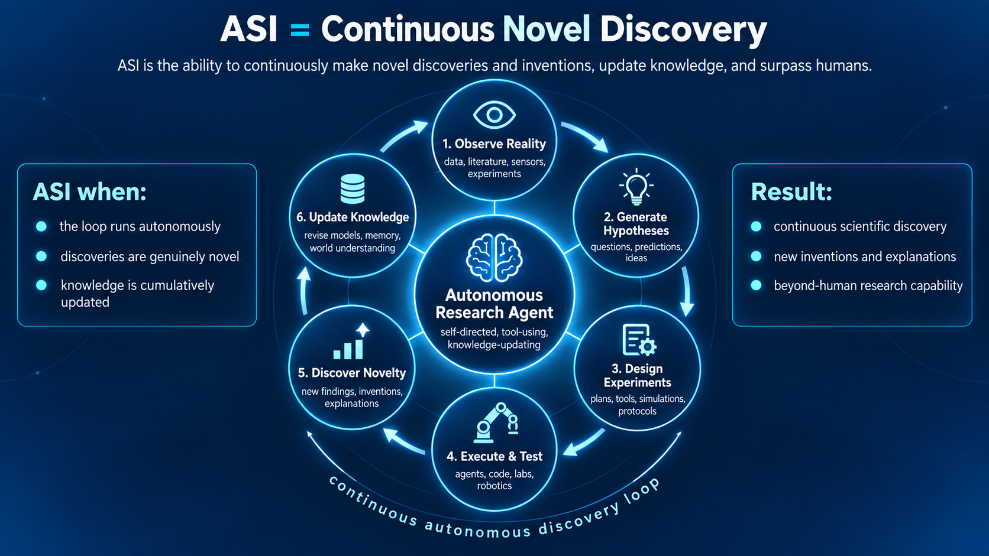
7. Synthesis
One Possible Design
Decompose the scientific process: observation → pattern recognition → hypothesis generation (abduction) → experiment design → experiment execution → result evaluation → hypothesis revision → law formulation
Each step is individually attackable as engineering. Experiment and observation are not exclusive to humans. Humans enter at judgment and direction.
26

Slide 27
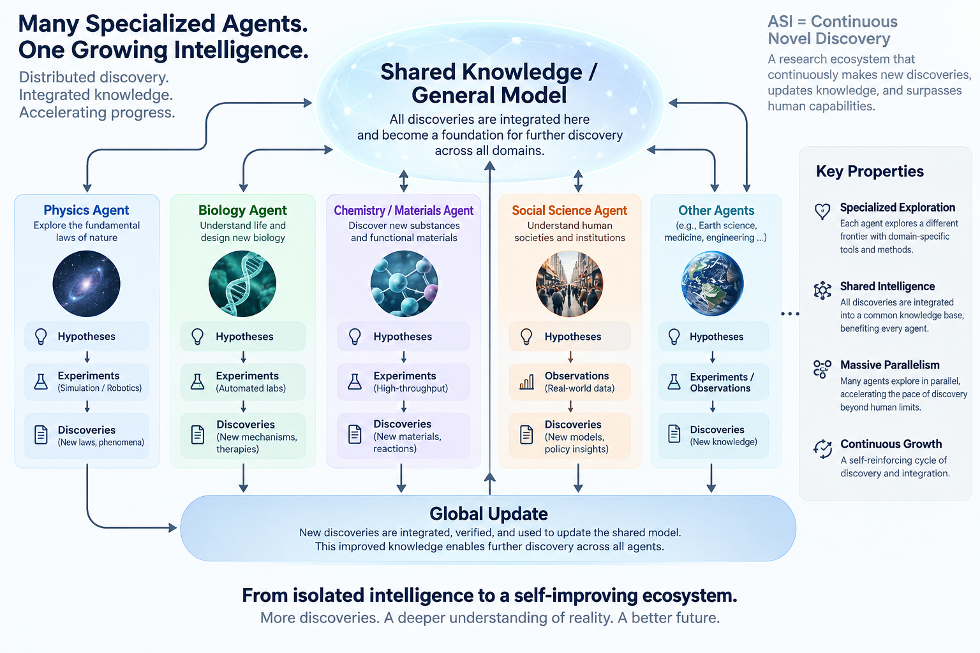
Experiment as a Service
Connect laboratories, electron microscopes, and telescopes into the loop, and novel discoveries will follow
Real-world verification infrastructure: automated labs, experiment APIs, cloud-accessible robotic laboratories. Not expanding the inside of language — connecting to the outside of language.
27

Slide 28
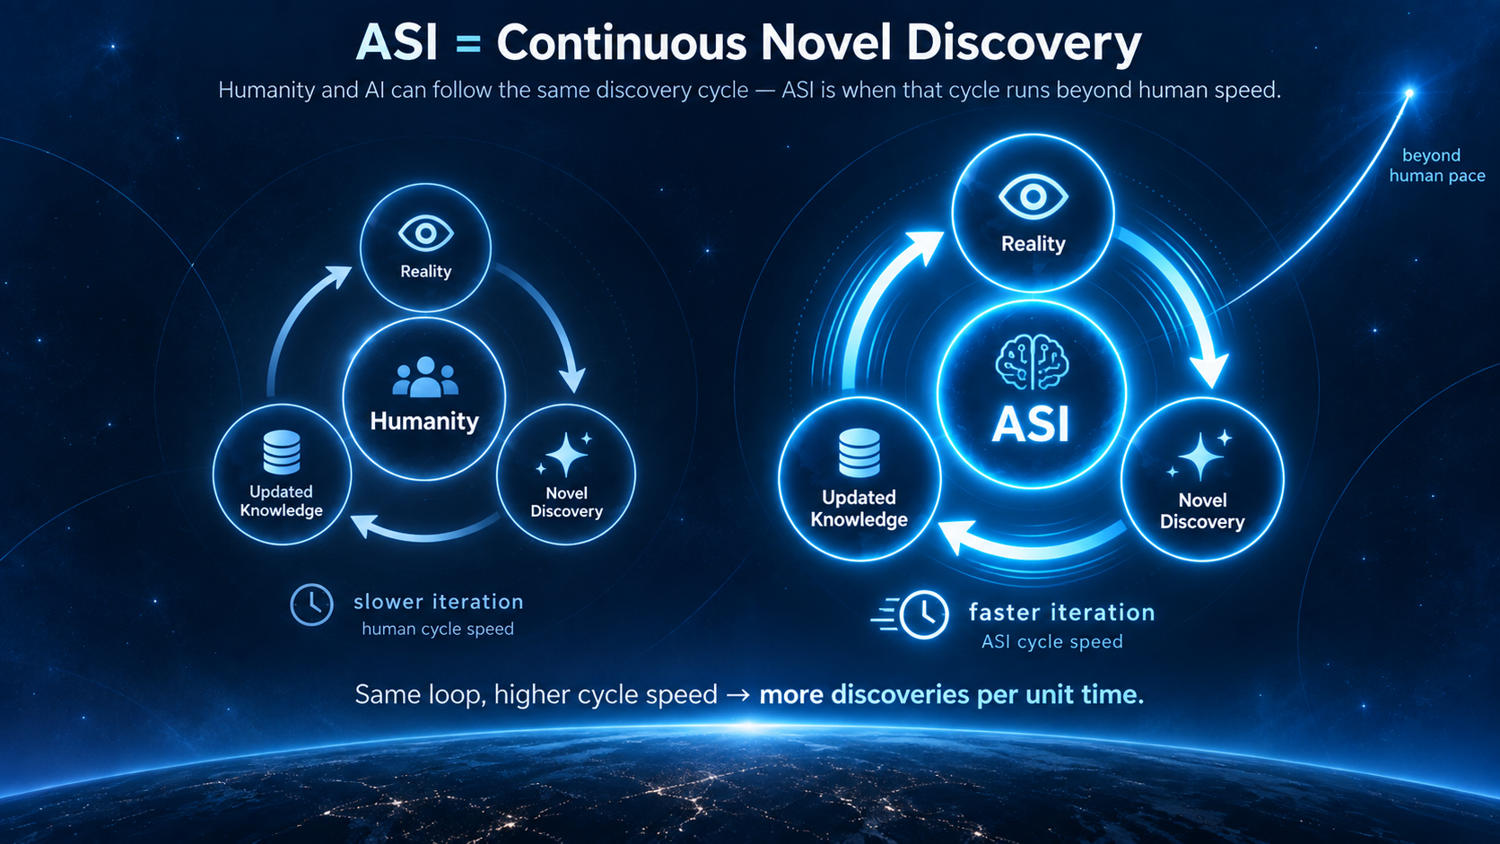
Accelerating Novel Discovery
Humanity has always advanced science by building tools that explore beyond what is currently known
An AI that can do this is Superintelligence.
28

Slide 29
Thank You / Questions
Speed and Collective Intelligence are already achieved. Scientific Creativity and General Wisdom under Complexity are not, and they are two independent axes — each requires its own design. ASI = the ability to continuously make novel discoveries and inventions, update knowledge, and surpass humans.
Contact franny.philos.sophia@elanare.jp
ORCID 0009-0004-7089-5265
OpenReview https://openreview.net/forum?id=lLWeptkTPH
Referenced papers DOIs on individual slides
Questions welcome — and counterexamples are especially welcome.
29

