Slide 1
Outline
Basic Characteristics of Study Cohort
APOE Polymorphisms and AD Biomarkers in Non-Hispanic Whites
Genome-Wide Analysis of AD biomarkers
Including Chr21 trisomy data
Non-Hispanic Whites DS cases
Multi-Phenotype analysis
Amyloid
Tau

Slide 2
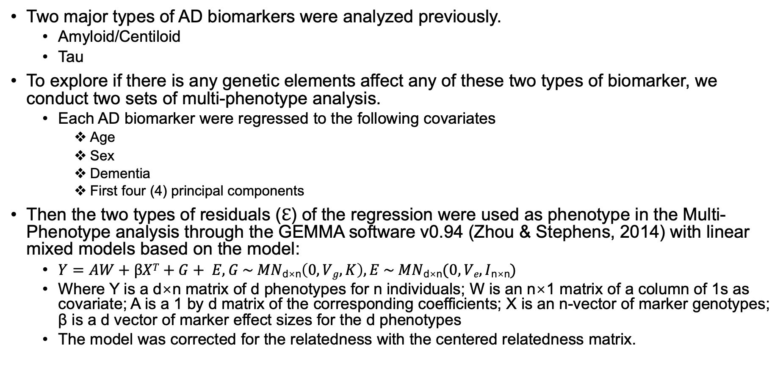
Multi-Phenotype Analysis of AD biomarkers
Two major types of AD biomarkers were analyzed previously.
Amyloid/Centiloid
Tau
To explore if there is any genetic elements affect any of these two types of biomarker, we conduct two sets of multi-phenotype analysis.
Each AD biomarker were regressed to the following covariates
Age
Sex
Dementia
First four (4) principal components
Then the two types of residuals (ℇ) of the regression were used as phenotype in the Multi-Phenotype analysis through the GEMMA software v0.94 (Zhou & Stephens, 2014) with linear mixed models based on the model:
$Y=AW+βXT+G+ E, G \sim MN\text{d}\text{×}\text{n}\left(0, Vg, K\right), E \sim MN\text{d}\text{×}\text{n}(0, Ve, I\text{n}\text{×}\text{n})$
Where Y is a d×n matrix of d phenotypes for n individuals; W is an n×1 matrix of a column of 1s as covariate; A is a 1 by d matrix of the corresponding coefficients; X is an n-vector of marker genotypes; β is a d vector of marker effect sizes for the d phenotypes
The model was corrected for the relatedness with the centered relatedness matrix.

Slide 3
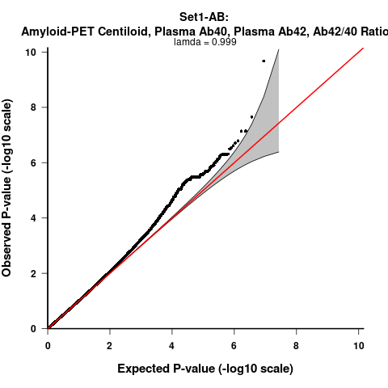
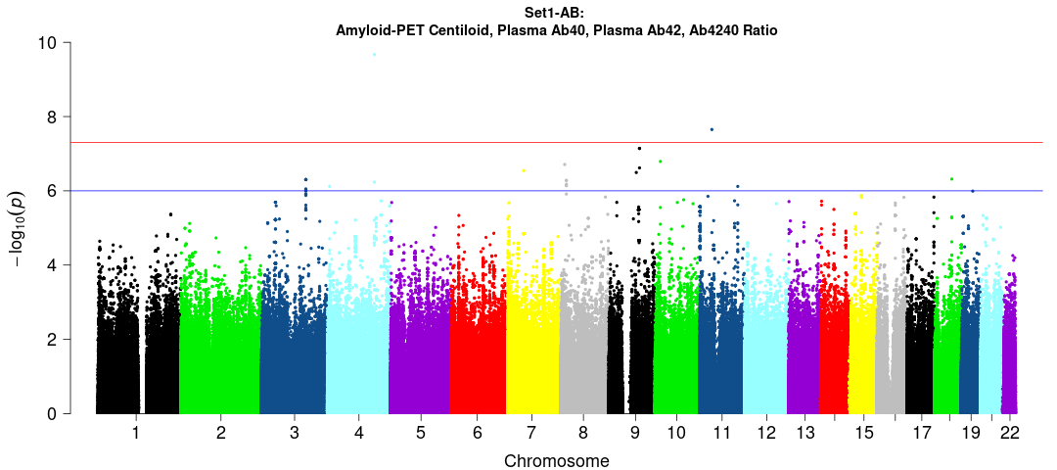
AB (N = 199):
Amyloid-PET Centiloid, Plasma Ab40, Plasma Ab42, Plasma Ab42/40 Ratio
rs2033613/RNF150,
MAF=0.05, p=2.12E-10, --++
rs12796256/IFTAP,
MAF=0.05, p=2.23E-08,
+-++
rs538665664/NFIL3,
MAF=0.06, p=2.23E-08,
+-++
rs1415618834/MINDY3,
MAF=0.05, p=1.62E-07, +-++
rs73211841/BFSP2,
MAF=0.09, p=4.99E-07, ++++
rs1062270/NFIL3,
MAF=0.06,
p=2.23E-08, --++
rs34658559/LINC01630,
MAF=0.09, p=4.82E-07, +---

Slide 4
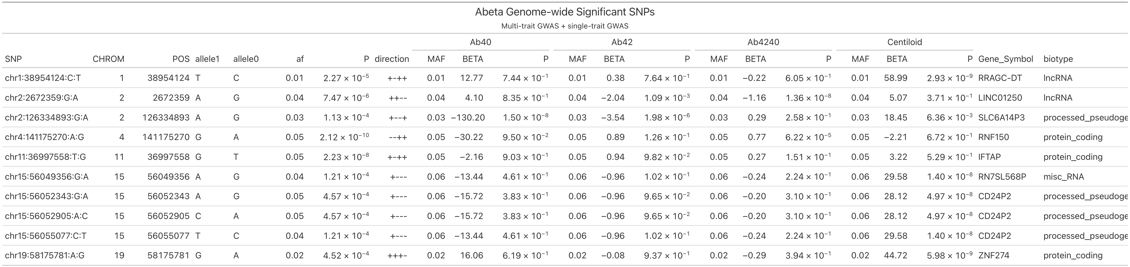
Table1. Summary of genome-wide significant SNPs across all AB-related traits

Slide 5
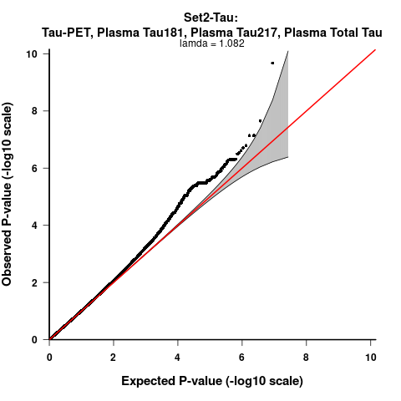
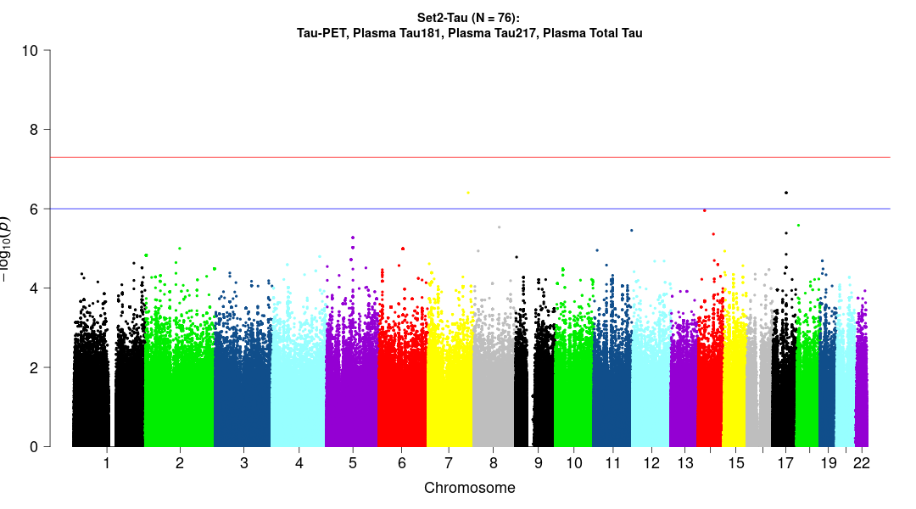
Tau (N = 76):
Tau-PET, Plasma Tau181, Plasma Tau 217, Plasma Total Tau
rs200122675/TBXAS1,
MAF=0.12, p=3.95E-07, +---
rs190676860/LRFN5,
MAF=0.08, p=1.11E-06,
-++-
rs3106346/ARL17A,
MAF=0.33, p=3.96E-07, ++-+

Slide 6
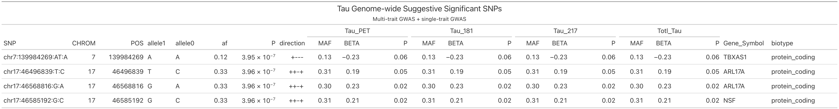
Table 2. Summary of genome-wide suggestive significant SNPs across all Tau-related traits

