Slide 1
Harmonization Data Report
Ruyu & Frank
2024/06/15

Slide 2
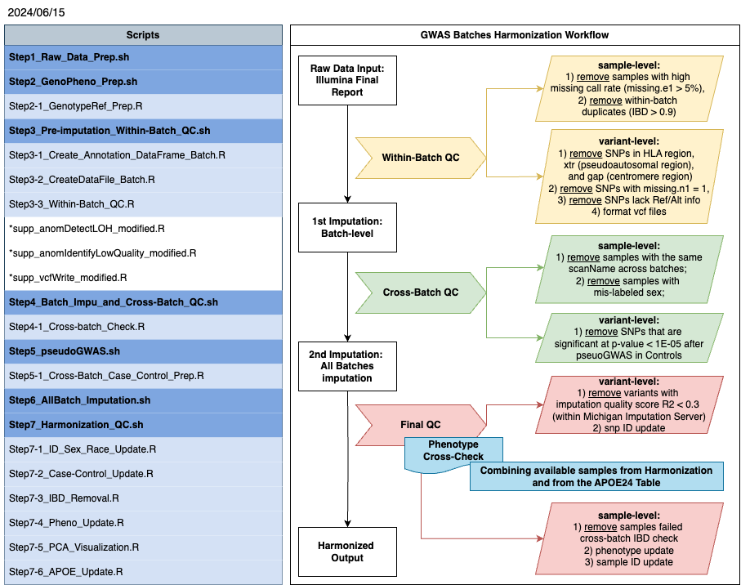
All scripts in the left panel was saved in Harmonization_scripts_for_BackUp.zip
All detailed sample exclusion was listed in Harmonization_Sample_
Stats_Final_2024_06_15.xlsx

Slide 3
Table 1. Summary of Study lists of samples included in GWAS Harmonization, N = 11,387
 | ADRC | ADRC,BACNE | ADRC,BACNE, WHITE | ADRC,GEM | ADRC,HCP | ADRC,HCP, BACNE | BACNE | BACNE,SARP | BACNE,SARP, WHITE
GEM | 0 | 0 | 0 | 1 | 0 | 0 | 0 | 0 | 0
GWAS1 | 1588 | 2 | 1 | 0 | 1 | 0 | 0 | 0 | 1
GWAS2 | 36 | 1 | 0 | 1 | 0 | 0 | 1 | 0 | 0
GWAS3 | 442 | 4 | 0 | 1 | 8 | 0 | 40 | 14 | 1
GWAS4 | 1183 | 2 | 1 | 1 | 64 | 2 | 85 | 5 | 0
GWAS5 | 9 | 0 | 0 | 0 | 0 | 0 | 2 | 0 | 0
 | BACNE,WHITE | BENIN | GEM | GEM,BACNE, SARP | GEM,BACNE, WHITE | GEM,MYHAT | HCP | Heartscore | IGNITE
GEM | 0 | 0 | 2794 | 1 | 1 | 3 | 0 | 0 | 0
GWAS1 | 8 | 0 | 0 | 0 | 1 | 0 | 0 | 0 | 0
GWAS2 | 0 | 0 | 84 | 0 | 0 | 6 | 0 | 0 | 0
GWAS3 | 11 | 0 | 115 | 2 | 2 | 0 | 0 | 0 | 0
GWAS4 | 0 | 787 | 10 | 0 | 1 | 0 | 174 | 141 | 459
GWAS5 | 0 | 0 | 0 | 0 | 0 | 0 | 13 | 9 | 214
 | LLDP | MOVIES | MYHAT | MYHAT_PiB, MYHAT | SARP,WHITE | SENIORS | SLVDS | WHITE
GEM | 0 | 0 | 0 | 0 | 0 | 0 | 0 | 0
GWAS1 | 26 | 397 | 307 | 25 | 3 | 0 | 0 | 80
GWAS2 | 0 | 0 | 576 | 15 | 0 | 0 | 0 | 0
GWAS3 | 0 | 0 | 0 | 0 | 0 | 0 | 0 | 0
GWAS4 | 0 | 380 | 571 | 77 | 0 | 20 | 576 | 0
GWAS5 | 0 | 0 | 0 | 0 | 0 | 1 | 0 | 0

Slide 4
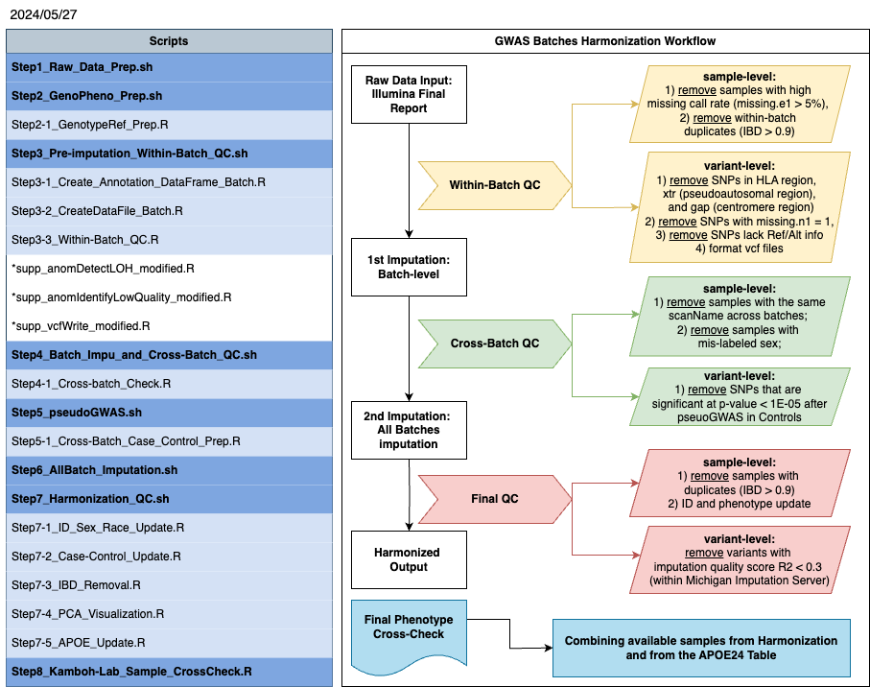
Table 2. Descriptive Summary of Main Steps involved in Harmonization pipeline
Within-Batch QC
Cross-Batch QC
Note: the sex-mislabeled issue was identified in the within-batch QC, but removed later

Slide 5
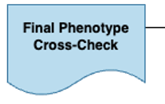
Table 2. Descriptive Summary of Main Steps involved in Harmonization pipeline (cont.)
GWAS Harmonization
Table provided by Lynda with APOE information
Final QC

Slide 6
ADRC | ADRC, BACNE | AgeWise4 | ALPS | BACNE | BACNE,SARP,WHITE | BACNE, WHITE | BENIN
1816 | 4 | 51 | 31 | 8 | 1 | 8 | 46
DEKOSKY | FLOYD | GEM | HCP | Heartscore | IGNITE | LLDP | MOVIES
5 | 17 | 127 | 9 | 4 | 2 | 522 | 129
MSBrain | MYHAT | MYHAT_PiB,MYHAT | RAW | SARP | SCOOP | SENIORS | SLVDS
262 | 851 | 5 | 117 | 163 | 69 | 98 | 199
SPOON | WHITE | WINDOWS
20 | 34 | 46
Samples_not_GWASed_in_APOE24_Table_2024_06_15.xlsx
ADRC | ADRC,BACNE | BACNE,SARP,WHITE | BACNE, WHITE | BENIN | GEM
2 | 3 | 1 | 8 | 1 | 119
GEM,BACNE,WHITE | IGNITE | LLDP | MYHAT | MYHAT_PiB,MYHAT | SENIORS | SLVDS
1 | 1 | 1 | 138 | 4 | 1 | 1
Samples_GWASed_not_in_APOE24_Table_2024_06_15.xlsx

Slide 7
N = 10,431
Batch | Final QC | Race Discrepancies
 |  | Self-reported White clustered in Black (PCA) | Self-reported Black clustered in White (PCA) | Self-reported Asian clustered in White (PCA) | No Race in Database
GEM | 2731 | 4 | 0 | 0 | 0
GWAS1 | 2194 | 12 | 1 | 0 | 0
GWAS2 | 606 | 0 | 0 | 0 | 0
GWAS3 | 414 | 4 | 1 | 1 | 0
GWAS4 | 4251 | 0 | 6 | 4 | 15
GWAS5 | 235 | 5 | 0 | 1 | 1
Total | 10431 | 25 | 8 | 6 | 16
 |  | 39 Race Discrepancies & 16 no Race in database

Slide 8
N = 10,431 (2024_06_15)
Batch | Final QC | APOE Discrepancies (Imputed | Lab)
 |  | 22|23 | 22|33 | 23|22 | 23|24 | 23|33 | 23|34 | 24|23 | 24|33 | 24|34 | 33|22 | 33|23 | 33|24 | 33|34 | 33|44 | 34|22 | 34|23 | 34|24 | 34|33 | 34|44 | 44|23 | 44|33 | 44|34 | No APOE in Database
GEM | 2731 | 2 | 2 | 9 | 1 | 18 | 0 | 0 | 3 | 4 | 3 | 106 | 1 | 22 | 0 | 0 | 2 | 25 | 14 | 0 | 1 | 1 | 0 | 110
GWAS1 | 2194 | 1 | 0 | 1 | 0 | 10 | 2 | 1 | 2 | 2 | 0 | 54 | 1 | 17 | 4 | 1 | 1 | 16 | 15 | 1 | 0 | 1 | 3 | 2
GWAS2 | 606 | 0 | 15 | 0 | 0 | 27 | 0 | 0 | 12 | 0 | 2 | 50 | 5 | 44 | 8 | 0 | 15 | 1 | 27 | 1 | 0 | 10 | 0 | 2
GWAS3 | 414 | 1 | 2 | 0 | 0 | 6 | 4 | 1 | 6 | 3 | 0 | 20 | 1 | 30 | 4 | 0 | 3 | 2 | 24 | 9 | 0 | 6 | 0 | 10
GWAS4 | 4251 | 3 | 0 | 10 | 0 | 18 | 4 | 6 | 3 | 14 | 3 | 117 | 1 | 19 | 0 | 1 | 3 | 38 | 26 | 11 | 0 | 2 | 7 | 141
GWAS5 | 235 | 0 | 0 | 2 | 0 | 2 | 0 | 0 | 0 | 0 | 0 | 15 | 0 | 1 | 0 | 0 | 0 | 5 | 0 | 0 | 0 | 0 | 0 | 0
Total | 10431 | 7 | 19 | 22 | 1 | 81 | 10 | 8 | 26 | 23 | 8 | 362 | 9 | 133 | 16 | 2 | 24 | 87 | 106 | 22 | 1 | 20 | 10 | 265
 |  | 997 APOE Discrepancies and 265 no APOE in database
Note: color-coded columns indicate two alleles change
Details of samples missing Lab APOE in database
 | ADRC | ADRC, BACNE | BACNE, SARP, WHITE | BACNE,WHITE | BENIN | GEM | LLDP | MYHAT | MYHAT_PiB,MYHAT | SENIORS | SLVDS
GEM | 0 | 0 | 0 | 0 | 0 | 110 | 0 | 0 | 0 | 0 | 0
GWAS1 | 1 | 0 | 0 | 0 | 0 | 0 | 1 | 0 | 0 | 0 | 0
GWAS2 | 0 | 0 | 0 | 0 | 0 | 0 | 0 | 2 | 0 | 0 | 0
GWAS3 | 0 | 1 | 1 | 8 | 0 | 0 | 0 | 0 | 0 | 0 | 0
GWAS4 | 0 | 2 | 0 | 0 | 1 | 0 | 0 | 132 | 4 | 1 | 1

