Slide 1

Evaluating Agreement, Adherence, and Diurnal Patterns in Cortisol & DHEA
Ryan Summers
2/4/26
Notes:
This project focuses on whether a booklet-based collection method can adequately capture collection times and expected cortisol and DHEA time patterns

Slide 2

Research Questions
What is the agreement between the subject’s Booklet-reported sampling times and by electronic monitoring cap?
  Hypothesis: Booklet-reported minutes since waking are linearly associated with electronic recorded cap minutes since waking
Are subjects adhering to +30min & +600min sampling times required by study protocol?
  Estimate the percentage of samples collected within ±7.5 and ±15 minutes of the scheduled time (descriptive).
What are the changes in cortisol and DHEA overtime?
  Hypothesis: Cortisol and DHEA concentrations increase from waking to 30 minutes after waking.
  Hypothesis: After 30 minutes post waking, cortisol and DHEA concentrations decline for the remainder of the day.
Notes:
This project was guided by three research questions:
First, it was asked whether booklet-reported sampling times agreed with the electronic cap times — the statistical question or hypothesis version, is whether booklet minutes since waking are linearly associated with cap-recorded minutes since waking.
Second, we are looking at whether subjects adhered to the study protocol by calculating the percentage of samples collected within ±7.5 and ±15 minutes of the scheduled post-waking sampling times.
Finally, we examined whether cortisol and DHEA concentrations showed expected diurnal patterns — namely, an increase shortly after waking followed by a decline over the remainder of the day.

Slide 3
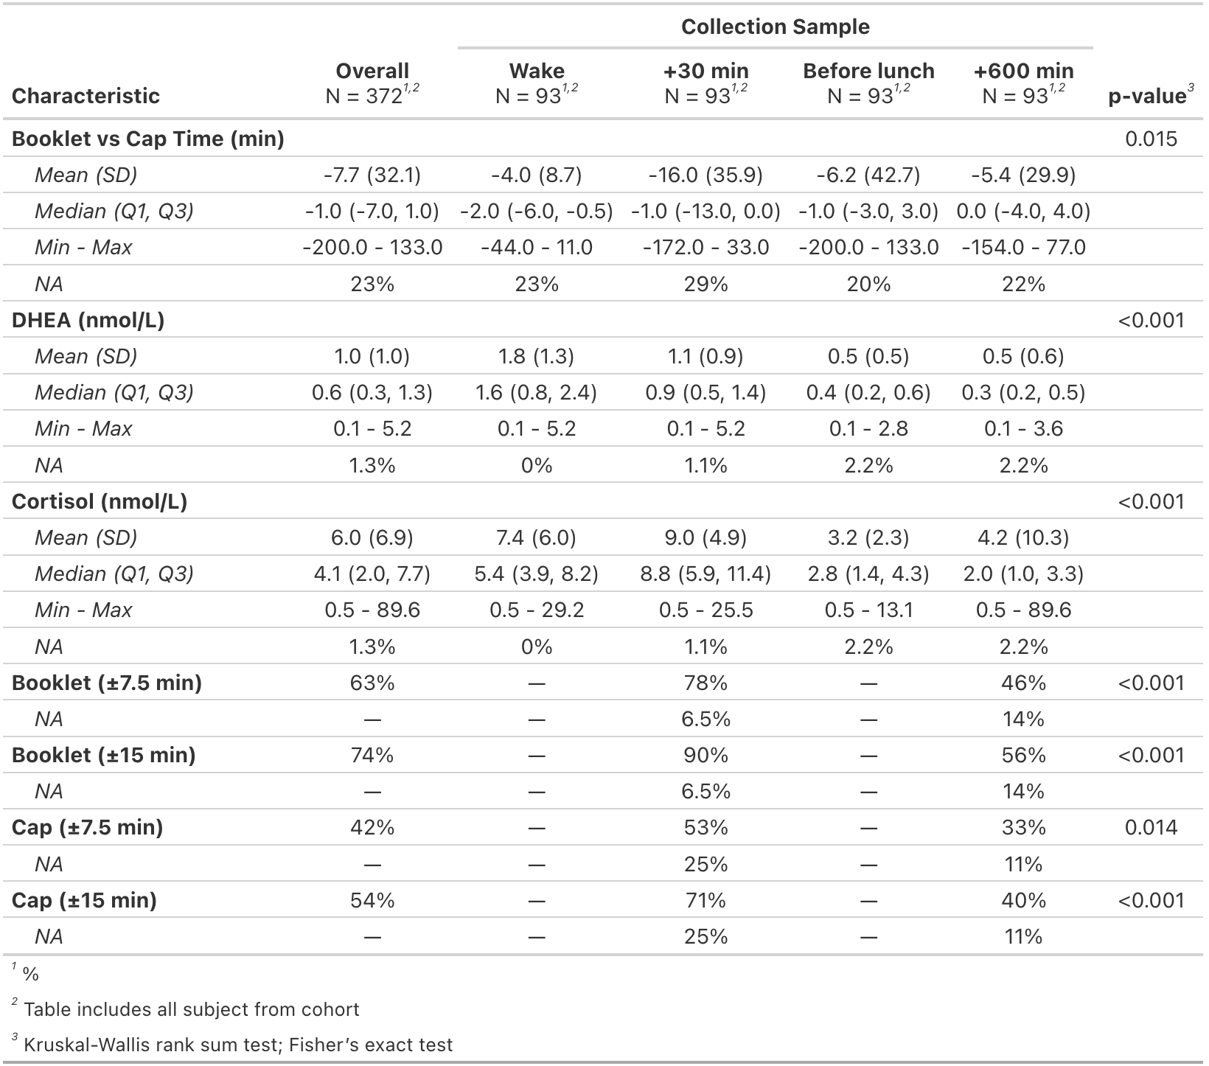
Data Overview
31 subjects total in study cohort
  One subject removed (multiple DHEA 5.205)
  One observation removed for unlikely cortisol value
Log-transformed cortisol/DHEA
  Right-skewed
Less NAs for booklet-recorded times
  BK NA: 35 (9.4%)
  Cap NA: 61 (16.4%)
Notes:
This study cohort included 31 subjects overall but One subject was excluded from the hormone trajectory analysis due to repeated DHEA values at 5.205 nmol/L. One cortisol observation was removed with a value over 80 nmol/L.
The hormone concentrations both exhibited right-skewness as indicated in this table where the means were greater than the medians - so they were log-transformed for analyses
and In terms of recorded times, the booklet had fewer missing values than cap times — about 9% missing for booklet versus 16% for cap — which led me to use booklet times for the trajectory analysis

Slide 4
Analysis
Agreement
  Linear Mixed Model w/ subject-specific random intercept
  Regressed booklet-record time on cap-record time
  Both variables were recorded as minutes since waking using sleep diary as reference point
Adherence
  Proportion samples collected within ±7.5 and ±15 minutes of the scheduled time (descriptive).
Cortisol/DHEA Changes over time
  Piece-wise Linear Mixed Model w/ Random intercept & knot at 30min post-waking
  Log-transformed Cortisol/DHEA
  Booklet-recorded times used due to lower instances of NAs
Notes:
Agreement between booklet and cap timing was assessed using a linear mixed-effects model with a subject-specific random intercept.
Book minutes since waking were regressed on cap minutes since waking, with both measures using sleep diary–reported wake time as reference.
Adherence was summarized as the proportion of samples collected within ±7.5 and ±15 minutes of scheduled collection times.
To evaluate changes in cortisol and DHEA over time, a piece-wise linear mixed-effects models was fit with a knot at 30 minutes post-waking. Again, I used booklet-record times because there were fewer missing values

Slide 5
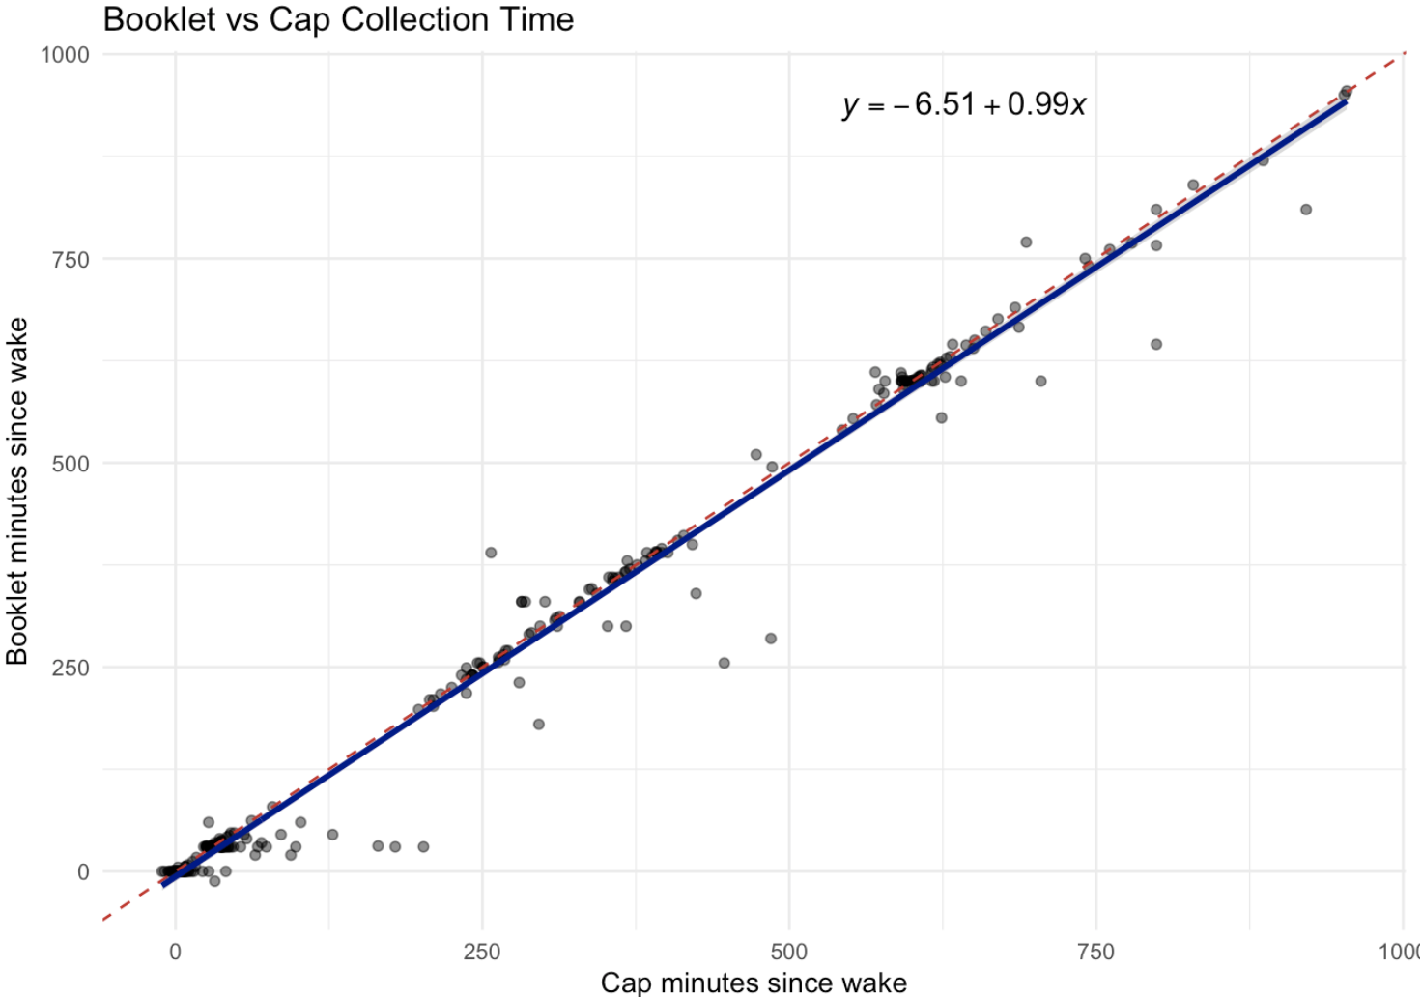
Results
Agreement:
On average, the intercept suggested that booklet-recorded times were about 6-7min earlier than cap (95% CI: -12.3 to -0.69; p<0.05)
On average, booklet times closely followed cap recorded times (95% CI: 0.98 to 1.01; p<0.001)
Adherence (Booklet vs Cap):
±7min:
  +30min: 78% vs 53%
  +600min: 46% vs 33%
±15min:
  +30min: 90% vs 71%
  +600min: 56% vs 40%
Notes:
Agreement results showed strong linear agreement between booklet- and cap-recorded times as shown by the scatterplot. Red dotted-line is perfect agreement and solid line is model line
The intercept indicated there was some bias where booklet times were recorded about 6 to 7 minutes earlier than cap times on average.
As for Adherence - it varied by collection time and window-threshold. In general, Booklet times outperformed Cap times and there was better adherence at the 30min sample time with the larger window-threshold

Slide 6
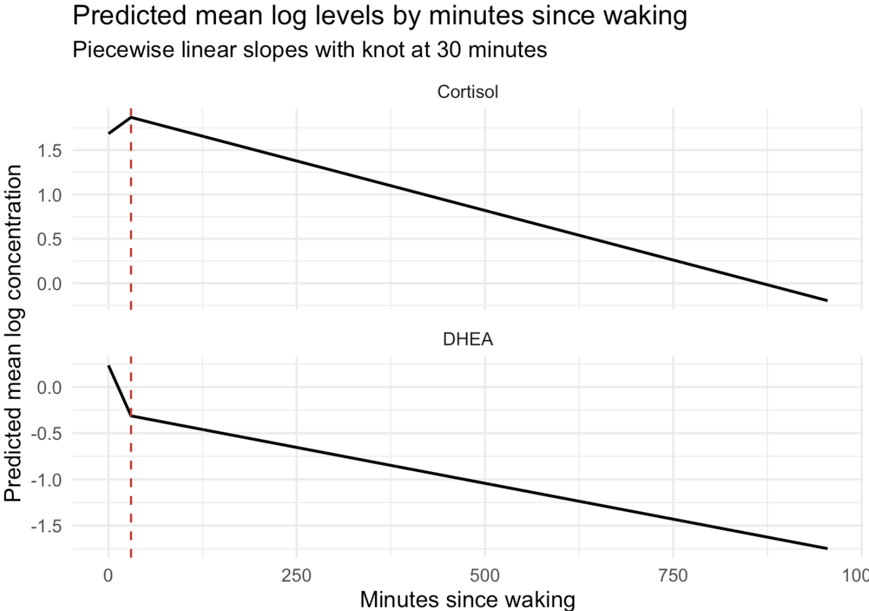
Results, continued
Cortisol Trends:
On average, a subject’s cortisol levels increased by 0.6% per minute (≈20% cumulatively) during the first 30min after waking (95% CI: -0.1% to 1.3%; p=0.09).
After 30min, a subject’s cortisol levels decreased by 12.5% per hour, on average (95% CI: -14.4% to -10.6%; p<0.001)
DHEA Trends:
On average, a subject’s DHEA levels decreased by 1.8% per minute (≈58% cumulatively) during the first 30min after waking (95% CI: -2.4% to -1.2%; p<0.001).
After 30min, a subject’s DHEA levels decreased by 8.9% per hour (95% CI: -10.5% to -7.2%; p<0.001)
Notes:
For the time trends, Cortisol and DHEA showed distinct diurnal patterns for the first 30min after waking. Cortisol levels increased by approximately 0.6% per minute or about 20% cumulatively, while DHEA levels decreased by 1.8% per minute
After 30 minutes, cortisol levels declined steadily at approximately 12.5% per hour and DHEA at about 8.9% per hour, on average

Slide 7
Conclusions
Booklet-record times closely tracked cap times, with an average bias of 6-7min being recorded by booklet method
Adherence to protocol defined collection windows varied by sample and window
  Lower adherence was noted at the +600min collection and ±7min window
  Booklet showed higher rates of adherence
Cortisol and DHEA concentrations collected using booklet showed expected patterns
  Prior literature has noted an inverse relationship (Ahmed et al 2023)
Overall, despite some timing biases and variable adherence, the SPIT booklet appears to have the ability to capture expected diurnal patterns
Limitations:
  Missing data – biases if missingness depended on unobserved events
  Simple linear mixed model is limited in that it can’t capture specific collection sample variability
Notes:
In summary, booklet-recorded times closely tracked cap times, with booklet times tending to be recorded earlier.
Adherence to protocol-defined windows varied by sample and threshold, with lower adherence being observed for later collections and tighter windows,
booklet-based timing showed higher adherence as compared to cap-based timing.
Cortisol and DHEA showed opposite rates of change during the first 30min of waking but based on prior literature this is to be expected.
which when taken all these points together, I believe these conclusion supports the feasibility of this type of collection method when studying hormone time patterns.
But there are Key limitations of this analysis including missing data, which can bias some of the results if there’s some dependency on unobserved data and the use of a simple mixed-effects models, when evaluating agreement between the two collection methods, which can not fully capture variability across the four collection samples

Slide 8
References
Ahmed, T., Qassem, M., & Kyriacou, P. A. (2023). Measuring stress: a review of the current cortisol and dehydroepiandrosterone (DHEA) measurement techniques and considerations for the future of mental health monitoring. Stress, 26(1), 29–42. https://doi.org/10.1080/10253890.2022.2164187

