Slide 1

Evaluating Two-Year HAART Treatment Response Among Hard Drug Users and Non-Users
Ryan Summers
3/2/26

Slide 2

Research Questions
Does baseline hard drug use affect treatment response two years after initiating HAART?
Viral load (HIV RNA copies/mL)
CD4 T-cell count
Physical QOL (0-100)
Mental QOL (0-100)
Hypotheses: Year-2 outcomes differ between baseline hard drug users and non-users
Does adherence mediate the association between hard drug use and year-2 outcomes?
Hypothesis: The association between hard drug use and treatment response will be weaker after accounting for adherence.
What are the dropout rates between hard drug users and non-users?
Hypothesis: Baseline outcomes differ between participants with complete and incomplete cases
Notes:
The primary objective of this project was to determine whether baseline hard drug use was associated with differences in treatment response two years after initiating HAART
The treatment responses being evaluated are: viral load, CD4 count, physical quality of life, and mental quality of life.
Secondary objectives are to test whether adherence mediates the association between hard drug use and year-2 outcomes
And to evaluate whether there's differences in baseline outcome measures between participants with complete and incomplete data, stratified by drug use.

Slide 3
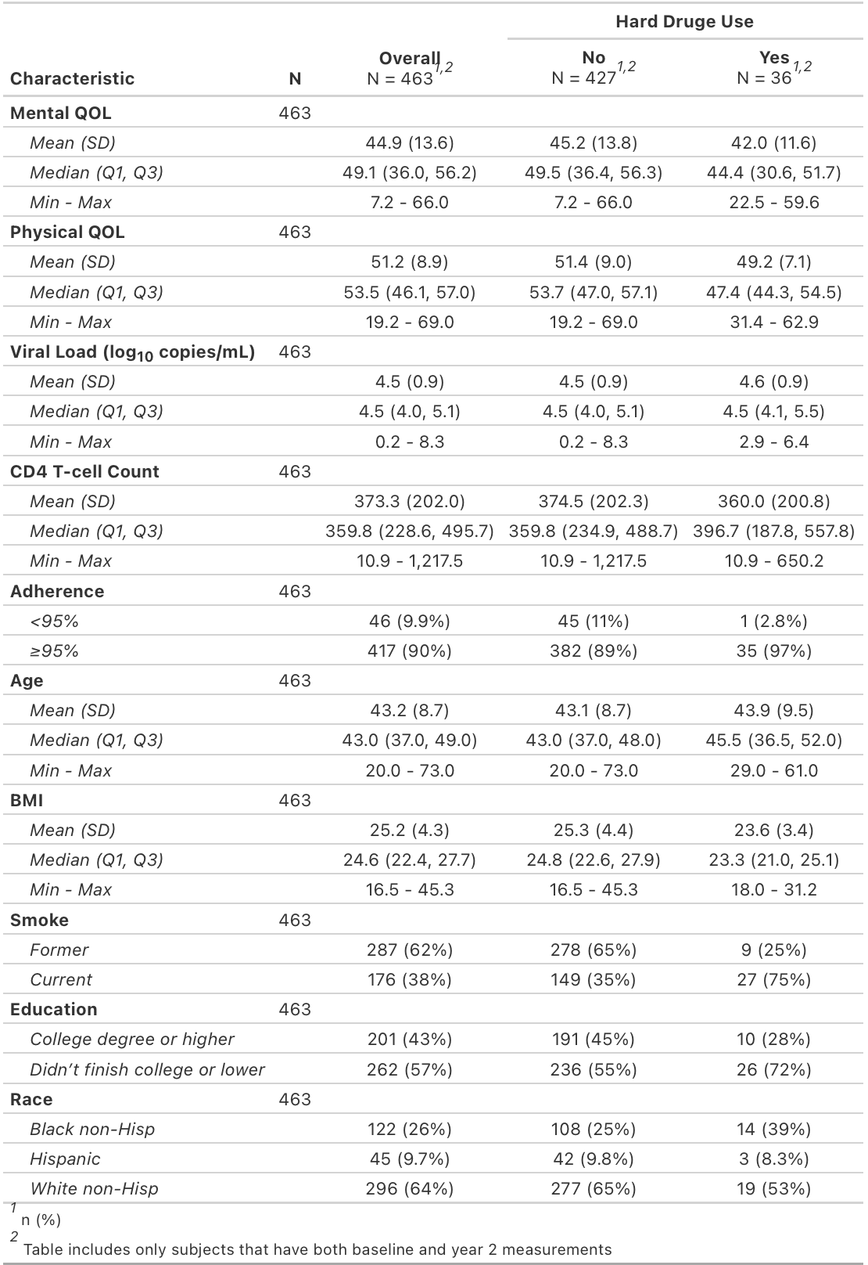
Data Overview
Multicenter AIDS Cohort Study (MACS)
Prospective study of HIV-1 in homosexual/bisexual men in four major cities
715 subjects in initial dataset
Implausible BMI values labeled as missing
Complete-case analysis
463 subjects used
Transformations
Log10 transformed viral load
All other variables kept on original scale
Hard drug use and adherence coded as binary
Notes:
The initial dataset contained 715 HIV-infected men initiating HAART from the MAC study.
Of these, 463 had complete baseline and Year 2 data and these subjects were included in all regression analyses.
Viral load was log10-transformed due to skewness, while CD4 and QOL measures were analyzed on their original scales.
Hard drug use and adherence were both coded as binary variables.
All but one of the hard drug users had adherence below 95%
Generally, Baseline hard drug users reported lower QOL scores and CD4 counts and were more likely to be current smokers as compared to non-users
Viral load and other covariates had similar distributions

Slide 4

Analysis
Primary: Year-2 Response
Bayesian regression (brms, HMC-NUTS) + parallel Frequentist regression
Priors: weakly(vague)-informative
N(0,${100}^{2}$) on regression coefficients
Half-t(3,0, ${100}^{2})$ on residual variance
Adjusted for:
Baseline outcome measure value, Age, BMI, smoking status, education, race/ethnicity
Secondary: Adherence
Adherence dichotomized (<95%, ≥95%) used to test association between hard drug users and response
Secondary: Dropout Rates
Complete (Baseline+Year-2) vs Missing Year-2 baseline outcomes
Nonparametric (Wilcoxon)
Logistic regression: Follow-up Status (Missing Year 2 = 1 vs complete = 0)
Function of baseline outcome and covariate measures
Notes:
To address the primary question of interest, Bayesian regression models was fit using weakly-informative priors for each outcome
All models adjusted for the corresponding baseline outcome measure and covariates
parallel frequentist models were also fit with identical covariate structure for comparison.
For adherence, the variable was dichotomized into less than 95% and greater than/equal to 95%
Models were compared with and without adherence to see whether there was a meaningfully change in the estimated hard drug association.
For analyzing drop-out rates, comparisons of baseline outcomes were made between participants with complete measurements and those missing year-2 using non-parametric Wilcoxon test
I also fit a logistic regression model using baseline outcome and covariate measures as potential predictors of dropout

Slide 5
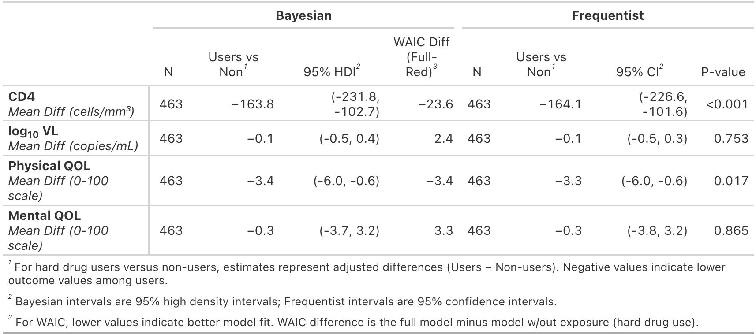
Results - Primary
CD4
−164 cells/mm³ (95% HDI: −263 to −103)
99.5% probability exceeds 50-cell clinical threshold
Viral Load
No meaningful difference
2.3% probability exceeds 0.5 log threshold
Physical QOL
−3.3 points
83% probability exceeds 2-point threshold
Mental QOL
No meaningful difference
26% probability exceeds 2-point threshold
Notes:
For primary results:
On average, hard drug users had approximately 164 fewer CD4 cell counts as compared with non-users with a
Posterior probability of 99.5% that this difference exceeded the clinically meaningful threshold of 50 cells
Physical QOL was also lower among hard drug users by approximately 3.3 points, and had a posterior probability of 83% that the difference exceeded the clinical threshold of 2 points
In contrast, we found no significant difference in viral or mental QOL scores between groups with posterior probabilities of exceeding their clinical threshold being quite low
In regard to model fit, there was a large and meaningful reduction in WAIC for CD4, but the other outcomes provided weaker evidence of better fit.

Slide 6
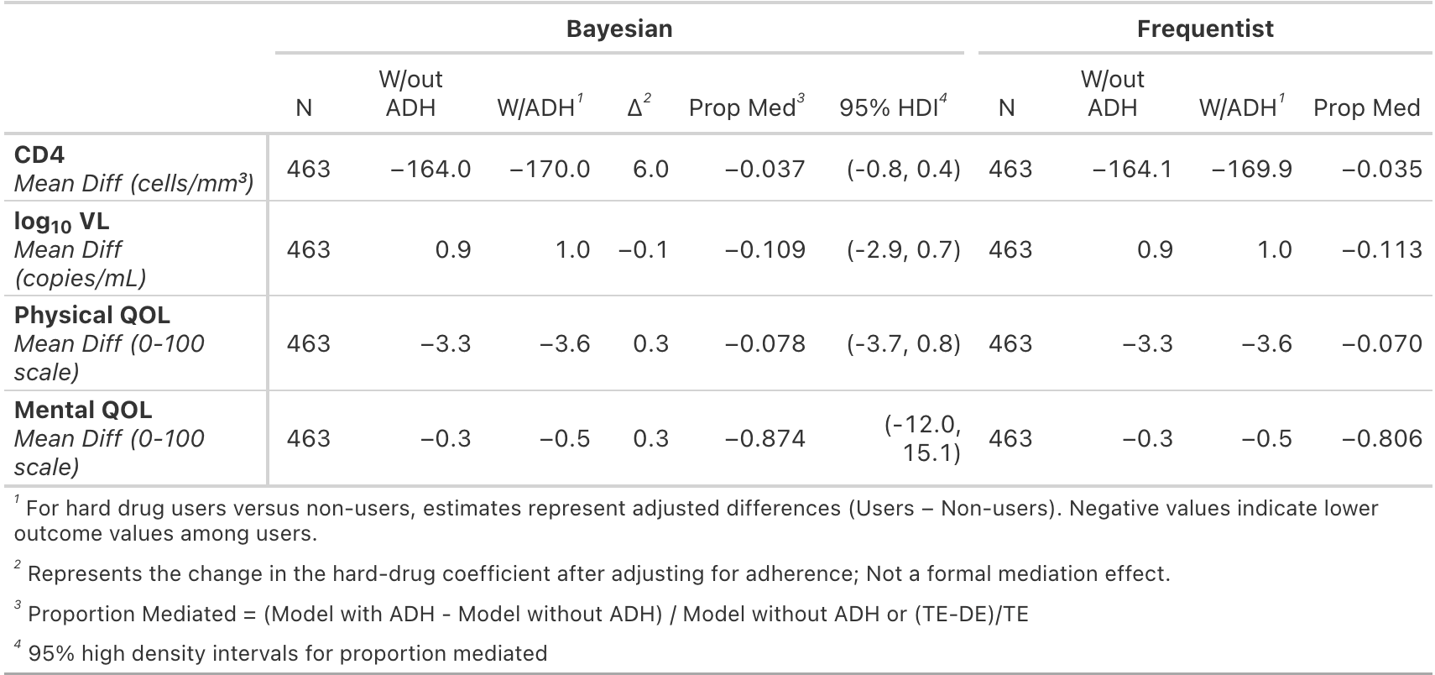
Results - Mediation
Inclusion of adherence increased magnitude of hard drug coefficient
<95% vs ≥95%
Proportion mediated negative
No evidence of meaningful mediation
Analysis limited by sparse data in adherence categories
Notes:
To test for mediation, two models were fit – one with and without the binary adherence variable
When adherence was included in the models, the hard drug coefficients slightly increased in magnitude across all outcomes
Which resulted in negative proportion mediated estimates and ultimately inconsistent mediation. This was likely due to sparse data in the adherence category.
Which was shown back in the data overview section where only one subject was in the less than 95% grouping
Overall, there was little evidence that adherence explained the association.

Slide 7
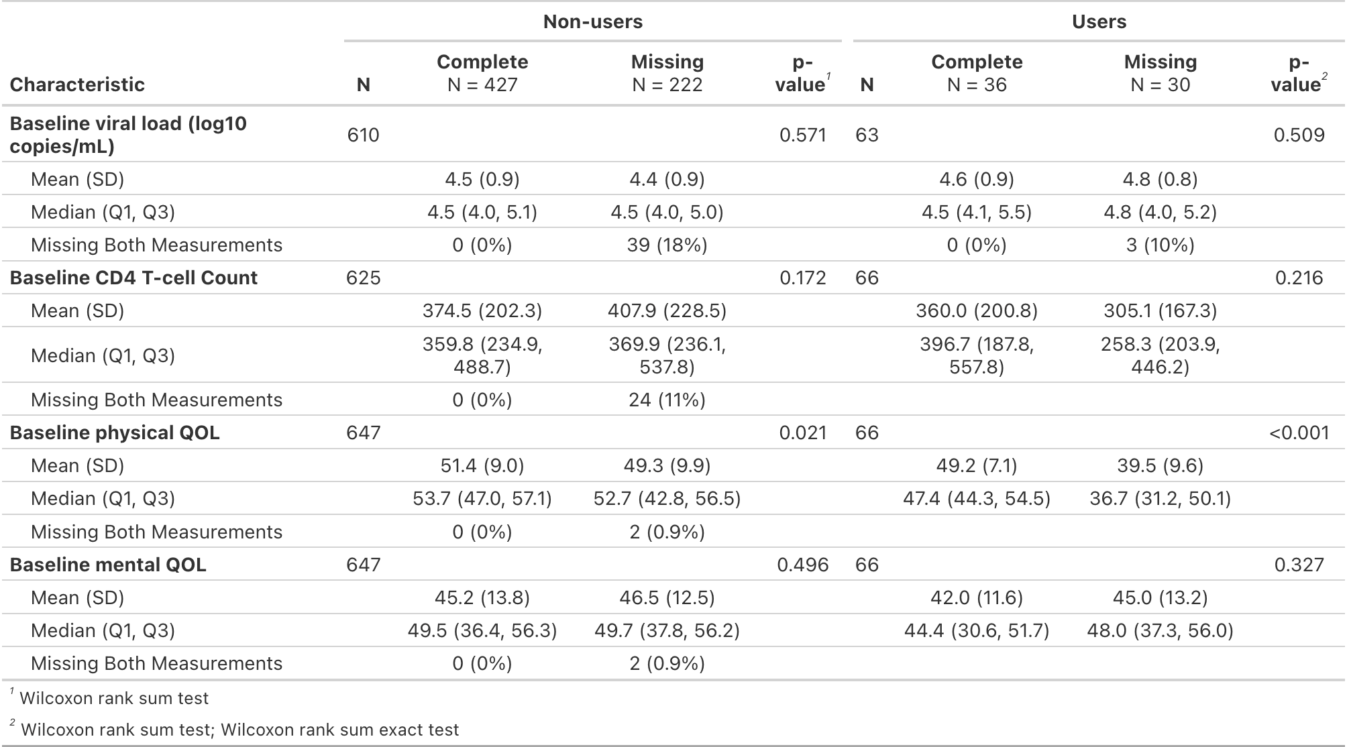
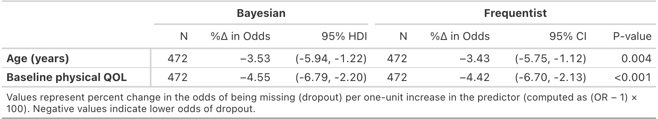
Results – Dropouts
252 participants were missing Year 2 data (≈35%)
Lower baseline physical QOL associated with dropout
Younger age associated with dropout
Notes:
Of the 715 participants, 252 or 35% of the dataset were missing Year 2 measurements
Baseline physical QOL scores were shown to be significantly lower among participants with missing year-2 data for both hard drug users and non-users. It was particularly noticeable in the drug users' group which was 10 pts lower or 5x the clinically meaningful difference of 2 points
In addition to lower baseline physical QOL scores, Logistic regression also showed that younger age was associated with higher odds of dropout.
For each additional year in age and increase in QOL score, there's a reduction in odds of dropping out
Younger age -> higher odds of dropping out
Lower physical QOL = higher odds of dropping out

Slide 8
Conclusions
Findings:
Lower CD4 T-cell counts among baseline hard drug users
Lower physical QOL scores
No meaningful differences in viral load or mental QOL
Adherence wasn’t meaningful
Younger age and physical QOL was associated with dropout
Limitations:
Observational study design
Adherence coded as binary (<95% vs ≥95%)
Mediation = exploratory/descriptive
Hard drug user group was relatively small (36)
Missing data suggests MAR but not proven
Notes:
Overall, these findings suggest that baseline hard drug use is associated with poorer immunologic recovery and lower physical QOL following HAART initiation, but adherence does not appear to meaningfully mediate these associations. Loss to follow-up indicated the age and physical health was associated with dropout
Limitations:
Observational studies typically suffer bias from lack of randomization and unmeasured variables
Adherence was coded as binary and only had one observation for hard drug user with less than 95% this was likely a reason for the negative proportion mediated, so Adherence could not be reliably estimated and should be treated as descriptive
Further, the Hard drug user group overall was relatively small so we may not have had enough to power to make precise comparisons
Lastly, while missingness appeared to be associated with age and physical health, which were observed, there may be some dependency on some unmeasured factor that we did not model. So, the missing data mechanism suggests MAR but wasn’t proven

