Slide 1

The Role of Inflammation in Alzheimer’s Disease
Ryan Summers
3/30/26

Slide 2

Study Aims
Aim 1:
H1a: Higher baseline peripheral inflammatory marker levels will be associated with greater 1-year decline in cognitive measures and AD-signature mean cortical thickness
H1b: Greater 1-year increases in peripheral inflammatory markers will be associated with greater 1-year declines in the same cognitive and cortical outcomes.
Aim 2:
H2: Amyloid deposition will modify the association between inflammation markers and 1-year decline in cognitive and AD-signature cortical thickness.

Slide 3
Analysis
Exposures
Linear regression models
Adjust for baseline outcomes + baseline covariates
Sensitivity for covariates
APOE, CDR, etc
Multiplicity
α=0.05/4 independent tests
Outcomes (2): Cognitive & Cortical
Predictors (2): Cytokines & Chemokines
Aim 2
Baseline Amyloid (Binary: Pos vs Neg)
Outcomes
Modifies H1a
H1a
Baseline Inflammation
(IL-6, TNF-α, MCP-1, Eotaxin-1)
1-year Change (baseline → 1yr):
• Cognitive Measures
• Cortical Thickness
H1b
Δ Inflammation
(baseline → 1yr)
Notes:
This diagram illustrates the framework used to test our hypotheses.
To address these aims and hypotheses linear regression models will be fit, which will allow adjustments for covariates and testing of interactions
In the aim 1 models, the two exposures of interest are baseline inflammation and 1yr change in inflammation.
For Aim 2, we will build upon H1a by introducing amyloid status as a binary predictor, to test whether the association between inflammation and outcomes differ by amyloid status
Models adjust for baseline covariates, and sensitivity analyses were conducted to assess their role as precision or confounders or mediators
For multiple testing we assumed there's 4 independent tests within each hypothesis
This was based on prelim data that showed strong correlations between predictors and weak correlations between cognitive and cortical outcomes

Slide 4
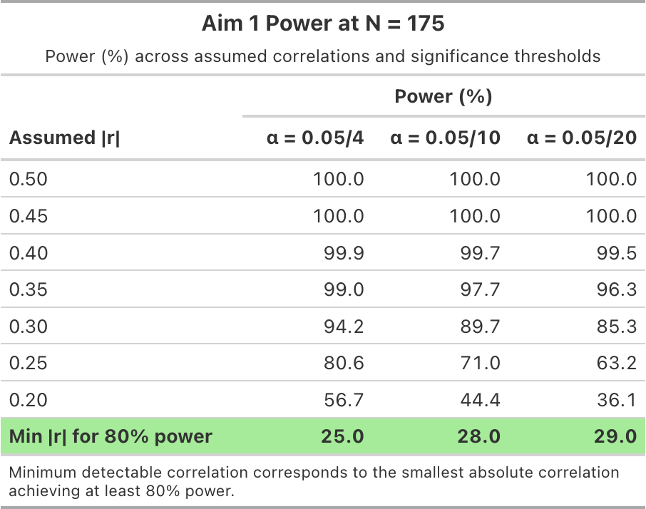
Power – Aim 1
Estimated using correlation-based methods
Evaluated across multiple α levels
Minimal impact on choice of α
80% power at |r| ≈ 0.25–0.29
Notes:
For Aim 1, power was estimated using correlation-based methods across a range of alpha thresholds to account for uncertainty in the number of independent tests
The range of alpha was chosen based on prelim data and possibility there could be more independent tests to adjust for
The optimistic alpha assumes there will be 4 independent with the most conservative at 20.
As you see the Choice of alpha didn’t have a huge impact on effect detection to achieve at least 80% power – which was within 4% of each other
This means that we have enough power to detect moderate associations, but smaller effects may not be detectable

Slide 5
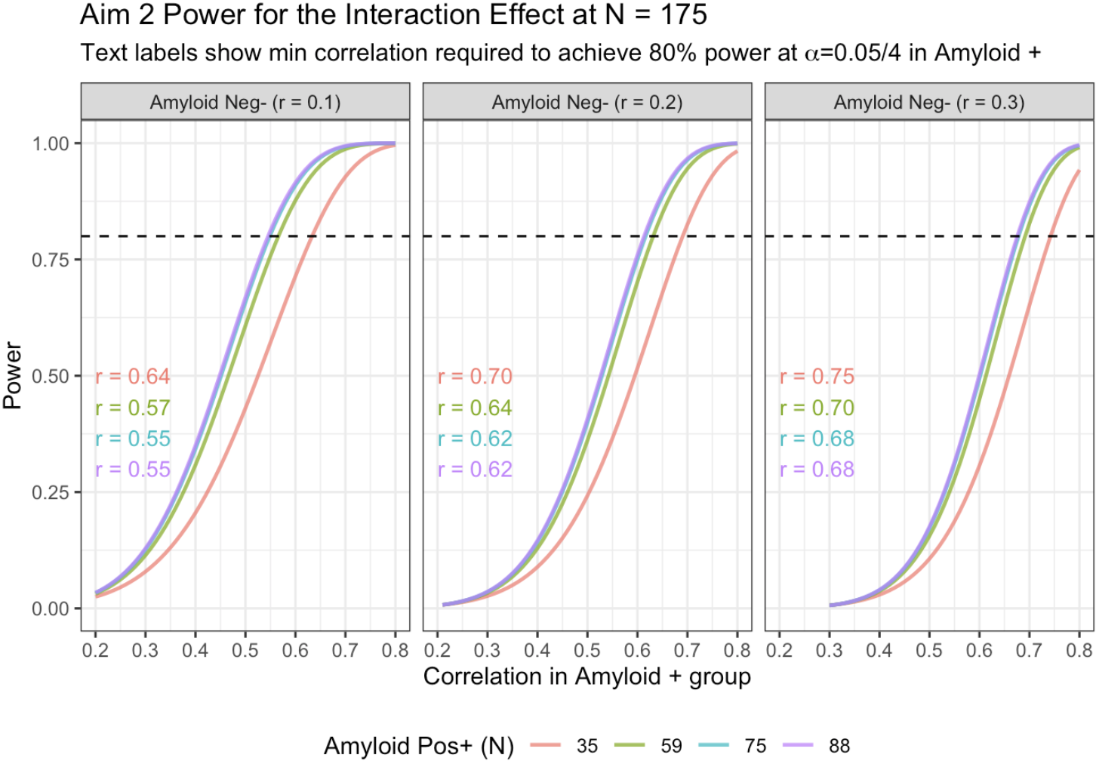
Power – Aim 2
Estimated using two-sample correlation method
α=0.05/4 = 0.0125
Per Aim 1
Power driven more by difference between groups
80% power requires:
|r|≈ 0.55–0.75 in Amyloid+ group
Least favorable
Most favorable
Notes:
For Aim 2 and for simplicity, power was evaluated 0.0125, since Aim 1 showed that power wasn’t highly sensitive to alpha.
Here, we used a two-sample correlation approach to compare associations between amyloid-negative and amyloid-positive groups.
The results showed that even in our most favorable conditions where we have equal group sizes and larger correlation differences between the groups, we would only have
Enough power at 80% to detect a moderately large effect and only gets worse as group sizes start to differ and correlation differences get smaller

Slide 6
Conclusions
Power:
Aim 1: Moderate effects detectable
Aim 2: Moderate-to-large interactions detectable
Limitations:
Limited power for small effects
Interaction effects harder to detect
Sample size is likely too small
Notes:
Overall, the proposed sample size of 175 provides adequate power to detect moderate associations in Aim 1.
For Aim 2, the study is powered to detect moderately large interaction effects, but smaller interaction effects may not be detected.
Which is important because interaction effects are typically smaller than main effects, which represents a key limitation of the study.

