Slide 1

10-year Stroke Risk in the Framingham Heart Study
Ryan Summers
4/22/26

Slide 2

Research Questions
Primary:
What baseline risk factors are associated with time to stroke?
Hypothesis: baseline risk factors are associated with time to stroke within 10 years of follow-up
H₀: HR=1 (no association) vs. Ha: HR ≠ 1 (association)
What are the 10-year stroke probabilities across risk profiles
Computed probabilities from fitted models
Secondary:
What is the change in key risk factors across three examination periods?
Descriptive
Notes:
The primary objective was to identify baseline risk factors associated with time to stroke over 10 years of follow up
With the formal hypothesis stating that baseline risk factors are associated with stroke risk
building on that, 10-year stroke probabilities across different risk profiles were estimated
and then as a Secondary objective we are interested in how key risk factors changed across the three examination periods to determine if a time-varying covariate analysis would be better equipped to answer these questions

Slide 3
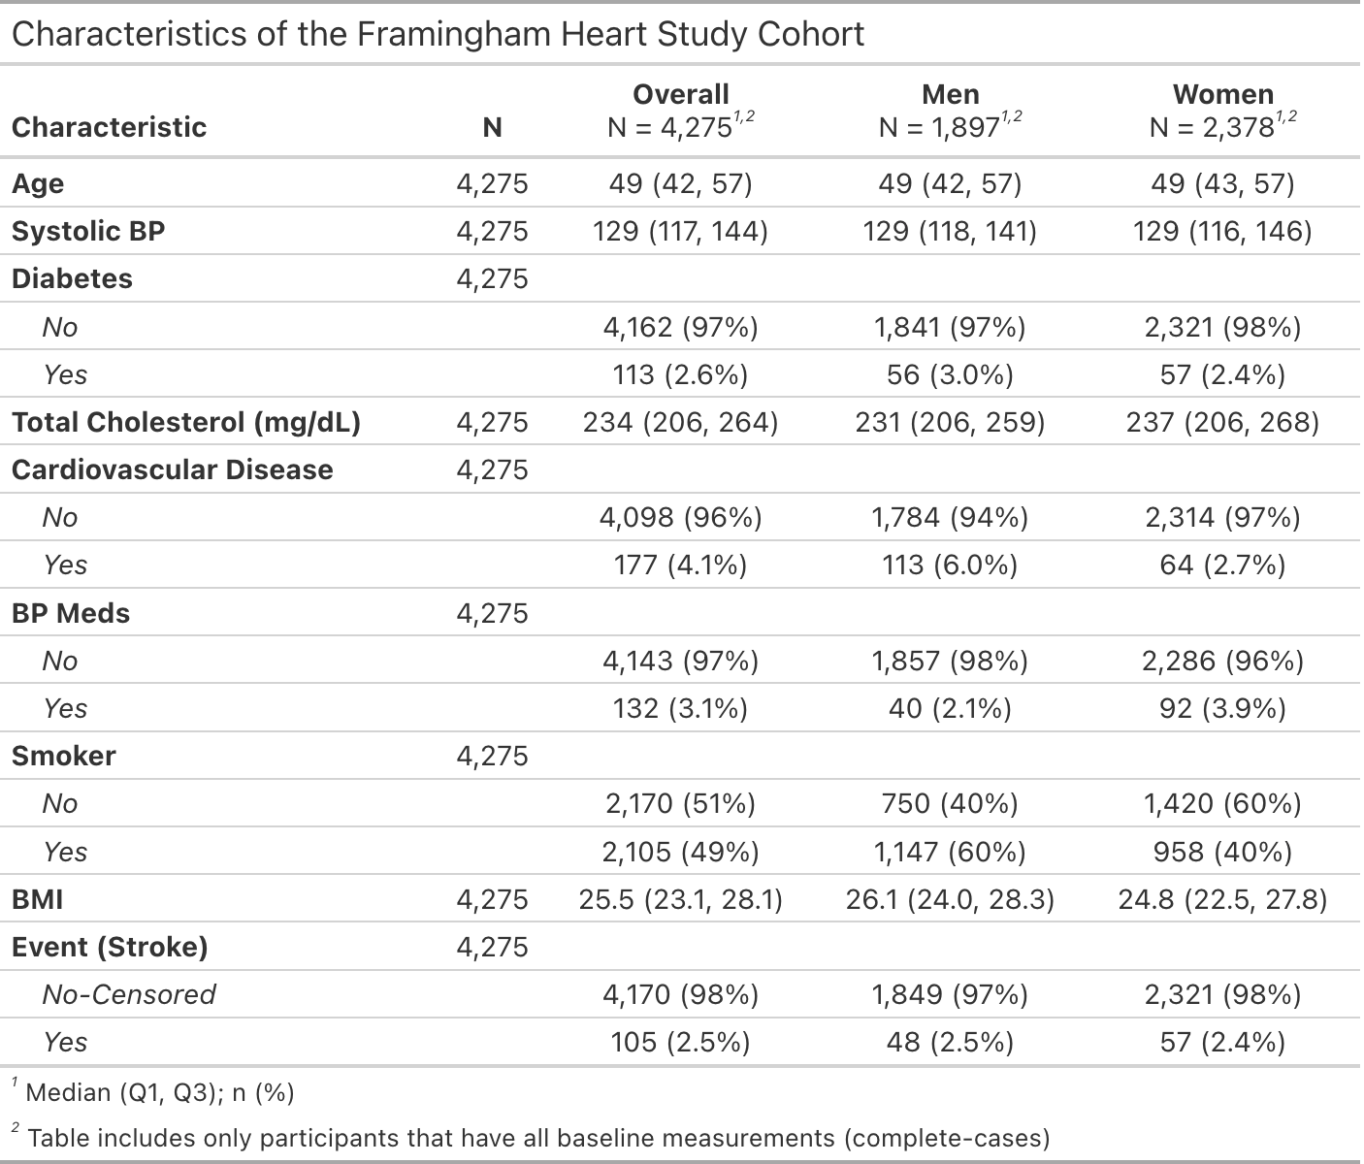
Data Overview
Full Cohort N=4,402
Excluded prior stroke
Restricted to baseline (Exam1) & first 10yrs of follow-up
Complete-case analysis
Women: N=2,378
Men: N=1,897
Missingness low (≈2.9%)
Smoking & CVD more common in men
105 stroke events
≈ 2.5% for both sexes
Notes:
So, starting with the dataset, we included approximately 4400 participants after excluding those with prior stroke and restricting to the first 10yrs of follow-up
After applying complete-case analysis, this resulted in a final sample included 2,378 women and 1,897 men. Missingness was low (2.9%), so any biases from the complete-case analysis should be minimal – MAR can not be formally verified
In terms of baseline characteristics, smoking and prior cardiovascular disease were more common in men, while other risk factors were generally similar between sexes.
Over the 10-year follow-up, there were 105 stroke events, corresponding to a crude cumulative incidence of approximately 2.5%, so stroke was a relatively uncommon outcome in this cohort.

Slide 4
Analysis
Primary: Risk factors of stroke
Sex-stratified Cox proportional hazards models
Variables:
Age, systolic blood pressure (SBP), diabetes (per PI)
Smoking, CVD, Total Chol, BP meds x SBP interaction (stepwise + clinical relevance)
Medication use expected to modify effect of SBP on risk
Primary: 10-year probability of stroke by risk profile at ages 40, 50, & 60
Estimated from survival models
Secondary: Time-varying covariates
Changes in risk factors across 3 exams
Summarized using means (SD) and proportions
Notes:
moving on to analysis, we used Cox proportional hazards models to assess risk factors for time to stroke.
Age, systolic blood pressure, and diabetes were included a priori, while smoking, CVD, cholesterol and BP med use x BP interaction variables were retained based on known importance while stepwise was used more as exploratory tool more than anything.
for the interaction we expected medication use to modify the effect of blood pressure.
Using these models, we then estimated predicted 10-year stroke probabilities by risk profiles across ages of 40, 50 & 60.
Finally, to address the secondary aim, we summarized changes in risk factors across three exams using marginal means and proportions.

Slide 5
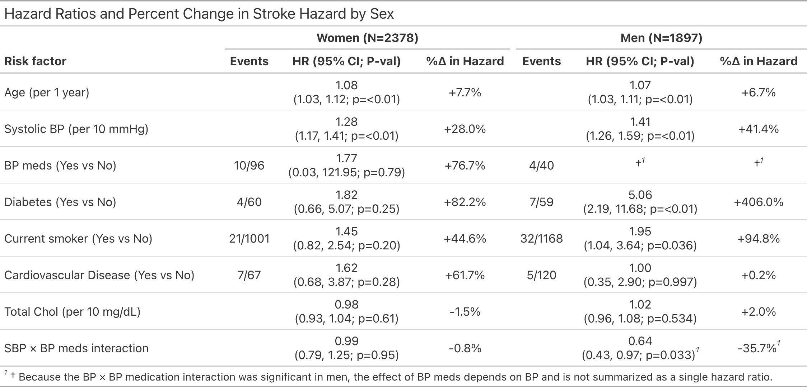
Results
Primary predictors
Age: +8% (women) ; +7% (men)
SBP: +28% (women) ; +41% (men)
Men only
Diabetes: ~5x risk of stroke
Smoking: ~2x risk of stroke
SBPxBP Meds: lower risk at higher SBP levels
Limited # of events across strata
Notes:
On to result, In both sexes, older age and higher systolic blood pressure were the primary predictors of stroke.
For each additional year of age there was an 8% increase in risk in women and 7% for men
While each 10 units of mmHg was associated with a 28% increase in risk for women and 41% for men
Among men, we had additional predictors of stroke. Diabetes was associated with roughly a fivefold higher risk, and smoking with about a twofold higher risk,the interaction suggests that the effect of SBP on risk was modified by medication use,
however, these estimates are somewhat uncertain due to small numbers of events which can be seen with these wide CI
Which I think has really limited the power to detect some of these relatively large effects

Slide 6
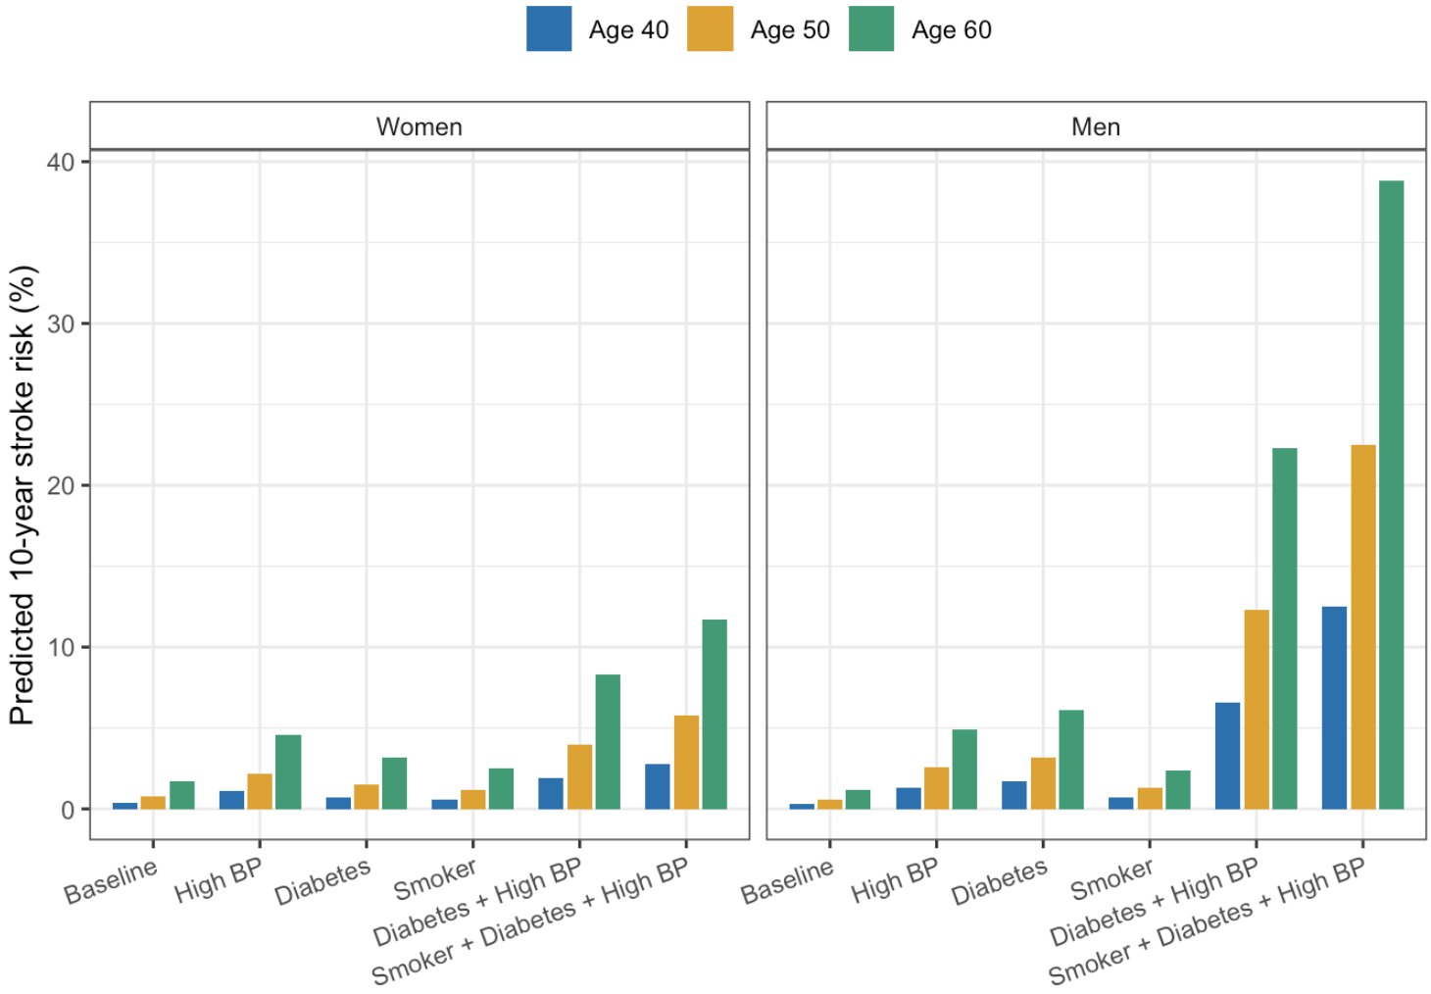
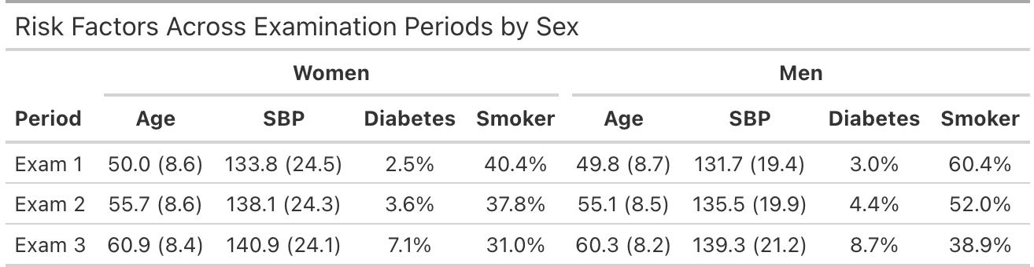
Results, continued
10-year stroke risk
Increases w/ age and concurrent risk factors
Overall higher risks for men
Highest risk profile:
Diabetes
High BP (≥160mmHg)
Smoking
Women ≈ 12%
Men ≈ 39%
Change in risk factors across exams
Marginal changes in means (SD) & proportions
SBP & Diabetes increased
Smoking decreased
Notes:
Next looking at predicted risk - 10-year stroke risk increased with age and the number of risk factors, with men having higher risk across all profiles
The highest risk was observed among individuals with diabetes, high BP and smoking, particularly among men.
Results from secondary aim, showed that risk factors did change over time. SBP and diabetes prevalence increased across exams, while smoking prevalence decreased.
So Together, these findings suggest that risk factors change over time, so a time-varying covariate analysis could improve estimation of stroke risk

Slide 7
Conclusions
Findings:
Older age and high BP are primary drivers of stroke risk in both sexes
Additional risk factors and stronger effects were identified for men
10yr stroke risk increased with age & accumulation of risk factors
Time-varying models may provide more accurate estimates
Limitations:
Limited number of stroke events = lower power
Baseline covariates may not capture changes in risk over time
Stepwise selection introduces biases, overfits, ignores clinical relevance
Complete-case analysis can be biased if missingness is not at random (MAR)
Notes:
In conclusion, older age and high BP were the primary drivers of stroke risk in both sexes. Additional risk factors, including diabetes and smoking, were more prominent among men.
Stroke risk increased with the accumulation of risk factors, and the highest predicted risks were observed in individuals with multiple concurrent conditions.
Summary measures of risk factors changed over time which suggest that incorporating time-varying covariates may improve future risk prediction.
Finally, Key limitations include the low number of stroke events, reliance on baseline covariates for estimating risk, stepwise selection is known to be biased and ignores clinical relevance and lastly the possibility of bias from complete-case analysis if missingness is not at random - MAR can not be formally verified so we are assuming MCAR

