Slide 1

Project 4 :
Interim Data Analysis Plan
Ryan Summers
5/4/26

Slide 2

Research Question / Aims
How do different variable selection methods perform in including true predictors and excluding irrelevant predictors in linear regression models under varying sample sizes and levels of variable correlation
Aims:
Compare variable selection accuracy across selection methods
Evaluate coefficient estimation performance (bias, CI coverage)
Assess Type I & II error post-model selection
Notes:
The main research question guiding this project is: how do different variable selection methods perform in identifying true predictors and excluding irrelevant ones under varying sample sizes and correlations
To address this, we have three aims: comparing variable selection accuracy across methods, evaluating coefficient estimation performance, and assessing Type I and Type II error rates

Slide 3

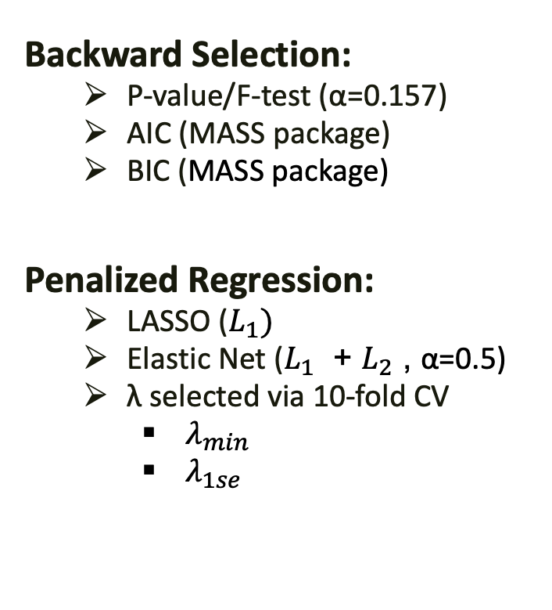
Design & Methods
Backward Selection:
P-value/F-test (α=0.157)
AIC (MASS package)
BIC (MASS package)
Penalized Regression:
LASSO ($L_{1})$
Elastic Net ($L_{1}$ + $L_{2}$ , α=0.5)
λ selected via 10-fold CV
$λ_{min}$
$λ_{1se}$
Simulation Design:
Data generated under Linear Regression using hdrm::gen_data()
$Y=Xβ+ε$
$X$ is $n_{obs} × 20 ; ε∼N(0,σ^{2})$
5 true predictors:
$β_{1:5} =\text{(}\text{0.5/3, 1/3, 1.5/3, 2/3, 2.5/3}$)
15 unrelated:
$β_{6:20} =\text{0}$
Sample sizes: $n_{obs}$∈ {250, 500}
Correlation: $ρ$ ∈ {0, 0.35, 0.7} (exchangeable/CS)
6 data-generating scenarios
Notes:
Starting with sim design, we will simulate data under a linear regression model using the ‘hdrm’ package
Each simulated dataset will include 20 continuous predictors, but only 5 of them are truly associated with the outcome, while the remaining 15 are null.
We then vary two parameters of this data-generating process.
The sample size, using 250 and 500 observations and correlation among the predictors using an exchangeable structure with values 0, 0.35, and 0.7.
Which will give us six scenarios to evaluate .
Across these six scenarios we will be comparing seven selection methods
The first group consists of backward selection approaches, which iteratively remove predictors based on different criteria: in our case, variables are removed if their p-value exceeds 0.157, or if removing them improves model fit according to AIC or BIC
The second group consists of penalized regression methods, including LASSO, which applies a penalty that can shrink coefficients to zero, and elastic net, that uses a combination of penalties is said to perform better when predictors are highly correlated.
For both, the tuning parameter lambda will be selected by 10-fold cross-validation, and two lambdas will be investigated, one that minimizes CV prediction error and a more conservative choice within 1 SE of that minimum.
λ_min → higher FP, lower FN (misses) λ_1se → lower FP, higher FN

Slide 4
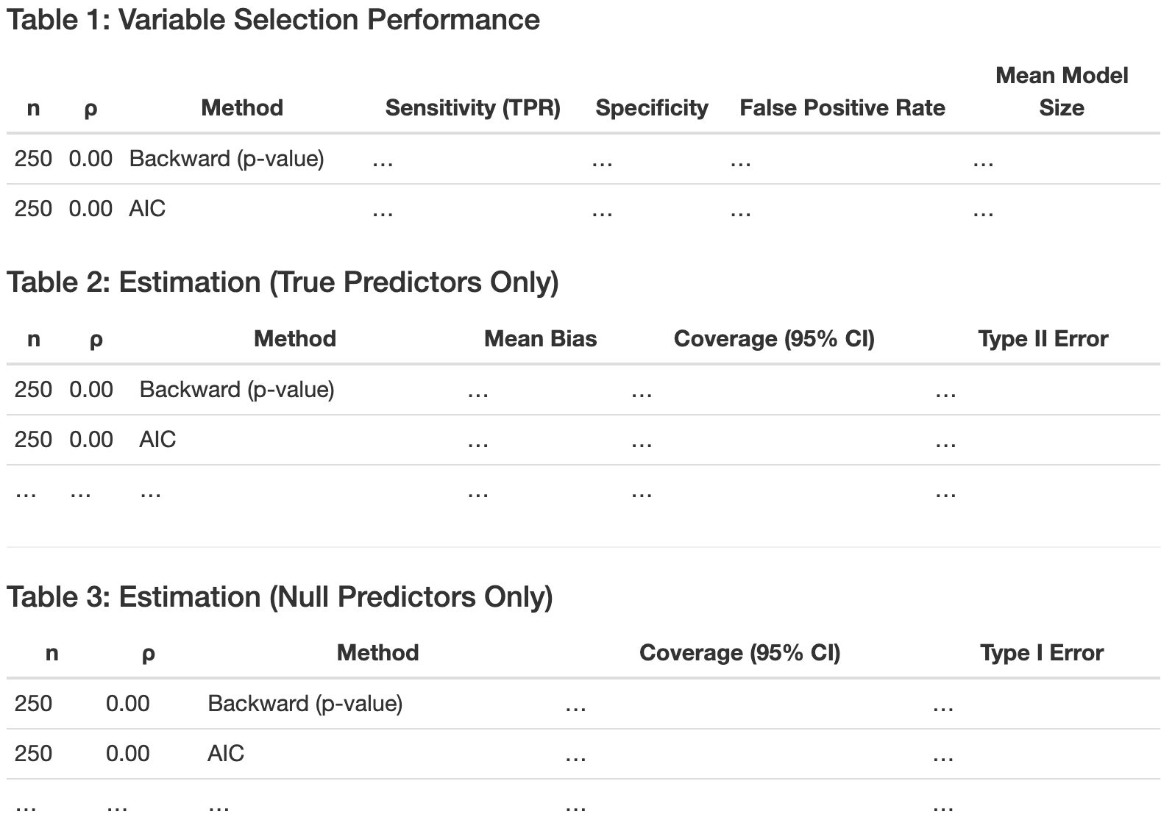
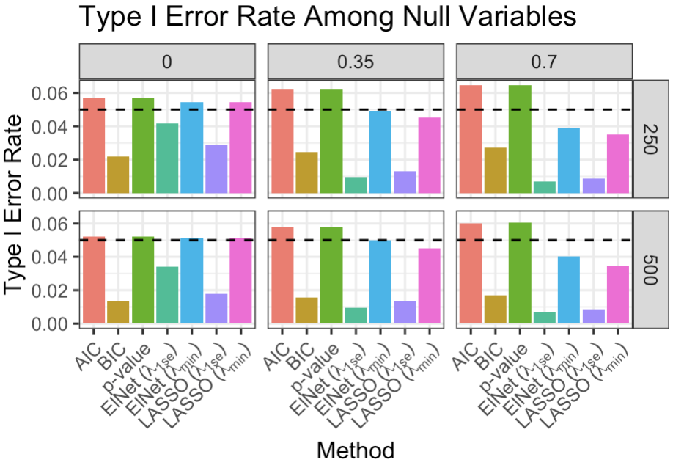
Analysis Plan
Simulation:
Generate dataset under specified scenario
Fit full model w/20 predictors
Apply all selection methods
Refit final model
Repeat 10k per scenario
Average across iterations
Selection Performance measures:
True Positive Rate (TPR)
Sensitivity
False Positive Rate (FPR)
1-Specificity
Mean model size (complexity)
Estimation Evaluation:
Bias of coefficients
95% CI coverage
Type I & II error
Notes:
For the simulation workflow, we will generate a dataset, fit the full model with all 20 predictors, and apply each selection method to obtain a final variable set.
We then refit the model using only the selected variables so we can compare estimates to the true β values
This process repeats 10,000 times per scenario, and results will be summarized as averages across iterations.
Each Methods Performance will be assessed across two areas. For variable selection, we evaluate how well each method identifies true predictors and avoids selecting null variables, using measures like sensitivity and false positive rate, along with mean model size as a measure of complexity
For estimation, we evaluate bias, 95% CI coverage, and Type I and Type II error rates. - with the key detail
That any variable that is not selected (true or not) will have its estimate treated as zero, which adds to bias and counts as non-coverage.
Once all simulations are complete, results will be summarized using tables and plots like the examples shown here,

