Slide 1

Longitudinal DNAm Changes in TEDDY

Slide 2

Recap
Clustering CpGs
by projected age curves fitted with cubic splines in lmer() age_grid = quantile(probs = seq(0, 1, length.out = 12)
[1] "0.203yrs-2mos" "0.501yrs-6mos" "0.750yrs-9mos" "0.994yrs" "1.235yrs" "1.498yrs” 1.755yrs" "2.055" "2.507" "3.003yrs" "3.724yrs" "6.190yrs”
biologically meaningful ages will be explored
Kmeans on a small sample of 50 CpGs
25 top increasing and 25 flat CpGs by fixed beta from lmer
Flat = filter(abs(fixed_slope) < 0.002, q_slope > 0.5)
Increasing = filter(fixed_slope > 0.01, q_slope < 0.01)

Slide 3
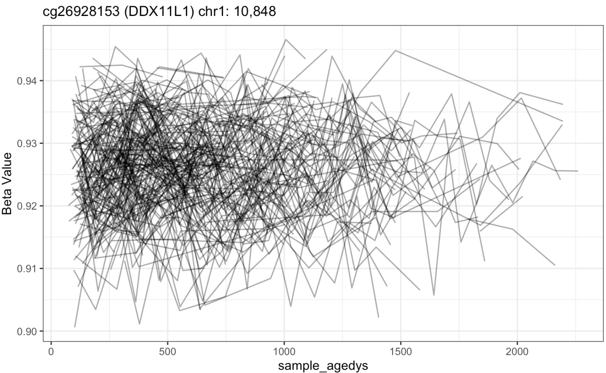
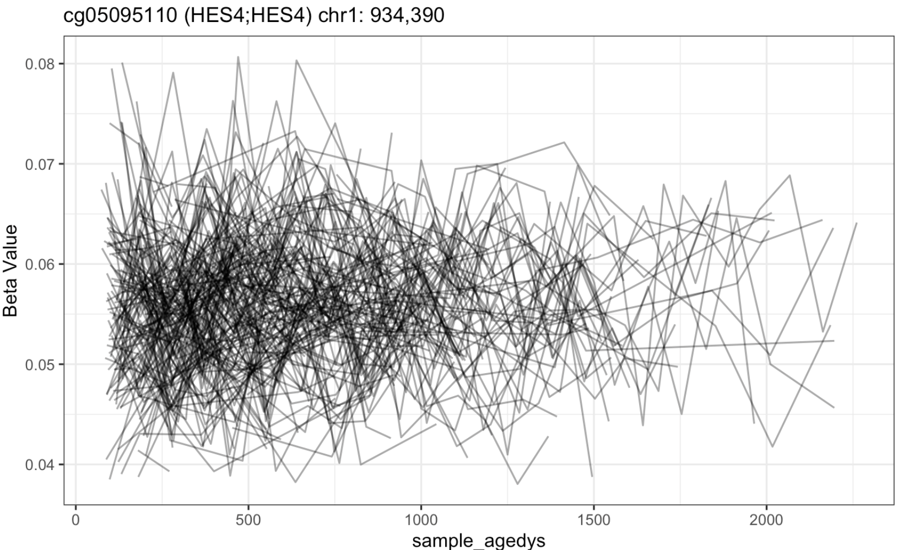
Clustering Results
Flat CpGs not clustering together
9 out of 25 “flat” CpGs were clustered in with increasing CpGs
All increasing CpGs were clustered together

Slide 4
Next Steps
Clustering Results
Examining why ”flat” CpGs are not being clustered together
Ages 4 to 6 are sparse – maybe highly leveraged?
Exploring other model outputs as inputs for clustering
BLUPs, AIC, BIC, etc
Methods based on Hossain et al & James et al
Papers provide approaches to clustering longitudinal data
Treat each subjects trajectory as a latent function or curve
Curves fitted by splines (ns=3)
Use RE model coeffs
Cluster using EM

