Slide 1

Longitudinal DNAm Changes in TEDDY
Ryan Summers
5/27/26

Slide 2

Thesis Aims
Explore longitudinal modeling and clustering methods to identify a meaningful representation of methylation trajectories
Using unsupervised machine learning techniques to cluster CpGs into classes based on similar trajectory profiles
(potential) Enrichment analysis on these trajectory classes
Notes:
hypothesis generating / exploration stage

Slide 3
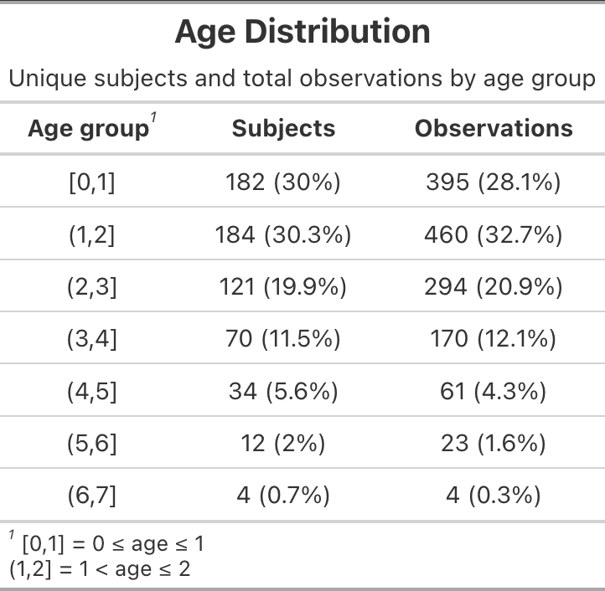
Data Overview
Full Cohort N=209
1407 observations per CpG site
790,944 CpGs
Age at Diagnosis (yrs)
Median (IQR): 2.5 (1.7, 3.6)
Min-Max : 0.9 – 6.3
Visits per subject
Median (IQR): 6.0 (4.0, 9.0)
Min-Max: 1.0 – 20.0
≈89% have 2 observations or more
≈77% have 3 or more
Preprocessing:
CpG wise MAD outlier detection (≈ 1.25% flagged)
Removed CpGs from chrX (≈17.5k)
Separate analysis??

Slide 4
Method Development
Mixed-effects Spline Model per CpG site
Nonlinear age effects
Uses basis functions & knots to allow a flexible fitted curve
Predicted methylation at age (a):
Clustering CpGs
Predicted m-values at age (a) used as features for K-means
Encodes a trajectory shape
Age grid (12 features): ~2.4mo – 6mo – 9mo – 1.2yrs – 1.5yrs – 1.75yrs – 2yrs – 2.5yrs -3yrs - 3.7yrs – 6.2yrs
Pipeline:
Longitudinal DNAm data
↓
Preprocessing
↓
CpG-wise mixed-effects spline models
↓
Predicted methylation trajectories
↓
Trajectory filtering (remove flat CpGs)
↓
Clustering of trajectories
↓
Identify trajectory dynamics
↓
Enrichment??
Prediction dataset format-CpG Specific (cg123…)
maskid | visit | Age (a) | gender | cc | cell_prop1 | cell_prop2 | Prediction (p)
1 | v1 | 0.994 | F | Finland | 0.42 | 0.11 | 3.66
2 | v2 | 0.994 | M | Sweden | 0.35 | 0.18 | 2.32
3 .. | v1 .. | 0.994 .. | F .. | Colorado .. | 0.5 .. | 0.09 .. | 2.77 …
 | p <- predict(model, newdata = nd, re.form = NA) |  |  |  |  | Avg:mean(p) | 3.658
Notes:
Basis = building blocks of predicted trajectory curve – weighted combination of basis functions build the trajectory curve
Knots = partitions ages into regions that allows the trajectory curve to be more flexibility
Natural splines model nonlinear trajectories by combining smooth basis functions whose flexibility is guided by knot locations, allowing local curvature while preserving one continuous trajectory across age.
Predicted methylation values implicitly encode the trajectory shape
Methods based on Hossain et al & James et al - Papers provide approaches to clustering longitudinal data
toy demonstration

Slide 5
Pre-liminary Results & Next Steps
Clustering:
”Gold Standard” CpGs
Visually increasing, flat, & decreasing CpGs were identified
Perfect separation for increasing and decreasing CpGs - struggled with “flats”
Next Steps:
Remove “flat” CpGs based on predicted m-values
Identify CpG sites with unique trajectories (next slide)
Explore other clustering methods
Run clustering algorithm on larger/complete CpG set

Slide 6
