Slide 1

Longitudinal DNAm Changes in TEDDY
Ryan Summers
6/18/26

Slide 2

Thesis Aims (WIP)
Apply longitudinal modeling methods to identify a meaningful representation of methylation trajectories
Apply Gaussian Mixtures Models (GMM) to identify CpGs with bi/trimodal trajectories
Apply unsupervised machine learning techniques to cluster CpGs into classes based on similar trajectory profiles
(potential) Perform enrichment analysis on trajectory classes
Notes:
hypothesis generating / exploration stage

Slide 3
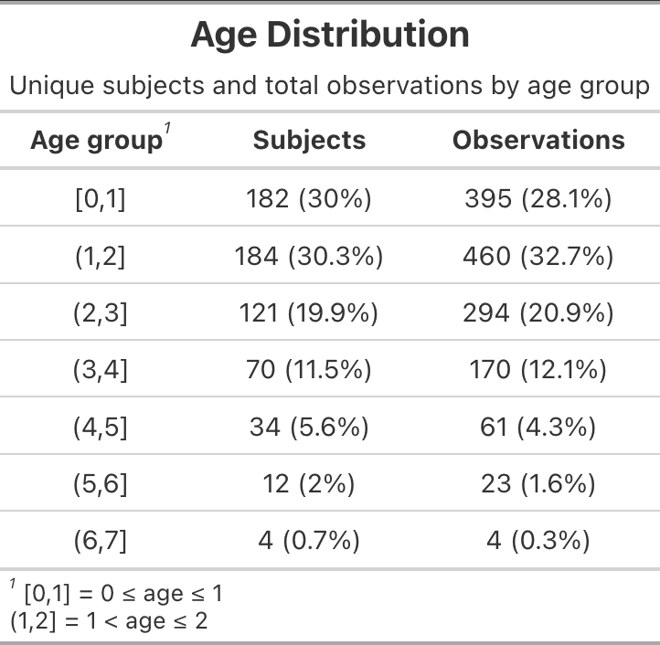
Data Overview
TEDDY
Longitudinal nested case-control design
Matched on Age, CC, T1D FH, sex
N=209 (107 cases vs 102 controls)
Age range : 2.5mos to 6.2yrs
1407 observations per CpG site
790,944 CpGs
>250 clinical & environmental variables
Visits per subject (obs)
Median (IQR): 6.0 (4.0, 9.0)
≈75% have 4 or more observations
Min-Max: 1.0 – 20.0
Preprocessing:
QC completed by IVYomics group
Removed CpGs from chrX (≈17.5k)
Outlier detection (TBD)
Notes:
CpG wise MAD outlier detection (≈ 1.25% flagged)
Observations labeled as NA - to avoid removing entire samples

Slide 4
Method Development
Mixed-effects Spline Model per CpG site
Nonlinear age effects
Uses basis functions & knots to allow a flexible fitted curve
Predicted methylation at age (a):
Identifying sub-trajectories
Apply GMM (in progress)
Using subject-level intercepts per CpG site as features
Clustering CpGs
Predicted m-values at age (a) used as features for K-means
Encodes a trajectory shape
Age grid (12 features): ~2.4mo – 6mo – 9mo – 1.2yrs – 1.5yrs – 1.75yrs – 2yrs – 2.5yrs -3yrs - 3.7yrs – 6.2yrs
Pipeline:
M-value Matrix (QC’d)
↓
Preprocessing
↓
CpG-wise mixed-effects spline models
↓
Predicted methylation trajectories
↓
Trajectory filtering
(flat CpGs & sub-trajectories)
↓
Cluster trajectories into classes
↓
Identify trajectory dynamics
↓
Enrichment??
Prediction dataset format-CpG Specific (cg123…)
maskid | visit | Age (a) | gender | cc | cell_prop1 | cell_prop2 | Prediction (p)
1 | v1 | 0.994 | F | Finland | 0.42 | 0.11 | 3.66
2 | v2 | 0.994 | M | Sweden | 0.35 | 0.18 | 2.32
3 .. | v1 .. | 0.994 .. | F .. | Colorado .. | 0.5 .. | 0.09 .. | 2.77 …
 | p <- predict(model, newdata = nd, re.form = NA) |  |  |  |  | Avg:mean(p) | 3.658
Notes:
Basis = building blocks of predicted trajectory curve – weighted combination of basis functions build the trajectory curve
Knots = partitions ages into regions that allows the trajectory curve to be more flexibility
Natural splines model nonlinear trajectories by combining smooth basis functions whose flexibility is guided by knot locations, allowing local curvature while preserving one continuous trajectory across age.
Predicted methylation values implicitly encode the trajectory shape
Methods based on Hossain et al & James et al - Papers provide approaches to clustering longitudinal data
toy demonstration

Slide 5
Pre-liminary Results & Next Steps
Clustering:
”Gold Standard” CpGs
Visually increasing, flat, & decreasing CpGs were identified
Perfect separation for increasing and decreasing CpGs - struggled with “flats”
Flats to be removed from downstream analysis (new)
Need to fine tune the definition of “flats”
Next Steps:
Analyze controls only (new direction)
Use GMM to identify CpGs with sub-trajectories (last slide)
Cluster on remaining CpGs & describe the trajectory classes
Interpret functional associations of CpGs in the clusters
Notes:
Possible trajectory classes:
Increasing - decreasing – early change followed by plateau
Are CpGs near promoters, enhancers, TF regions, islands, etc
Island/shore/shelf/open sea – near gene – regulatory elements - pathway

Slide 6
