Slide 1

Azure HayMaker
Autonomous Cloud Security Testing with AI Agents
Architecture, Deployment, and Demo • November 2025

Slide 2
Why Azure HayMaker?
The Challenge
Current Limitations
50+ Azure services with unique security models
Manual testing doesn't scale
Configuration drift goes undetected
Compliance validation is time-consuming
Manual checklists (slow, inconsistent)
Static security scanners (limited scope)
Penetration tests (expensive, infrequent)
Configuration audits (point-in-time only)

Slide 3
Azure HayMaker: Autonomous Security Testing
What It Does
Key Innovation
Deploys 50+ distinct Azure operational scenarios
Uses AI agents (Claude Sonnet 4.5) for autonomous execution
Runs continuously (4x daily across global regions)
Self-provisioning, self-contained, self-cleaning
Generates benign security telemetry for monitoring
Goal-seeking agents that troubleshoot their own issues
Complete lifecycle automation (deploy → operate → cleanup)
Zero manual intervention required

Slide 4
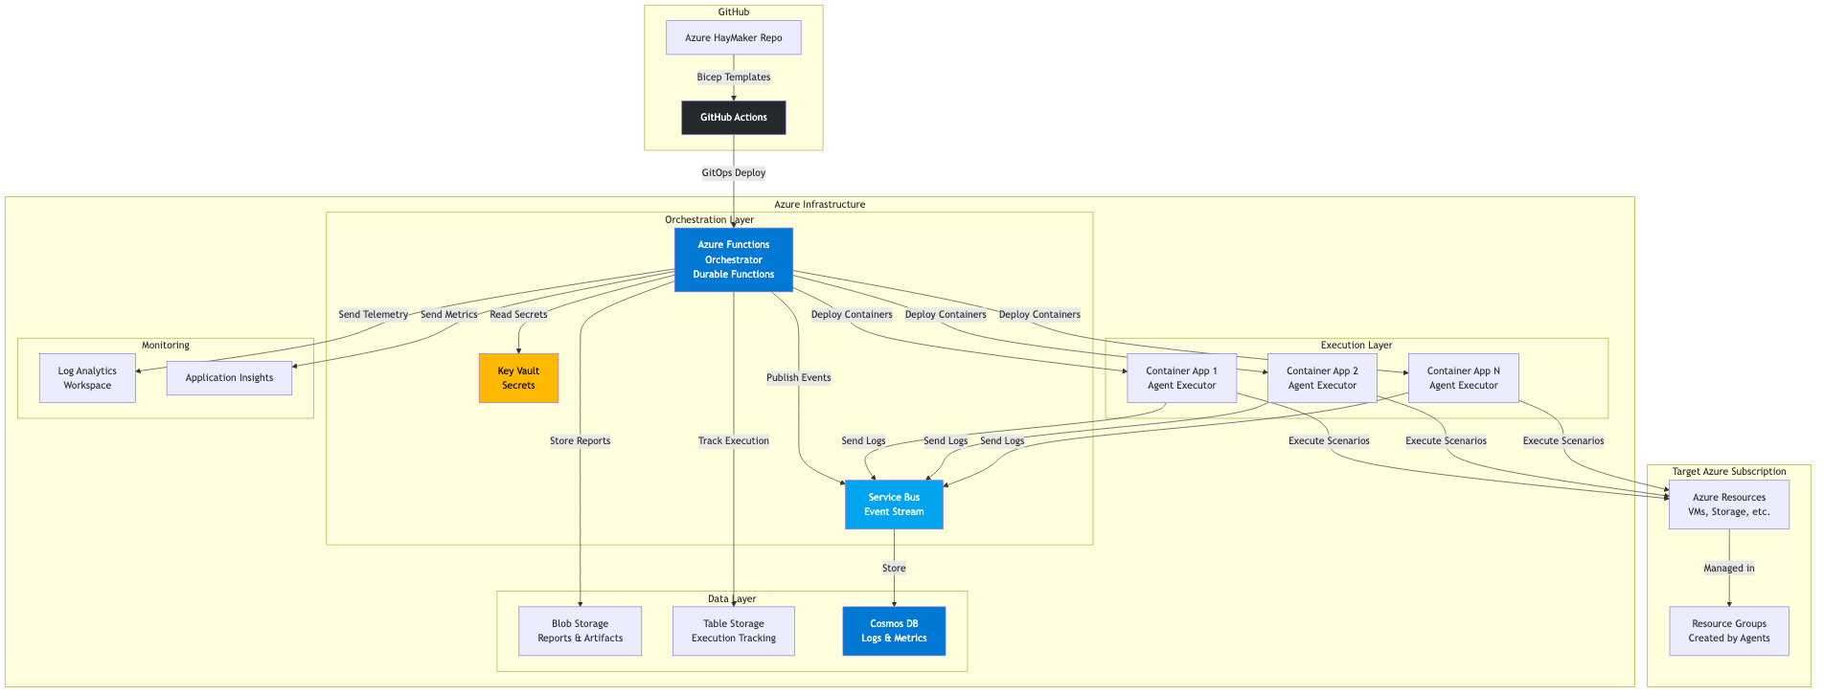
High-Level Architecture

Slide 5
System Components
Orchestrator Layer
Azure Durable Functions (Python)
Manages scheduling, provisioning, monitoring
Agent Execution Layer
Azure Container Apps with Claude Sonnet 4.5
64GB RAM, 2 CPU per agent
Event & Storage Layer
Service Bus (real-time streaming)
Cosmos DB (historical logs, 7-day TTL)

Slide 6
Technology Choices
Component | Technology | Why?
Orchestrator | Durable Functions | Long-running workflows, checkpointing
Agents | Container Apps | Isolation, managed, secure secrets
AI Model | Claude Sonnet 4.5 | Goal-seeking, troubleshooting
Event Bus | Service Bus | Guaranteed delivery, DLQ
Log Storage | Cosmos DB | Fast queries, TTL, partitioning
Secret Management | Key Vault | RBAC, audit logs, rotation
Infrastructure | Bicep | Azure-native, readable, modular
CI/CD | GitHub Actions | Native OIDC, matrix builds

Slide 7
Security Architecture
Identity Management
Main SP: Orchestrator with Contributor + User Access Admin
Scenario SPs: Ephemeral, created per-agent, deleted after cleanup
Secret Management
All secrets in Azure Key Vault
Function App uses Key Vault references (NOT direct values)
Secrets NEVER visible in Azure Portal
Audit & Compliance
All Azure Activity logged (90 days)
Key Vault access logged (2 years)

Slide 8
End-to-End Workflow
1. Timer Trigger (4x daily at 00:00, 06:00, 12:00, 18:00 UTC)2. Validation (credentials, APIs, quotas)3. Selection (random N scenarios based on simulation_size)4. Provisioning (parallel)
Create service principals
Deploy Container Apps5. Monitoring (8 hours)
Subscribe to Service Bus
Aggregate logs to Cosmos DB6. Cleanup Verification
Query Azure Resource Graph7. Forced Cleanup (if needed)8. Report Generation & Archival

Slide 9
Key Benefits
Continuous Validation
4x daily execution ensures configurations stay compliant
Zero Manual Effort
Complete automation from deployment to cleanup
Cost-Effective
Automatic cleanup prevents cost accumulation
Comprehensive Coverage
50+ scenarios across all Azure service categories

Slide 10
Deployment Prerequisites
Azure Requirements
Tools Required
Active subscription with quota
Owner or Contributor role
Function Apps (Premium tier)
Container Apps (64GB instances)
Azure CLI (latest)
Bicep CLI (latest)
GitHub CLI (optional)
Anthropic API key

Slide 11
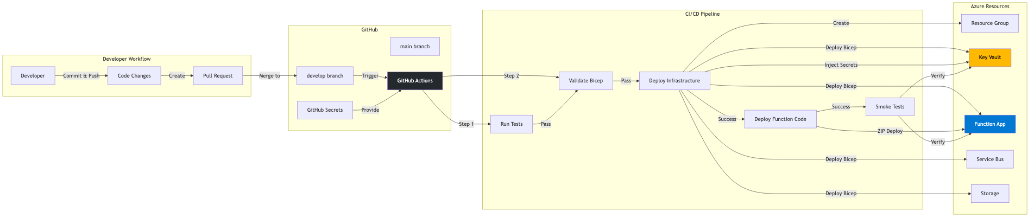
GitOps Continuous Deployment

Slide 12
CI/CD Pipeline Stages
Stage 1: Validate
Bicep template validation, syntax checksStage 2: Test
pytest (276 tests), ruff, pyrightStage 3: Deploy Infrastructure
Create RG, deploy Bicep, inject secrets, wait for RBAC (60s)Stage 4: Deploy Function App
Package Python, deploy, configure, restartStage 5: Smoke Tests
Verify Function responding, Key Vault access, Service Bus
Duration: ~10-15 minutes per deployment

Slide 13
Infrastructure as Code (Bicep)
Modular Design
infra/bicep/├── main.bicep (Orchestrates all modules)├── parameters/ (dev, staging, prod)└── modules/ ├── function-app.bicep ├── keyvault.bicep ├── servicebus.bicep ├── cosmosdb.bicep └── monitoring.bicep
Key Features: Idempotent, Parameterized, Optional resources for dev

Slide 14
Environment Differences
Aspect | Dev | Staging | Prod
Function App | Consumption | Premium (EP1) | Elastic (EP2)
Simulation Size | 5 scenarios | 15 scenarios | 30 scenarios
Schedule | On startup | 2x daily | 4x daily
Cosmos DB | Optional | Serverless | Provisioned
Cost/Month | $50-100 | $200-400 | $800-1200

Slide 15
Secret Management - THE FIX
BEFORE (Insecure)
Benefits
az functionapp config appsettings set
--settings ANTHROPIC_API_KEY="sk-ant-..."
❌ EXPOSED in Azure Portal!
Secrets NEVER visible in Portal
Consistent across ALL environments
Automatic rotation support
Audit logs in Key Vault
RBAC-controlled access
AFTER (Secure)
Step 1: Inject to Key Vault
az keyvault secret set --vault-name $KV
--name anthropic-api-key
--value "$ANTHROPIC_API_KEY"
Step 2: Function App references KV
value: @Microsoft.KeyVault(
VaultName=...; SecretName=...)
✅ NEVER visible in Portal!

Slide 16
Deployment Steps
1. Fork repository and clone2. Create service principal with Contributor role
az ad sp create-for-rbac --name AzureHayMaker-Main3. Configure GitHub OIDC federated credentials
scripts/setup-oidc.sh4. Add GitHub Secrets
AZURE_TENANT_ID, AZURE_CLIENT_ID, ANTHROPIC_API_KEY, etc.5. Push to develop branch
GitHub Actions automatically deploys to dev environment6. Verify deployment
haymaker status

Slide 17
Common Deployment Issues
Issue | Solution
Bicep validation fails | Run az deployment group validate locally
RBAC access denied | Wait 60s for propagation, retry
Container Registry unavailable | Use Basic tier or skip for dev
Cosmos DB region error | Change region or use Table Storage
Key Vault access denied | Check RBAC assignments and firewall
Function App won't start | Verify Key Vault references correct

Slide 18
Installing the CLI
# Install uv package manager
curl -LsSf https://astral.sh/uv/install.sh | sh
# Clone repository
git clone https://github.com/your-org/AzureHayMaker.git
cd AzureHayMaker/cli
# Install CLI and dependencies
uv sync
# Verify installation
uv run haymaker --help
Requirements: Python 3.11+, Network access to Function App API

Slide 19
Configuring the CLI
# Set Function App endpoint
uv run haymaker config set endpoint \
https://haymaker-dev-func.azurewebsites.net
# View configuration
uv run haymaker config list
# Test connection
uv run haymaker status
# Output:
✓ Orchestrator: Running
✓ Last execution: 2025-11-17 12:00 UTC
✓ Next scheduled: 2025-11-17 18:00 UTC
✓ Active agents: 5
✓ Pending cleanup: 0 resources

Slide 20
Checking Orchestrator Status
uv run haymaker status
┌─────────────────────────────────────────┐
│ Azure HayMaker Status │
├─────────────────────────────────────────┤
│ Orchestrator Status: ✓ Running │
│ Current Run ID: run-2025-11-17 │
│ Execution Started: 12:00:00 UTC │
│ Time Remaining: 3h 25m │
│ │
│ Active Agents: 5 running │
│ Completed Agents: 0 │
│ Resources Created: 127 │
│ │
│ Next Scheduled Run: 18:00:00 UTC │
└─────────────────────────────────────────┘

Slide 21
Viewing Agent Execution
uv run haymaker agents list
┌─────────────┬──────────────┬─────────┬──────────┐
│ Agent ID │ Scenario │ Status │ Duration │
├─────────────┼──────────────┼─────────┼──────────┤
│ agent-abc │ compute-01 │ Running │ 3h 20m │
│ agent-def │ storage-01 │ Running │ 3h 18m │
│ agent-ghi │ network-01 │ Running │ 3h 15m │
│ agent-jkl │ ai-ml-01 │ Running │ 3h 13m │
│ agent-mno │ database-01 │ Running │ 3h 10m │
└─────────────┴──────────────┴─────────┴──────────┘
# Get details for specific agent
uv run haymaker agents get agent-abc

Slide 22
Viewing Agent Logs
# Tail last 50 log entries
uv run haymaker logs --agent-id agent-abc --tail 50
┌──────────────────────────────────────────────┐
│ Agent Logs: agent-abc │
├───────────┬────────┬─────────────────────────┤
│ Timestamp │ Level │ Message │
├───────────┼────────┼─────────────────────────┤
│ 12:05:23 │ INFO │ Starting scenario │
│ 12:05:45 │ INFO │ Resource group created │
│ 12:06:12 │ INFO │ Virtual network created │
│ 12:07:01 │ INFO │ VM deployed │
│ 12:08:45 │ INFO │ Web server accessible │
│ 15:25:34 │ INFO │ Initiating cleanup │
│ 15:26:01 │ INFO │ Cleanup completed ✓ │
└───────────┴────────┴─────────────────────────┘

Slide 23
Streaming Logs in Real-Time
# Follow logs in real-time (like tail -f)
uv run haymaker logs --agent-id agent-abc --follow
Following logs for agent-abc (Ctrl+C to exit)
12:05:23 INFO Starting scenario: compute-01
12:05:45 INFO Resource group created
12:06:12 INFO Virtual network created
12:06:34 INFO NSG configured
12:07:01 INFO Virtual machine deployed
12:07:23 WARNING Public IP exposed (expected)
12:08:45 INFO Web server accessible
12:09:12 INFO Security validation: PASSED
# ... logs continue streaming ...
• Default poll interval: 5 seconds
• Displays logs immediately as they arrive
• Perfect for debugging live executions

Slide 24
Listing Deployed Resources
# List resources by scenario
uv run haymaker resources list --scenario compute-01
┌─────────────────┬───────────────┬────────┐
│ Resource Type │ Resource Name │ Status │
├─────────────────┼───────────────┼────────┤
│ Resource Group │ rg-agent-abc │ Active │
│ Virtual Network │ vnet-web │ Active │
│ NSG │ nsg-web │ Active │
│ Public IP │ pip-web │ Active │
│ Virtual Machine │ vm-web-server │ Running│
└─────────────────┴───────────────┴────────┘
# List ALL resources across ALL agents
uv run haymaker resources list --all

Slide 25
Deploying Scenarios On-Demand
# Deploy specific scenario immediately
uv run haymaker deploy --scenario compute-01-linux-vm
⏳ Step 1: Creating service principal...
✓ Service principal created
⏳ Step 2: Assigning roles...
⏳ Waiting 60s for RBAC propagation...
✓ Roles assigned
⏳ Step 3: Deploying container app...
✓ Container app deployed
⏳ Step 4: Starting agent execution...
✓ Agent started successfully
Agent ID: agent-abc123
Scenario: compute-01-linux-vm
Status: Running

Slide 26
Demo: Linux VM Web Server
Scenario: compute-01-linux-vm-web-server
Phase 1: Deploy (5-7 minutes)
Create resource group, VNet, NSG, Ubuntu VM
Assign public IP, install Nginx web server
Phase 2: Operate (8 hours)
Serve HTTP traffic, generate logs, health checks
Phase 3: Cleanup (2-3 minutes)
Stop VM, delete all resources, verify cleanup

Slide 27
Starting the Agent
uv run haymaker deploy --scenario compute-01 --wait
Deploying scenario: compute-01-linux-vm
⏳ Creating service principal...
✓ SP created: AzureHayMaker-compute-01-admin
⏳ Assigning roles (Contributor + User Access)...
⏳ Waiting 60s for RBAC propagation...
✓ Roles assigned
⏳ Deploying container app...
✓ Container deployed: ca-agent-abc123
Resources: 64GB RAM, 2 CPU
Image: haymaker.azurecr.io/agent:latest
⏳ Starting agent execution...
✓ Agent started successfully

Slide 28
Watching the Agent Work
uv run haymaker logs --agent-id agent-abc123 --follow
15:30:45 INFO Starting scenario: compute-01
15:30:45 INFO Phase 1: Deployment
15:31:12 INFO Creating resource group: rg-agent-abc
15:31:34 INFO ✓ Resource group created
15:32:01 INFO Deploying virtual network (10.0.0.0/16)
15:32:23 INFO ✓ VNet created with subnet
15:32:45 INFO Configuring NSG: Allow HTTP, SSH
15:33:01 INFO ✓ NSG configured
15:34:12 INFO Deploying VM: Standard_D2s_v3
15:36:45 INFO ✓ VM deployed (2m 33s)
15:37:01 INFO Assigning public IP: 40.112.45.67
15:37:45 INFO Installing Nginx via cloud-init
15:38:23 INFO ✓ Nginx started
15:38:45 INFO Testing web server...
15:38:47 INFO ✓ HTTP 200 OK
15:38:50 INFO Phase 2: Operations (8 hours)

Slide 29
Resources in Azure Portal
Azure Portal View: Resource Group
5 Resources Created:
1. Resource Group: rg-agent-abc123-westus2
2. Virtual Network: vnet-web (10.0.0.0/16)
3. Network Security Group: nsg-web
• Allow HTTP (80) from Internet
• Allow SSH (22) from home IP
4. Public IP Address: pip-web (40.112.45.67)
5. Virtual Machine: vm-web-server (Running)
All resources tagged:
AzureHayMaker-managed: true
Scenario: compute-01-linux-vm
Agent: agent-abc123

Slide 30
Autonomous Cleanup
uv run haymaker agents get agent-abc123
Agent ID: agent-abc123
Scenario: compute-01-linux-vm
Status: Completed
Started: 2025-11-17 15:30:45 UTC
Ended: 2025-11-17 15:46:19 UTC
Duration: 15m 34s
Resources:
Created: 5 resources
Cleaned: 5 resources
Cleanup Status: ✓ Verified
Orchestrator Cleanup Report:
┌───────────────────────────────────────┐
│ Cleanup Verification Report │
├───────────────────────────────────────┤
│ Expected Deletions: 5 resources │
│ Actual Deletions: 5 resources │
│ Forced Deletions: 0 resources │
│ Service Principal: ✓ Deleted │
│ Cleanup Status: ✓ VERIFIED │
└───────────────────────────────────────┘

Slide 31
Summary
1. Autonomous Security Testing
50+ scenarios, self-provisioning, zero manual intervention
2. Production-Ready Architecture
Durable Functions, Container Apps, Key Vault, Cosmos DB
3. GitOps-Driven Deployment
Infrastructure as Code, automated CI/CD, consistent secrets
4. Real-Time Monitoring
CLI for management, streaming logs, resource tracking
5. Cost-Effective
Automatic cleanup prevents cost accumulation

Slide 32
Questions & Resources
Resources
Thank You!
GitHub Repository: github.com/your-org/AzureHayMaker
Documentation: /docs directory (comprehensive)
Architecture Guide: specs/architecture.md
Deployment Guide: docs/GITOPS_SETUP.md
Questions?
Feedback welcome!
Let's discuss demos,
deployment strategies,
or specific scenarios.

