Slide 1
Scale Operations Implementation
Azure Tenant Grapher • Issue #427 • November 2025

Slide 2
What Was Accomplished
Implementation of scale-up and scale-down operations
7 Python services, 7 CLI commands, 12 UI React components
Tested with real DefenderATEVET17 tenant data
Multiple bugs found and fixed through end-to-end testing
Comprehensive documentation and architecture diagrams
This work represents initial implementation with room for
continued improvement based on real-world usage

Slide 3
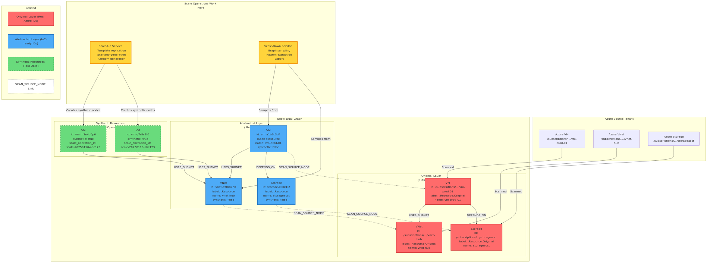
Architecture: Dual-Graph Design
Scale operations work only on abstracted layer, preserving original data

Slide 4
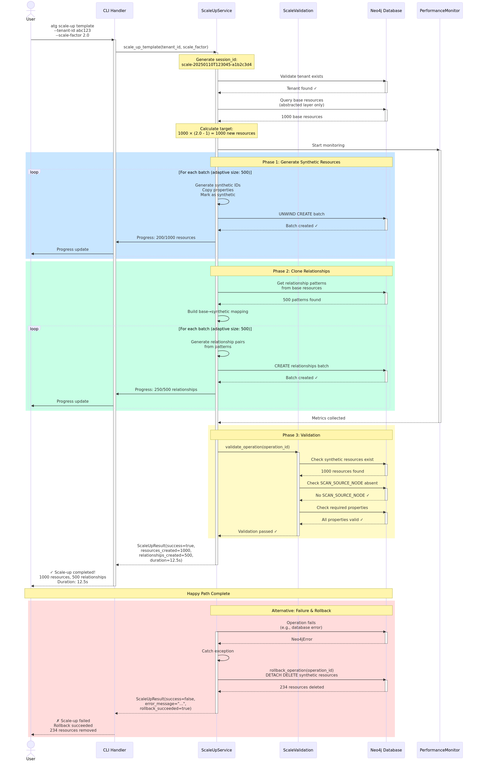
Scale-Up Operation Flow
Complete sequence from CLI to validation

Slide 5
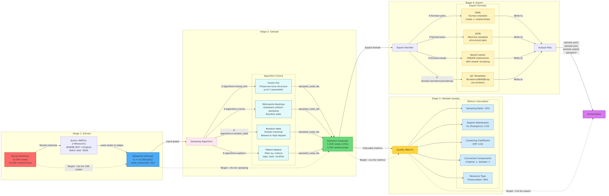
Scale-Down Pipeline
Extract → Sample → Validate → Export

Slide 6
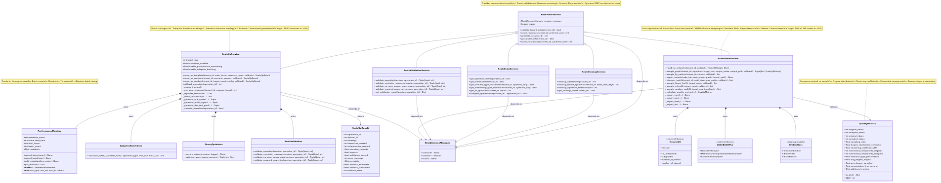
Component Architecture
Service hierarchy and dependencies

Slide 7
Baseline: DefenderATEVET17 Original State
Command: atg scan --tenant-id 3cd87a41-1f61-4aef-a212-cefdecd9a2d1
Total abstracted resources: 3,766
Top resource types:
• Subnets: 2,265
• Virtual Networks: 309
• Network Interfaces: 175
• Managed Identities: 114

Slide 8
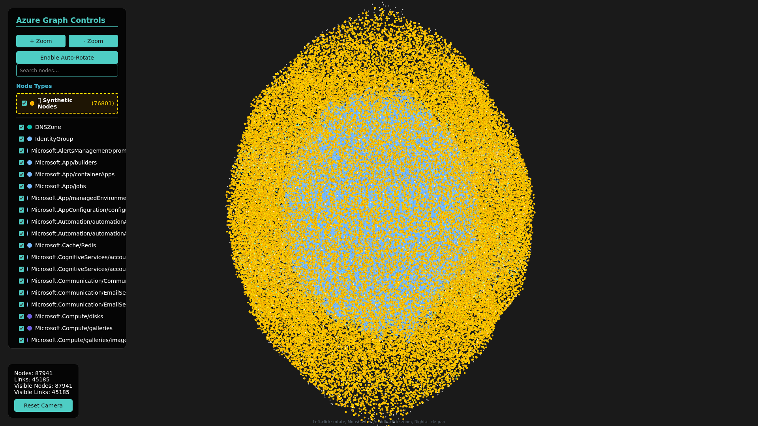
Graph After Scale Operations
87,941 nodes visualized from actual atg visualize command

Slide 9
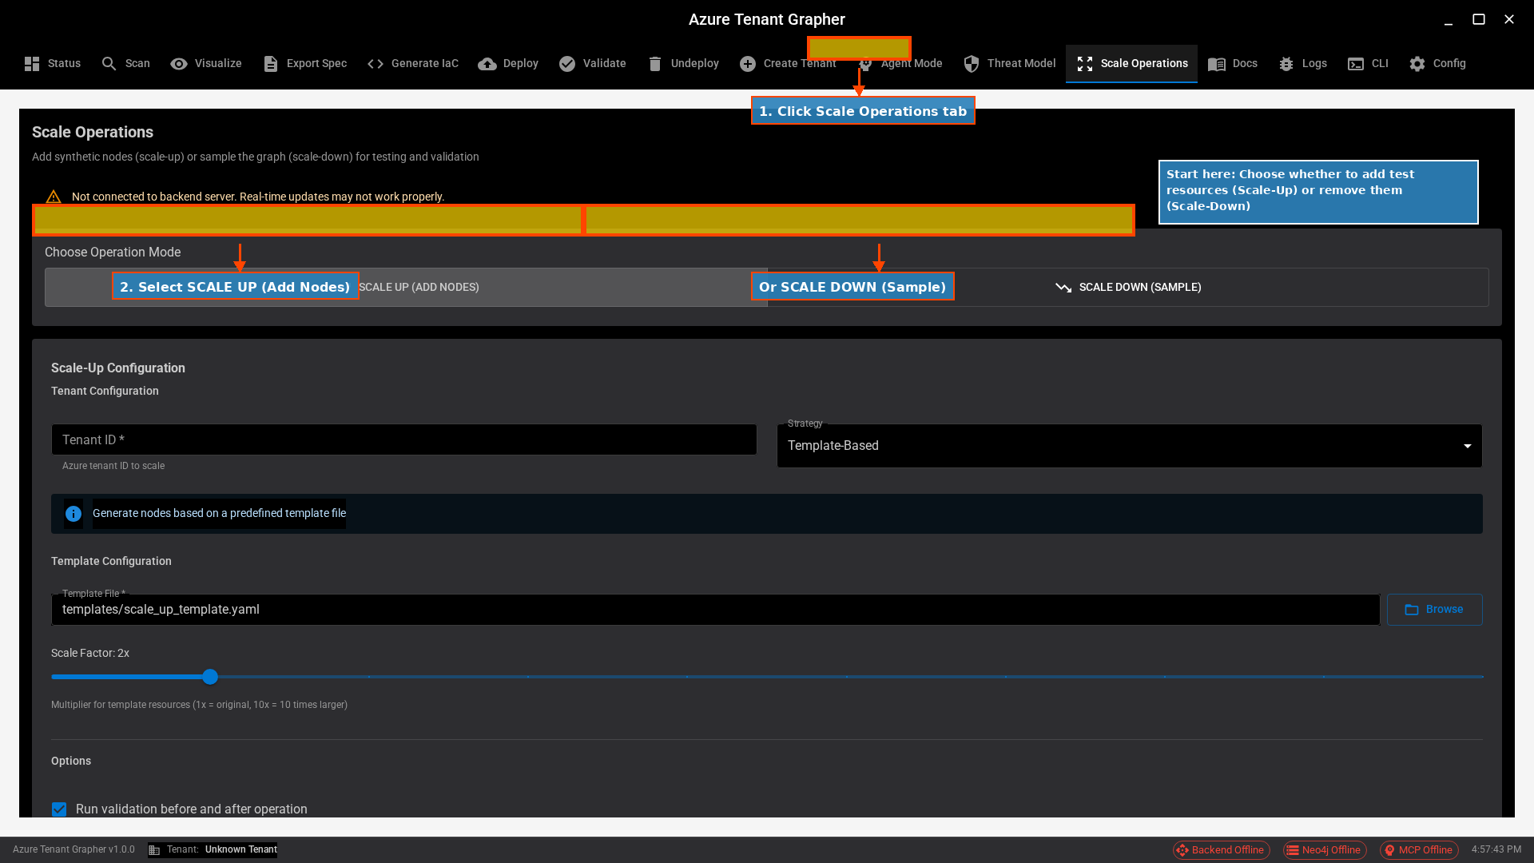
UI Tutorial: Getting Started
Navigate to Scale Operations tab

Slide 10
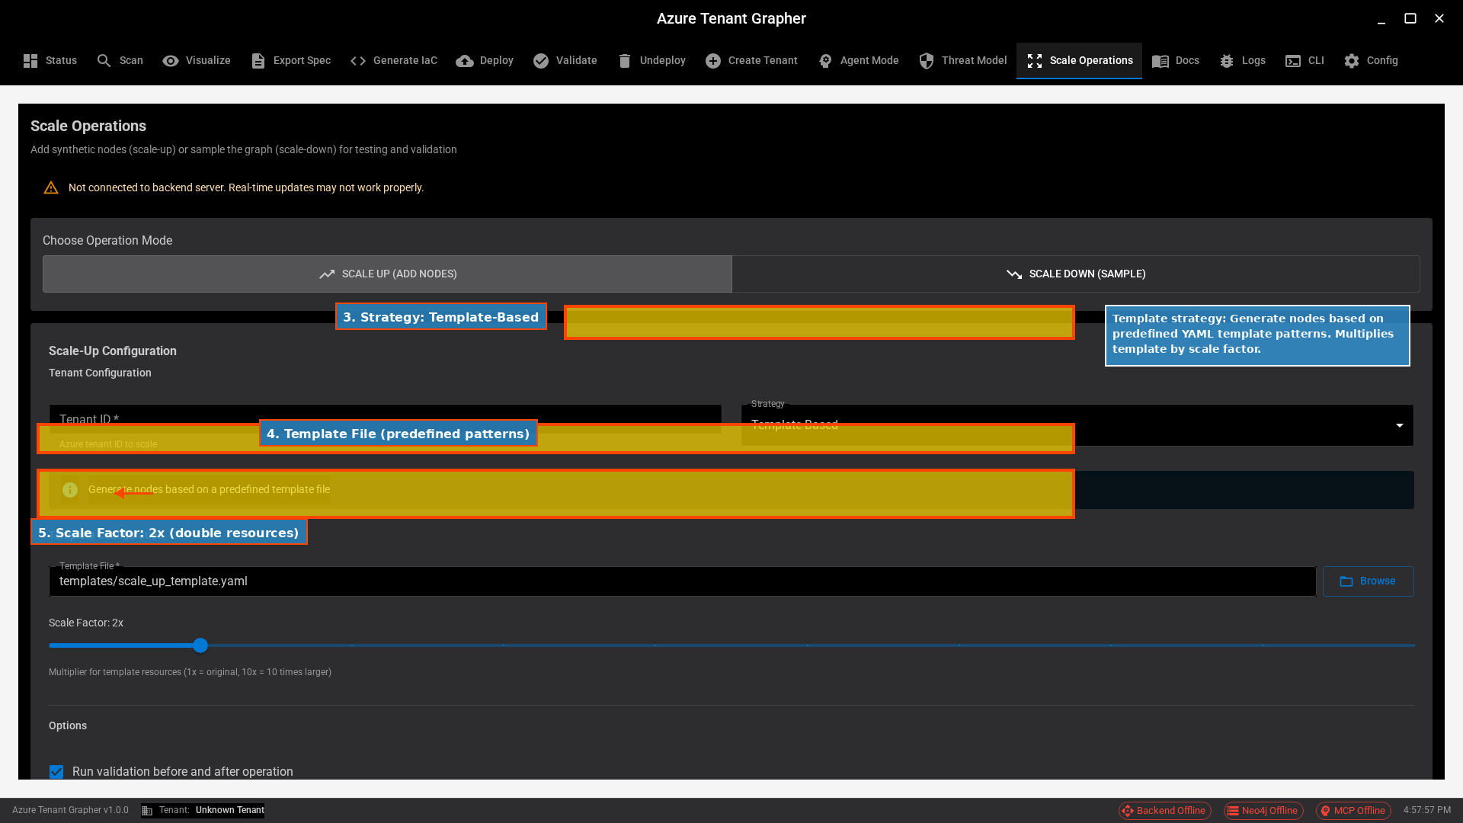
UI Tutorial: Template Strategy
Select template-based scaling

Slide 11
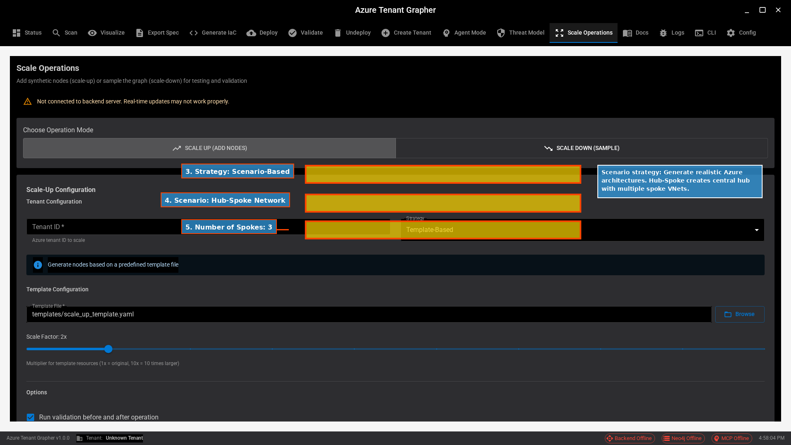
UI Tutorial: Scenario
Choose hub-spoke topology

Slide 12
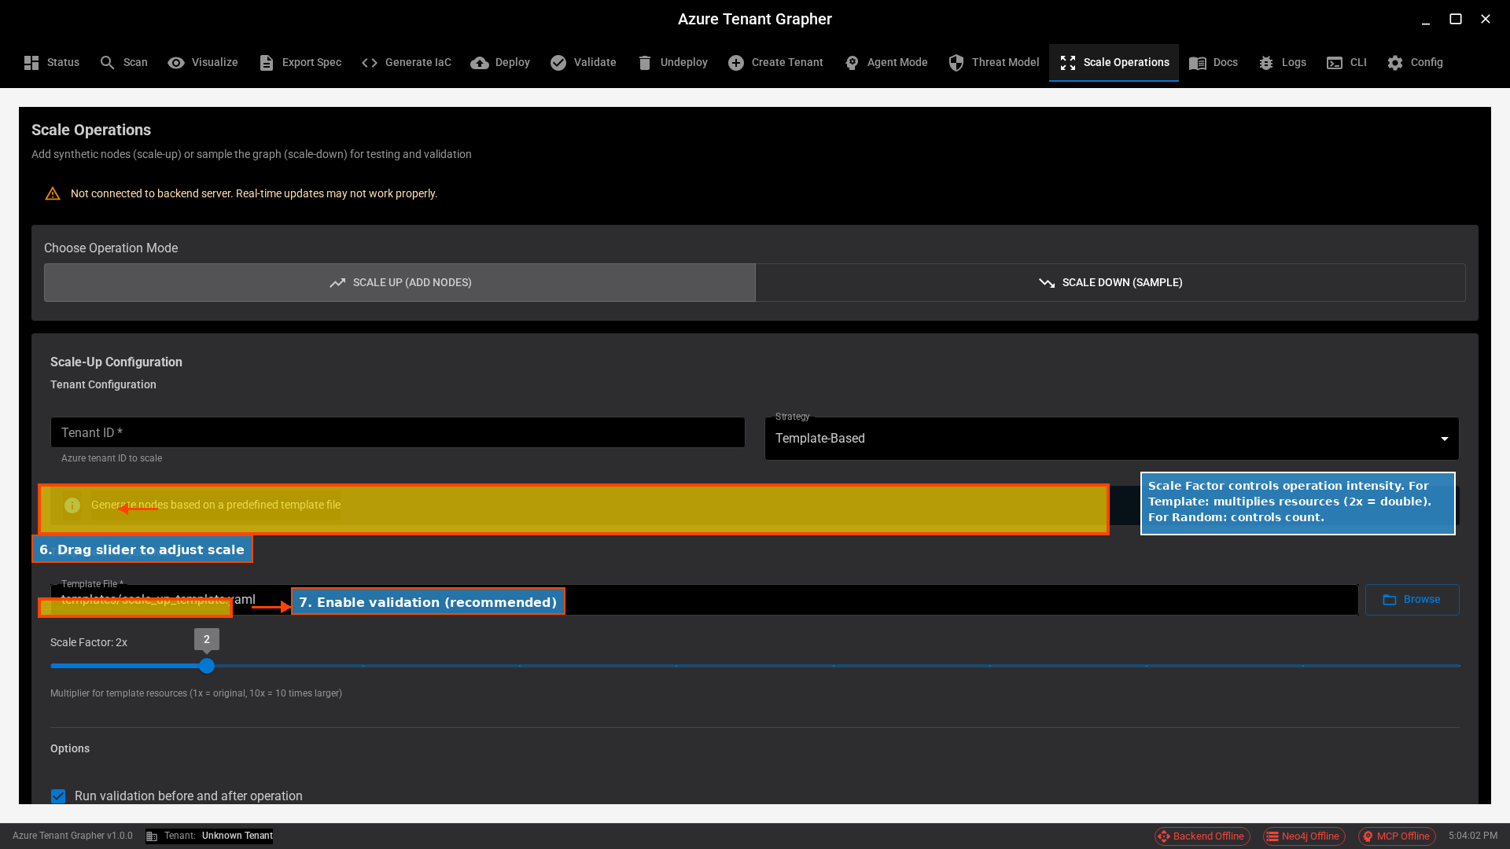
UI Tutorial: Scale Factor
Adjust intensity (1x-10x)

Slide 13
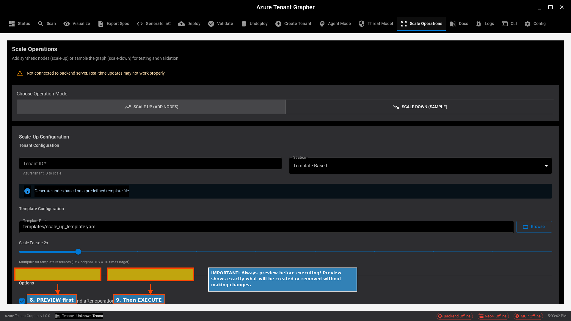
UI Tutorial: Execute
Preview then execute operation

Slide 14
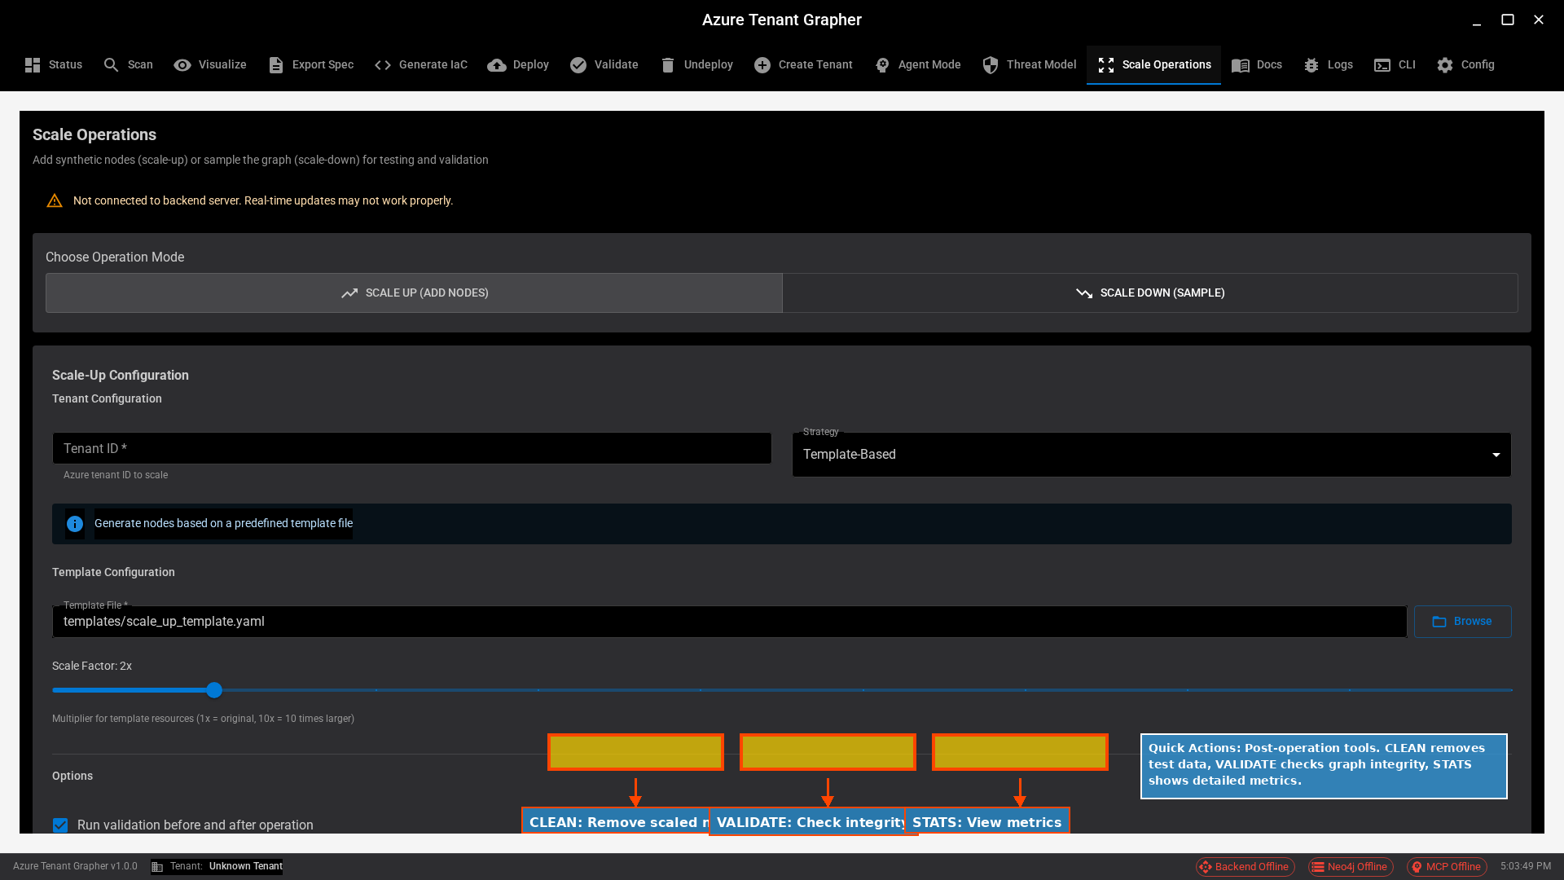
UI Tutorial: Quick Actions
Clean, validate, analyze

Slide 15
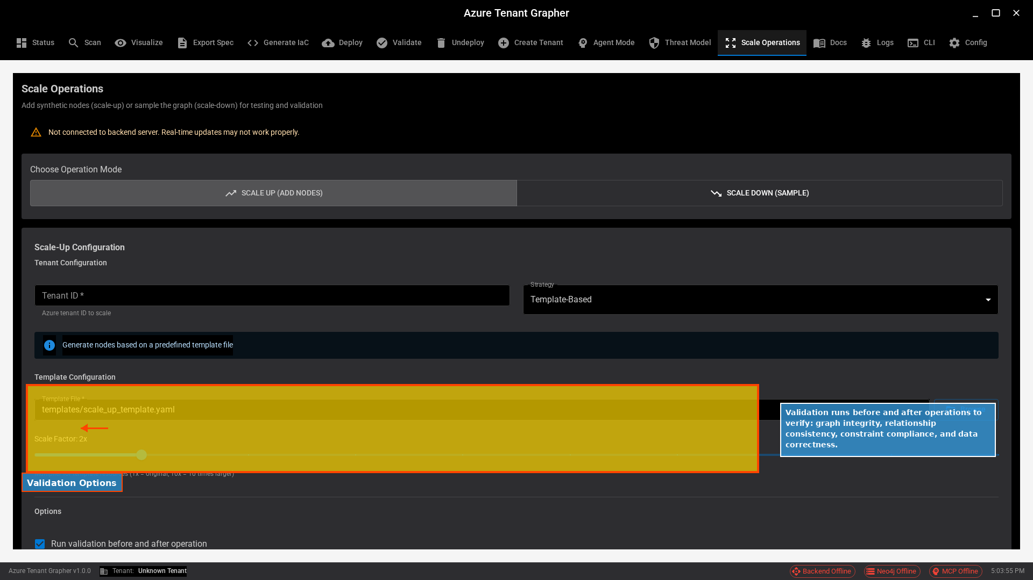
UI Tutorial: Validation
Graph integrity checks

Slide 16
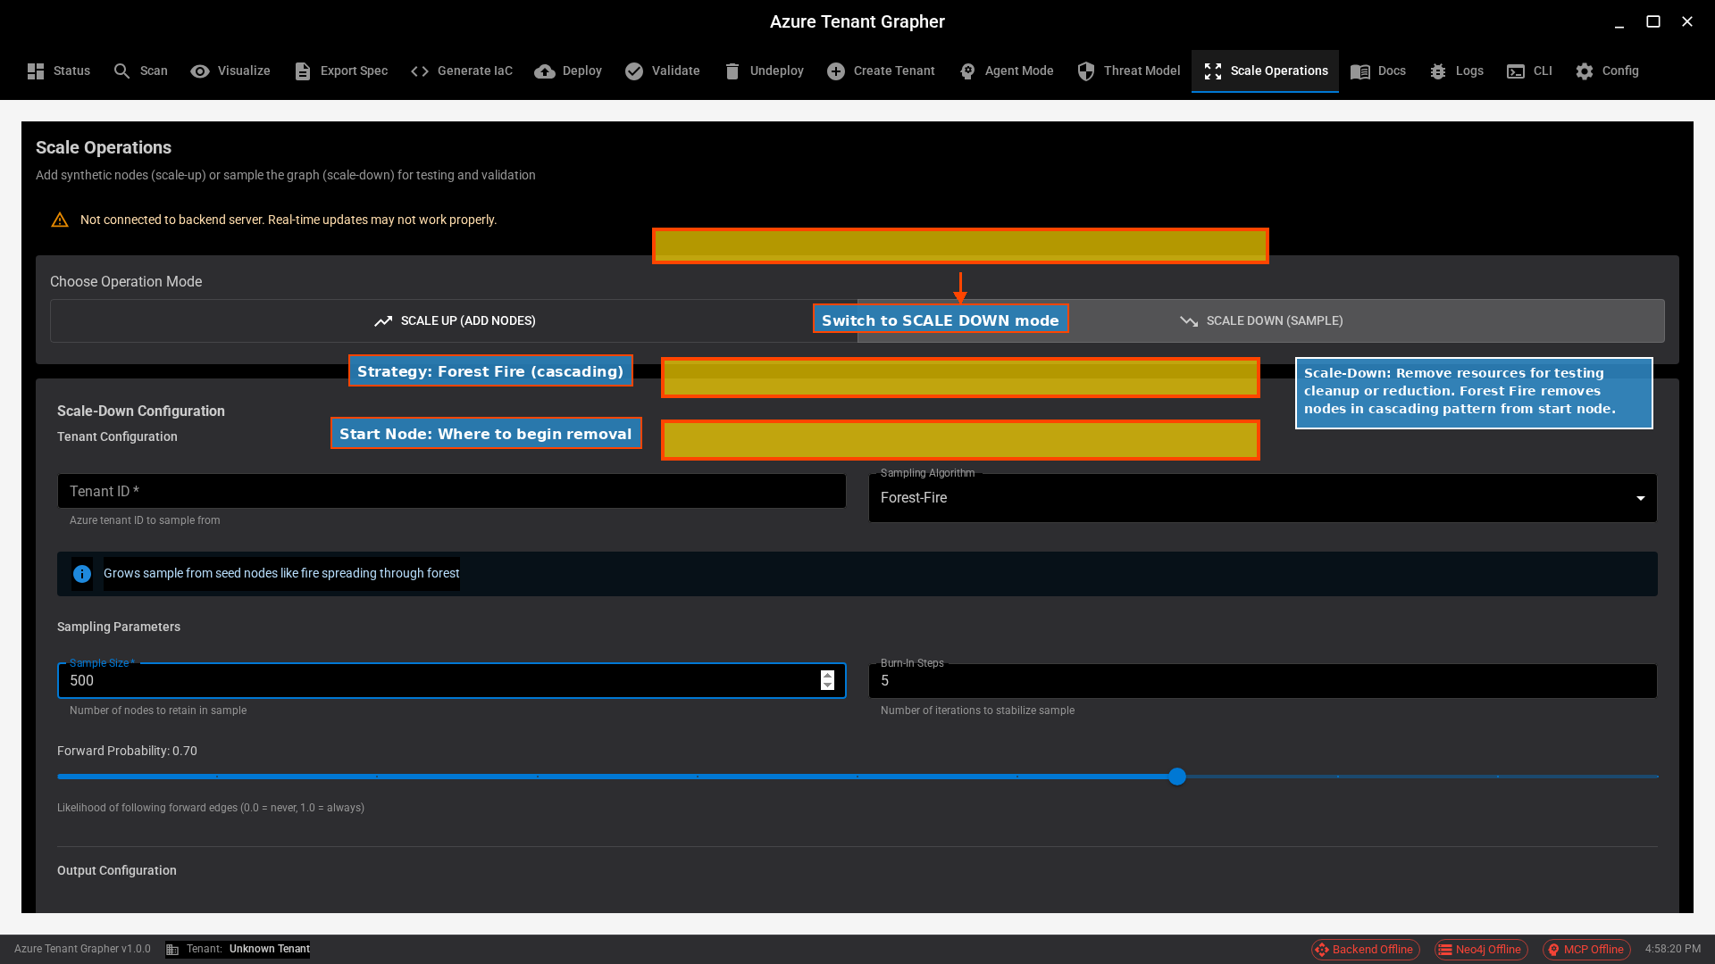
UI Tutorial: Scale-Down
Sampling configuration

Slide 17
CLI Tutorial: Scale-Up
$ atg scale-stats --tenant-id <ID>
→ Check current graph state
$ atg scale-up scenario --scenario hub-spoke --spokes 5
→ Generate hub-spoke topology
$ atg scale-validate --check all
→ Verify graph integrity
$ atg scale-stats --detailed
→ View updated statistics

Slide 18
End-to-End Testing Approach
Comprehensive testing revealed real implementation issues:
Bugs Found:
• CLI argument validation (fixed)
• tenant_id filter bugs (fixed)
• Sparse graph topology (architectural finding)
Testing Infrastructure:
• 534 unit/integration/E2E tests
• Real tenant data (DefenderATEVET17)
• Pattern-based sampling proven effective

Slide 19
Working Functionality
Scale-Up:
• Template-based generation functional
• Scenario generation (hub-spoke, multi-region)
• Tested at scale (87k resources achieved)
Scale-Down:
• Pattern-based sampling working (427 node sample)
• Direct Neo4j queries effective for sparse graphs
Visualization:
• Synthetic node highlighting implemented
• Orange color, dashed borders, 'S' indicator

Slide 20
Summary
Implementation provides working scale operations functionality.
Key Learnings:
• End-to-end testing essential for finding real bugs
• Graph topology impacts algorithm selection
• Pattern-based approaches work for sparse graphs
This work establishes a foundation with opportunities for
continued refinement based on deployment experience.
Feedback and real-world usage will guide improvements.

