Slide 1
Multi-Layer Graph Projections
Azure Tenant Grapher
Preserving Original Data While Enabling Graph Transforms

Slide 2
Multi-Layer Architecture: How It Works
Azure Tenant Grapher preserves your original scan data while enabling non-destructive graph transformations through a multi-layer architecture:
  Original Graph Layer: Immutable source of truth (5,584 nodes)
  Multiple Abstracted Layers: Independent graph projections
  Active Layer Concept: One layer is current workspace
  Layer Independence: Modifications never affect other layers

Slide 3
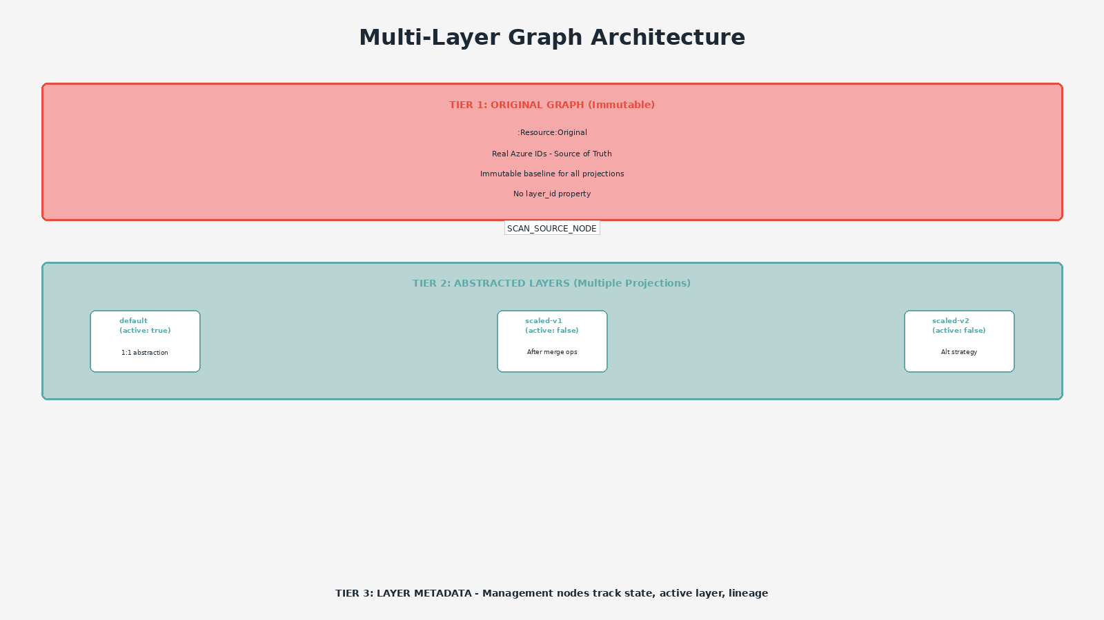
Three-Tier Architecture

Slide 4
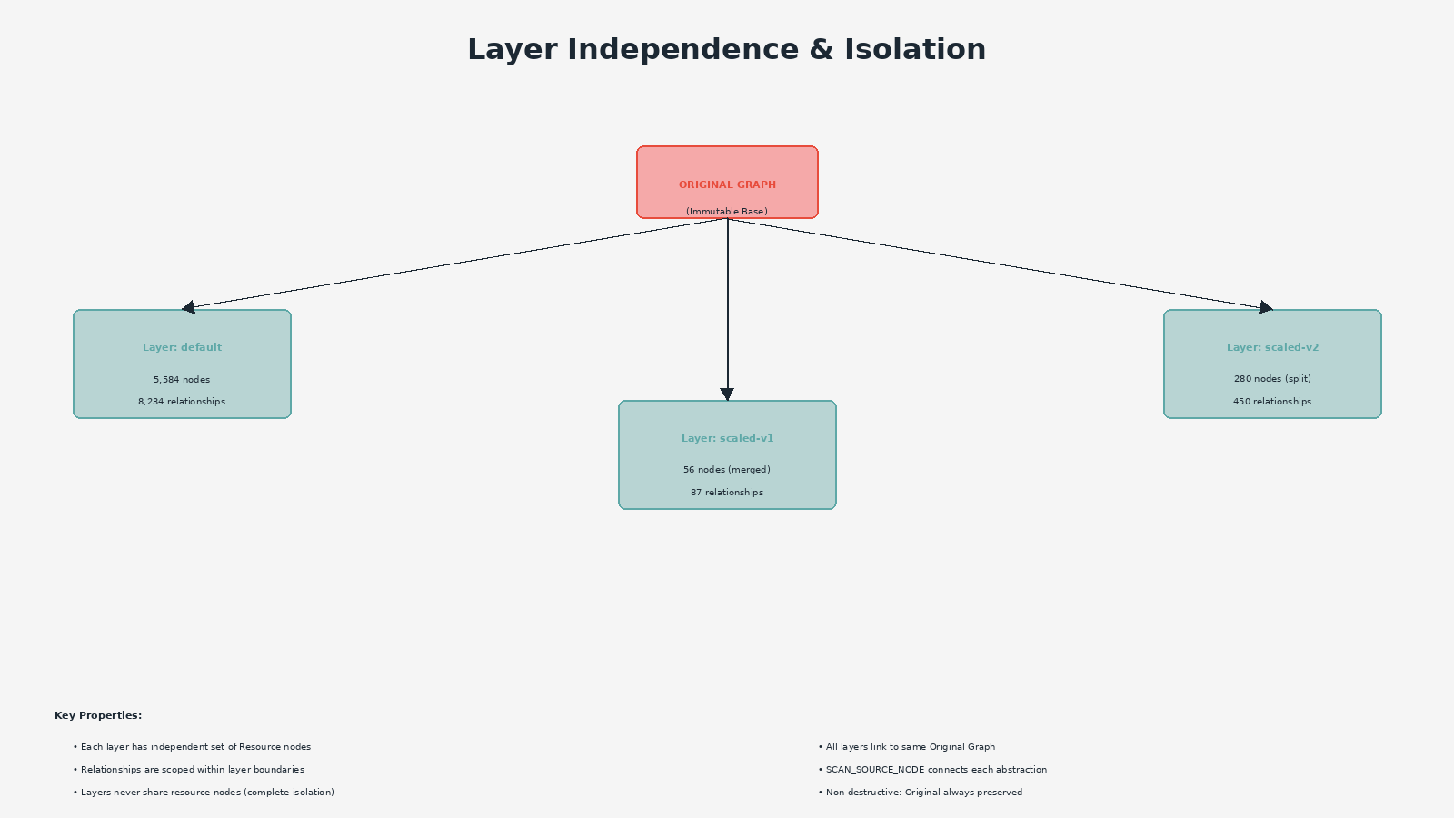
Layer Independence Model

Slide 5
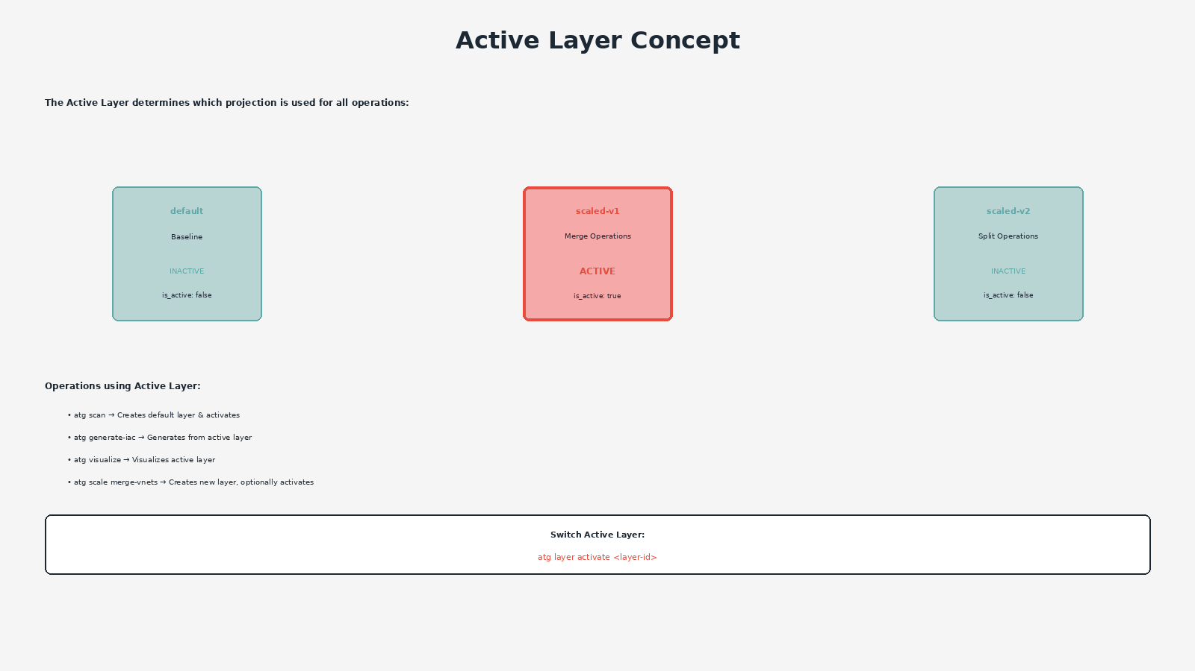
Active Layer Concept

Slide 6
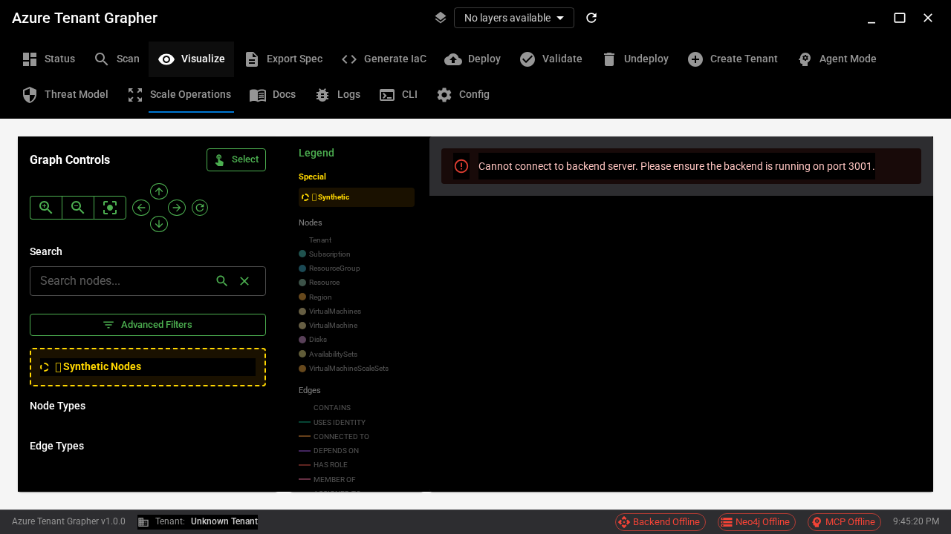
Baseline Layer Visualization (SPA)
Baseline Layer
Layer ID: default
Type: baseline
Node Counts:
• VMs: 50
• VNets: 6
TOTAL: 56 nodes
Relationships: 5

Slide 7
CLI Layer Management Commands
11 commands for complete layer control:
atg layer list
atg layer show <layer-id>
atg layer active [layer-id]
atg layer create <layer-id> --name "Name" --type baseline|experimental
atg layer copy <source> <dest>
atg layer diff <layer1> <layer2>
atg layer delete <layer-id>
atg layer validate <layer-id>

Slide 8
CLI Tutorial: List Layers
Command:
$ atg layer list
Output:
┌──────────┬─────────┬──────┬────────┬───────┐
│ Layer ID │ Name │ Type │ Active │ Nodes │
├──────────┼─────────┼──────┼────────┼───────┤
│ default │ Default │ base │ ✓ │ 56 │
└──────────┴─────────┴──────┴────────┴───────┘

Slide 9
CLI Tutorial: Show Layer Details
Command:
$ atg layer show default
Output:
╭──────── Layer: default ────────╮
│ Name: Default Baseline │
│ Type: baseline │
│ Status: Active, Baseline │
│ │
│ Statistics: │
│ Nodes: 56 resources │
│ Relationships: 5 connection │
│ │
│ Resource Types: │
│ VirtualMachines: 50 │
│ VirtualNetworks: 6 │
╰────────────────────────────────╯

Slide 10
CLI Tutorial: Create New Layer
Command:
$ atg layer create experimental-v1 \
--name "Test Environment" \
--type experimental
Output:
Created layer: experimental-v1 (active=False)
✓ Layer created successfully
Layer ID: experimental-v1
Node count: 0 (empty layer)

Slide 11
Scale-Up to New Layer (Non-Destructive)
Command to scale-up without modifying baseline:
$ atg scale-up template \
--template-file templates/scale_up_template.yaml \
--scale-factor 5 \
--target-layer scaled-5x
Result:
• Creates NEW layer: scaled-5x
• Baseline layer untouched (still 56 nodes)
• Scaled layer: ~280 nodes (5x scale)
• Original scan preserved (5,584 nodes)

Slide 12
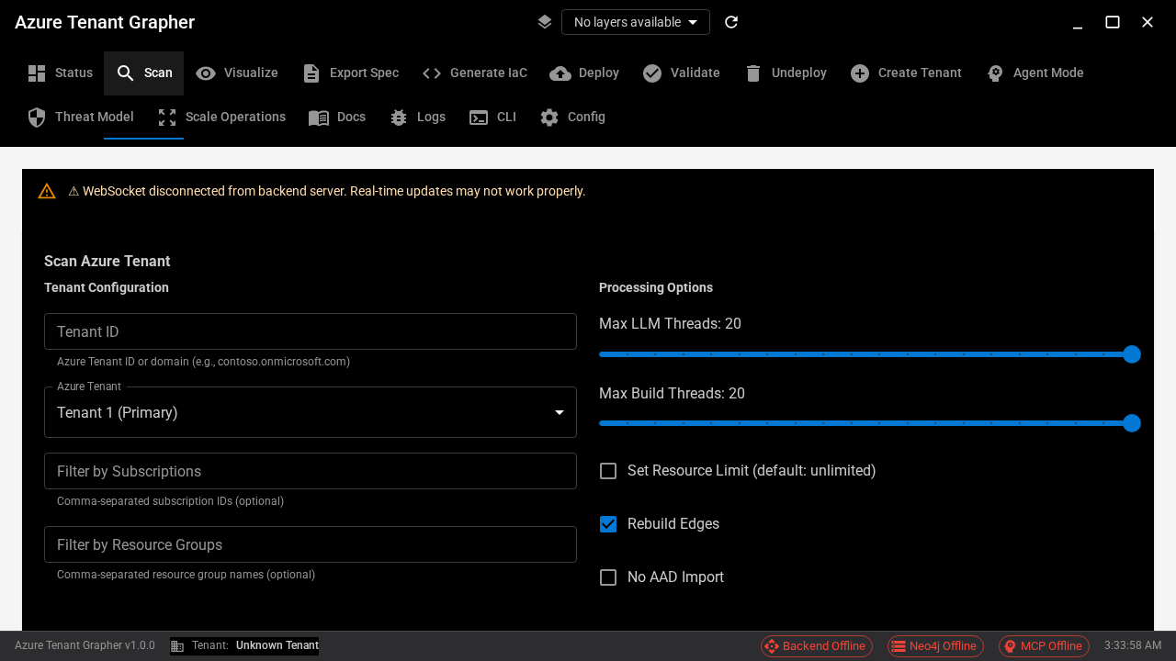
UI: Layer Selector in Application Header

Slide 13
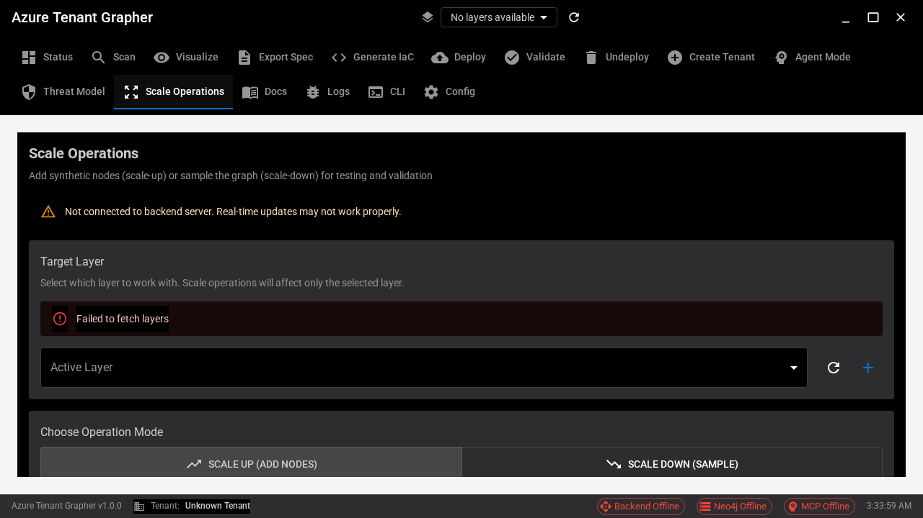
UI: Layer Selector in Scale Operations Tab

Slide 14
SPA Visualization Tab: Interactive Graph View

Slide 15
Key Features
Immutable Original
  5,584 nodes preserved forever, never modified
Multiple Layers
  Create unlimited independent graph projections
Active Layer
  One workspace at a time, switch anytime
Non-Destructive
  Scale operations create new layers
Layer Management
  11 CLI commands for complete control
UI Integration
  Visual layer selector in SPA
Git-Like Workflow
  Branch, compare, merge graph topologies

Slide 16
Multi-Layer Graph Projections
Documentation & Resources:
Architecture: /docs/architecture/MULTI_LAYER_GRAPH_ARCHITECTURE.md
CLI Reference: atg layer --help
E2E Testing: 96% pass rate (24/25 tests)
Issue #456 | PR #459
Implementation Status:
✓ Production Ready

