Slide 1

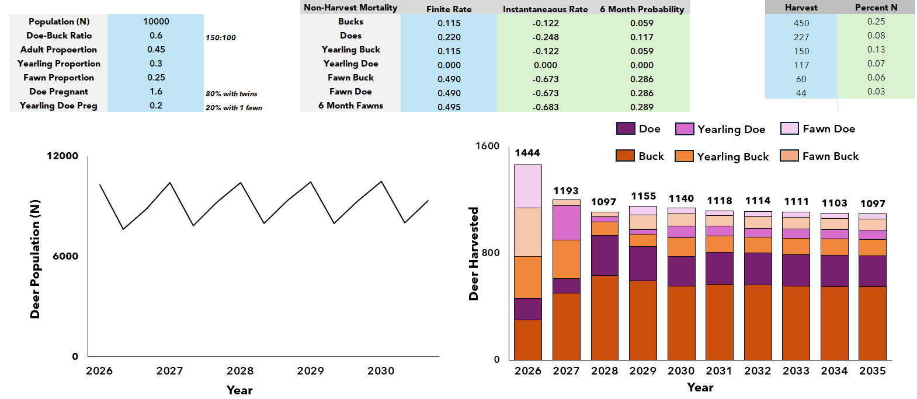











Deer Population Modeling Project
July 18, 2025
PhD Student: Rylee Tomey (rdt0029@auburn.edu)
PIs: Aniruddha Belsare, Jonathon Valente
Spring –
Dr. Belsare’s Course & Spreadsheet Model
Data
Framework
Management
Summer –
Regroup, Read, Reevaluate
Dr. Belsare’s ‘rule of 3’
Quality in = quality out
Fall – Chapter 1
Deer Population Management in the 21st Century
Conceptual synthesis with perspective elements
Challenges
Questions
Decision-Making Framework
Flexible – Accessible – Reproducible

