Slide 1
Alabama Wildlife Biologists' Knowledge, Attitudes, and Practices on Wildlife Health & Zoonoses

Slide 2
Participants
REQ - 19 YRS+, live/work in AL, wildlife biologist
150 target respondents → 283 total
Removed if:
Not living/working in AL
Taken outside of main distribution dates (May 15 – Sept 20, 2024
Flagged by Qualtrics ‘bot detection’
Comment that ‘not wildlife biologist but friend shared’
survey completion
<50% = 59
>60% = 155
>70% = 150
100% = 146
ZIPCODE

Slide 3
Processing & Analysis
Categorized all Q/As as binary (logic, median)
Chi sq / cramers V
Demographics variable relationship to knowledge, attitudes, and practices
Experience levels of wildlife biologists in Alabama
Knowledge of wildlife disease basics
Knowledge on disease management
Practice on how frequently the respondent encounters wildlife directly
Attitudes on the importance of climate change and wildlife health
Attitudes on the utility of incorporation of an undergraduate wildlife health course for the profession
Attitudes on the likely participation at a free, online Auburn sponsored course on wildlife health and zoonoses

Slide 4
Processing & Analysis
Categorized all Q/As as binary (logic, median)
Chi sq / cramers V
Demographic information and knowledge +certainty
Education and knowledge +certainty
Fieldwork and handling and knowledge +certainty
Opinion questions and knowledge +certainty
Field handling and PPE usage
Knowledge compared to certainty

Slide 5
Demographics variable relationship to knowledge, attitudes, and practices
GENDER
106 male; 43 female (1 other, 5 prefer not answer)
AGE
Median - 37 (used for older/younger)
Min 21 ; max 68

Slide 6
Demographics variable relationship to knowledge, attitudes, and practices
What was your approximate household income in 2023?

Slide 7
Demographics variable relationship to knowledge, attitudes, and practices
Age and certainty in knowledge section (median-9 and 50%)
Gender and certainty in knowledge section (50%)
Gender and correct (50% and median-6) – stronger association than other significant relationships

Slide 8
Education & Experience levels of wildlife biologists in Alabama
No (61.3%)
Yes (38.7%)
<5 years (31.7%)
5-10 years (23.3%)
>10 years (45%)
Have you had a formal course on wildlife health? When?

Slide 9
Education & Experience levels of wildlife biologists in Alabama
Time working as a wildlife biologist
1-5 years | 31 | 0.2000000
10-20 years | 23 | 0.1483871
5-10 years | 29 | 0.1870968
<1 year | 43 | 0.2774194
>20 years | 29 | 0.1870968

Slide 10
Practice on how frequently the respondent encounters wildlife directly
No (62%)
Yes (38%)
No Sedate
34%
Sedated
7%
Dead
59%
Do you regularly collect samples in
the field from wildlife in Alabama?
Daily | 35 | 0.22580645
Monthly | 39 | 0.25161290
Never | 4 | 0.02580645
Rarely | 31 | 0.20000000
Weekly | 46 | 0.29677419
Do you handle wildlife?
State of Animal?

Slide 11
Knowledge of wildlife disease basics

Slide 12
Attitudes on the likely participation at a free, online Auburn sponsored course on wildlife health and zoonoses
If there was a free course on wildlife health in Alabama, how would you like to participate?
Would you be interested in learning more about wildlife health in Alabama?
One day in-person conference | 90 | 0.3896103
One day virtual conference | 83 | 0.3593073
Other (almost all requesting asynchronous) | 7 | 0.0303030
Year-long once a month virtual conference | 43 | 0.1861471
No | 2 | 0.01360544
Unsure | 12 | 0.08163265
Yes | 133 | 0.90476190
8 NAs

Slide 13
Academic Publications | 99 | 0.26329787
Conferences | 63 | 0.16755319
Friends/Family | 13 | 0.03457447
I have Not looked for health information | 11 | 0.02925532
News Sources | 37 | 0.09840426
Other | 10 | 0.02659574
Social Media | 25 | 0.06648936
State Wildlife Agency | 110 | 0.29255319
What is your preferred source to obtain information regarding wildlife health in Alabama?

Slide 14
CWD | 112 | 0.16666667
Influenza | 84 | 0.12500000
Leptospirosis | 71 | 0.10565476
One Health | 54 | 0.08035714
Other | 23 | 0.03422619
Rabies | 100 | 0.14880952
Raccoon roundworm | 55 | 0.08184524
SarsCoV2 | 74 | 0.11011905
Vector borne diseases | 91 | 0.13541667
What topics would you like to obtain more information regarding wildlife health in Alabama?
LPDV in wild turkeys
ASF
white Nose syndrome
Wide scope of diseases with a focus on more immediate threats like those carried in wild pigs
Nongame diseases ie ranavirus SFD etc

Slide 15
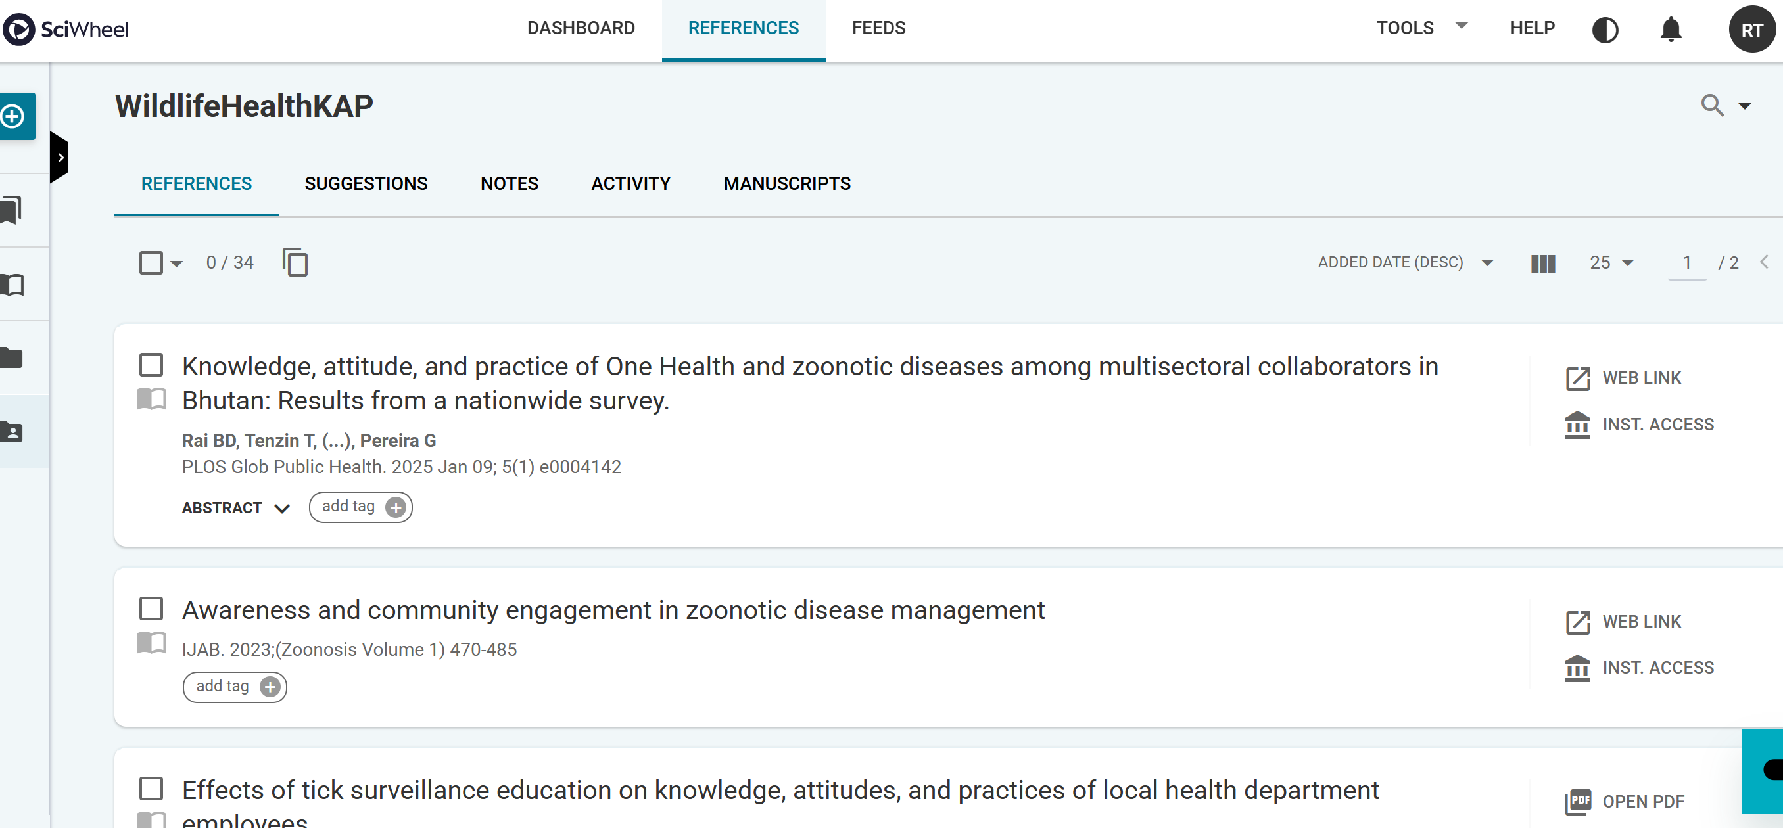

Slide 16
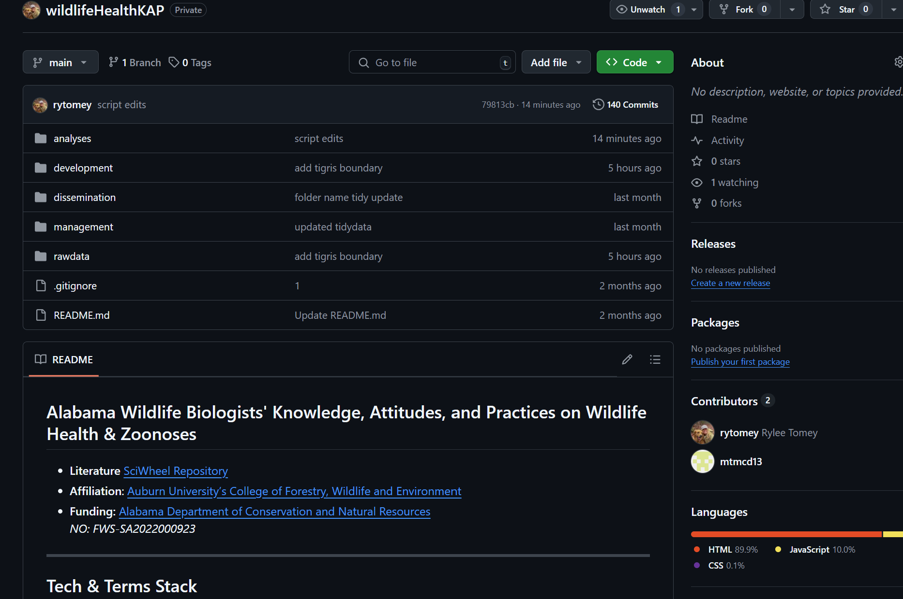

Slide 17
