Slide 1
CS 2080: Programming with UNIX
Dr. Armin moin, assistant professor
Quantum-Classical AI and Software Engineering (QAS) Lab
Department of computer science
University of Colorado colorAdo springs (uccs)
Summer 2024

Slide 2
Lecture 4: Linux Bash Shell commands I + Linux file permissions
Outline:
Switching user
Installation
Information
Communication
Comparison
File management and permissions
Miscellaneous
SSH keys

Slide 3
Switching user
su
Switch to a different user, e.g., su alice
Switch to the superuser (root): su or su –
sudo
Switch to the superuser (root) without the need to enter the root password, if the user is listed in /etc/sudoers
To add a user to the sudoers list: usermod -aG sudo username
Reminder: On your AWS EC2 VMs, set the root password through sudo passwd root
whoami
Print the name of the current user

Slide 4
installation
sudo apt install: Install a new software package
apt search: Search for a software package
/etc/apt/sources.list
Ubuntu sources have moved to /etc/apt/sources.list.d/ubuntu.sources

Slide 5
installation
/etc/apt/sources.list
Main - Canonical-supported free and open-source software.
Universe - Community-maintained free and open-source software.
Restricted - Proprietary drivers for devices.
Multiverse - Software restricted by copyright or legal issues.

Slide 6
Upgrade
sudo apt update
﻿sudo apt list --upgradable
sudo apt upgrade

Slide 7
information
man: Get information on a command (You will need to read the man pages!)
E.g., man su
info: The GNU info system for online documentation.
E.g., info su
help: Information on built-in commands.
E.g., help echo
Write help to see a list of these commands!

Slide 8
communication
ssh: Connect to another system securely via SSH
ftp: Interactive file transfer program
login: Sign on to Linux (open a new session)
slogin: Sign on to remote Linux using secure shell (i.e., SSH)
mailx: Read or send emails (if not installed, first run sudo apt install mailutils)
wget: Download resources from the Internet
curl: Transferring from/to a server)

Slide 9
comparison
cmp: Compare two files byte by byte (by default, reports the location of the first mismatch)
comm: Compare items in two sorted files line by line
diff: Compare two files line by line; or compare two directories
Options: --ignore-case, --ignore-blank-lines or –B, --ignore-space-change or –b, --ignore-all-space or –w
sdiff: Compare two files side by side
diff3: Compare three files

Slide 10
File management and permissions
chmod: Change access modes on files (Use the –R option for directories and their content)
User (u), group (g), others (o)
Read (r), write (w), execute (x)
-rwxrwxrwx

Slide 11
File management and permissions - examples
E.g., chmod u-x -> -rw-rwxrwx
E.g., chmod o-r -> -rw-rwx-wx
E.g., chmod u+x -> -rwxrwx-wx

Slide 12
File management and permissions
Alternative to r, w, and x: Numeric codes:
0 = No permission
1 = Execute
2 = Write
4 = Read

Slide 13
File management and permissions
For example, for -rw-------
User: r and w, thus 4+2=6
Group: 0
Others: 0
Hence: 600

Slide 14
File management
chown: Change file owner (Use the –R option for directories and their content)
chgrp: Change file group (Use the –R option for directories and their content)
cksum: Print a file checksum, POSIX standard algorithm
md5sum: Print a file’s checksum using the Message Digest 5 (MD5) algorithm
cp: Copy files (cp –r for copying directories)

Slide 15
File management
cd: Change directory (requires execution permissions in that directory)
file: Determine a file’s type (e.g., ASCII text)
head: Show the first few lines of a file (use the –n option to specify the number of lines)
E.g., head –n 10
tail: Show the last few lines of a file (use the –n option to specify the number of lines)
E.g., tail –n 10

Slide 16
File management
more: Display files by screenful
less: Similar to more, but more sophisticated
ls: List files or directories
ls -l
ls -a

Slide 17
File management
ln: Create file name aliases
By default, a hard-link (must be on the same filesystem). Still works after moving the target!
If –s or –symbolic used, a separate file (sort of a “shortcut”) created. Moving would break it!
locate: locate or plocate is a fast way to find a file based on its name (matching pattern)
mkdir: Create a directory

Slide 18
File management
mv: Move or rename files or directories
rm: Remove files (use –r or rmdir for removing directories)
pwd: Print the working directory’s path

Slide 19
File management
scp: Copy files to a remote system securely using SSH
csplit: Break files at specific locations
E.g., csplit f1.txt 2 (i.e., from line 2)
split: Split files evenly
Default size: 1000 lines

Slide 20
File management
wc: Count a file’s lines, words, and characters (use –m for characters, –w for words, and -l for lines) – by default lines
cat: Concatenate files or print the content (use >> to append or > to substitute content)
cat f1
cat f1 >> f2
cat f1 > f2
nano: Simple text editor (We’ll talk about editors in Lecture 7 and Lab 5)

Slide 21
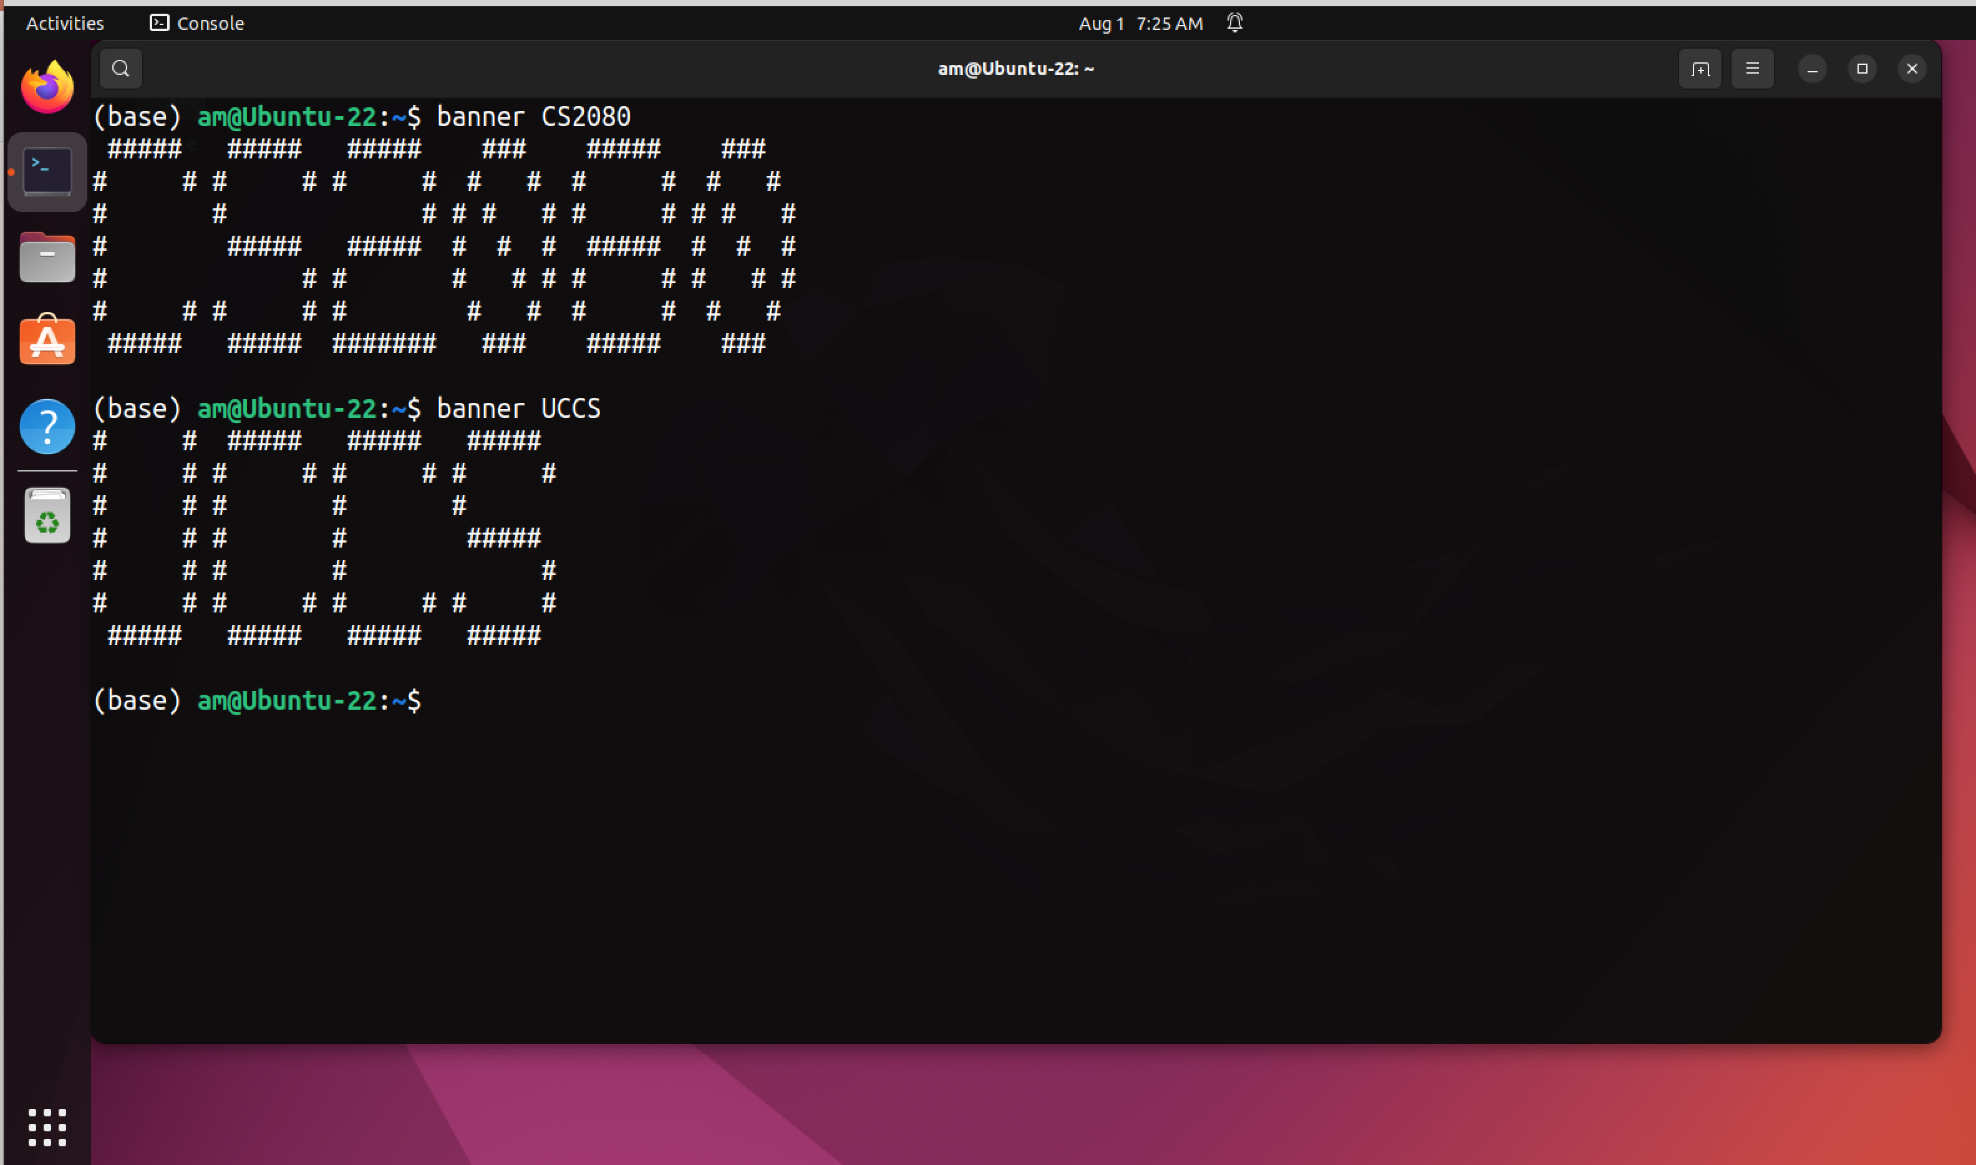
miscellaneous
banner

Slide 22
Ssh keys
A key pair: public key + private key for each machine
Pairing enabled by a cryptographic algorithm
Public key: To be shared globally
Private key: To be kept secret (never share)
The concept is known as asymmetric cryptography or public key cryptography
Use cases: password-less (more secure) authentication and digital signatures (e.g., OpenPGP)
Here, we focus on the former (authentication)

Slide 23
Ssh keys: Authentication with and without them
Client
User’s Password
Server
Client
User’s SSH Public Key
Server

Slide 24
Ssh keys: Authentication with and without them
Client
User’s Password
Server
Client
User’s SSH Public Key
Server
User already exists in /etc/passwd.
Public Key already added to /home/user/.ssh/authorized_keys

Slide 25
creating an Ssh key pair/importing a public key
Creating an SSH key pair
AWS Dashboard: We’ll see how to do this in Lab 2.
The ssh-keygen command in the terminal
Other tools (e.g., PuTTY, see https://www.putty.org)
Importing an existing SSH public key (We’ll see how to do this in Lab 2)
AWS Dashboard
Append the public key to /home/user/.ssh/authorized_keys

Slide 26
Questions?
See you!

