Slide 1
Probability and Statistics for Data Science 2
All-NBA Team Predictions
Luigi Noto, Ryan Drost
Notes:
Predicting All-NBA teams year-by-year and over the course of a career. This is a proxy for star players, help predict level of star players.
Since 1989, there are 3 teams of 5 players each, so a total of 15 each season. We use the data since 1990 for the model since the 15 number is consistent.

Slide 2
Dataset
P A R T 0 1
Over 18000 player seasons from 1980-2022
Over 200 potential features (player statistics, team statistics, awards)
Notes:
-scraped data from basketball reference. Player stats, team stats, awards data (MVP, All-NBA teams, All-stars, All-rookie teams, etc.) from 1989 through last season (2022)

Slide 3
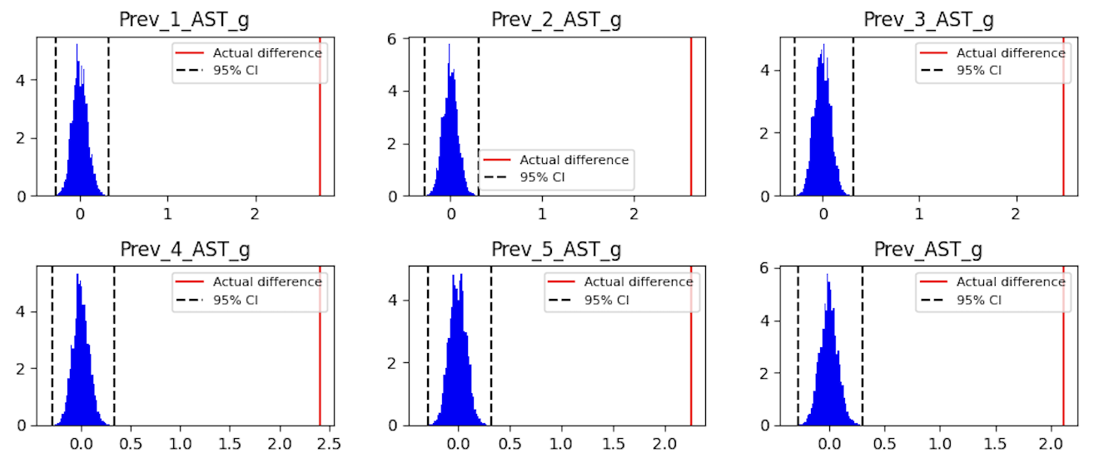
Hypothesis Testing
P A R T 0 1
Notes:
-permutation tests to see which statistics are significant. Got a lot of graphs like this, everything is super super significant! This is with bonferroni’s correction, many have p-value of zero.
-needed to use the existing features to create new ones that helped the model learn the relationship (feature engineering)
We did permutation tests for 177 predictors using the difference in median or mean values, depending which was more appropriate for the specific statistic, between the two classes (All-NBA: 1, otherwise: 0). We found that, regardless of the length of the window, almost every statistic was very significant even when accounting for the number of hypothesis tests with Bonferroni's correction.

Slide 4
Year-by-Year Prediction
P A R T 0 2
Predict All-NBA teams for each season (based on data available prior to that season)
Use logistic regression and random forest models
Notes:
-attempted to classify each team (first, second, third) but sparsity was already an issue with 15 out of 300-500 so didn’t want to make it more sparse
-use baseline model with one variable and compare performance to that

Slide 5
Feature Engineering
P A R T 0 2
Created features from existing predictors to help the model capture the relationship
Sparsity of positive class made it difficult to capture relationship with linear variables
Final model has 10 features including continuous variables (such as win shares per game) and binary variables (such as whether or not a player averaged fewer than 28 minutes per game)
Notes:
-independence of observations, checked a residual series plot, looked okay, used 1989-2020 seasons as training set.
-models improve upon baseline significantly in precision and log loss. Implied probabilities are important because we know 15 players make it.
-challenge was recall. Accuracy is obviously very good.
Prev 1 AllNBA: Made All-NBA Team in previous season
Prev 1 AllNBAV: Value metric for All-NBA team from previous season: 10 for first team, 5 for second team, 1 for third team, 0 for none
old first: Age >= 28, Made All-NBA team for the first time in the previous season, but was not on first team
young star: Age < 25, Made All-NBA first or second team in any season previously
prev rotation: Played < 15 minutes per game in previous season
prev starter: Played < 28 minutes per game in previous season
YrsOff: Number of seasons missed since the player’s most recent season
Prev 1 WS g: Win shares per game in previous season
Injured: Fewer than 50 games in previous season with more than 15 points per game and Prev AllNBAV decay > 10 (a metric based on AllNBAV with beta decay)
high pick: Drafted in the top 10, made All-Rookie first team, and fewer than 3 years of experience

Slide 6
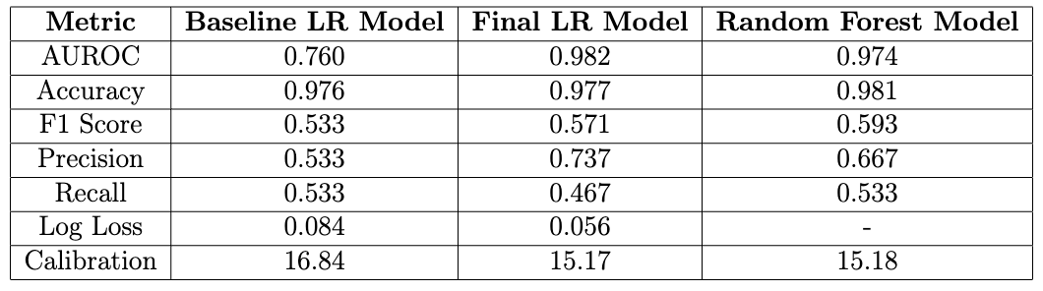
Model performance
P A R T 0 2
Baseline LR Model: model using only one binary predictor (whether or not the player earned an All-NBA award in the previous season)
Notes:
-independence of observations, checked a residual series plot, looked okay, used 1989-2020 seasons as training set.
-models improve upon baseline significantly in precision and log loss. Implied probabilities are important because we know 15 players make it.
-challenge was recall. Accuracy is obviously very good.

Slide 7
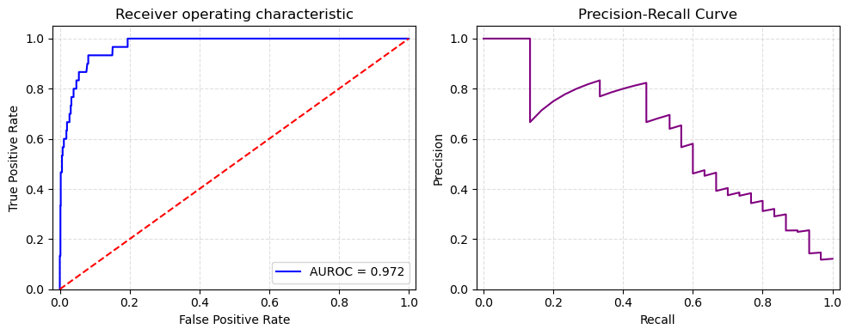
Model performance
P A R T 0 2
Logistic Regression Model AUROC and PR Curve
Notes:
-independence of observations, checked a residual series plot, looked okay, used 1989-2020 seasons as training set.
-models improve upon baseline significantly in precision and log loss. Implied probabilities are important because we know 15 players make it.
-challenge was recall. Accuracy is obviously very good.

Slide 8
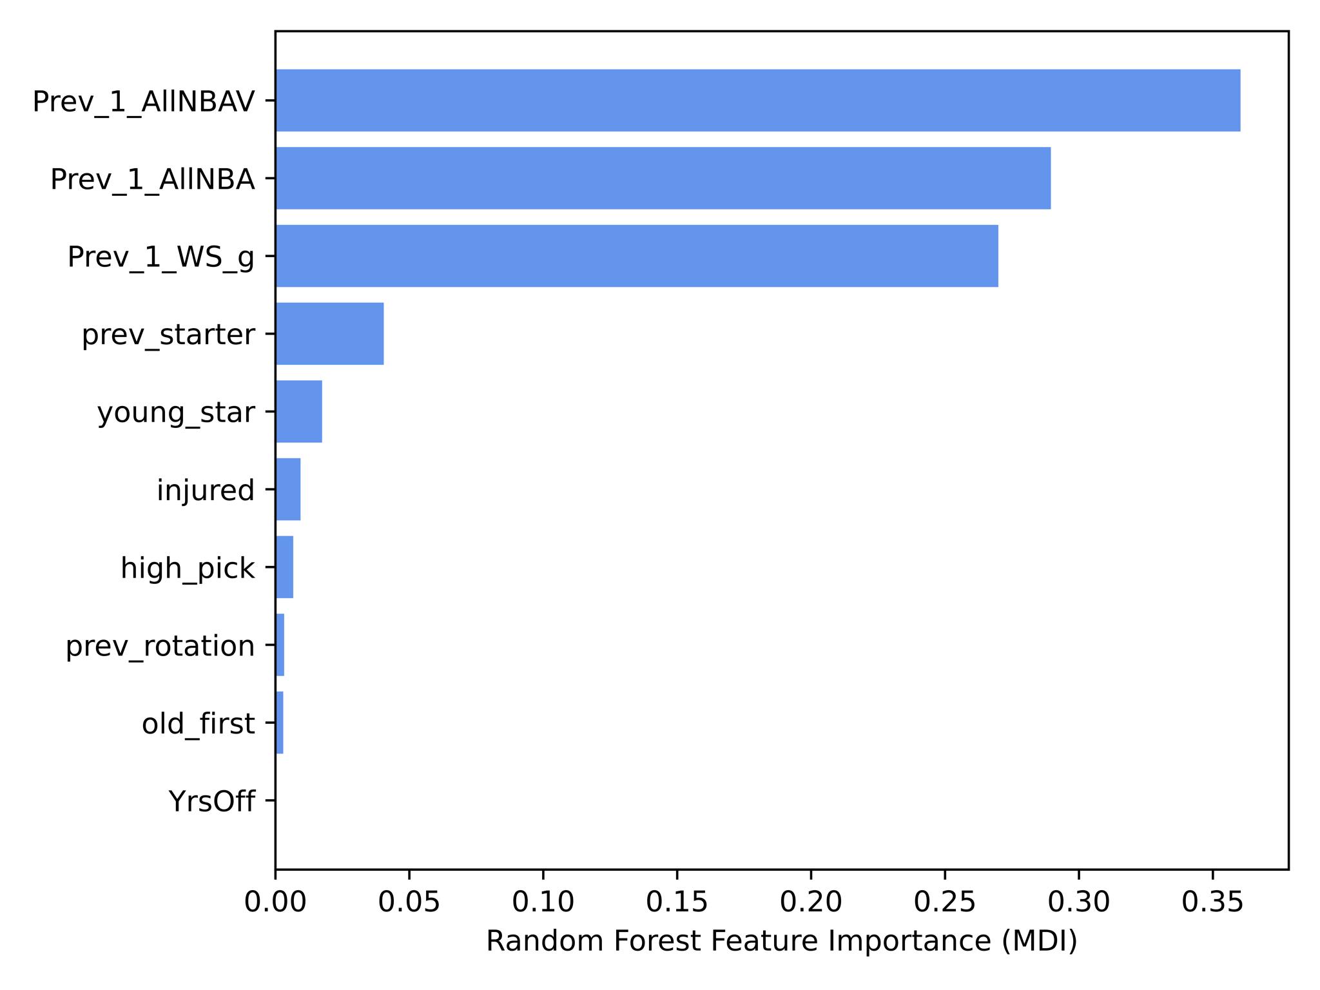
Model performance
P A R T 02
Notes:
-random forest feature importance (add image)
We can see that the baseline predictor variable (Prev_1_AllNBA) and a closely related variable (Prev_1_AllNBAV) have the largest importance, but also other variables have a substantial influence on the prediction, in particular Prev_1_WS_g, which represents the player's win shares per game in the previous season.

Slide 9
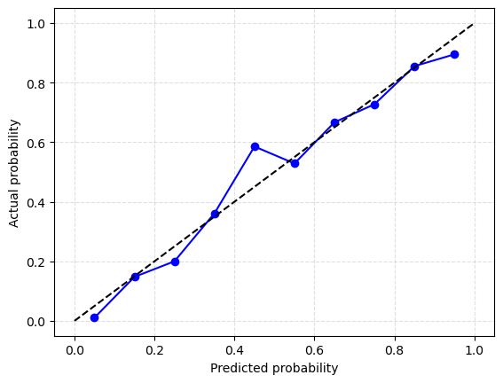
Model performance
P A R T 02
Logistic Regression Model Calibration
Notes:
-calibration. We know 15 players make it each year so the sum of individual probs should add to 15. We also see it’s well calibrated

Slide 10
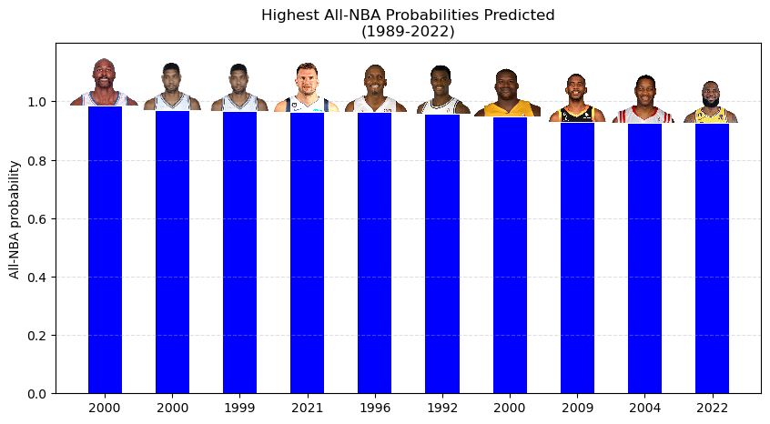
Results
P A R T 02
Notes:
All of them are great players, between 92% and 98% probability. All 10 were correct

Slide 11
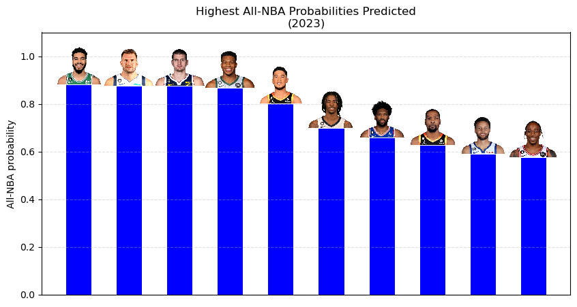
Results
P A R T 02
Notes:
57% to 88%. 2023 season has happened but voting isn’t in (only used data from prior to the season). 6 are almost certainly correct, and then 2 maybes and 2 unlikely.

Slide 12
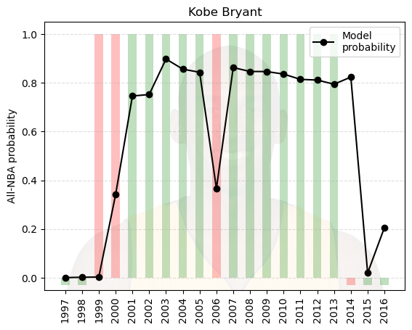
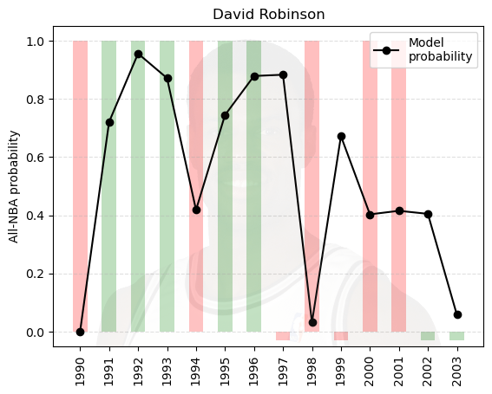
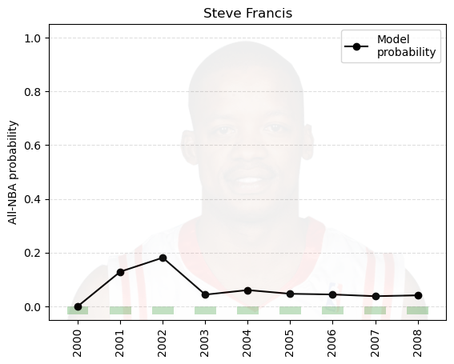
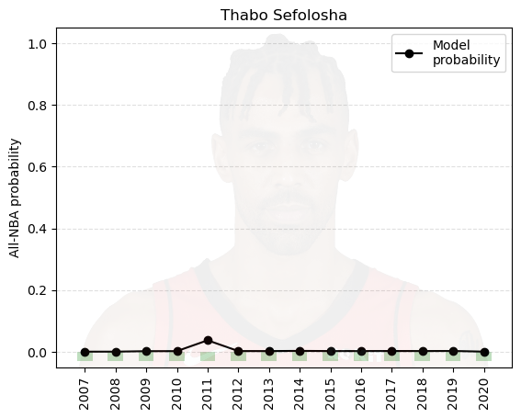
Results
P A R T 0 3
Notes:
Here’s what it looks like for a specific player. A bar of 1 means made it, bar at 0 means did not make it, color indicates whether it was predicted correctly or not
Kobe it does well, makes it every year and once it catches on it basically just keeps saying he’ll make it.
David Robinson it struggles with, actually gets it wrong 5 years in a row. Those are the more interesting ones. Most players never make it and it predicts they never make it. One example is Steve Francis who was actually promising as a young player and gets up to 20% probability one year. But most of these individual player charts will look like Thabo, never made it, never predicted to have any chance of making it.

Slide 13
Future All-NBA Team Predictions
P A R T 0 3
Predict number of future All-NBA team awards for each player in every season (based on data available prior to that season)
Use linear regression model with feature engineering
Notes:
-predict future All-NBA awards. Use data from 1990-2005 to build the model, can’t use later data because we don’t have ground truth since players are still active and can make more All-NBA teams
-use baseline model with one variable and compare performance to that

Slide 14
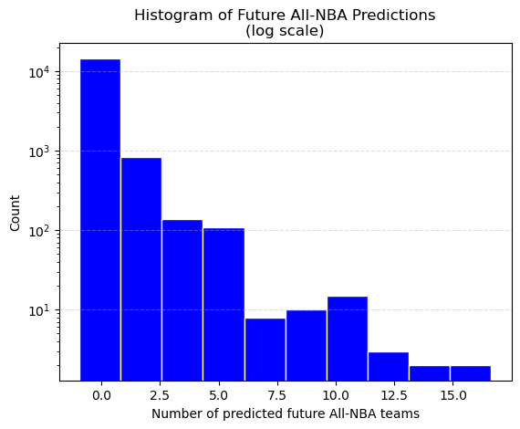
Results
P A R T 0 3
Notes:
-R^2 of 0.28. Challenging question, obviously the vast majority are correctly predicted for nearly zero, and then very few are much higher
-R^2 of 0.15 for baseline model

Slide 15
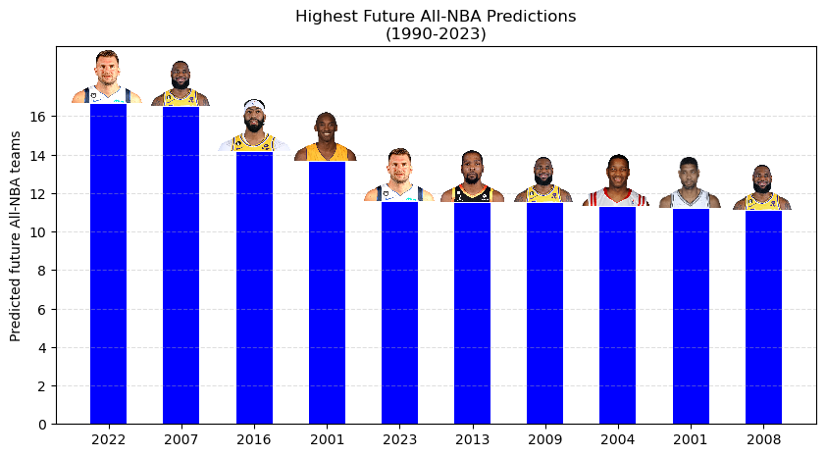
Results
P A R T 0 3
Notes:
Some of these we can’t compare to actual (the highest prediction is for Luka who obviously is very young). The highest for a career that’s over is Kobe in 2001, 13.63 predicted and actually 13. So that was great!

Slide 16
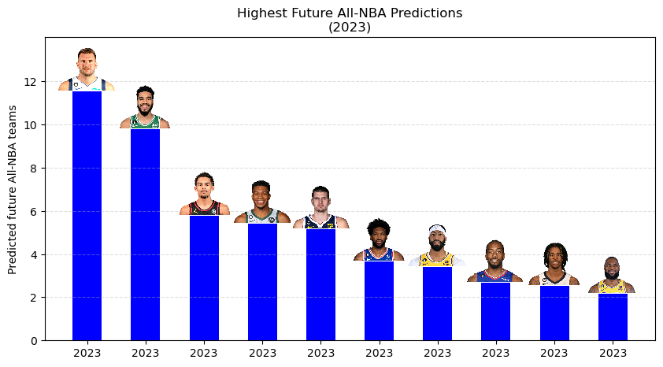
Results
P A R T 0 3
Notes:
We’ll see! But the predictions are logical. Luka has some of the highest predictions in the whole dataset.

Slide 17
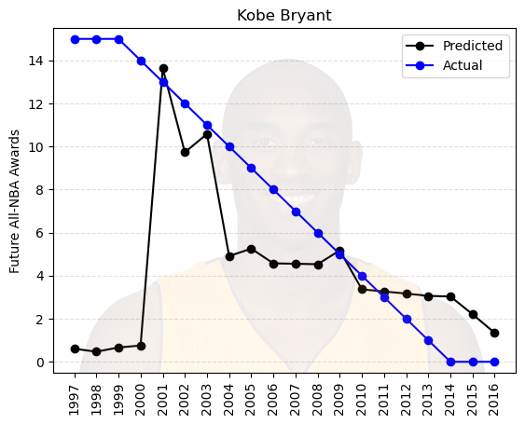
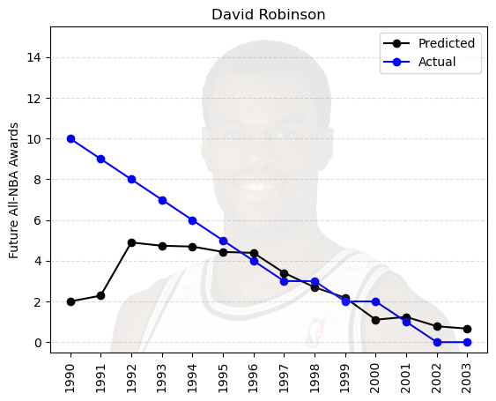
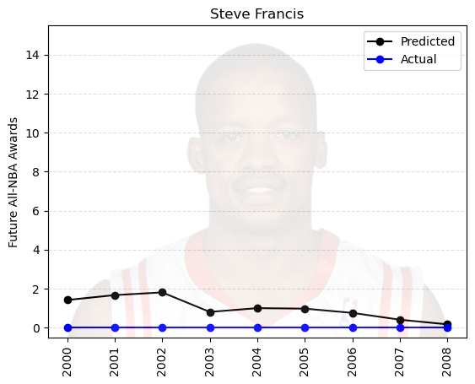
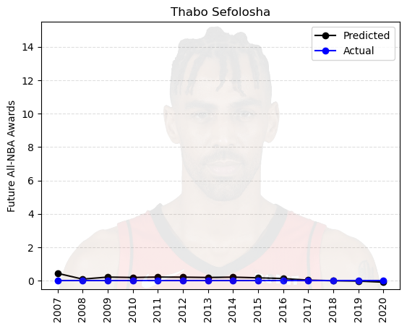
Results
P A R T 0 3
Notes:
Same 4 players, here are the individual graphs. Kobe and david robinson they are a little behind in realizing how good they are (that’s to be expected, it’s never going to predict some for 10-15 All-NBA awards off the bat). Again, Francis it likes as a young player and slowly likes less and less (even 2 All NBA awards is a high prediction and means a very good player)
Most graphs will look like Thabo. Very low prediction and never makes one.

Slide 18
Summary
P A R T 0 4
Notes:
-ultimately models do a decent job but suffer from the same issue us humans have! Identifying players who will be good before they are actually good

