Slide 1





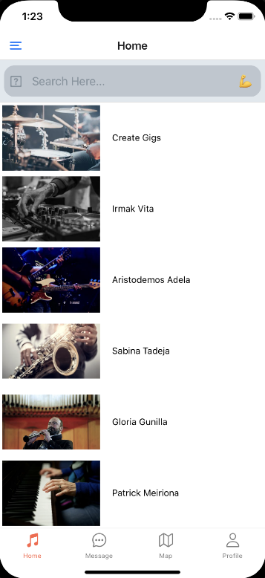
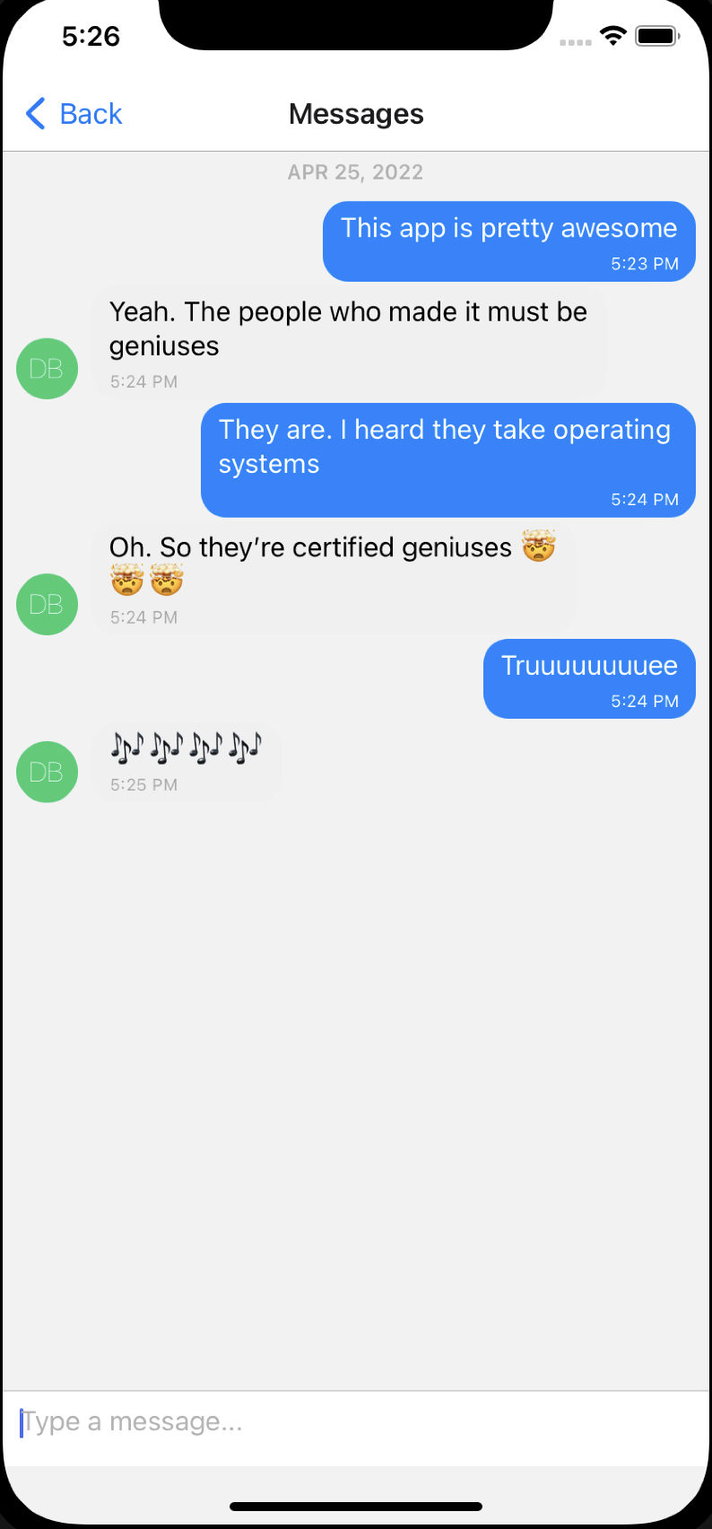
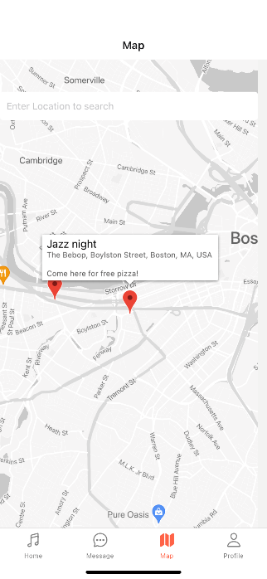
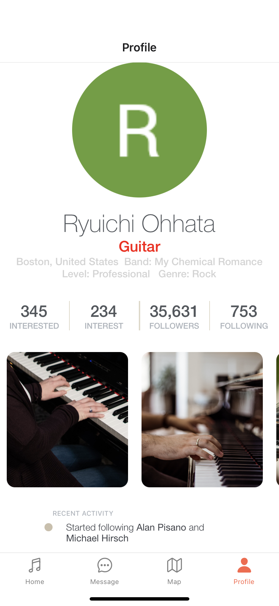
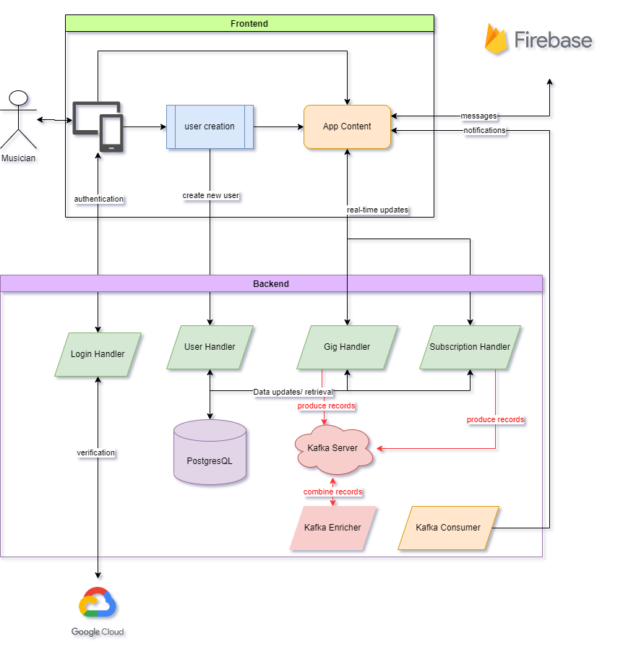
An App for Musicians
Team 7 - D. Bhatia, R. Ohhata, S. Au, J. Wasson, B. DeSiata
Project Overview
Primary Application Content
Amadeus is a mobile application designed for musicians to connect and self-promote. The application will allow users to create a profile to showcase themselves playing, tether those profiles to a musical group, and network with other musicians. These individuals and groups can communicate with others and promote events to their network. The ultimate result of this project will be a shippable mobile application with profiles, direct messaging, and a hyper-local map to which registered users can add entries to.
System Overview
Home Screen
Messaging Screen
Map Screen
Profile Screen
Key Functionalities
Future Work
Profile Storage
User Authentication & Verification
Peer-to-peer Messaging
Global Profile Searching
Musician Subscriptions through a notification system
Gig Location Uploading
Remote Hosting
Large-scale stress tests
Increase application efficiency
Fully tether profiles to database & allow users to upload media
Full deployment to Apple’s App Store
Further market research
Conclusions
Ultimately, we see this platform as a springboard for many musicians to grow confidence in their skills, collaborate with each other, and develop incredible music together. By implementing the functionalities above, this project could be easily transitioned to the open market upon completion. Though a highly competitive market, Amadeus carves a comfortable niche in the musical community - one that we plan to continue to learn more about as we develop the service further.

